Slide 1


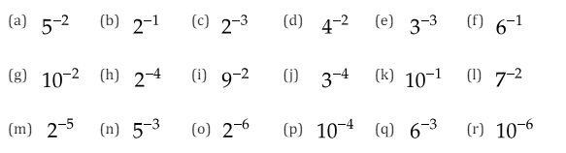
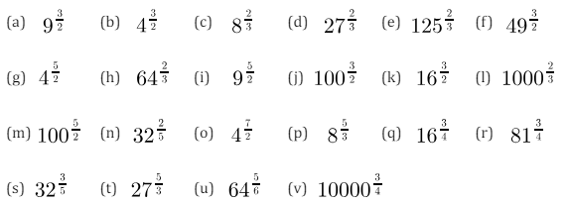
Simplifying and evaluating expressions involving negative and fractional indices
Enter code U985 and U772 in the Sparx independent learning section and/or
Follow these links to watch videos on “indices”
https://corbettmaths.com/2013/03/24/negative-indices/
https://corbettmaths.com/2013/03/03/fractional-indices/
Work through the questions below to check your understanding (solutions on next page):
Q1
Q2

Slide 2
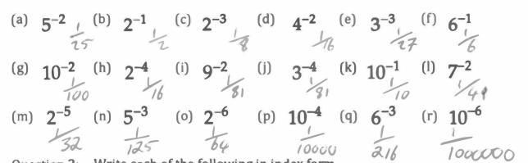

Solutions

