Slide 1




Rationalising the denominator of a fraction that involves multiple terms
Enter code U707 and U281 in the Sparx independent learning section and/or
Follow this links to watch a video on “rationalising denominators”
https://corbettmaths.com/2013/05/11/rationalising-denominators/
Work through the questions below to check your understanding (solutions on next page):
Q1
Rationalise the denominator.
(a) $\frac{1+\sqrt{2}}{\sqrt{5}}$ (b) $\frac{2−\sqrt{2}}{\sqrt{5}}$
(c) $\frac{2−3\sqrt{2}}{\sqrt{7}}$ (d) $\frac{5+\sqrt{5}}{\sqrt{3}}$
(e) $\frac{10−\sqrt{2}}{\sqrt{3}}$ (f) $\frac{2+\sqrt{3}}{3\sqrt{5}}$
Q2
Rationalise the denominator.
(a) $\frac{1}{2+\sqrt{5}}$ (b) $\frac{2}{2−\sqrt{5}}$
(c) $\frac{\sqrt{2}}{3+\sqrt{7}}$ (d) $\frac{2\sqrt{5}}{3−\sqrt{7}}$
(e) $\frac{10\sqrt{2}}{5+\sqrt{3}}$ (f) $\frac{2+\sqrt{3}}{3−\sqrt{5}}$
(g) $\frac{2+\sqrt{3}}{5+\sqrt{3}}$ (h) $\frac{2+3\sqrt{3}}{3−4\sqrt{5}}$

Slide 2
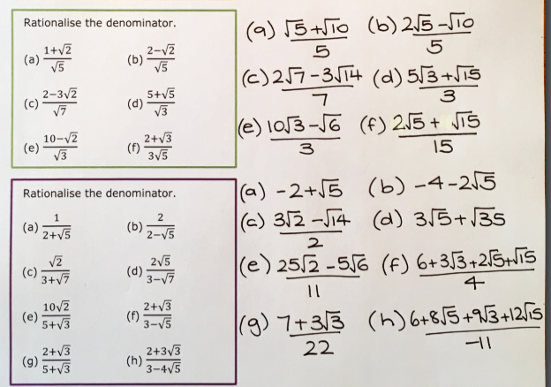
Solutions

