Slide 1


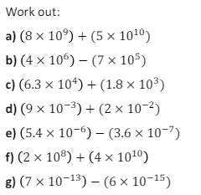

Perform all four operations on numbers written in standard form, without a calculator
Enter code U707 and U281 in the Sparx independent learning section and/or
Follow this links to watch a video on “rationalising denominators”
https://corbettmaths.com/2013/05/11/rationalising-denominators/
Work through the questions below to check your understanding (solutions on next page):
Q1
Q2
Without using a calculator, work out the following, giving your answer in standard form.
(a) $\left(2×{10}^{5}\right)+\left(3×{10}^{4}\right)$
(b) $\left(6.2×{10}^{7}\right)−\left(5×{10}^{6}\right)$
(c) $\left(3×{10}^{−2}\right)+\left(7×{10}^{−1}\right)$
(d) $\left(1.5×{10}^{−4}\right)−\left(9×{10}^{−5}\right)$
(e) $\left(2×{10}^{5}\right)×\left(3×{10}^{4}\right)$
(f) $\left(6×{10}^{8}\right)÷\left(2×{10}^{4}\right)$
(g) $\left(1.5×{10}^{−4}\right)×\left(3×{10}^{8}\right)$
(h) $\left(4.4×{10}^{7}\right)÷\left(1.1×{10}^{−3}\right)$

Slide 2
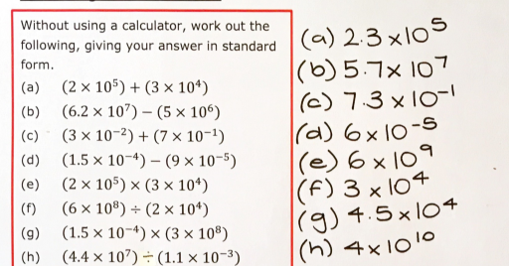
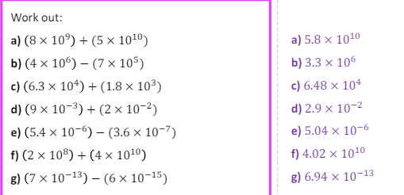
Solutions

