Slide 1


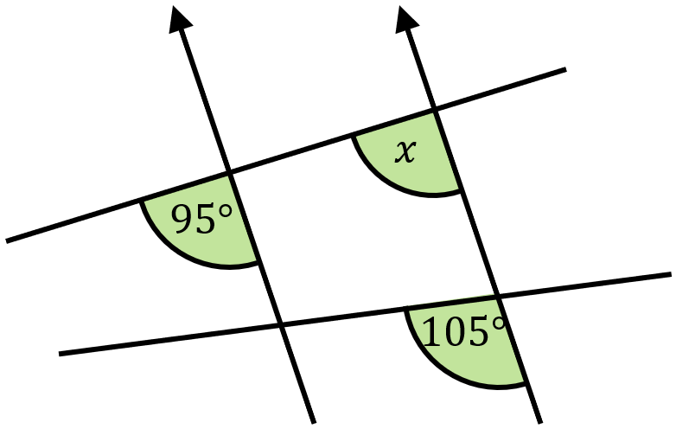
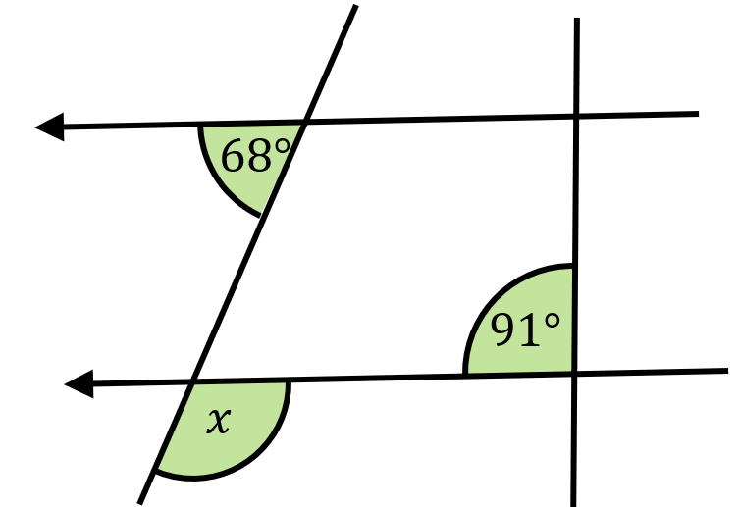
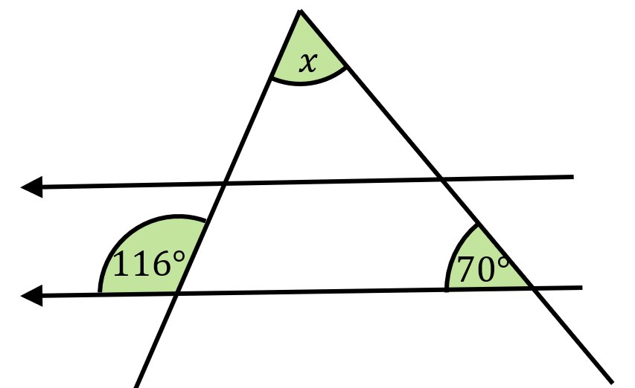
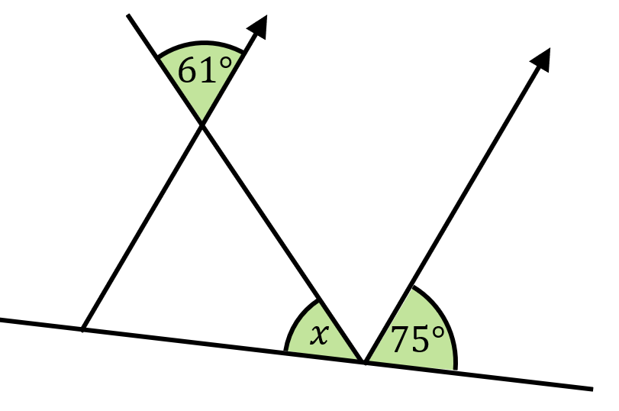
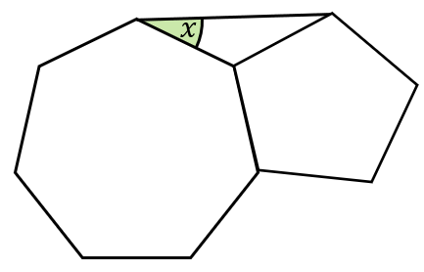
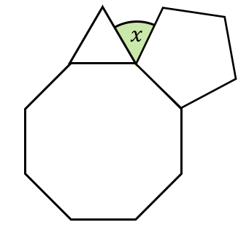
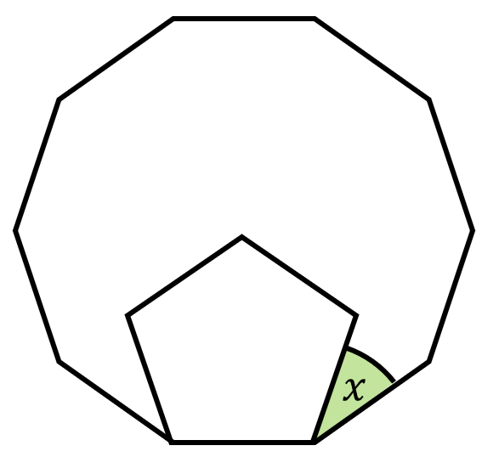
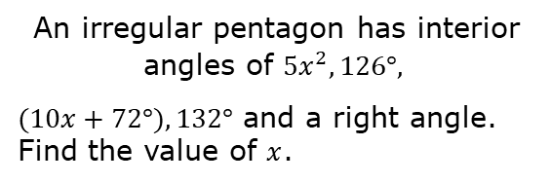
Finding missing angles in complex diagrams using facts about angles on parallel lines, and regular polygons
Enter code U826 and U329 in the Sparx independent learning section and/or
Follow these links to watch videos on “Angles and parallel lines and polygons”
https://corbettmaths.com/2013/04/04/parallel-lines-angles/
https://corbettmaths.com/2012/08/10/angles-in-polygons/
Work through the questions below to check your understanding (solutions on next page):
An irregular pentagon has interior angles of $5x^{2}, 126°,$
$(10x+72°), 132°$ and a right angle. Find the value of $x$.

Slide 2
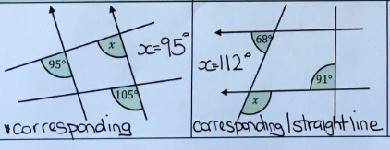
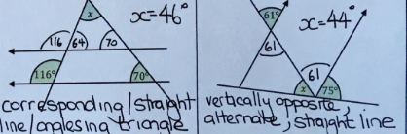
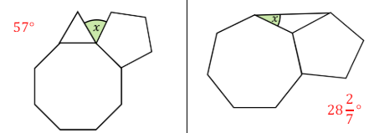
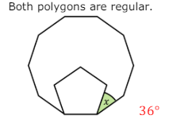
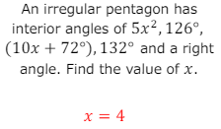
Solutions

