Slide 1
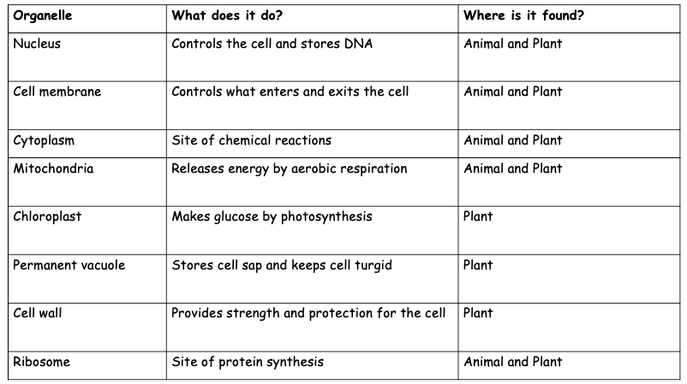
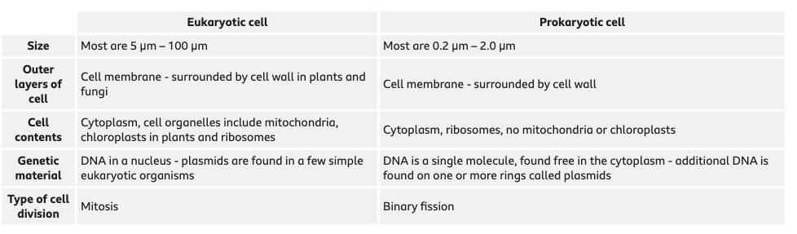
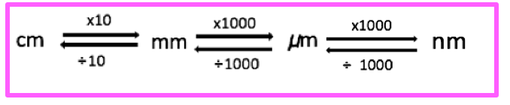
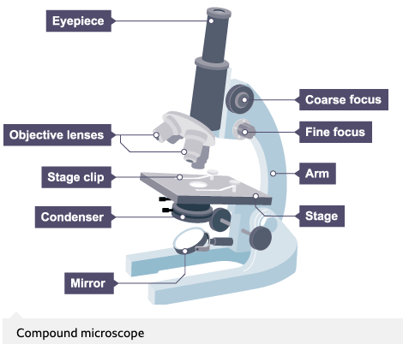
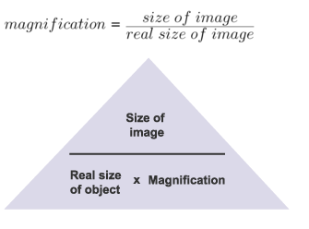
Biology: 4.1 cell biology Graphic Organiser
Organelles | Prokaryotic cells
Eukaryotes include animals, plants and fungi. Animals and plants have the following organelles. Make sure you know which are exclusive to plant cells! | Prokaryotic cells possess fewer organelles compared to eukaryotic cells. Bacteria and archaea are prokaryotes. Their structure is more simplistic compared to eukaryotes, and they do not have a membrane bound nucleus!
Magnification and microscopes | Specialsied cells
 | There are many different types of cells in animals, each is specialized for a role.
Cell | How is it adapted to its function?
Sperm cell | Long tail which whips from side to side to help move the sperm through water or the female reproductive system. Middle section is full of mitochondria which transfer the energy needed for the tail to work.
Muscle cell | Contain many mitochondria to transfer the energy needed for the chemical reactions that take place as the cells contract and relax.
Red blood cell | No nucleus to more room for oxygen and biconcave dis shape increases the surface area to volume ratio to help carry more oxygen to respiring tissues.
Leaf palisade cell | They contain specialised green structures – chloroplast – that contain chlorophyll. Chlorophyll is the green pigment in plants, that traps light energy for photosynthesis. They are usually positioned at the top of the leaf so they absorb as much light as possible.
Root hair cell | The hair like projections greatly increase the surface area available for water to move into the cell. Lots of mitochondria for the active transport of ions from soil into plant.
The image size and actual size must be in the same units!
The compound microscope uses two lenses to magnify the specimen – the eyepiece and an objective lens.
Electron microscopes can be used to view smaller organisms and have a higher magnification and resolving power.
Increasing the power of the objective lens increases the magnification.
The focus dials improve the resolution.
What do power and magnification mean?

Slide 2
Biology: 4.1 cell biology Graphic Organiser
Organelles | Prokaryotic cells
Eukaryotes include animals, plants and fungi. Animals and plants have the following organelles. Make sure you know which are exclusive to plant cells! | Prokaryotic cells possess fewer organelles compared to eukaryotic cells. Bacteria and archaea are prokaryotes. Their structure is more simplistic compared to eukaryotes, and they do not have a membrane bound nucleus!
Magnification and microscopes | Specialsied cells
 | There are many different types of cells in animals, each is specialized for a role.
Cell | How is it adapted to its function?
Sperm cell | Long tail which whips from side to side to help move the sperm through water or the female reproductive system. Middle section is full of mitochondria which transfer the energy needed for the tail to work.
Muscle cell | Contain many mitochondria to transfer the energy needed for the chemical reactions that take place as the cells contract and relax.
Red blood cell | No nucleus to more room for oxygen and biconcave dis shape increases the surface area to volume ratio to help carry more oxygen to respiring tissues.
Leaf palisade cell | They contain specialised green structures – chloroplast – that contain chlorophyll. Chlorophyll is the green pigment in plants, that traps light energy for photosynthesis. They are usually positioned at the top of the leaf so they absorb as much light as possible.
Root hair cell | The hair like projections greatly increase the surface area available for water to move into the cell. Lots of mitochondria for the active transport of ions from soil into plant.
The image size and actual size must be in the same units!
The compound microscope uses two lenses to magnify the specimen – the eyepiece and an objective lens.
Electron microscopes can be used to view smaller organisms and have a higher magnification and resolving power.
Increasing the power of the objective lens increases the magnification.
The focus dials improve the resolution.

Slide 3
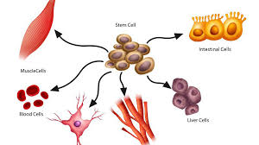
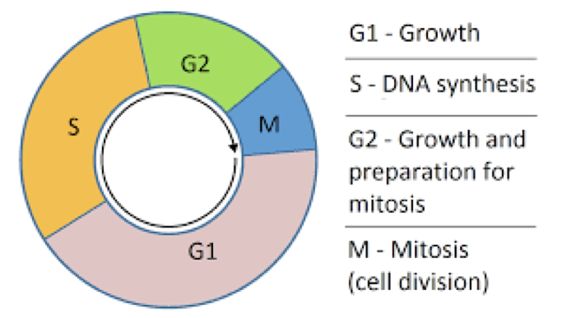
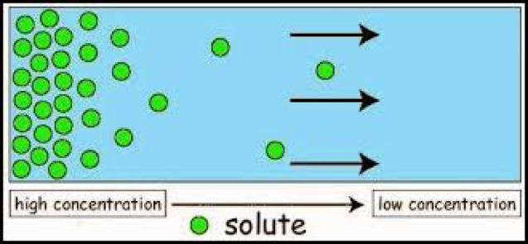
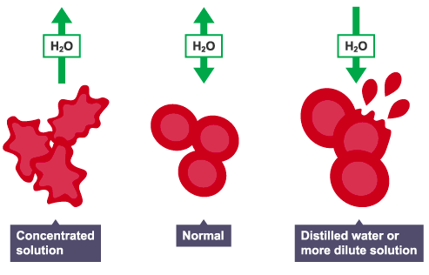
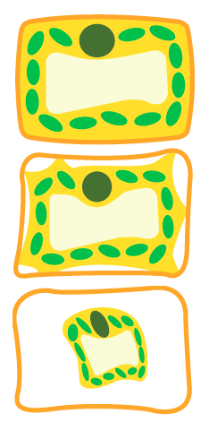
Stem cells |  | Mitosis and the cell cycle
 |  | t
Diffusion | Active transport | Osmosis
 |  | Osmosis is the diffusion of water molecules, from a region where the water molecules are in higher concentration, to a region where they are in lower concentration, through a partially permeable membrane. A dilute solution contains a high concentration of water molecules, while a concentrated solution contains a low concentration of water molecules.
Stem cells are cells that have not undergone differentiation. A cell which has not yet become specialised is called undifferentiated.
An embryo develops from a fertilised egg. Cells at the early stages in the development of the embryo are stem cells.
Some stem cells remain in the bodies of adults – adult stem cells. Adult stem cells are found in limited numbers at certain locations in the body. Adult stem cells will differentiate into a narrower range of cell types. Embryonic stem cells can differentiate into a wider range of cell types, but are difficult to obtain and their use raises ethical challenges.
at any time during the life of the plant.
Therapeutic cloning
Adult stem cell transplants use a patient's own stem cells.
They are therefore genetically identical and will not be rejected by the patient's immune system
Cells divide when:
an organism grows
an organism becomes damaged and needs to produce new cells
It is essential that any new cells produced contain genetic information that is identical to the parent cell
What are stem cells and why are they important?
How many daughter cells are made? | 2
What are the daughter cells like compared to the parent cells? | Genetically identical/ clones
Why does mitosis happen? | For growth, repair, and to replace worn out cells
PLANTS.
Cell division in plants occurs in regions called meristems, near the tip of the roots and shoots.
Cells of the meristem can differentiate to produce all types of plant cells
What are meristems?
qEach cell goes through a series of stages while it is dividing.
qIt is really important that DNA replicates itself before Mitosis (M) can happen.
The net movement of particles from a high to low concentration. It is a passive process.
Osmosis is:
Diffusion is:
Active transport is:
It requires:
Active transport is the movement of particles from a low to high concentration.
This is against the concentration gradient.
It requires energy, released from the mitochondria.
Animals:
Glucose is moved from the lumen of the small inestine into the blood by active transport
LOW --> HIGH CONCENTRATION
Plants:
Most mineral ions are moved from the soil into the root hair cells by active transport
LOW --> HIGH CONCETRATION
Factor | How it affects diffusion
Temperature | The higher the temperature, the more kinetic energy the particles will have, so they will move and mix more quickly.
Concentration gradient | The greater the difference in concentration, the quicker the rate of diffusion.
Surface area | The greater the surface area, the faster the rate of diffusion.
1
Difference in plant cells:
Plant cells have a cell wall so will not burst.
1.Turgid
2. Flaccid
3. Plasmolysed
2
Solution is hypertonic. Water leaves the cell by osmosis and it shrinks
Solution is isotonic. No net movement of water.
Solution is hypotonic. Water enters cell by osmosis and cell bursts.
3.

Slide 4
Stem cells |  | Mitosis and the cell cycle
 |  | t
Diffusion | Active transport | Osmosis
 |  | Osmosis is the diffusion of water molecules, from a region where the water molecules are in higher concentration, to a region where they are in lower concentration, through a partially permeable membrane. A dilute solution contains a high concentration of water molecules, while a concentrated solution contains a low concentration of water molecules.
Stem cells are cells that have not undergone differentiation. A cell which has not yet become specialised is called undifferentiated.
An embryo develops from a fertilised egg. Cells at the early stages in the development of the embryo are stem cells.
Some stem cells remain in the bodies of adults – adult stem cells. Adult stem cells are found in limited numbers at certain locations in the body. Adult stem cells will differentiate into a narrower range of cell types. Embryonic stem cells can differentiate into a wider range of cell types, but are difficult to obtain and their use raises ethical challenges.
at any time during the life of the plant.
Therapeutic cloning
Adult stem cell transplants use a patient's own stem cells.
They are therefore genetically identical and will not be rejected by the patient's immune system
Cells divide when:
an organism grows
an organism becomes damaged and needs to produce new cells
It is essential that any new cells produced contain genetic information that is identical to the parent cell
How many daughter cells are made? | 2
What are the daughter cells like compared to the parent cells? | Genetically identical/ clones
Why does mitosis happen? | For growth, repair, and to replace worn out cells
PLANTS.
Cell division in plants occurs in regions called meristems, near the tip of the roots and shoots.
Cells of the meristem can differentiate to produce all types of plant cells
qEach cell goes through a series of stages while it is dividing.
qIt is really important that DNA replicates itself before Mitosis (M) can happen.
The net movement of particles from a high to low concentration. It is a passive process.
Active transport is the movement of particles from a low to high concentration.
This is against the concentration gradient.
It requires energy, released from the mitochondria.
Animals:
Glucose is moved from the lumen of the small inestine into the blood by active transport
LOW --> HIGH CONCENTRATION
Plants:
Most mineral ions are moved from the soil into the root hair cells by active transport
LOW --> HIGH CONCETRATION
Factor | How it affects diffusion
Temperature | The higher the temperature, the more kinetic energy the particles will have, so they will move and mix more quickly.
Concentration gradient | The greater the difference in concentration, the quicker the rate of diffusion.
Surface area | The greater the surface area, the faster the rate of diffusion.
1
Difference in plant cells:
Plant cells have a cell wall so will not burst.
1.Turgid
2. Flaccid
3. Plasmolysed
2
Solution is hypertonic. Water leaves the cell by osmosis and it shrinks
Solution is isotonic. No net movement of water.
Solution is hypotonic. Water enters cell by osmosis and cell bursts.
3.

Slide 5
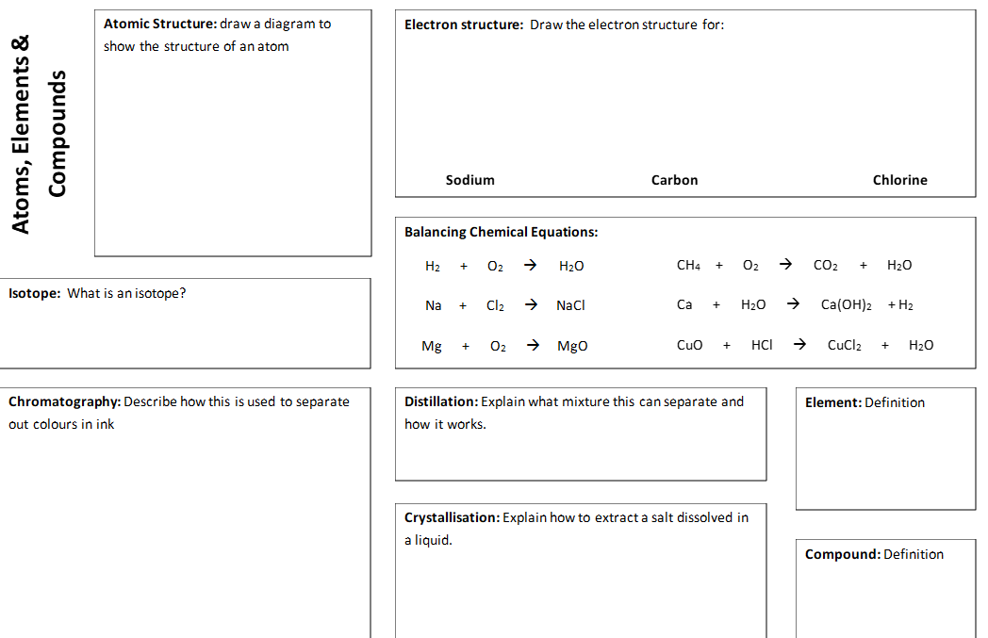

Slide 6
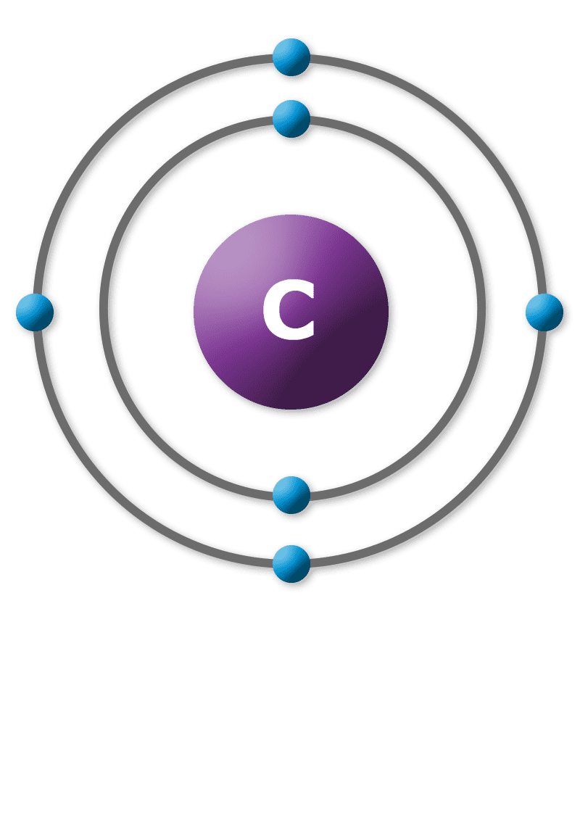
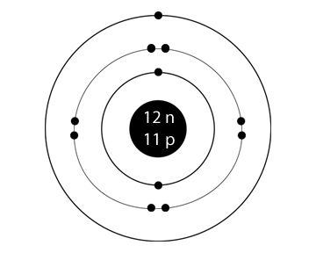
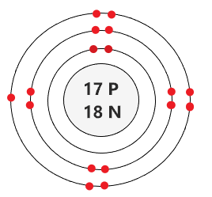
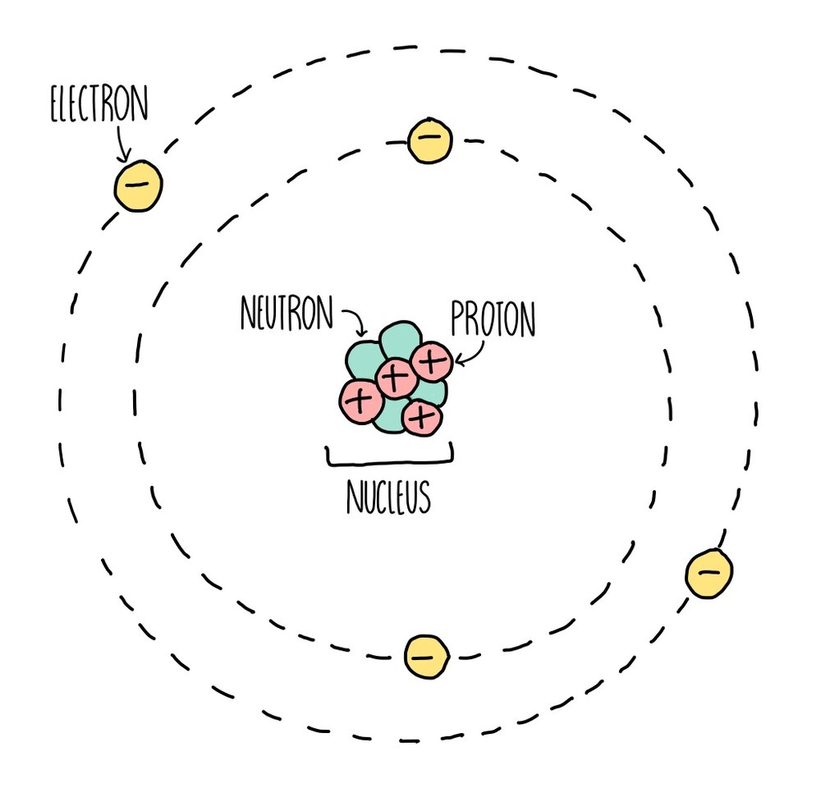
2
2
2
2
Isotope =each of two or more forms of the same element that contain equal numbers of protons but different numbers of neutrons in their nuclei, and hence differ in relative atomic mass but not in chemical properties; in particular, a radioactive form of an element.
2
2
2
2
2
2
Chromatography can be used to separate mixtures of coloured compounds. Mixtures that are suitable for separation by chromatography include inks, dyes and colouring agents in food. Simple chromatography is carried out on paper. A spot of the mixture is placed on a pencil line near the bottom of a piece of chromatography paper – the line must be in pencil because pencil is insoluble in water and so will not move as the chromatography progresses. The paper is then placed upright in a suitable solvent, such as water.
As the solvent soaks up the paper, it carries the mixtures with it. Different components of the mixture will move at different rates. This separates the mixture out.
Distillation separates a liquid from a solution. For example, water can be separated from salty water by simple distillation. This method works because the water evaporates from the solution, but is then cooled and condensed in a condenser and collected in a separate container. The salt does not evaporate and so it stays behind.
An element is a substance that cannot be broken down into any other substance. Every element is made up of its own type of atom
One way to separate a soluble solid from its solution is to make crystals. This involves evaporating the solution to a much smaller volume and then leaving it to cool. As the solution cools, crystals form, and these can be obtained by filtration.
A compound is a substance that contains two or more elements that are chemically combined

Slide 7
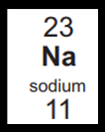
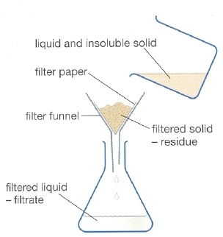
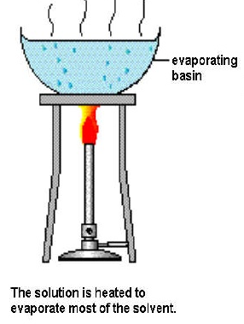
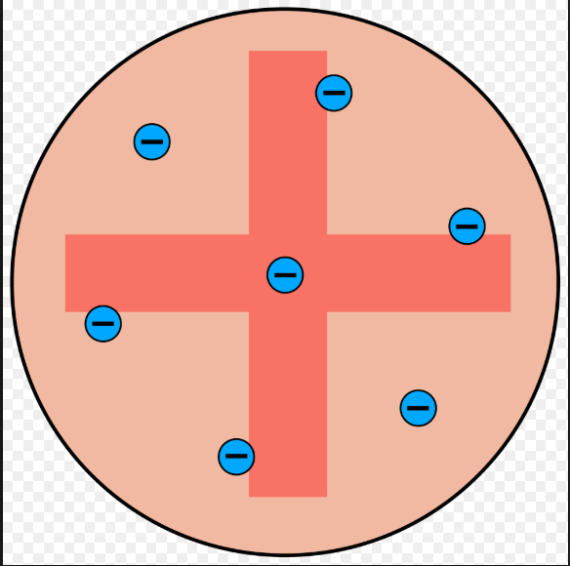
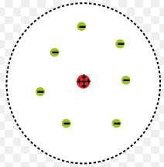
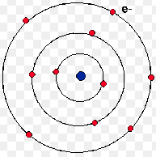
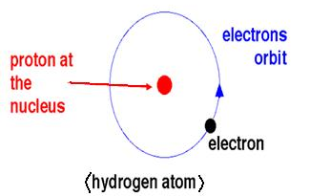
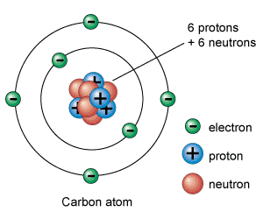
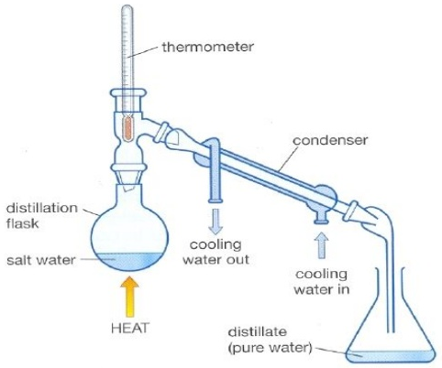
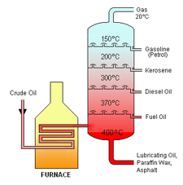
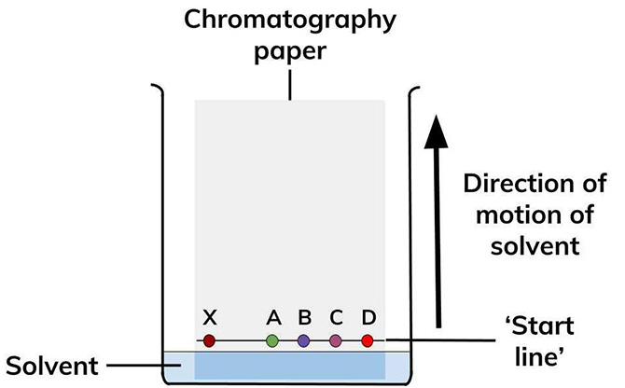
Particle | Mass
Proton
Neutron
Electron
Particle | Relative charge
Proton
Neutron
Electron
H
tier
 | A substance made of one type of atom only.
 | Two are more different types of atoms chemically bonded together
 | Elements and/or compounds combined together but not bonded. Can easily be separated
________________ = ________ + _________
Steps in the development of the periodic table
Before the discovery of protons, neutrons and electrons, scientists attempted to classify the elements by arranging them in order of their _____________ _____________.
The early periodic tables were _____________ and some _____________ were placed in inappropriate groups if the strict order of atomic weights was followed.
Mendeleev overcame some of the problems by _________ ______ for elements that he thought had not been _____________ and in some places changed the _____________ based on atomic weights.
Elements with ___________ predicted by Mendeleev were ___________ and filled the gaps. Knowledge of _____________ made it possible to explain why the order based on atomic weights was not always correct.
_____________ = ____________________
1. Atoms have the same number of _____________ and _____________
2. Atoms of the same element can have different numbers of _____________; these atoms are called _____________ of that element.
3. Isotopes of the same element have the same number of _____________ and _____________
4. To calculate the _____________ _____________ _____________ of an element taking into consideration isotopes then you need the following equation:
(percentage of isotope 1 x mass of isotope 1) + (percentage of isotope 2 x mass of isotope 2)
100
Separation techniques
1. ________________ 2. ________________ 3. ________________ 4. ________________ 5. ________________
Development of the atomic model
 | JJ Thomson | Ernest Rutherford | Niels Bohr |  | James Chadwick
2
1
3
4
5

Slide 8
Particle | Mass
Proton | 1
Neutron | 1
Electron | Very small
Particle | Relative charge
Proton | +1
Neutron | 0
Electron | -1
H
tier
Element | A substance made of one type of atom only.
Compound | Two are more different types of atoms chemically bonded together
Mixture | Elements and/or compounds combined together but not bonded. Can easily be separated
Relative atomic mass = protons + neutrons
Steps in the development of the periodic table
Before the discovery of protons, neutrons and electrons, scientists attempted to classify the elements by arranging them in order of their atomic weights.
The early periodic tables were incomplete and some elements were placed in inappropriate groups if the strict order of atomic weights was followed.
Mendeleev overcame some of the problems by leaving gaps for elements that he thought had not been discovered and in some places changed the order based on atomic weights.
Elements with properties predicted by Mendeleev were discovered and filled the gaps. Knowledge of isotopes made it possible to explain why the order based on atomic weights was not always correct.
Atomic number = number of protons
1. Atoms have the same number of protons and electrons
2. Atoms of the same element can have different numbers of neutrons; these atoms are called isotopes of that element.
3. Isotopes of the same element have the same number of protons and electrons
4. To calculate the relative atomic mass of an element taking into consideration isotopes then you need the following equation:
(percentage of isotope 1 x mass of isotope 1) + (percentage of isotope 2 x mass of isotope 2)
100
Separation techniques
1. Filtration 2. Crystallisation 3. Simple distillation 4. Fractional distillation 5. Chromatography
Development of the atomic model
 | JJ Thomson | Ernest Rutherford | Niels Bohr |  | James Chadwick
Solid spheres | Plum pudding model | Nuclear model | Electrons in shells | Protons | Neutrons

Slide 9
Atomic structure and the periodic Table
Atoms Atomic number = Mass number = + Number of neutrons = + | Isotopes | History of the Atom
Electron Structure | Metals and Non-metals | Development of the periodic table

Slide 10
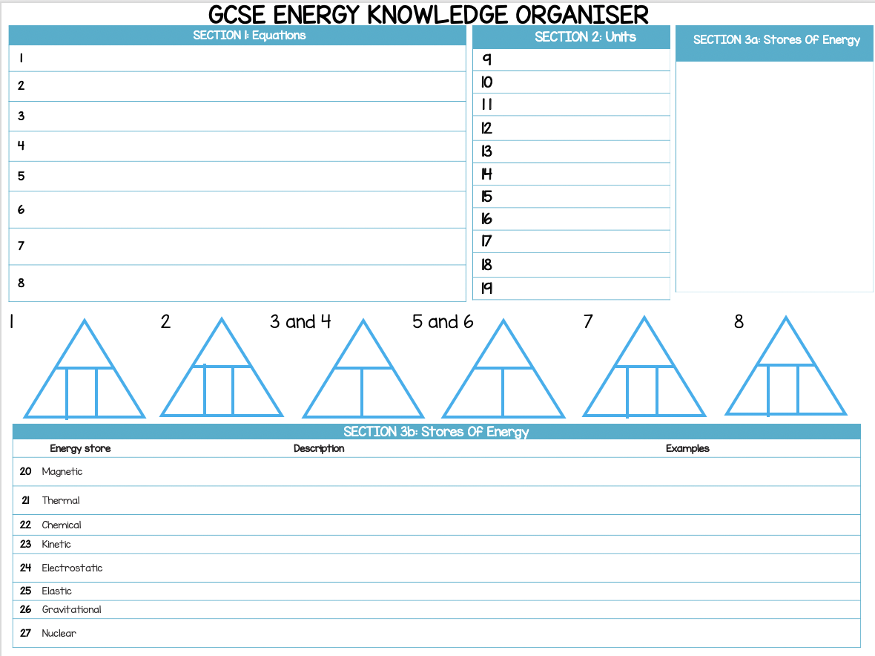
Physics energy knowledge organiser

Slide 11
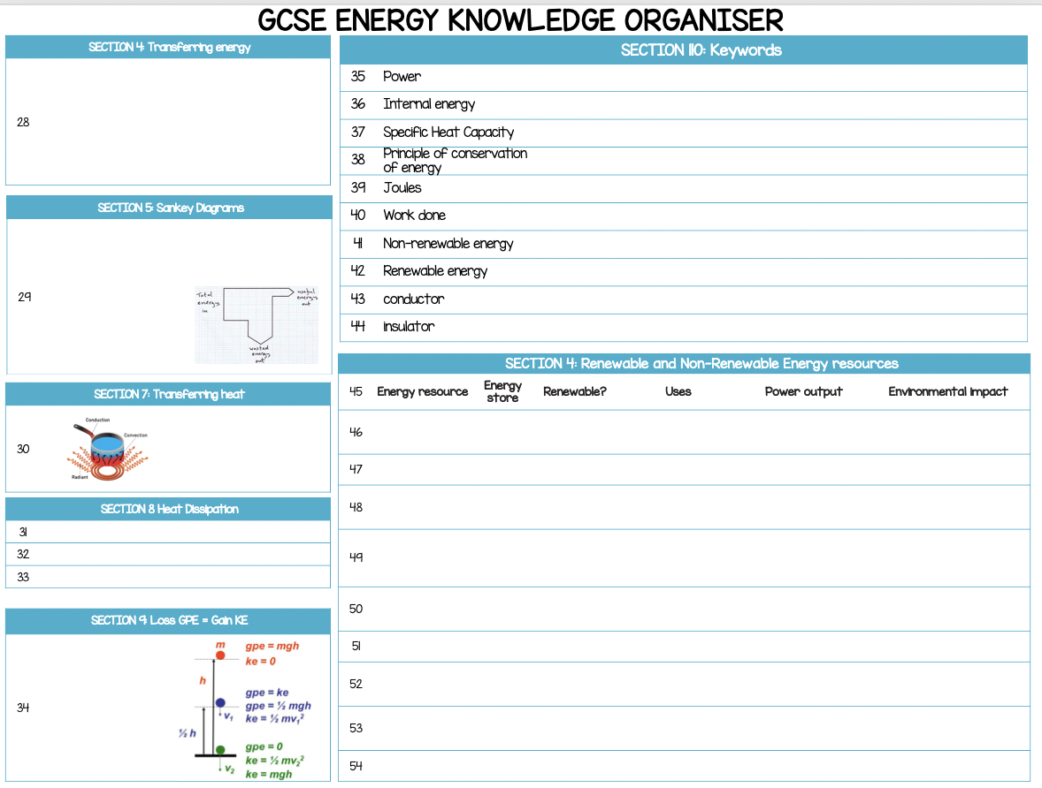
Physics energy knowledge organiser

Slide 12
Physics energy knowledge organiser

Slide 13
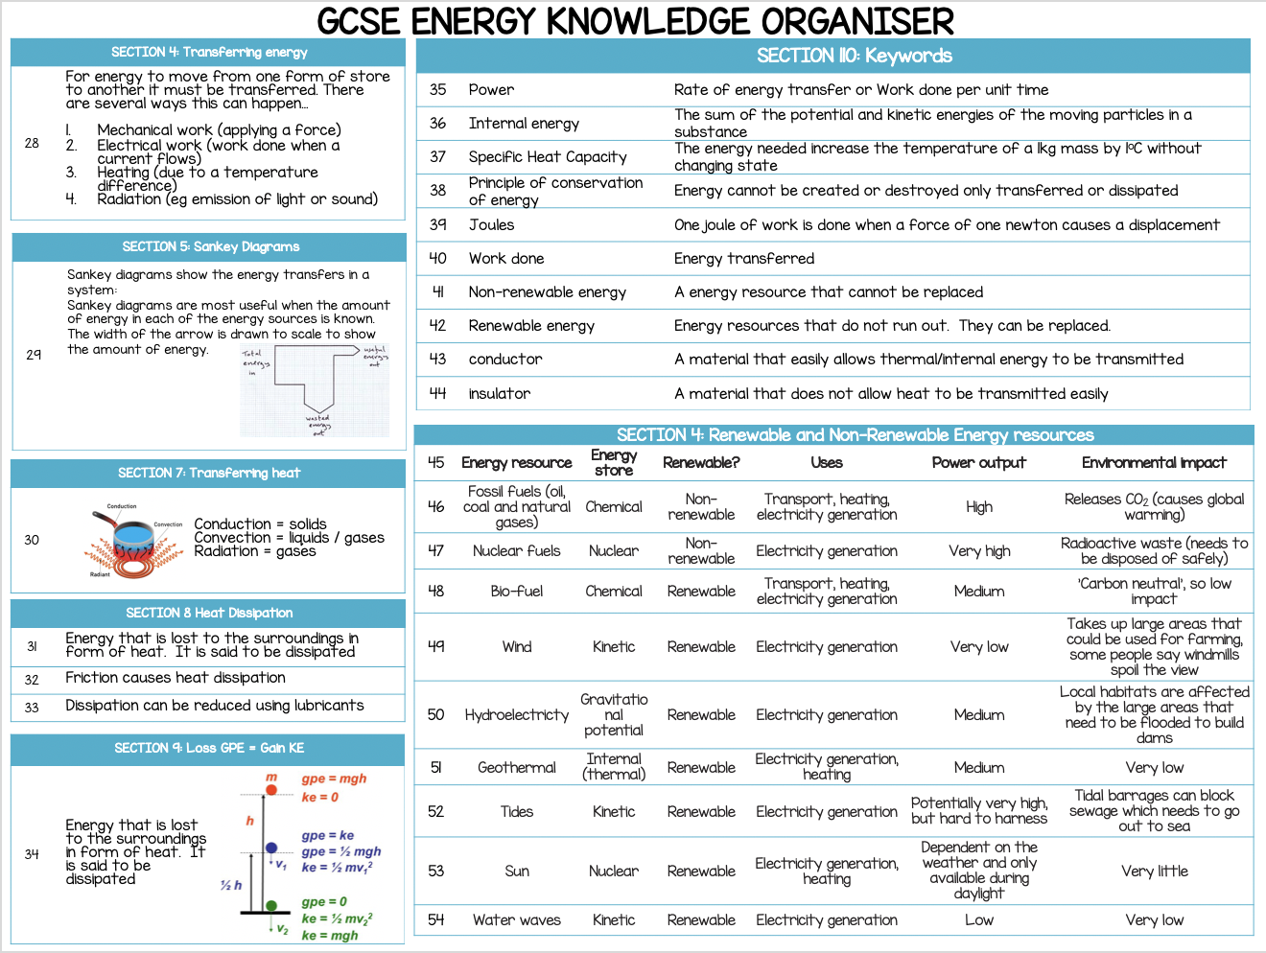
Physics energy knowledge organiser

Slide 14
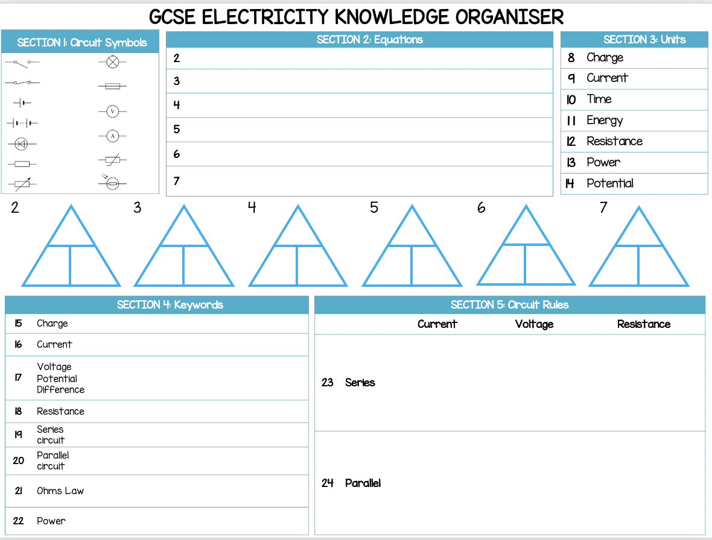
Physics electricity knowledge organiser

Slide 15
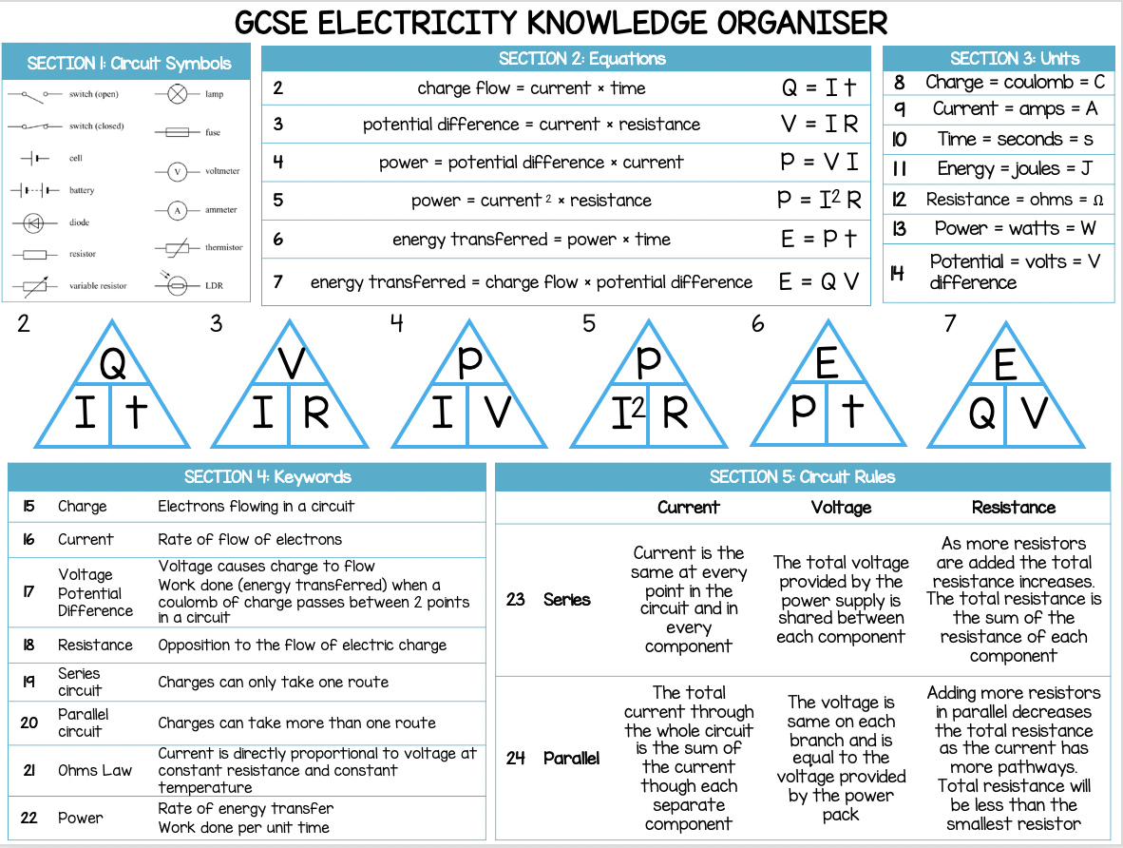
Physics electricity knowledge organiser

