Slide 1
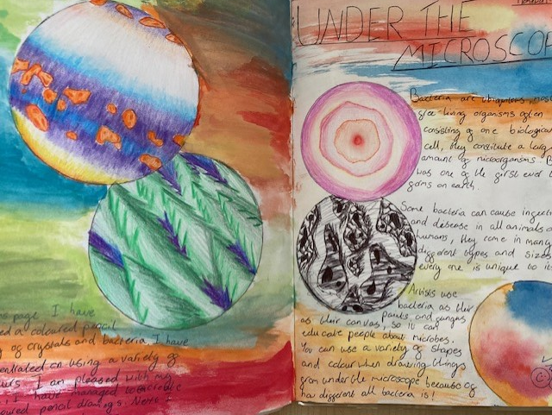
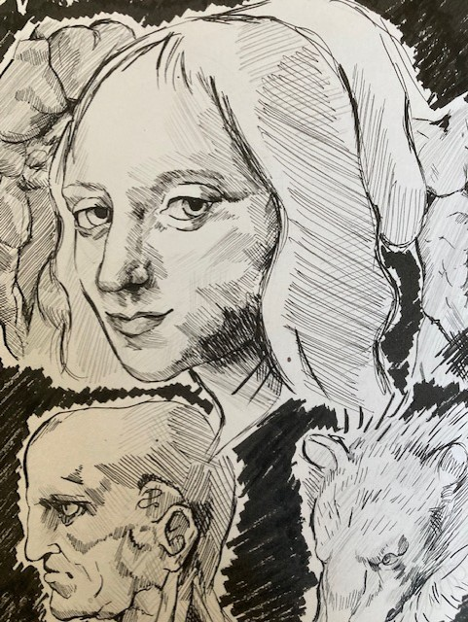
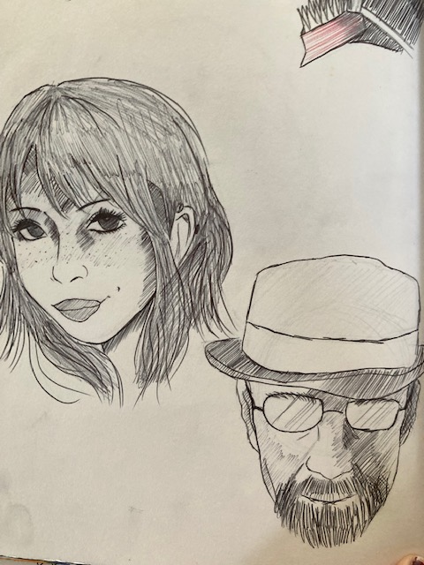
Examples of Drawing/Recording
Confident used of line in the pen drawings to create depth. Colour pencil work is layered to create extra depth. Both examples demonstrate excellent control over materials.

Slide 2
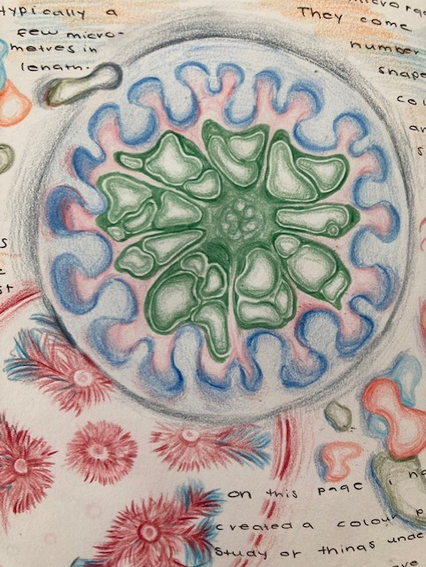
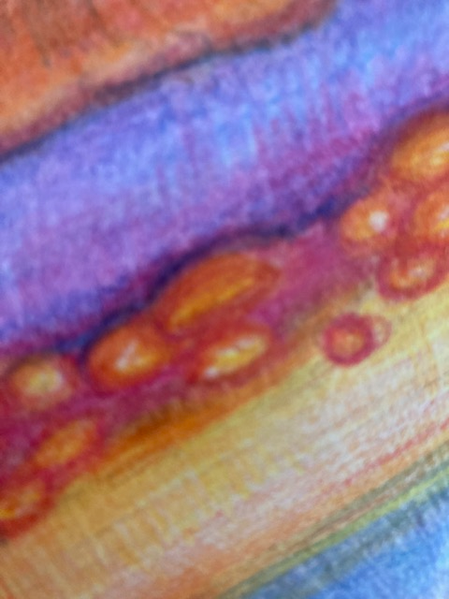
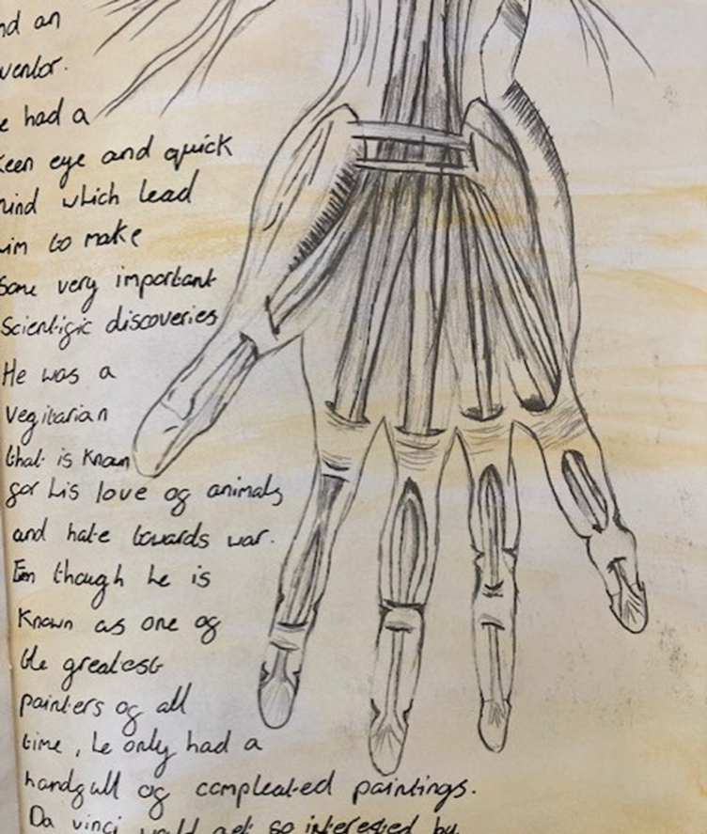
Colour pencil work is layered to create extra depth.
Both examples demonstrate excellent control over materials to create subtle changes in tone.
Highlights are used by the student in a very confident way.

Slide 3
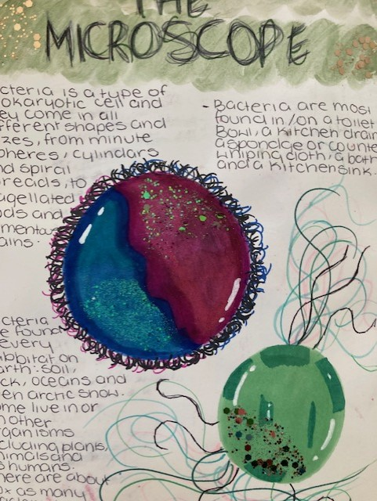
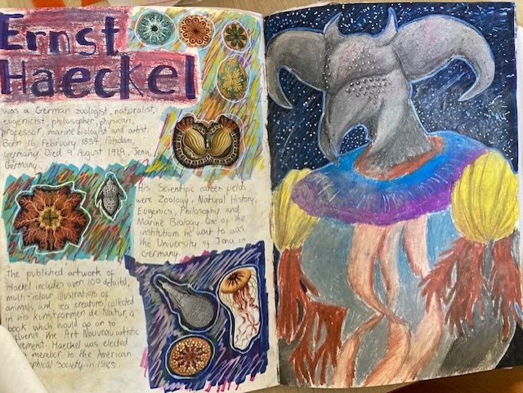
Strong Artist Responses

Slide 4
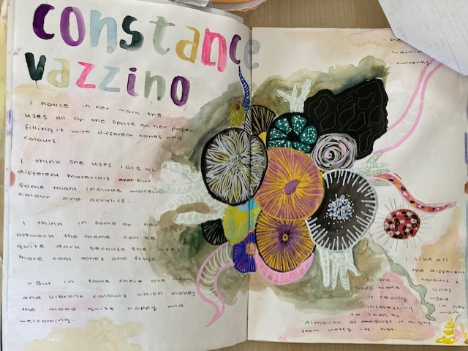
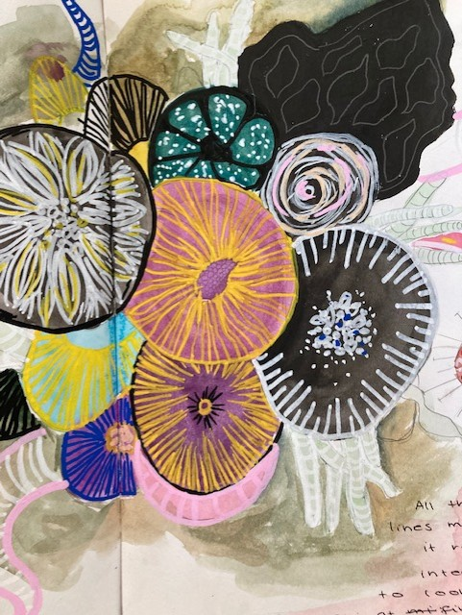

Slide 5
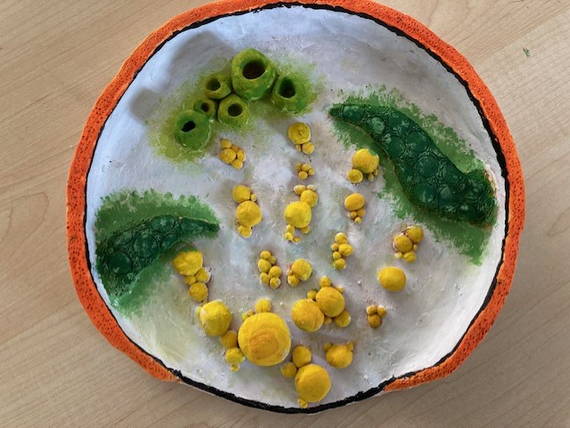
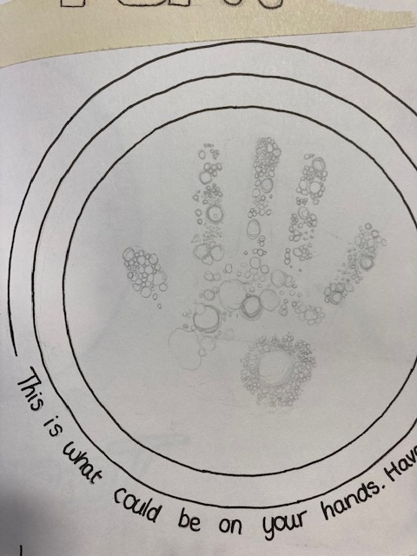
3D/Relief work
Very fine and delicate clay work developed from the student’s initial drawing. The student has used a mixture of applied clay techniques and carving to produce this piece. The idea for the final piece was inspired by germs on our hands.

Slide 6
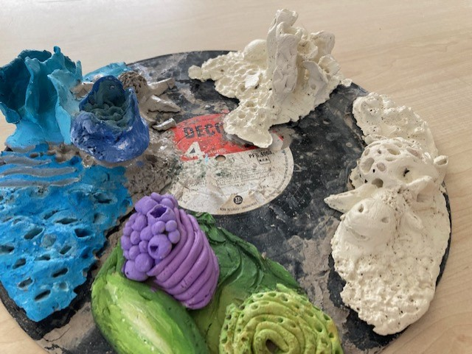
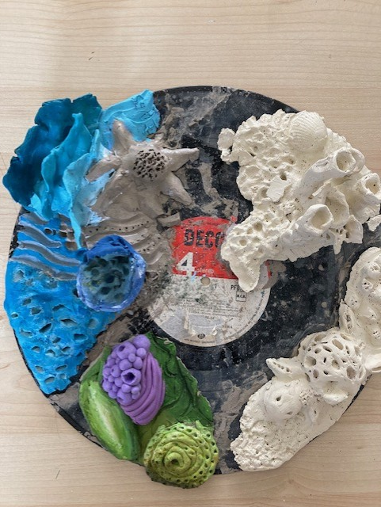
The student used great independence and imagination to design and create this vinyl record covered in mould. The design is closely linked to the student’s artist research, but the ideas has been pushed further by the student.
There’s clear evidence of delicate textures created with a range of tools, including dental fine tools and sponges.

Slide 7
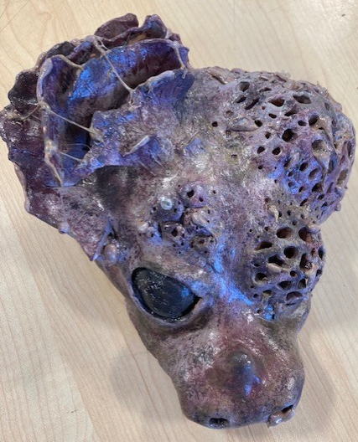
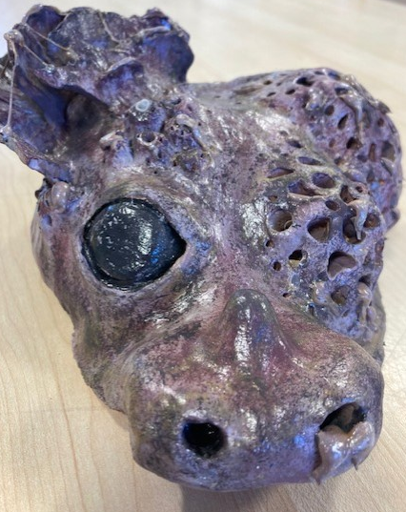
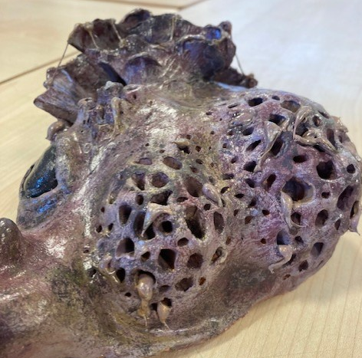
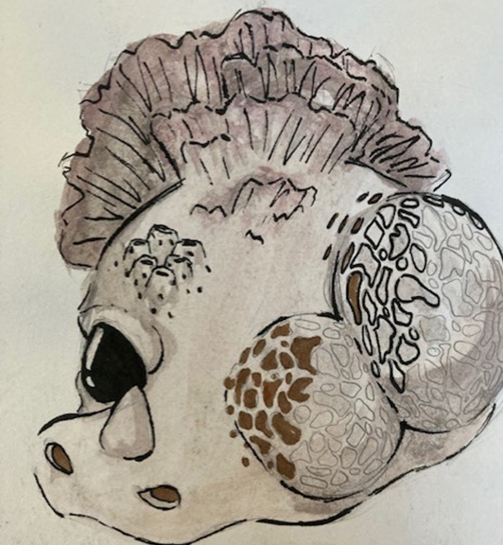
The student has developed the sculpture from their sketchbook drawing. All linking securely with the theme. The student has taken great care when considering each viewpoint of the 3D sculpture. The dark colour palette and use of the hot glue gun were both ideas developed my the student.

