Slide 1
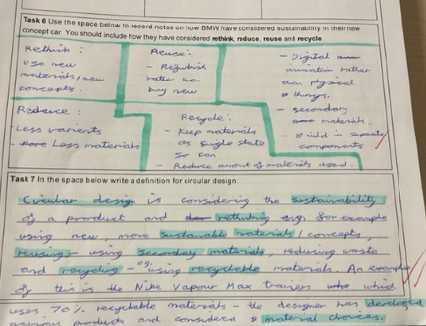
Sustainable Design
Students have completed a short sustainability project in the last half term. The project included theory work about the meaning of sustainable design, the 6R’s of sustainability and their application, upcycling and how to upcycle successfully.
The examples shown are of a very high quality. Students have been able to define key terms in their own words using sophisticated vocabulary. They have researched the 6R’s of sustainability and in their responses they have shown that they understand how they can be applied to products and everyday life. High achieving students were also able to apply the 6R’s to a design challenge to completely change impact of a product on the environment.

Slide 2
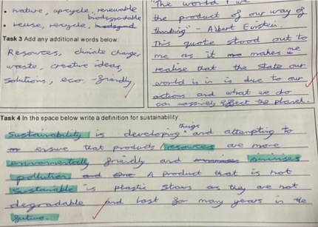
Sustainable Design
Students have completed a short sustainability project in the last half term. The project included theory work about the meaning of sustainable design, the 6R’s of sustainability and their application, upcycling and how to upcycle successfully.
The examples shown are of a very high quality. Students have been able to define key terms in their own words using sophisticated vocabulary. They have researched the 6R’s of sustainability and in their responses they have shown that they understand how they can be applied to products and everyday life. High achieving students were also able to apply the 6R’s to a design challenge to completely change impact of a product on the environment.

Slide 3
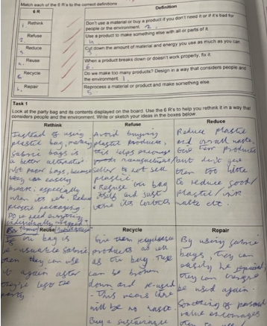
Sustainable Design
Students have completed a short sustainability project in the last half term. The project included theory work about the meaning of sustainable design, the 6R’s of sustainability and their application, upcycling and how to upcycle successfully.
The examples shown are of a very high quality. Students have been able to define key terms in their own words using sophisticated vocabulary. They have researched the 6R’s of sustainability and in their responses they have shown that they understand how they can be applied to products and everyday life. High achieving students were also able to apply the 6R’s to a design challenge to completely change impact of a product on the environment.

Slide 4
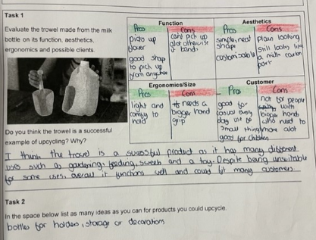
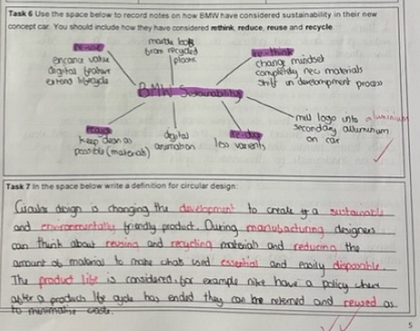
Sustainable Design
Students have completed a short sustainability project in the last half term. The project included theory work about the meaning of sustainable design, the 6R’s of sustainability and their application, upcycling and how to upcycle successfully.
The examples shown are of a very high quality. Students have been able to define key terms in their own words using sophisticated vocabulary. They have researched the 6R’s of sustainability and in their responses they have shown that they understand how they can be applied to products and everyday life. High achieving students were also able to apply the 6R’s to a design challenge to completely change impact of a product on the environment.

Slide 5
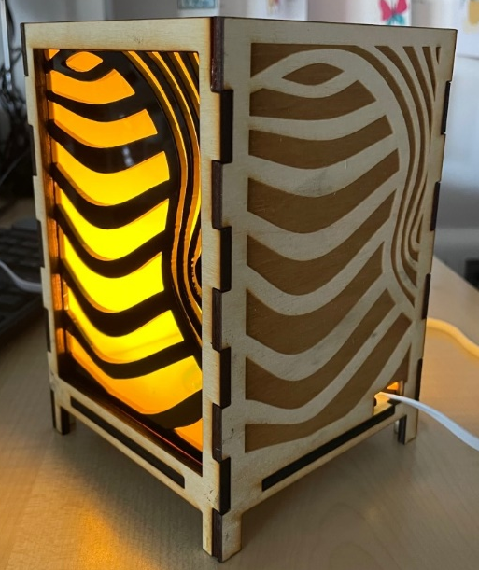
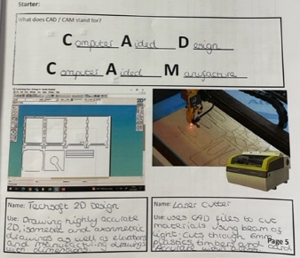
What is CAD/CAM?
Year 9 students have been recently started a CAD/CAM lighting project. The project involves lots of design and practical work but we have also covered theory about CAD/CAM.
High achieving students will be able to explain the term CAD/CAM, identify where it is used in our school and discuss a range of advantages and disadvantages for CAD/CAM.
In the examples, students have use the information from our theory lessons to explain the applications of CAD/CAM and traditional methods. The students have responded in detail using the structure provided to fully explain their thoughts. The students have also used a variety of high quality subject specific vocabulary to create a more sophisticated response.

Slide 6
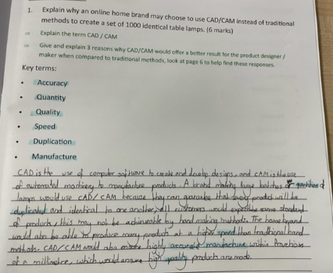
What is CAD/CAM?
Year 9 students have been recently started a CAD/CAM lighting project. The project involves lots of design and practical work but we have also covered theory about CAD/CAM.
High achieving students will be able to explain the term CAD/CAM, identify where it is used in our school and discuss a range of advantages and disadvantages for CAD/CAM.
In the examples, students have use the information from our theory lessons to explain the applications of CAD/CAM and traditional methods. The students have responded in detail using the structure provided to fully explain their thoughts. The students have also used a variety of high quality subject specific vocabulary to create a more sophisticated response.

Slide 7
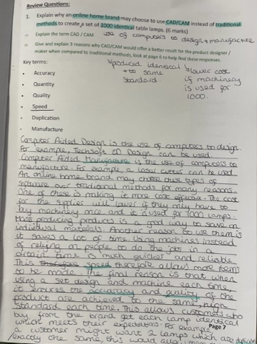
What is CAD/CAM?
Year 9 students have been recently started a CAD/CAM lighting project. The project involves lots of design and practical work but we have also covered theory about CAD/CAM.
High achieving students will be able to explain the term CAD/CAM, identify where it is used in our school and discuss a range of advantages and disadvantages for CAD/CAM.
In the examples, students have use the information from our theory lessons to explain the applications of CAD/CAM and traditional methods. The students have responded in detail using the structure provided to fully explain their thoughts. The students have also used a variety of high quality subject specific vocabulary to create a more sophisticated response.

Slide 8
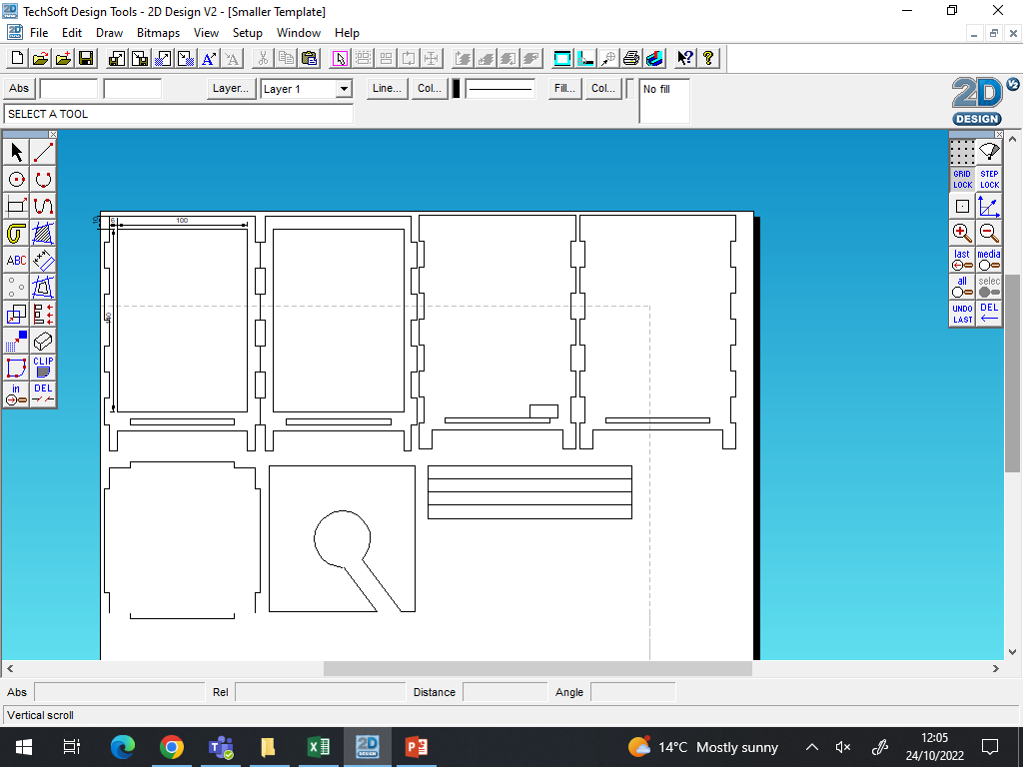
CAD / CAM
Year 9 students have been using a piece of CAD software called 2D Design. This software allows the students to draw product parts with a very high degree of accuracy and then send their work to our laser cutter. The laser cutter will then cut their product parts ready for the students to assemble and finish.
High achieving students will be able to use a range of the CAD tools independently and with a high degree of accuracy.

Slide 9
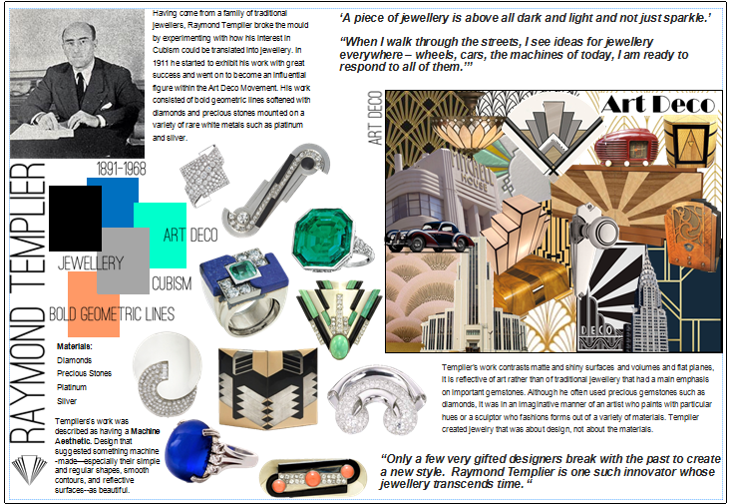
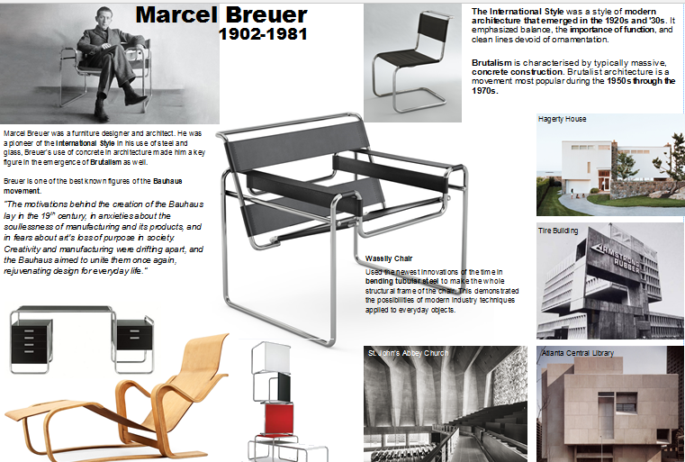
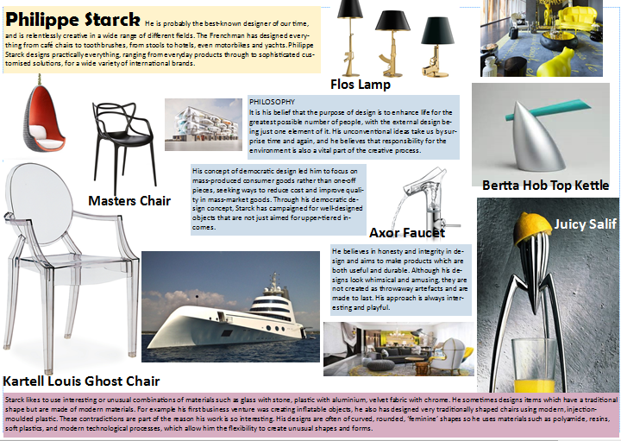
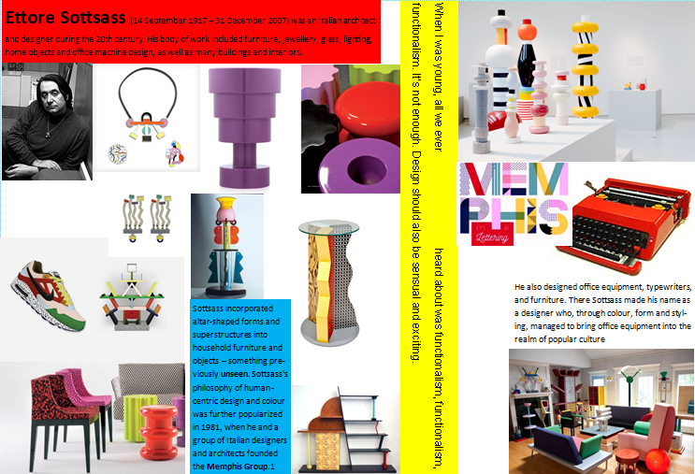
The Work of Others:
Students have been researching the work of iconic designers which will be studied further at GCSE level.
Students have used information sheets to explore the designers style, philosophy and design disciplines.
High achieving students will be able to independently discuss the work of 4 designers and explain the design characteristics which make them distinctive. They will also use sophisticated vocabulary in their descriptions.

Slide 10
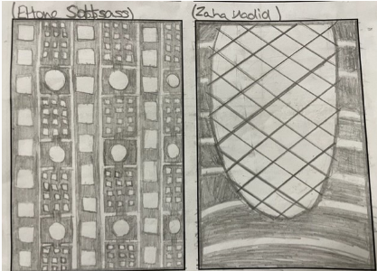
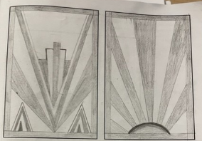
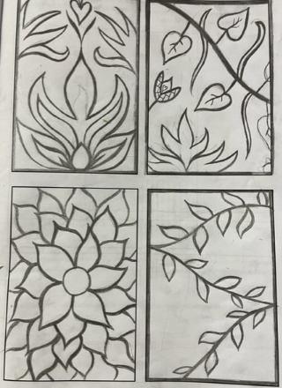
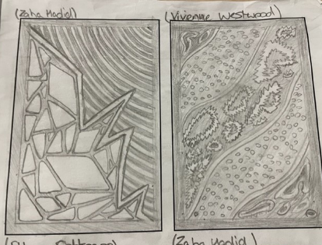
Design Inspiration:
Students used the information sheets provided to create shape and pattern developments inspired by the designer’s work.
The examples on this page show very high quality create responses. They are inspired by the designers but do not simply copy their work. The space is used well and full of interesting forms, textures, patterns and tone. The best examples use contrast e.g. thick and thin, sharp and smooth, light and dark, to create a dynamic appearance.
Students then used their shape and pattern developments to inspire the design on 2 tiles which could be added to their lamp. Good examples show an understanding of what will be solid and cut away and how this would be created on a laser cutter.

