Slide 1
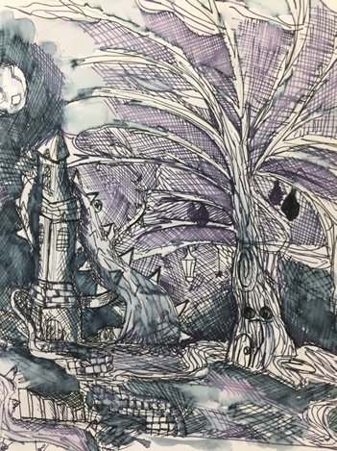
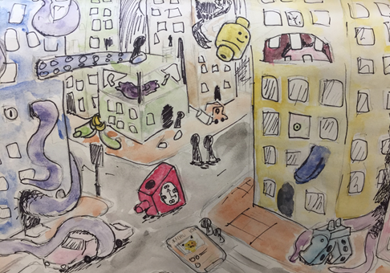
Observational Skills
The student uses a wider range of mark-making skills to create this dramatic surreal landscape inspired by Ian Miller, but also manages to construct her own composition.
The student has created this perspective drawing from building references but has used his imagination to add surreal objects. The design clearly demonstrates an excellent imagination.

Slide 2
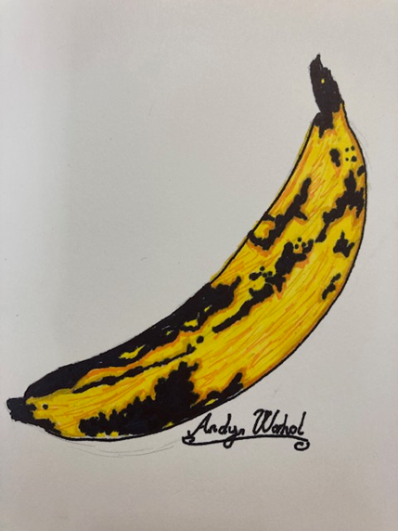
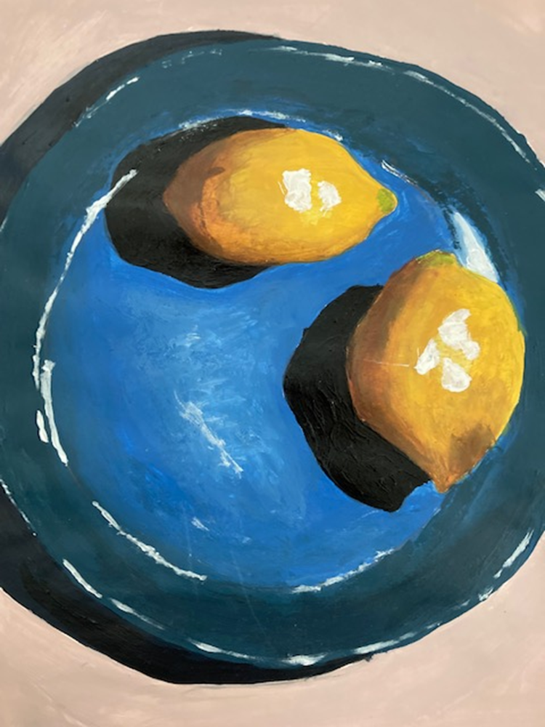
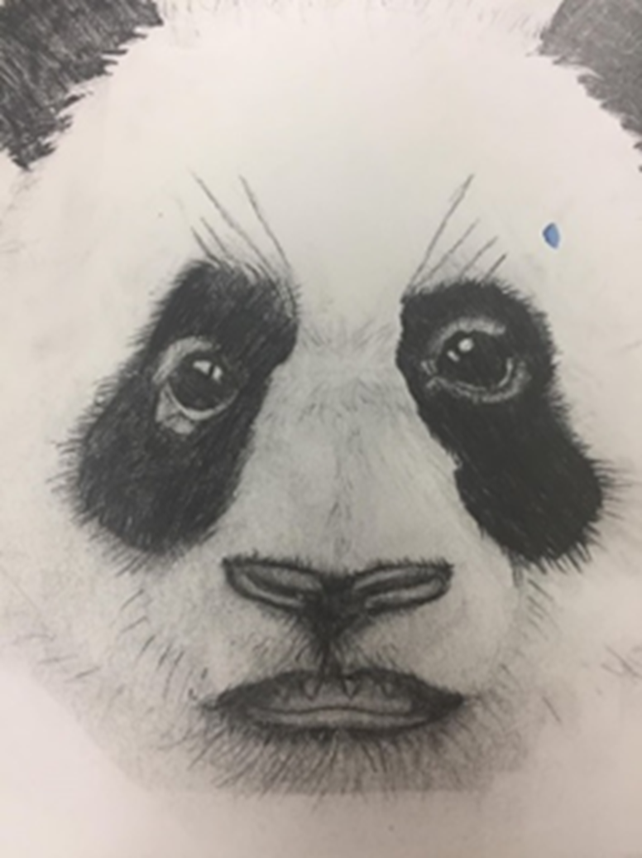
Year 8 examples show brilliant confidence when using a wider range of tonal shades, including dramatic shadow and clever use of highlight. There are subtle changes in the tones which create a sophistication to the observations.

Slide 3
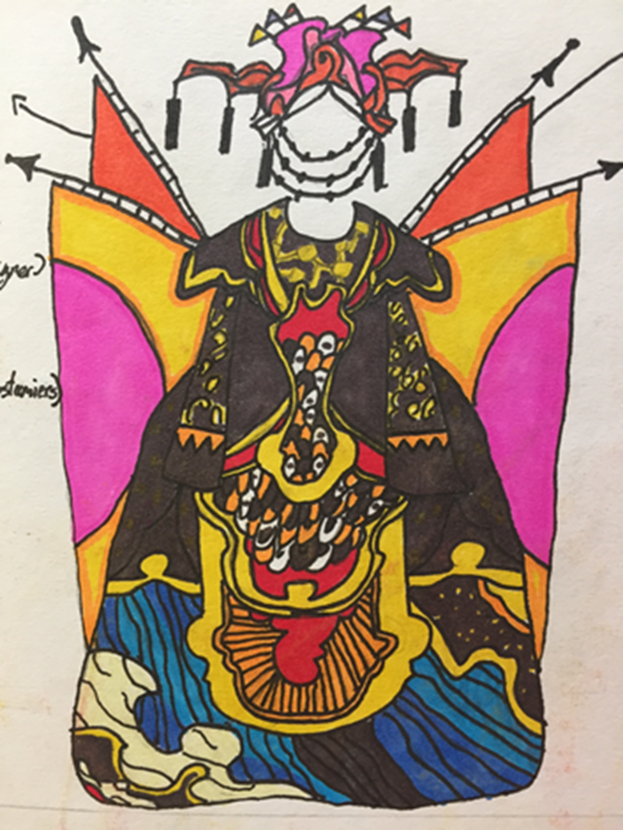
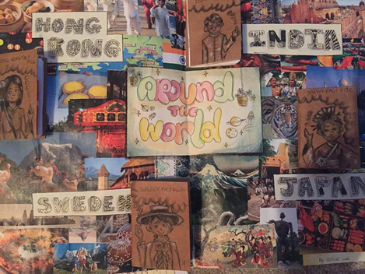
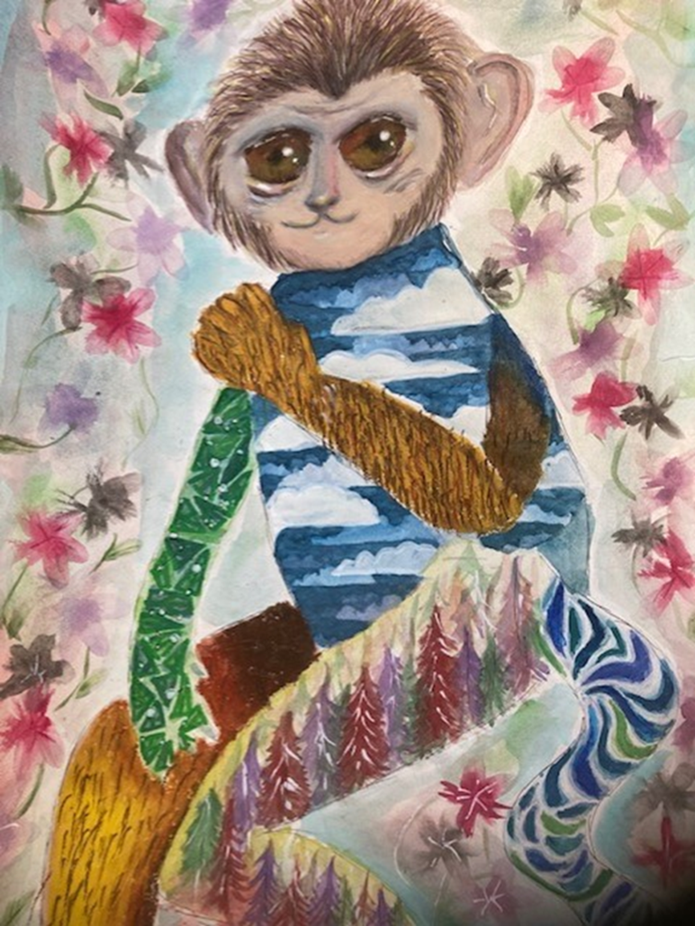
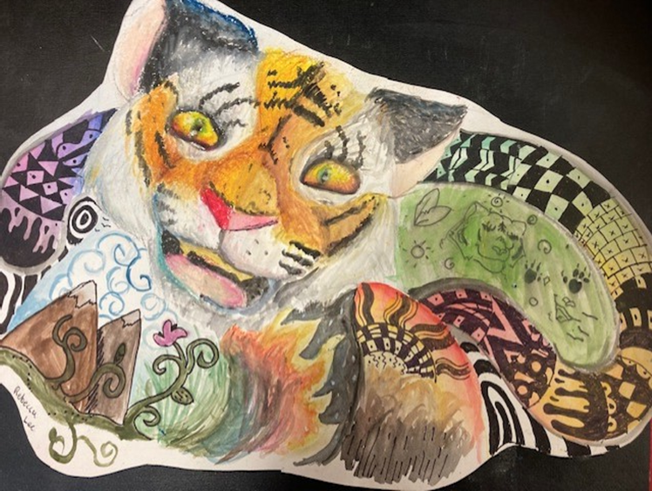
Students have been resourceful with research based on the theme ‘Around the World’ and the work of Daniel Mackie to create individual compositions with superb control over mixed media materials and techniques.

