Slide 1
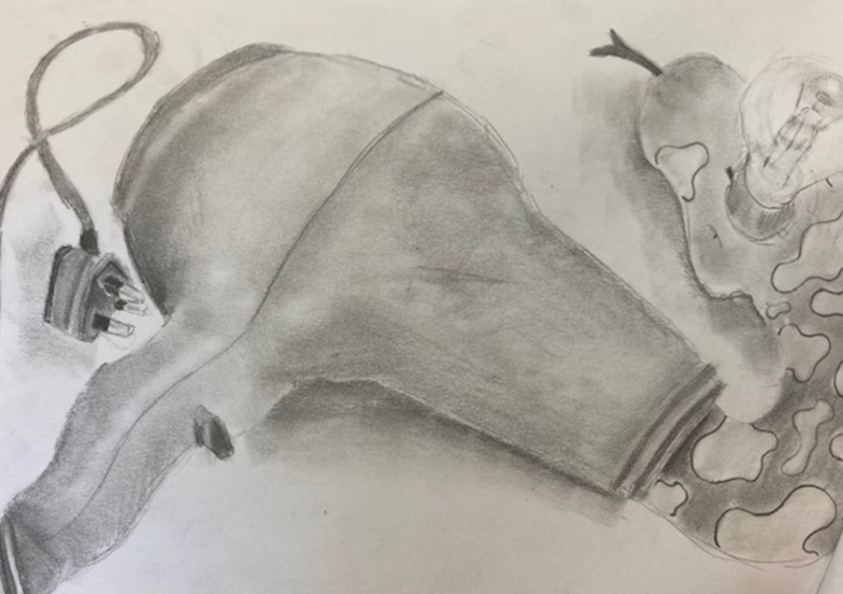
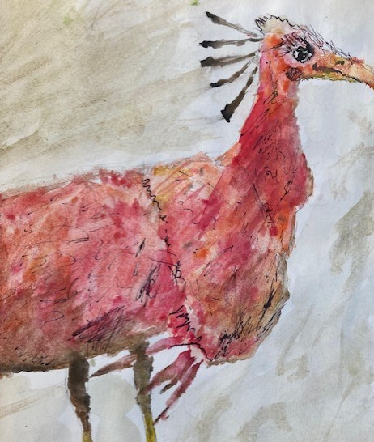
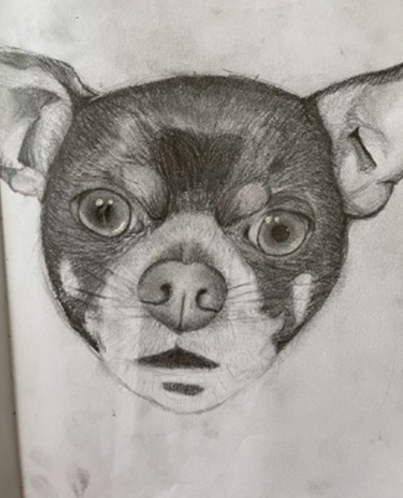
Year 7 Examples
Quality of recording examples
The student has created the object from 1st hand observation, but has developed the piece into a surreal drawing by adding the snake and light bulb. The student has confidently used a range of tones to add depth to the objects.
Student has confidently layered watercolours, brusho inks and fine liner to create texture closely linked to Olivia Lomenech Gill’s work.

Slide 2
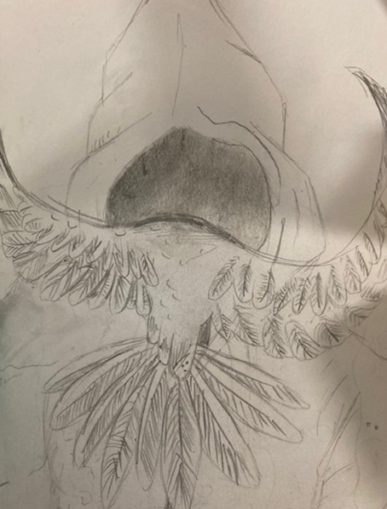
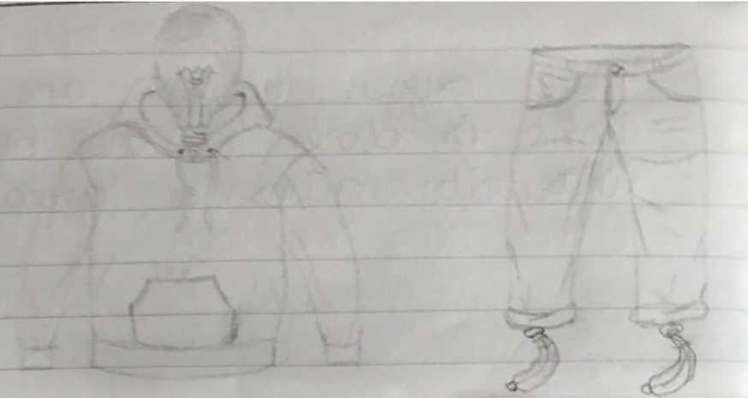
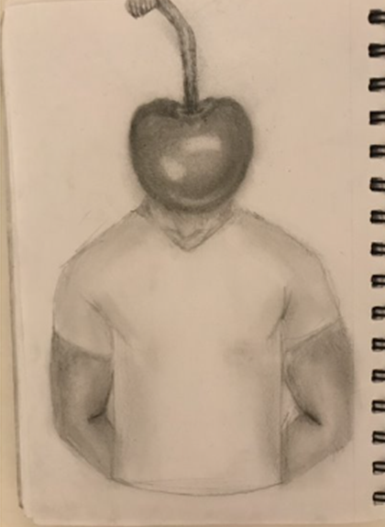
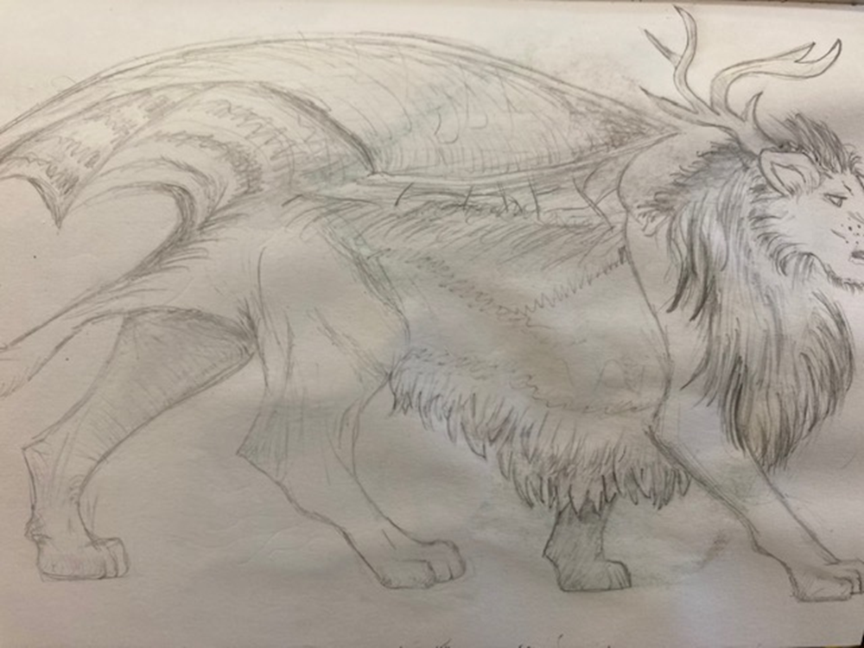
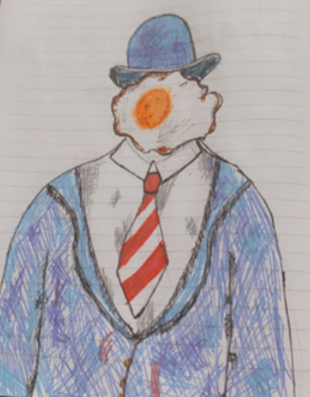
Examples of students developing their own ideas with imagination, independence and reference to the artists studied and the theme.

Slide 3
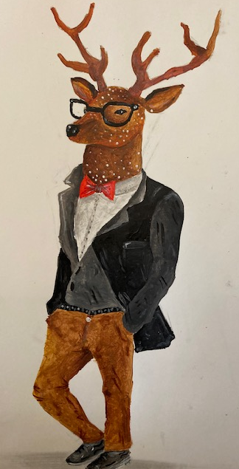
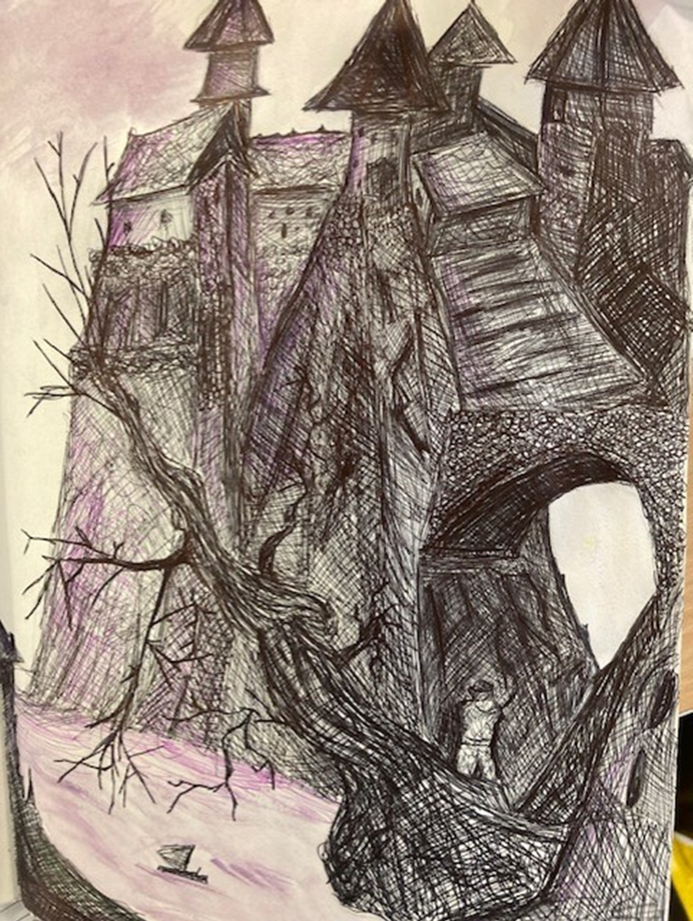
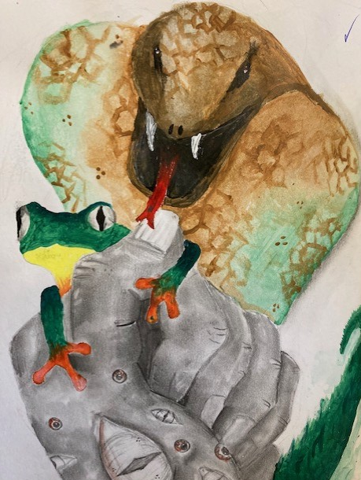
Refined drawings and paintings have been developed from the student’s research. The exceptional quality is achieved with a sophisticated use of materials e.g. lighter washes of colour layered with different diluted inks and watercolours

