Slide 1
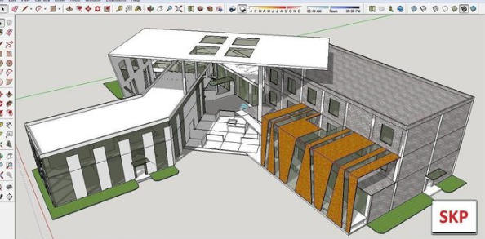
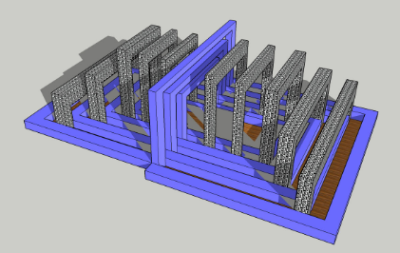
Further use of CAD:
Google SketchUp is a free piece of 3D CAD software which is available to use online and has cloud storage built into user accounts. We use this software in Year 10 and beyond create CAD prototypes of our designs.
As further learning, follow the links below to create your own Trimble user account and log in to Google SketchUp.
Trimble Identity
Below are links to YouTube videos and playlists of simple tutorials for using the software. Watch the videos and follow their tasks to build up a good level of skill.
Sketchup for Schools tutorials – YouTube
SketchUp - Tutorial for Beginners in 10 MINUTES! [ COMPLETE ] – YouTube

