Slide 1

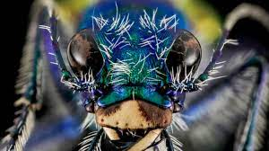
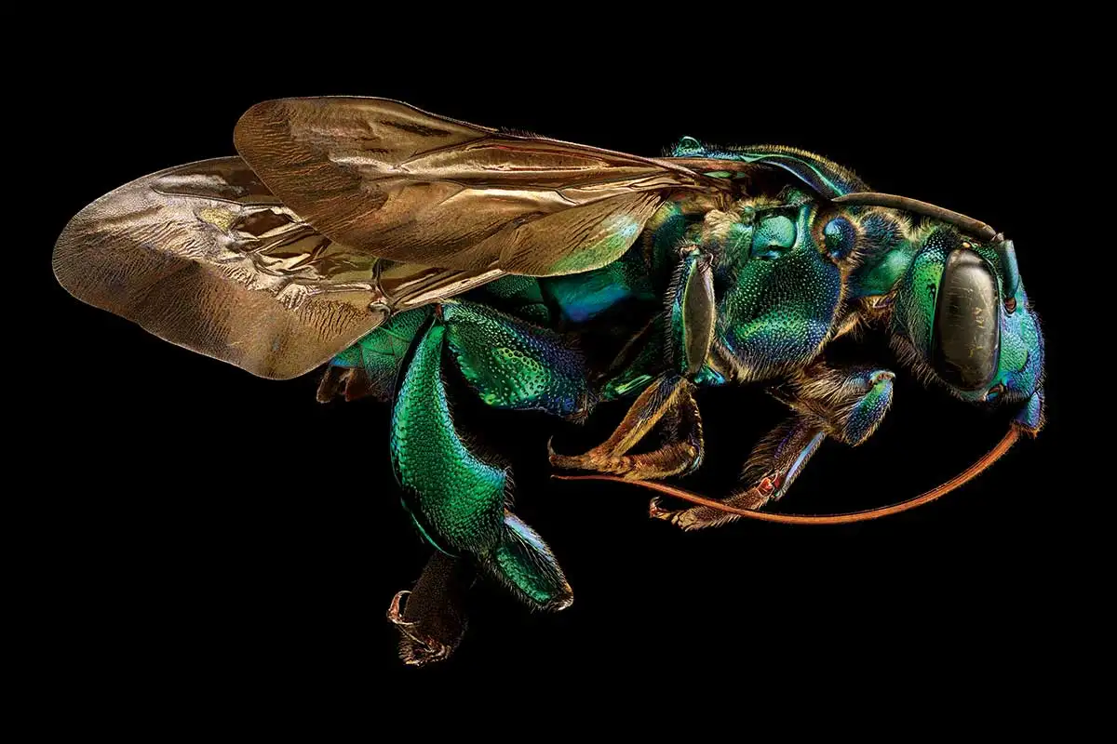
Task: Recording more details in your observational drawings and working closely from resources images.

Slide 2
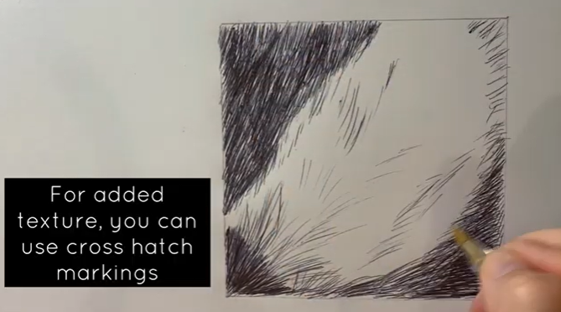
Aim: To notice more surface detail in the objects you are drawing and record them in your work.
1/ Drawing Exercises/Timed drawing
https://www.youtube.com/watch?v=YjpHRkFQn20
2/ Watch the video of how you should approach the task. (1 min 2secs)
https://www.youtube.com/watch?v=rOM0OpCML2w
Draw a small box on your page in pencil and select a close up images from the following slides.
Only record the lines, marks and shadows that you see. Avoid making anything up.

Slide 3
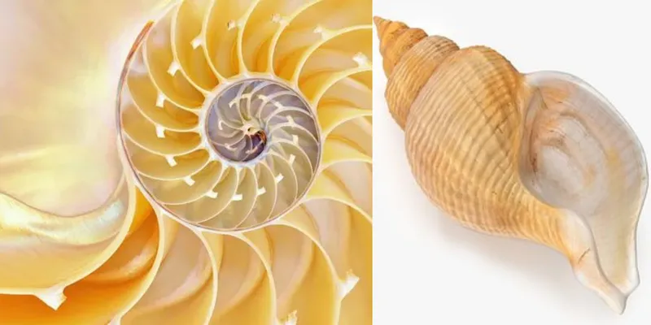
Organic Forms to draw from
You can select anything to draw from for these activities, as long as you have a good view of the object or image. Avoid just drawing from your head and things you already know you can draw! Challenge yourself ☺

Slide 4
