Slide 1
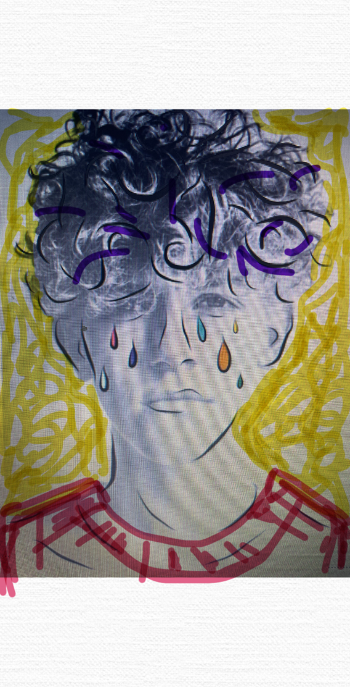
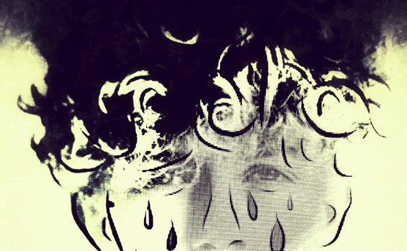
Aim: Developing a wider variety of final ideas. Task: Developing 1 image into several different styles through digital apps!

Slide 2
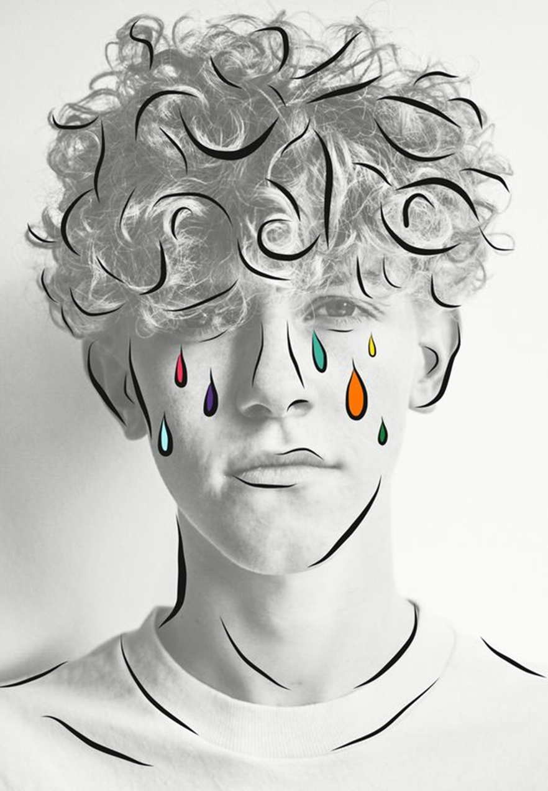
EDITING APPS FOR FREE
Take a photo of your chosen object/place/person.
Use the list of free editing has to apply filters and tools to develop your original image.
Optional: You may have access to digital drawing programmes on your phone or tablet. You could try to change your original photo by drawing on top of it.
Digital drawing/editing apps:
Tayasui sketches
Glitchlab
Mirrorlab
Hypocam
Instasquare
Photoshop express
Hipstamatic
Pixlr
Snapseed
Fragment
Kaleidacam
Prisma
Instagram Layout
PhotoPea - www.photopea.com
Pixlr
VSCOcam
Tiny Worlds (99P)
Autodesk sketchbook
Snap seed
FXStencil
Vinci
Prisma

Slide 3
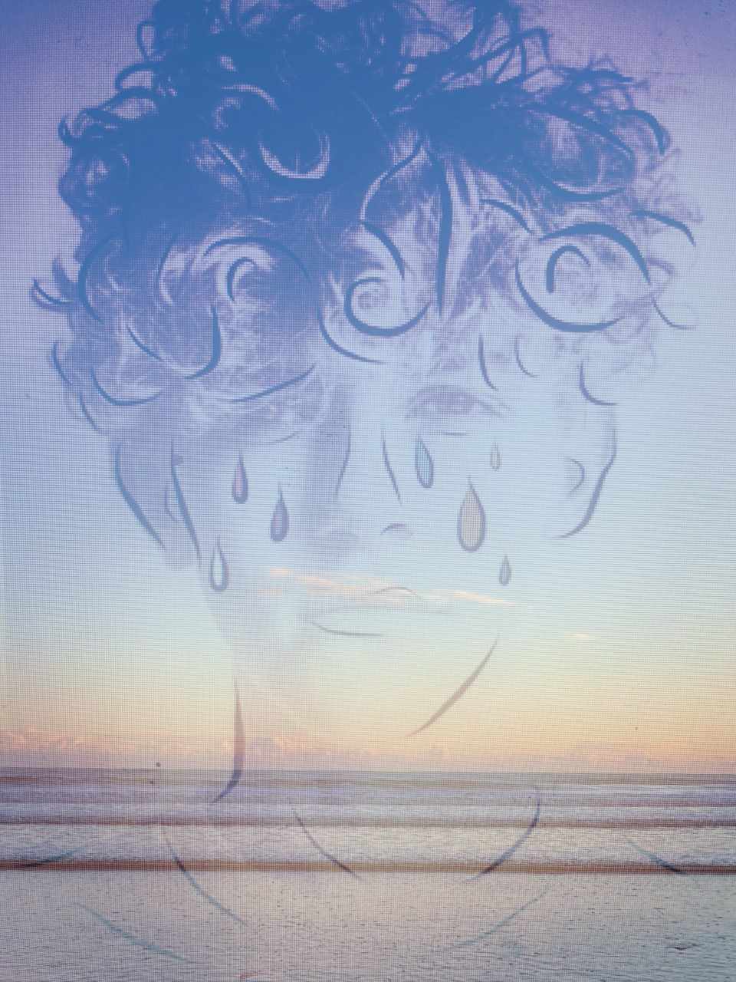
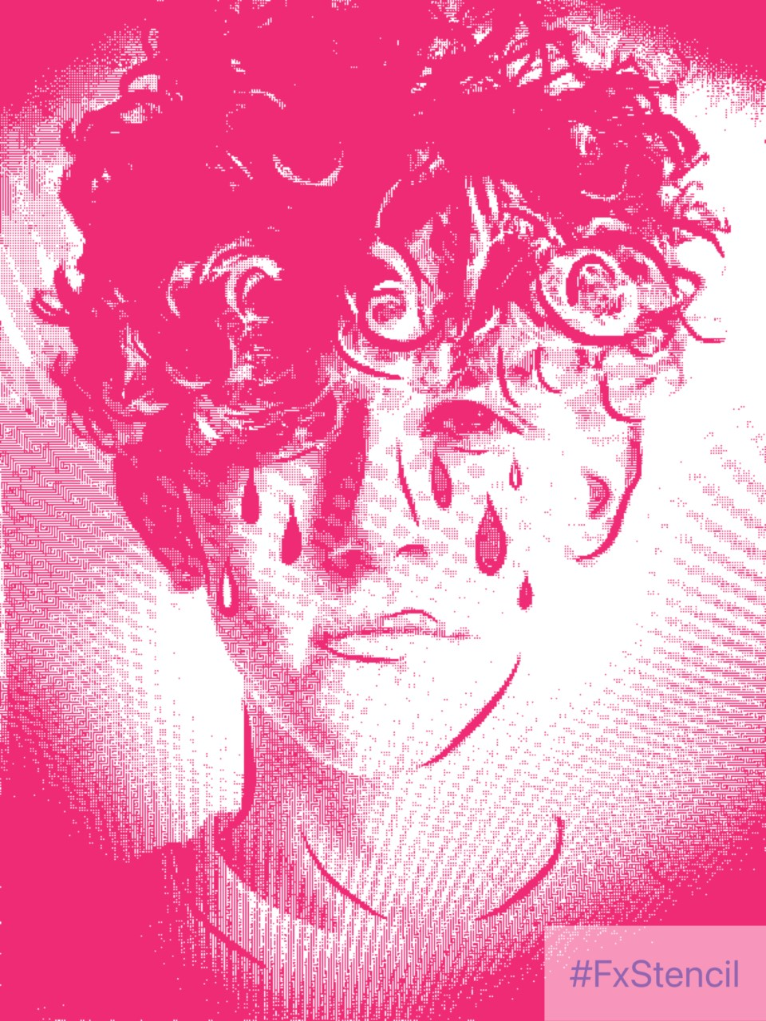
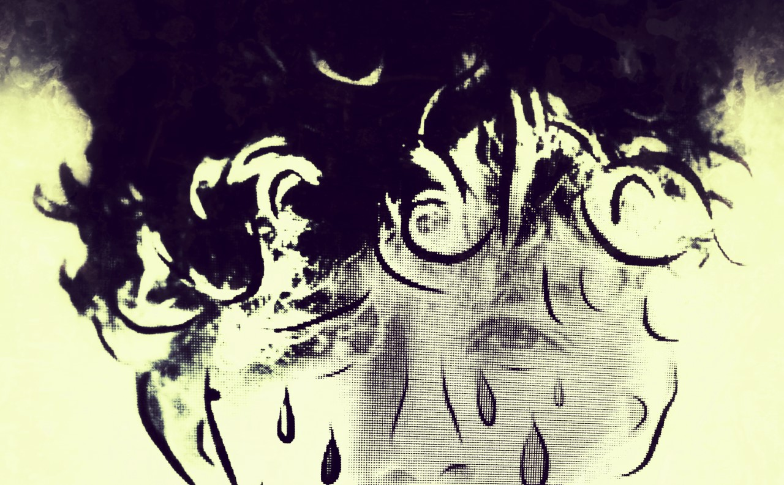

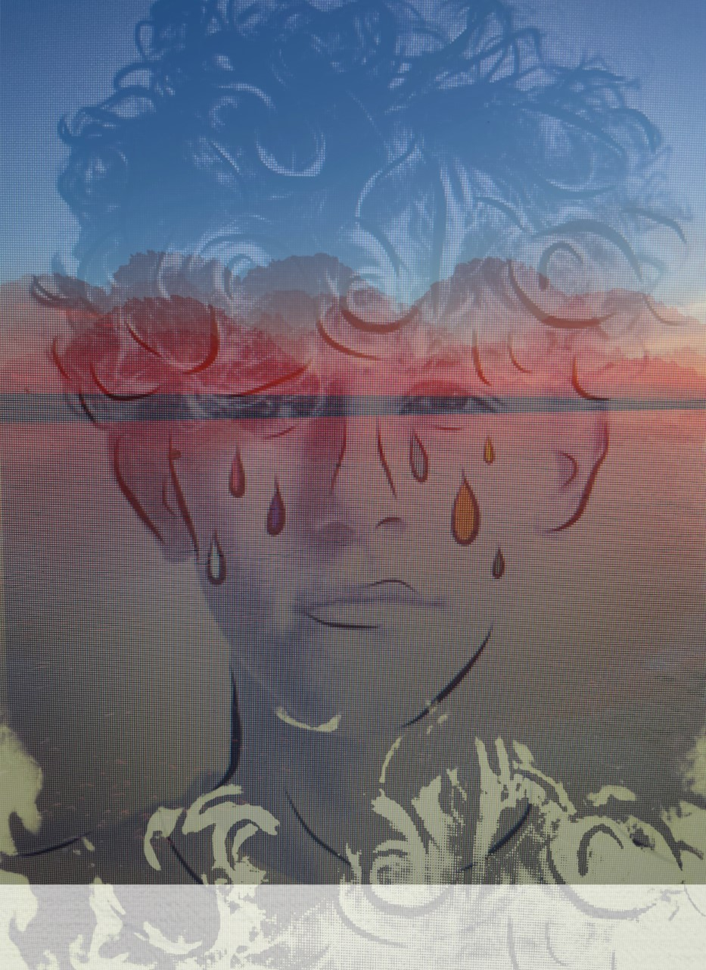

Once you have changed your images using the apps. You could always use these new images to draw or paint from.

