Slide 1
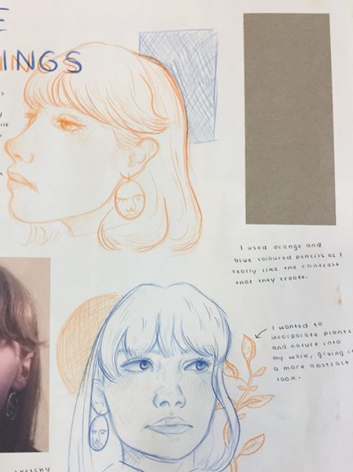
Developing Drawing Styles
To push your drawing skills further, you should stay open minded to different approaches to drawing and recording.
On the next slide there are several different drawing techniques. Practice the different styles and keep your drawings in a sketchbook/folder so you can refer back to them.

Slide 2
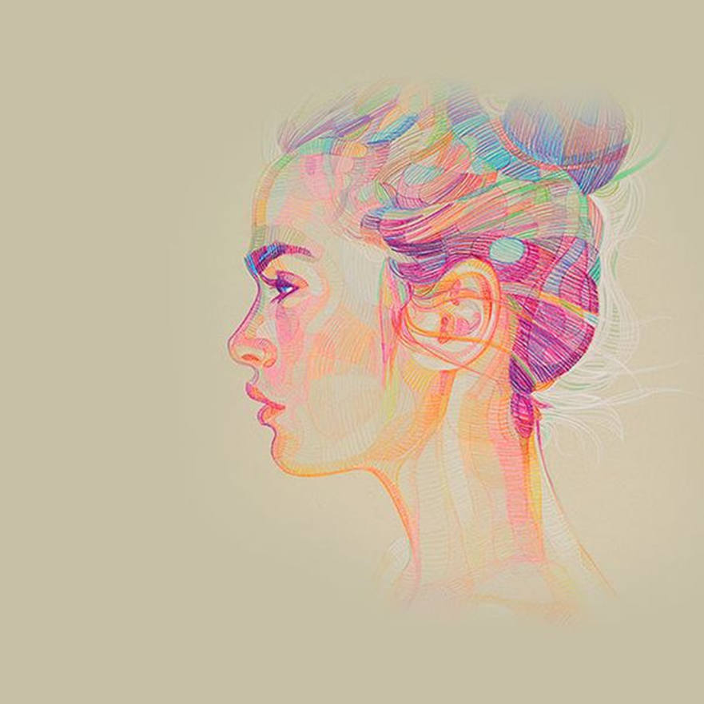
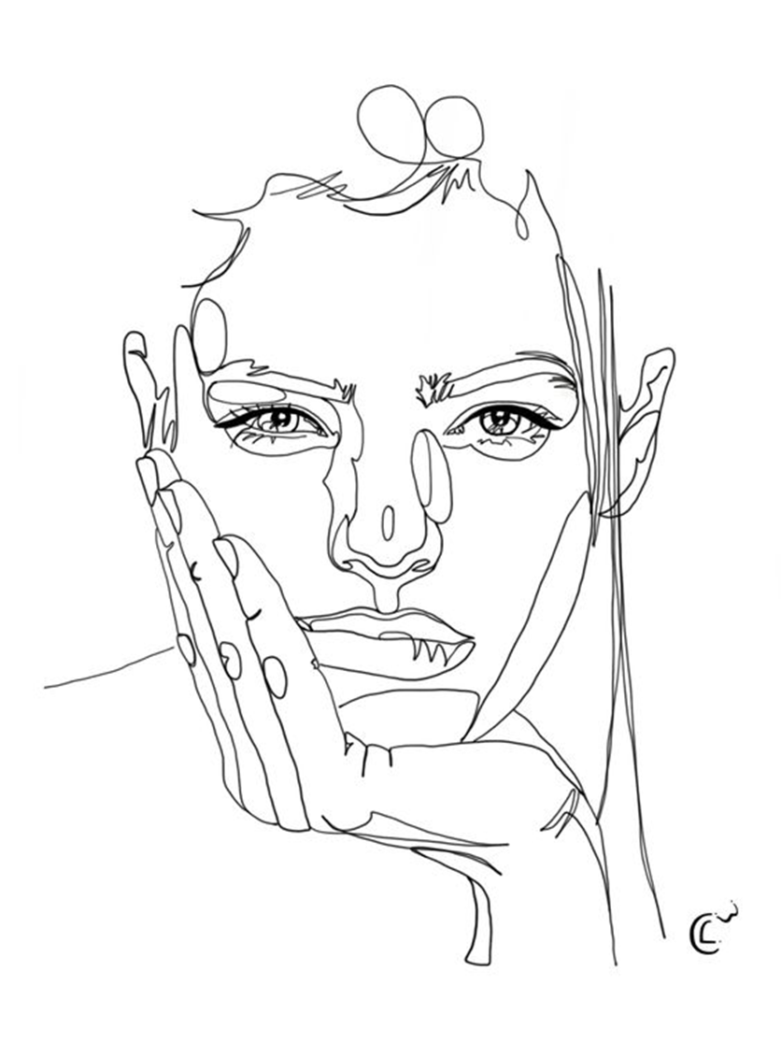
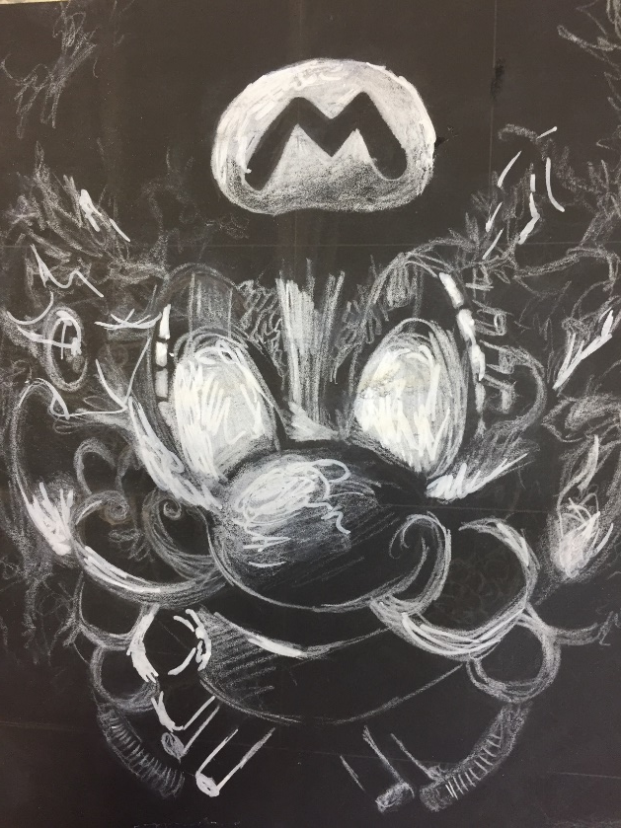
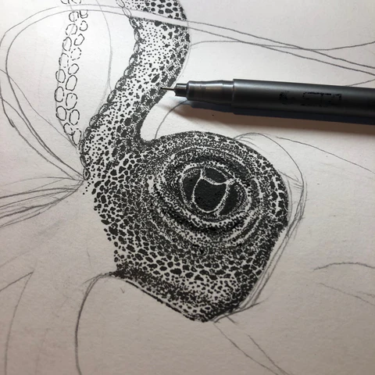
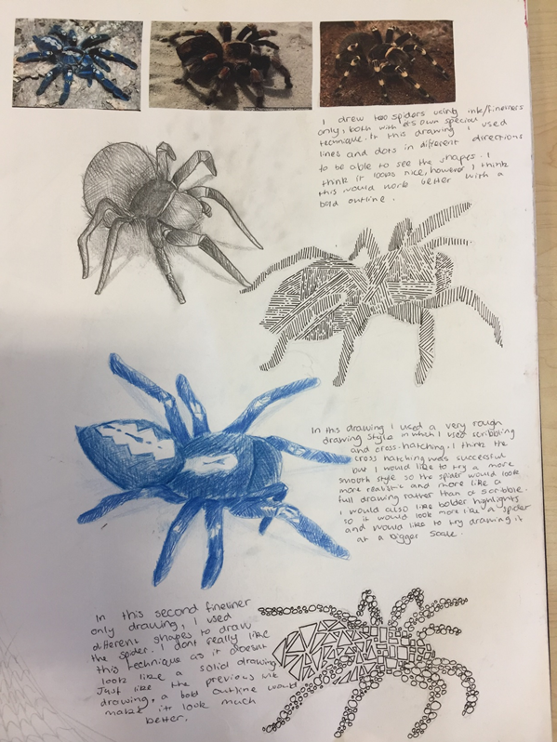

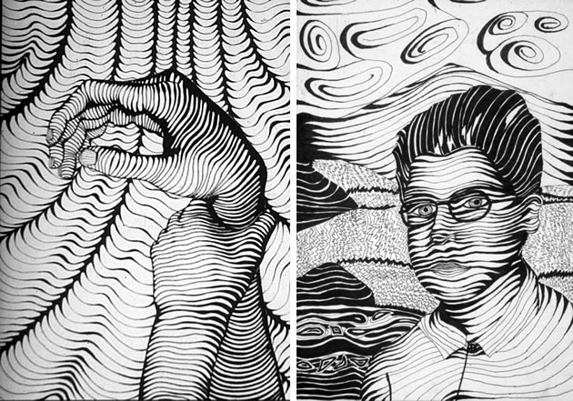
Continuous lines
SCRIBBLES/CIRCULAR
THE OPTIONS…….
Cross hatching
Line
Pointillism (drawing with dots)
Select a photographic image to work from.
Suggested:
Close up animal image
Eyes
Characters
Portraits
SHORT LINES
Directional line
& knitting lines together

Slide 3
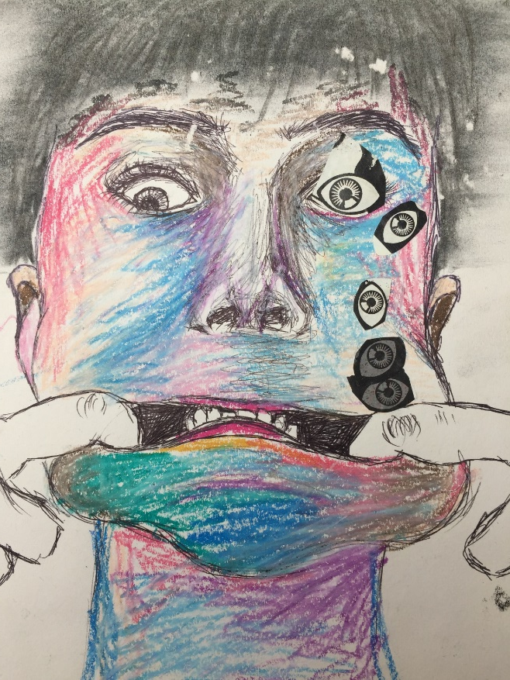
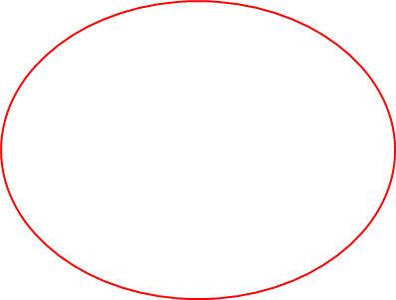
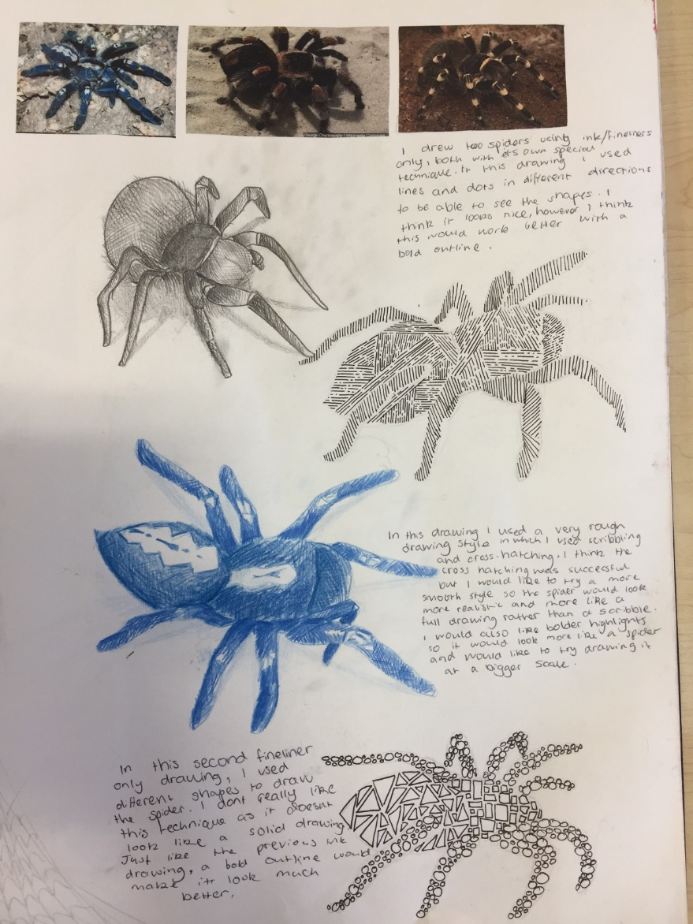
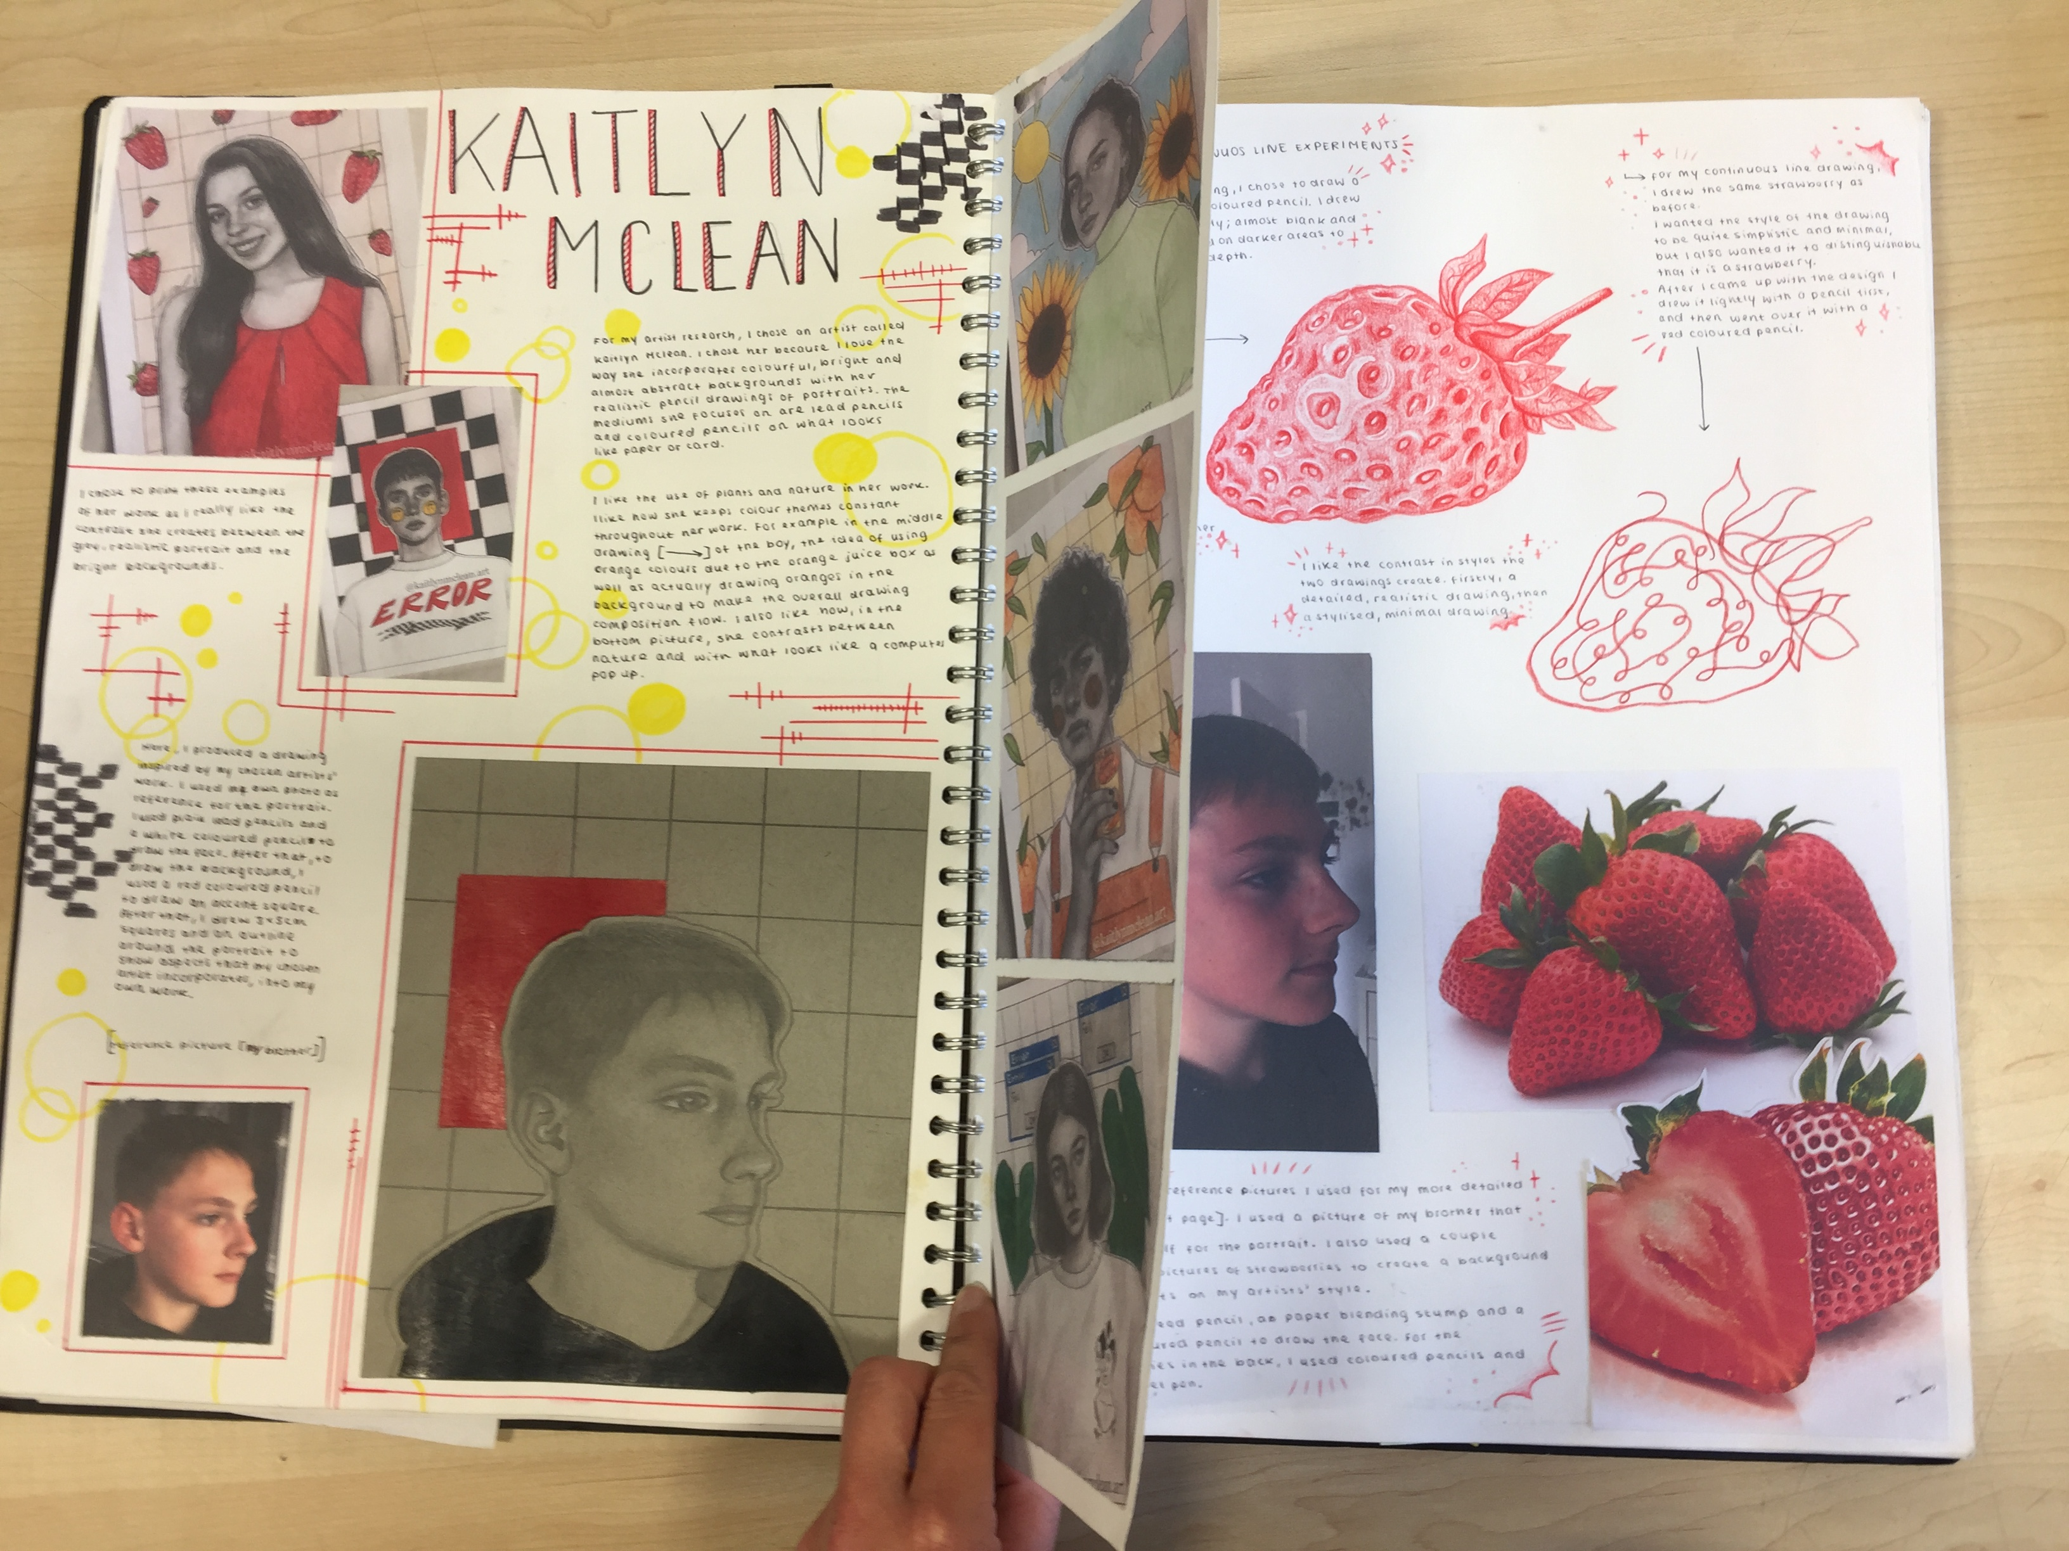


These are Year 11 Sketchbook pages. You can see the students are choosing different drawing techniques to suit the chosen images.

