Slide 1


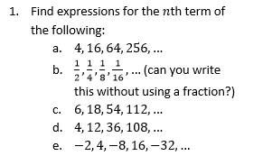
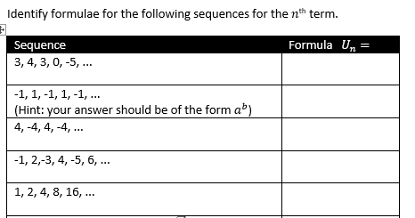
Finding the nth term of a geometric progression
Follow this link to watch a video on “Finding the nth term of a geometric progression”
https://www.youtube.com/watch?v=8idda0ZuU0w
Work through the questions below to check your understanding (solutions on next page):
2.

Slide 2
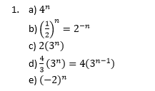
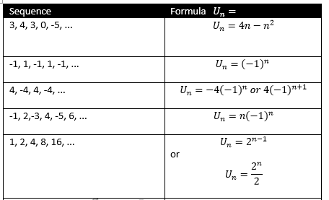
Solutions:

