Slide 1


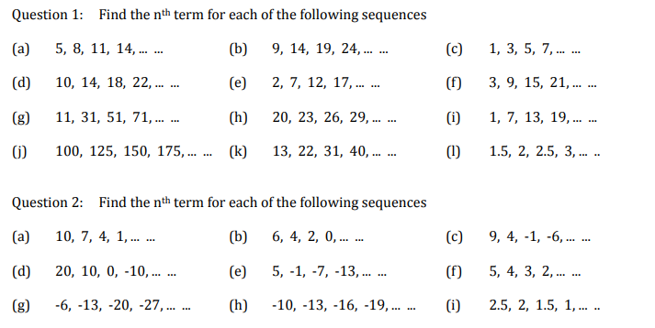
Using the nth term to identify if a given number is in a sequence
Follow this link to watch a video on “Finding the nth term of a linear sequence”
https://corbettmaths.com/2012/08/20/the-nth-term-for-linear-sequences/
Work through the questions below to check your understanding (solutions on next page):

Slide 2
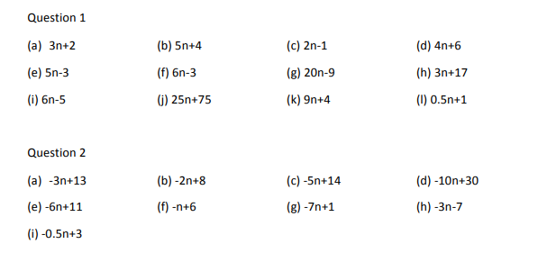
Solutions:

