Slide 1
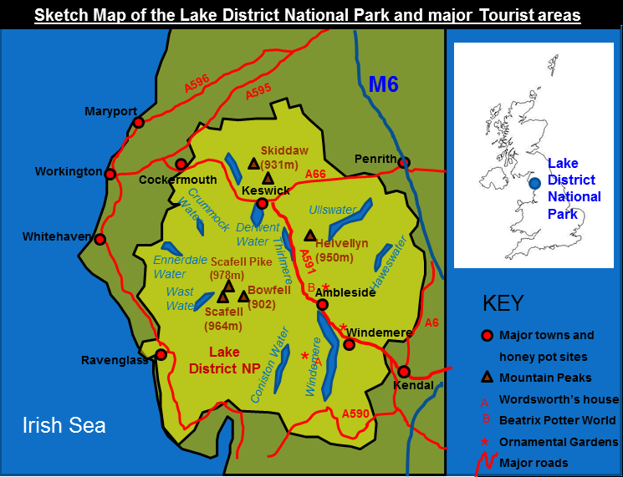
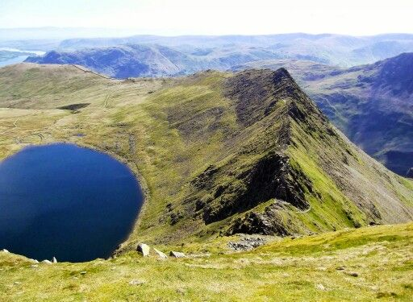
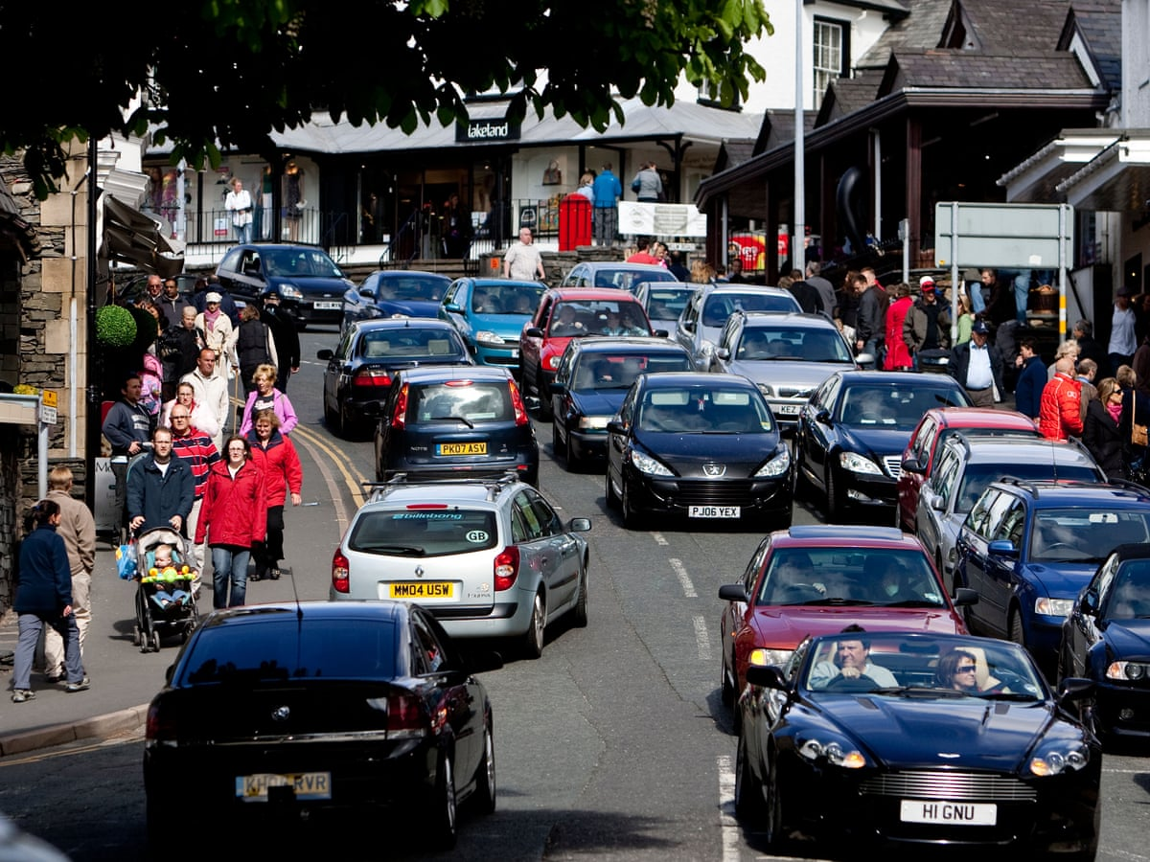
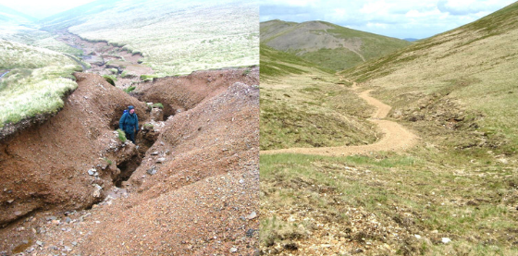
Impacts of tourism on the Lake District, a glacial environment
Read about some of the impacts on the Lake District here - https://www.lakedistrict.gov.uk/learning/factstourism/impactsoftourism
Read more detailed notes on impacts and management on these websites - https://www.studysmarter.co.uk/explanations/geography/glaciated-landscapes/lake-district-case-study/ and https://www.coolgeography.co.uk/gcsen/PL_Lake_District_Tourism.php

