Slide 1




Using the nth term to identify if a given number is in a sequence
Follow this link to watch a video on “Using the nth term to identify if a given number is in a sequence”
https://www.youtube.com/watch?v=ahgHYPquFK0
Work through the questions below to check your understanding (solutions on next page):
1
The first four terms of a sequence are $6, 9, 12, 15,…$ Is $39$ in the sequence?
(b) The first four terms of a sequence are $7, 10, 13, 16,…$ Is $67$ in the sequence?
(c) The first four terms of a sequence are $5, 8, 11, 14,…$ Is $40$ in the sequence?
2.
The nth term of a sequence is $3n−2$. Is $95$a term of the sequence.
(b) The nth term of a sequence is $5n+3$. Is $118$a term of the sequence?
(c) The first four terms of a sequence are $7, 11, 15, 19,…$ Is $97$ in the sequence?
(d) The first four terms of a sequence are $−2, 5, 12, 19,..$ Is $110$ in the sequence?

Slide 2
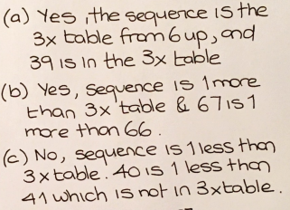
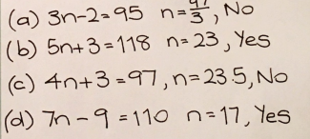
Solutions:
1
2

