Slide 1
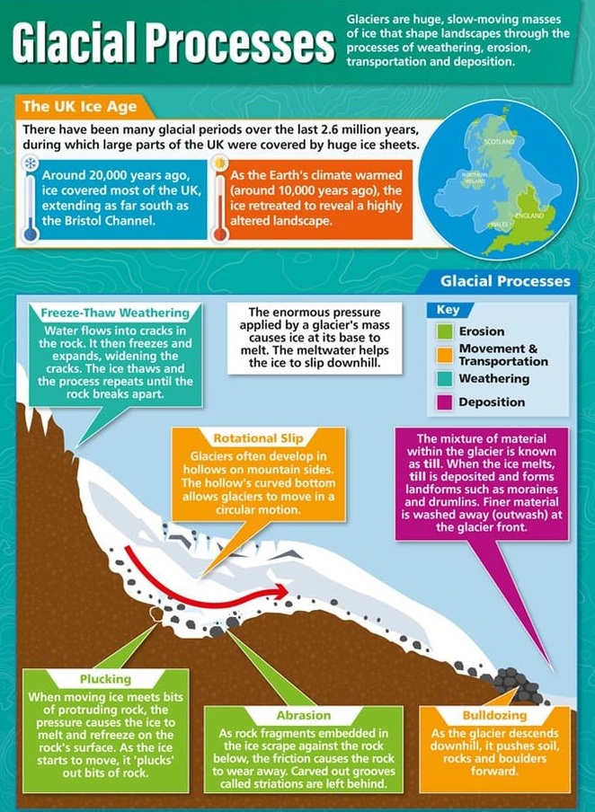
Glacial processes
Watch this video which shows evidence of UK glaciation and deglaciation - https://timeforgeography.co.uk/videos-list/glaciation/evidence-uk-glaciation-deglaciation/
Read the notes on this website - https://www.bbc.co.uk/bitesize/guides/zxn87hv/revision/1 and https://www.bbc.co.uk/bitesize/guides/zxn87hv/revision/3
Read the notes, watch the videos and test your knowledge on this website - https://www.bbc.co.uk/bitesize/topics/zpcqxnb/articles/zdw8dp3

