Slide 1
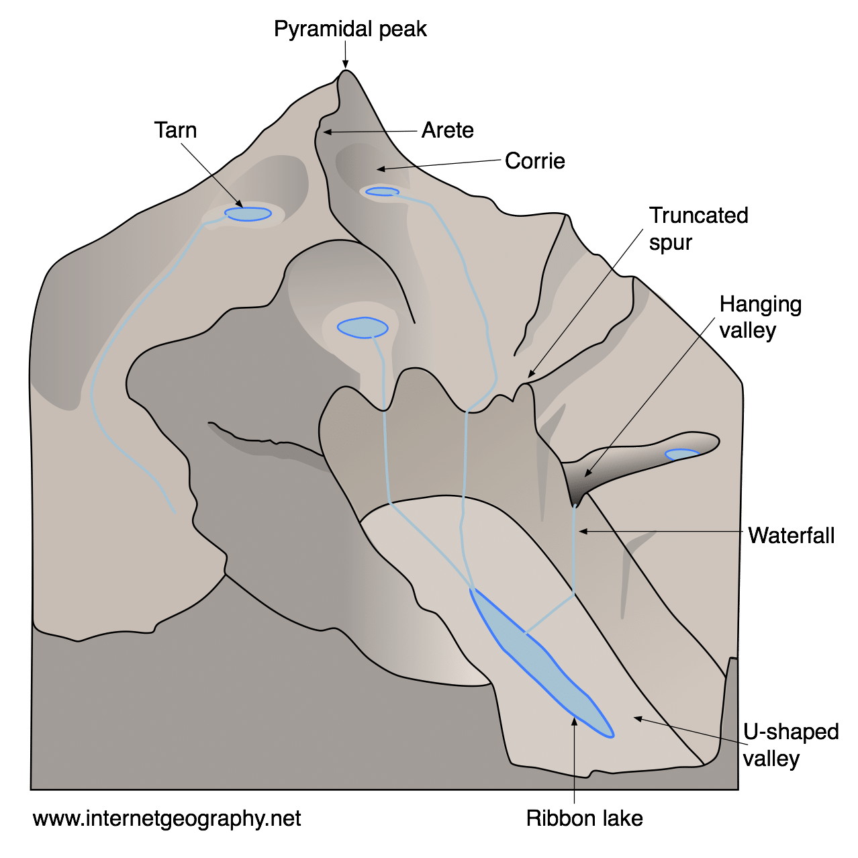
Glacial landforms
Read the notes on erosional and depositional landforms on these websites - https://www.bbc.co.uk/bitesize/guides/zxn87hv/revision/2 and https://www.bbc.co.uk/bitesize/guides/zxn87hv/revision/4
Watch the videos below to learn about features and formations of glacial landforms
  Corries, Cirques, Cwms - https://timeforgeography.co.uk/videos-list/glaciation/corries/
  Arêtes - https://timeforgeography.co.uk/videos-list/glaciation/Aretes/
  Pyramid peaks - https://timeforgeography.co.uk/videos-list/glaciation/Pyramid-peaks/
  U-shaped valleys - https://timeforgeography.co.uk/videos-list/glaciation/formation-of-U-shaped-valleys/
  Types of Moraine - https://timeforgeography.co.uk/videos-list/glaciation/glacial-deposits-types-moraine/
  Drumlins - https://timeforgeography.co.uk/videos-list/glaciation/formation-drumlins/
Read the notes and test your knowledge on this website - https://www.bbc.co.uk/bitesize/topics/zpcqxnb/articles/zwjdwnb

