Slide 1
What are natural resources, fossil fuels and renewables
Natural resources – complete these 2 lessons https://classroom.thenational.academy/lessons/what-are-the-worlds-natural-resources-6mu3et and https://classroom.thenational.academy/lessons/how-has-the-use-of-natural-resources-changed-65j36d
Fossil fuels – read the 3 sections on this website https://www.bbc.co.uk/bitesize/guides/zxxq4xs/revision/1
Energy – read through this webpage and try the quiz! https://www.bbc.co.uk/bitesize/topics/zjsc87h/articles/z3bgvwx and https://www.bbc.co.uk/bitesize/topics/zxy4cmn/articles/zncyn9q

Slide 2
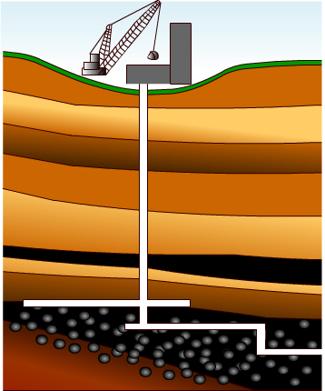

Formation of coal
300 million years ago, plants photosynthesized and stored the Sun’s energy. Dead plants fell into swampy water and the mud stopped them from rotting away.
Over the years, the mud piled up and squashed the plants. After millions of years under this pressure, the mud becomes rock and the plants become coal.
There is still a great deal of coal and this resource will last the longest. However, it also creates the most pollution when burnt.

Slide 3
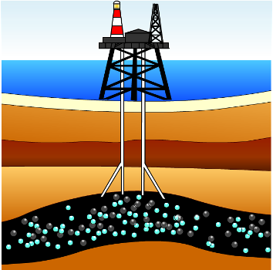
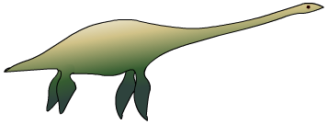
Formation of crude oil and natural gas
Oil is also biological in origin. Millions of years ago tiny animals lived in the sea. Like now, their ecosystem was dependent upon heat and light from the Sun and photosynthesis by plants.
When they died they fell into mud and sand at the bottom of the sea but they did not rot away.
Over millions of years, they got buried deeper by the mud and sand. The temperature and pressure (caused by the weight of the sediments and deep burial) changed the mud and sand into rock and the dead animals into crude oil and natural gas.

Slide 4
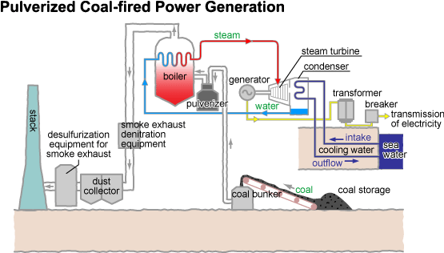
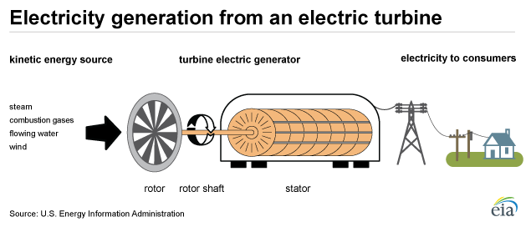
How is Electrical Energy Produced?
Oil, gas, coal wood and rubbish are burned to create heat |  |  | Natural sources are used to create power
The heat generated from the fuel is used to boil water and create steam, and a jet of this is sent to the turbine. |  |  | Wind, fast flowing water and tides are able to move a turbine.
The turbine spins
A generator containing the electromagnet and coil is powered by the turbine
As the electromagnet turns electricity is produced!
Cables are used to carry electricity away to where it is needed such as schools and homes.

Slide 5
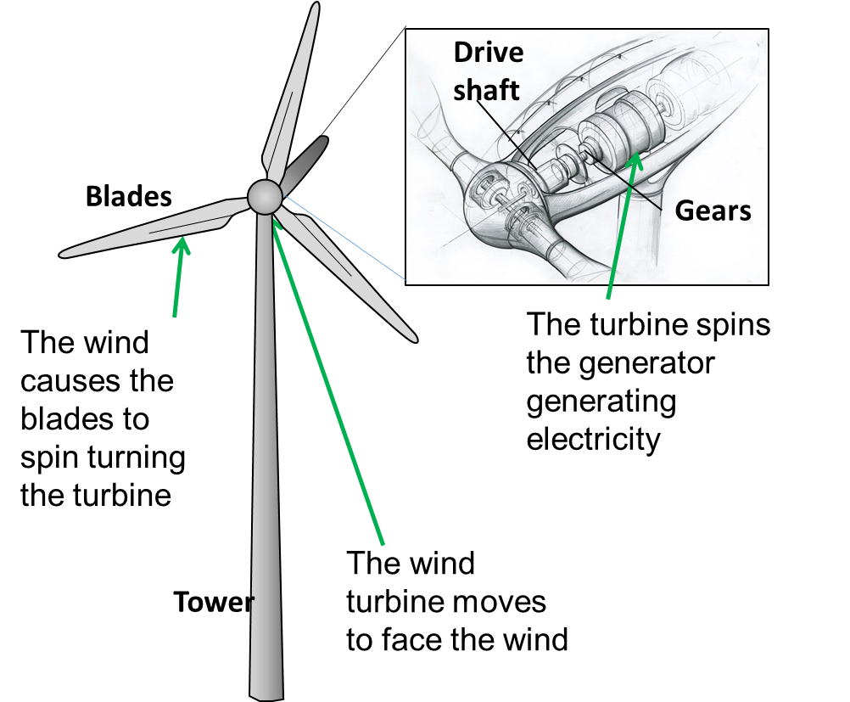
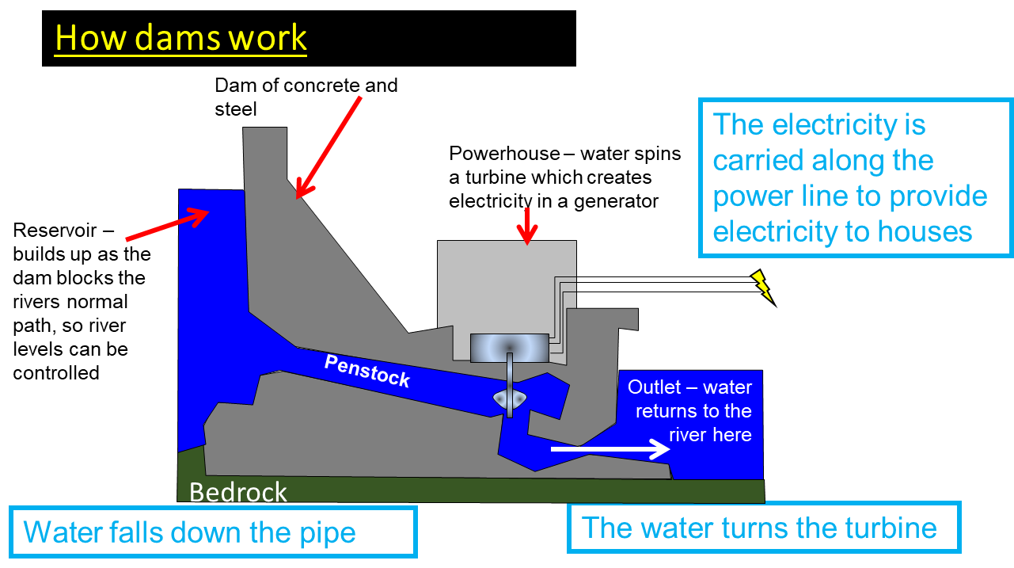
How is Renewable Energy Produced?

