Slide 1
Measures of central tendency (mean, median and mode) and measures of dispersion (range and interquartile range
MEAN
The sum of all the values divided by the number of values.
MEDIAN
The middle value when they are arranged in size order.
MODE
The most common value.
RANGE
The difference between the highest and lowest values.
INTERQUARTILE RANGE
This measures the spread of the middle half of your data

Slide 2
Mean
The sum of all the values divided by the number of values.
7
11
8
11
3
7+8+11+3+11 =
5
40 =
5
8

Slide 3
Median
The median is the middle value when they are arranged in size order.
7
11
8
11
3
8
3
11
7
11

Slide 4
Mode
The mode is the most common value
7
11
8
11
3
8
3
11 11
7

Slide 5
Range
The range is difference between the highest and lowest value.
7
11
8
11
3
11 – 3 =
8

Slide 6
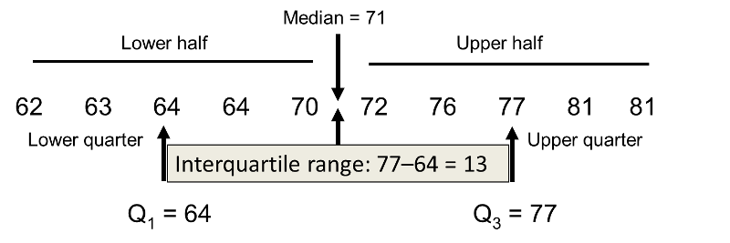
Interquartile range
Order the data into numerical data and then split into the top half and bottom half. Then find the upper quartile (middle point of the top half) and the lower quartile (middle point of the bottom half). The interquartile range is the Upper quartile – Lower quartile

Slide 7
Videos and extra guidance on using graphical and statistical skills in Geography
Statistical skills help - https://www.bbc.co.uk/bitesize/guides/zyhd6fr/revision/1
Graphical skills help:
  Watch the video and read the 3 pages on this website. You could even try the test at the end https://www.bbc.co.uk/bitesize/guides/z2qpg82/revision/1
  Some interactive resources are found here https://www.internetgeography.net/gcse-geography-interactive-revision/graphical-skills-in-geography-interactive-revision/

