Slide 1


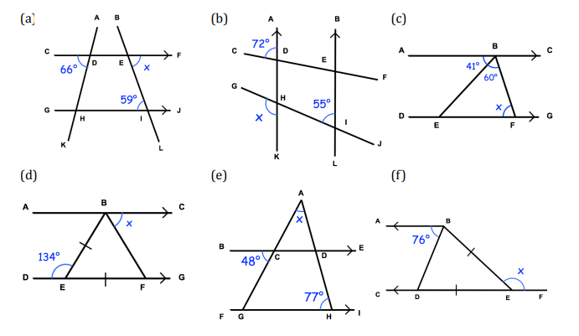
Using basic angle facts, alongside facts of angles in parallel lines to find missing angles in geometrical diagrams
Follow this link to watch a video on “Angles in parallel lines”
https://corbettmaths.com/2013/04/04/parallel-lines-angles/
Work through the questions below to check your understanding (solutions on next page):

Slide 2
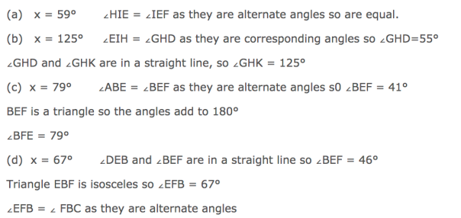
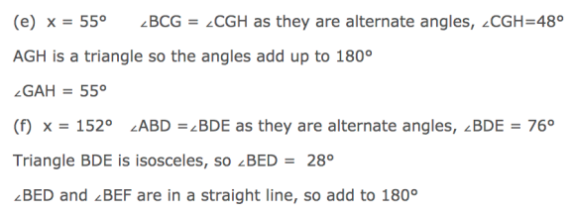
Solutions

