Slide 1


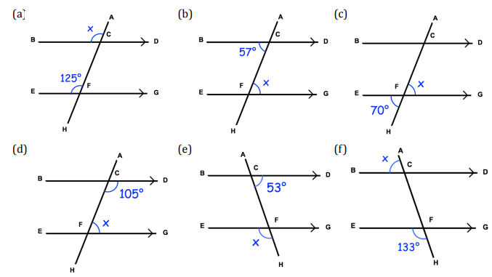
Solve problems involving a single missing angle in parallel lines and apply basic angle facts
Follow this link to watch a video on “Angles in parallel lines”
https://corbettmaths.com/2013/04/04/parallel-lines-angles/
Work through the questions below to check your understanding (solutions on next page):
Find the angle x in each question below. Give reasons for your answer.

Slide 2
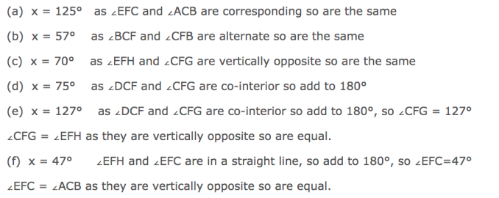
Solutions

