Slide 1


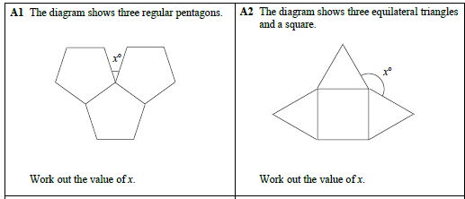
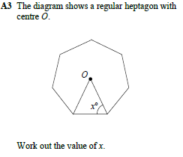
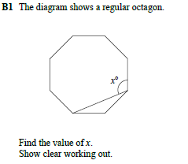
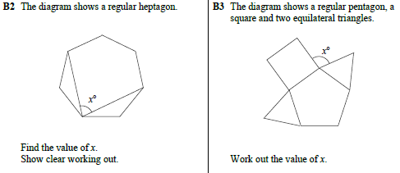
Solve missing angle problems in more complex geometrical diagrams
Follow this link to watch a video on “angles in polygons”
https://corbettmaths.com/2012/08/10/angles-in-polygons/
Work through the questions below to check your understanding (solutions on next page):

Slide 2
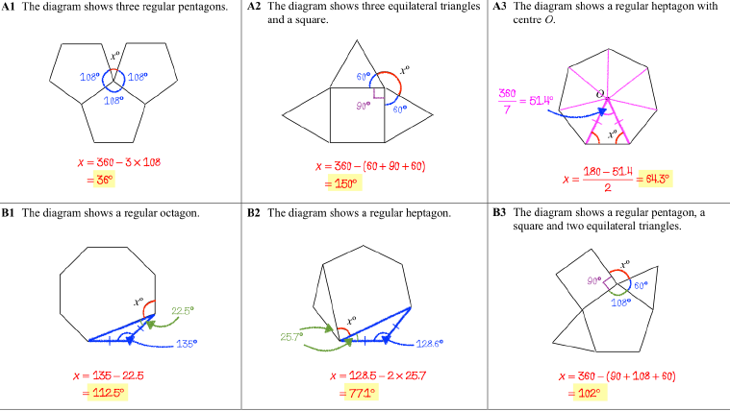
Solutions:

