Slide 1


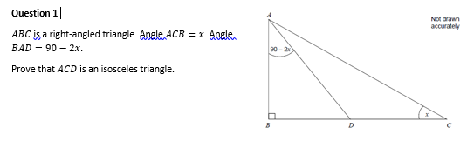
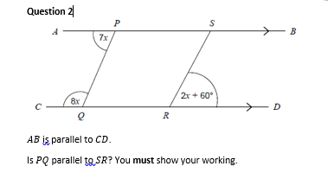
Create a formal geometrical proof
Follow this link to watch a video on “Geometric Proof”
https://corbettmaths.com/2019/12/31/geometric-proof-video/
Work through the questions below to check your understanding:

Slide 2
