Slide 1


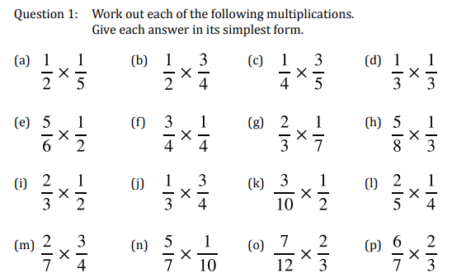
Confidently multiply and divide proper fractions
Follow this link to watch a video on “Multiplying and Dividing Fractions”
https://corbettmaths.com/2012/08/21/multiplying-fractions-2/
https://corbettmaths.com/2012/08/21/division-with-fractions/
Work through the questions below to check your understanding (solutions on next page):

Slide 2
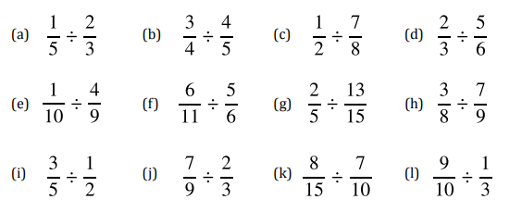
Question 2

Slide 3
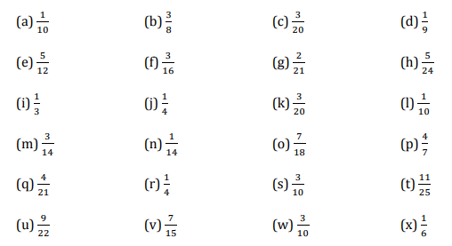
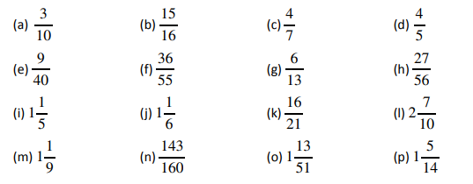
Solutions
Question1
Question2

