Slide 1


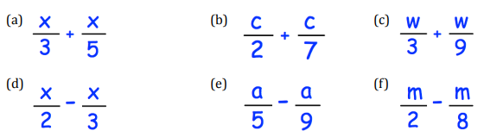
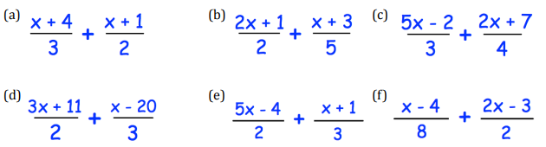
Add, subtract, multiply and divide simple algebraic fractions
Follow these links to watch a video on “Algebraic fractions”
https://corbettmaths.com/2013/01/19/adding-algebraic-fractions/
https://corbettmaths.com/2013/01/19/multiplying-algebraic-fractions/
https://corbettmaths.com/2013/01/19/dividing-algebraic-fractions/
Work through the questions below to check your understanding (solutions on next page):
Question 1
Question 2

Slide 2
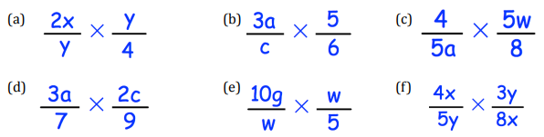
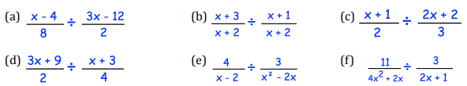
Question 3
Question 4

Slide 3
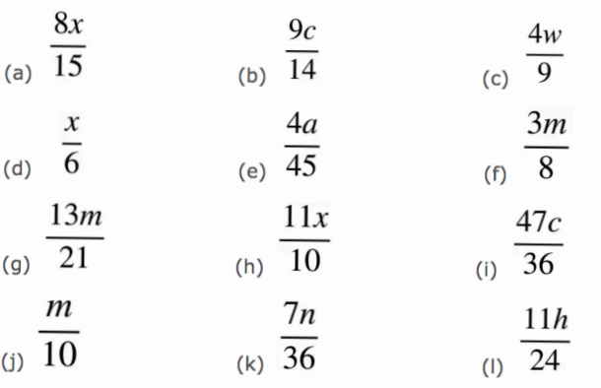
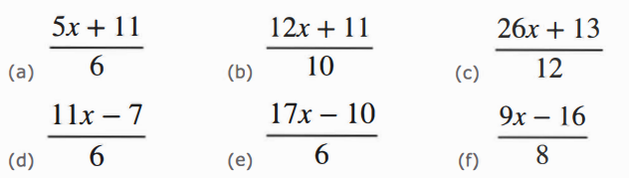
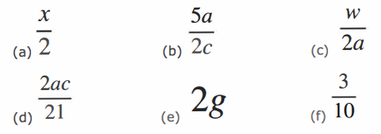
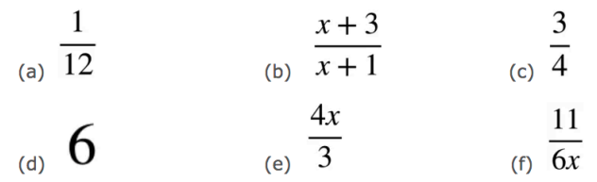
Solutions
Question1
Question2
Question3
Question4

