Slide 1


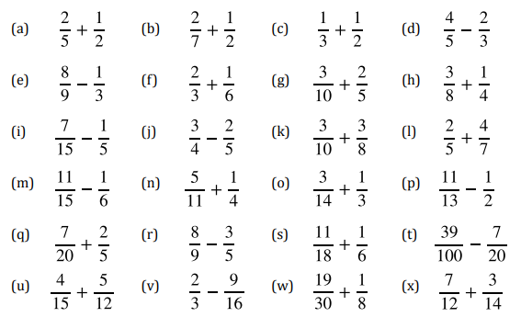
Confidently add and subtract proper fractions with different denominators
Follow this link to watch a video on “Fraction addition and subtraction”
https://corbettmaths.com/2012/08/21/fractions-addition-and-subtraction/
Work through the questions below to check your understanding (solutions on next page):

Slide 2
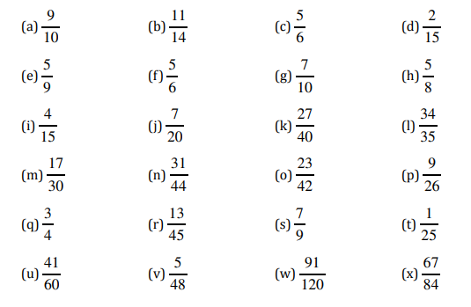
Solutions

