Slide 1
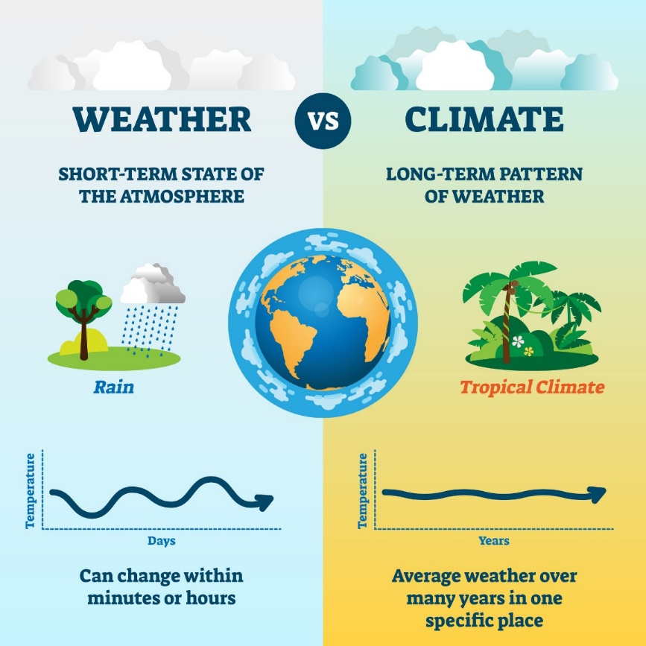
Weather and Climate
Weather describes the short-term state of our atmosphere. This may include information about the air temperature, precipitation, air pressure and cloud cover. Our local weather changes daily due to the movement of air in our atmosphere.
Climate is the average weather over a long time period (30 years) for a particular region or place. The climate affects a number of environmental factors within the region including the type and growth of vegetation and wildlife. The climate is determined by large scale factors such as the Earth’s orbit around the Sun, the position of the continents and the composition (make up) of the atmosphere.
Video from the BBC outlining the difference between weather and climate - https://www.youtube.com/watch?v=8J_RDfcy-00

Slide 2

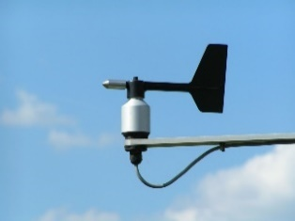
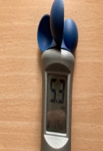
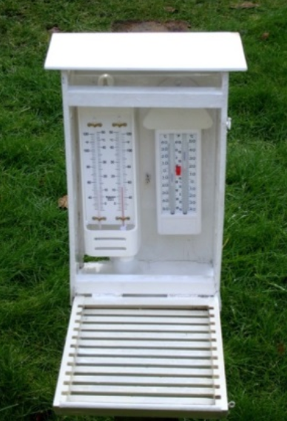
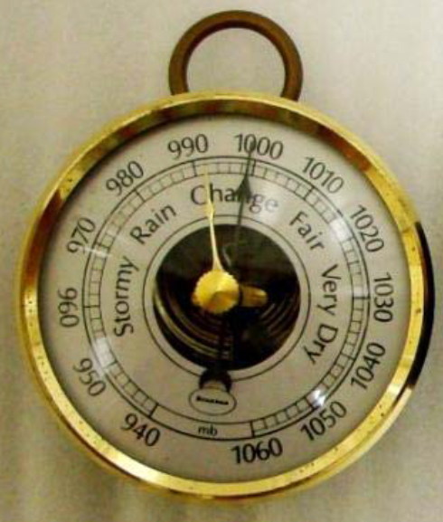
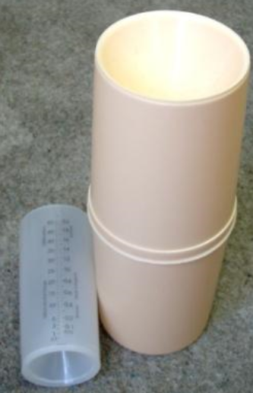
Types of weather and how we can measure them
Weather element | Instrument | Units | Image
Air pressure | Barometer | mb (millibars)
Cloud cover | Satellite or human sight | Oktas (0 to 8 eighths)
Precipitation | Rain gauge | mm (millimetres)
Temperature | Thermometer | °C (degrees centigrade)
Wind direction | Wind vane | Compass point that the wind is coming from (e.g. north)
Wind speed | Anemometer | m/s or km/h (metres per second or kilometres per hour) or sometimes the Beaufort scale

Slide 3
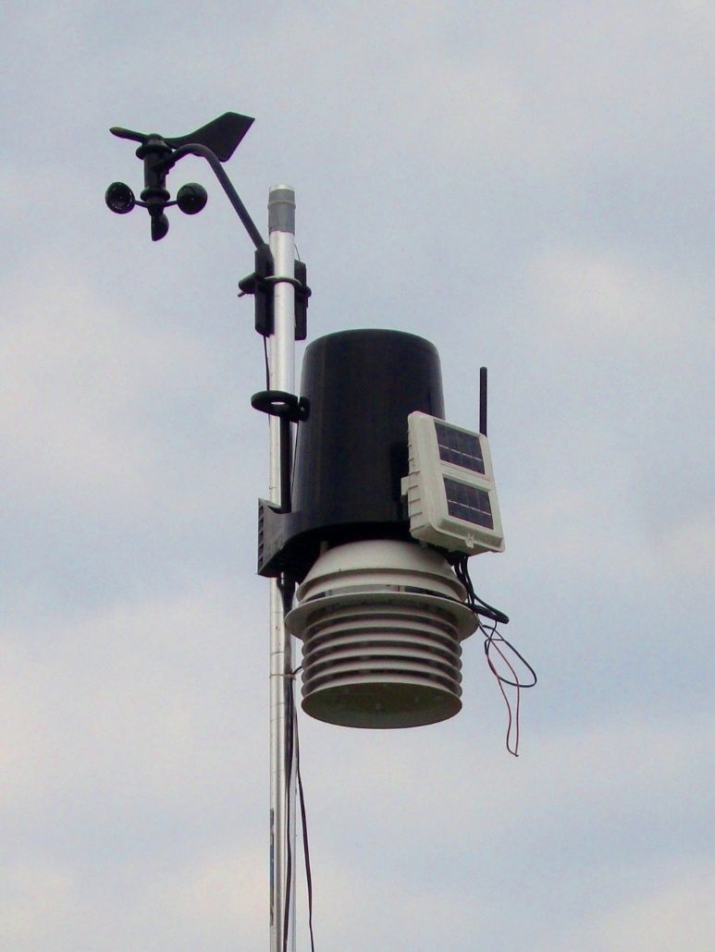
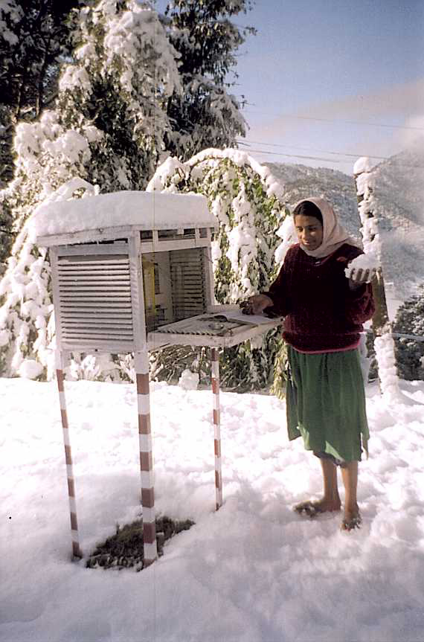
Weather Stations – what they are and where to place them
Wind speed (Anemometer)
Wind direction (Wind vane)
Rainfall (via a rain gauge)
This is the data logger
Temperature (digital thermometer) inside a well ventilated screen.
This is a solar panel to power the unit. Ideal for remote use.
A school weather station in the Himalayas

Slide 4
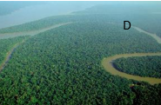
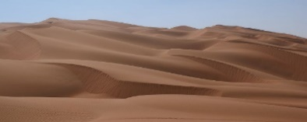
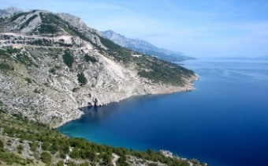
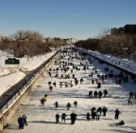
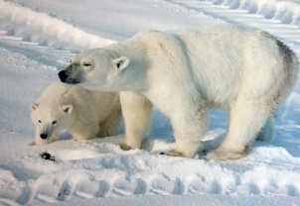
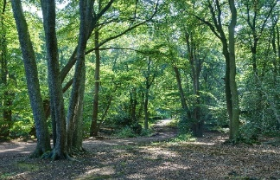
Global Climate Zones
Climate name | Climate Description | Photograph?
Tropical | These climates are home to the world's rainforests, where rainfall and humidity are high. Temperatures are generally 25-35 °C and vary little through the year. The Amazon is an example
Dry | These dry regions are linked to the High pressure, cloud free belts at the edges of the Hadley cells. Cold ocean currents can contribute to reduced availability of rainfall. The temperature range in these areas can be large, regularly exceeding 45 °C by day in summer and often falling to below freezing overnight in winter. The Sahara is an example.
Mediterranean | These climates vary seasonally and have hot, dry summers and cooler, wetter winters. Southern Spain and Greece have these climates
Continental | Far from the effect of the oceans, these climates are characteristic of the interior of large land masses of middle latitudes; the main climate features are large annual ranges of air temperature, with low rainfall a further characteristic feature. Moscow has a climate like this.
Polar | Linked to the Polar Cell, these climates can be subdivided into Tundra and ice cap/frost depending on whether the mean temperature of the warmest month is above or below 0°C. The Arctic climate is moderated by the relatively warm Atlantic Ocean. In the Antarctic, the distance from the ocean and a source of water vapour can mean that is truly too cold to snow.
Temperate | These climate zones lie between the tropics and the polar circles in the westerlies of the Ferrell cell. The changes in these regions between summer and winter are generally subtle (warm or cool), rather than extreme, (hot or freezing cold) and all of these regions have four distinct seasons. These climates can have very highly variable weather. One day it may be sunny, the next it may be raining. These climates can have be influenced by the sea.

Slide 5
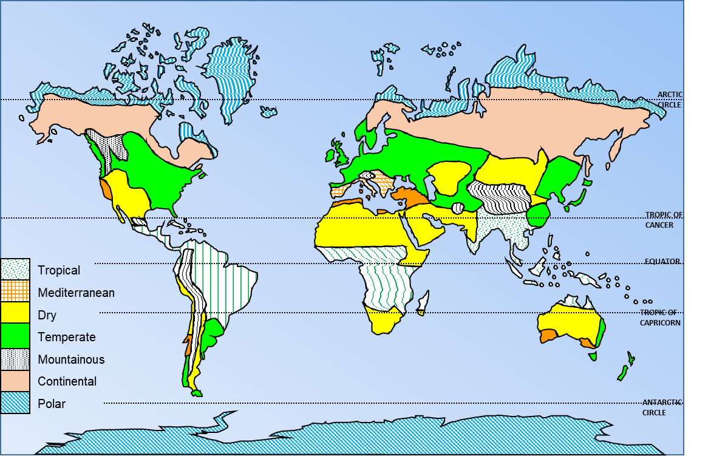
Outline Sketch map of the World’s Climatic zones

Slide 6
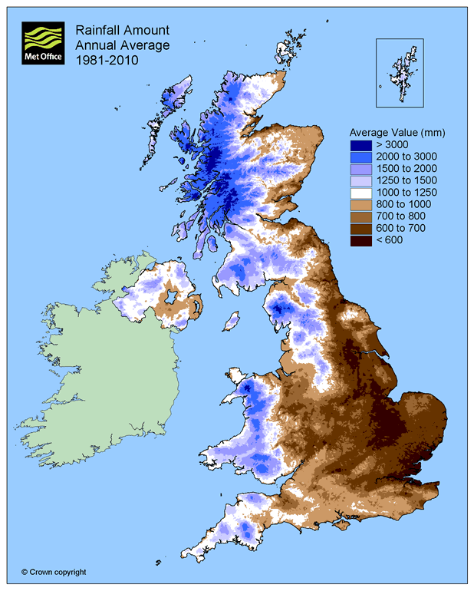
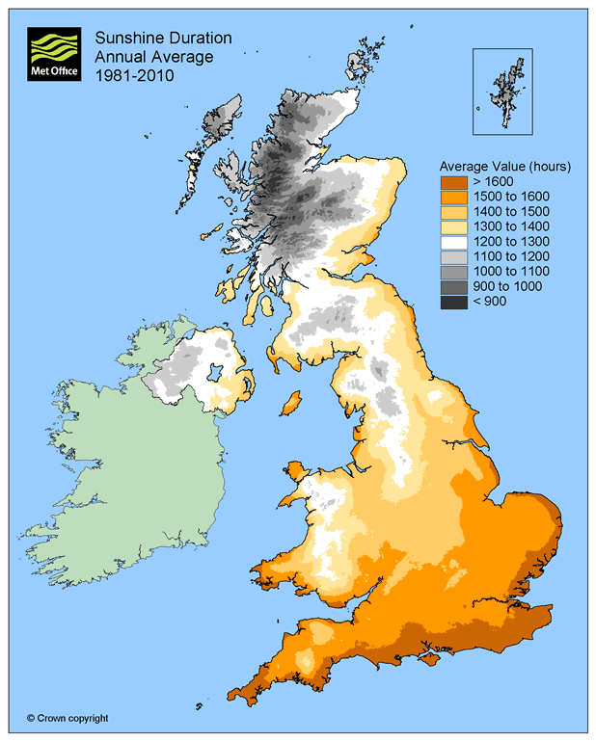
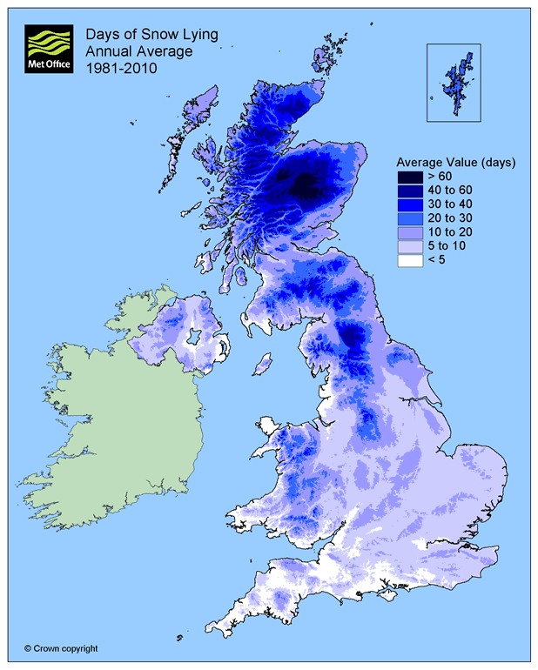
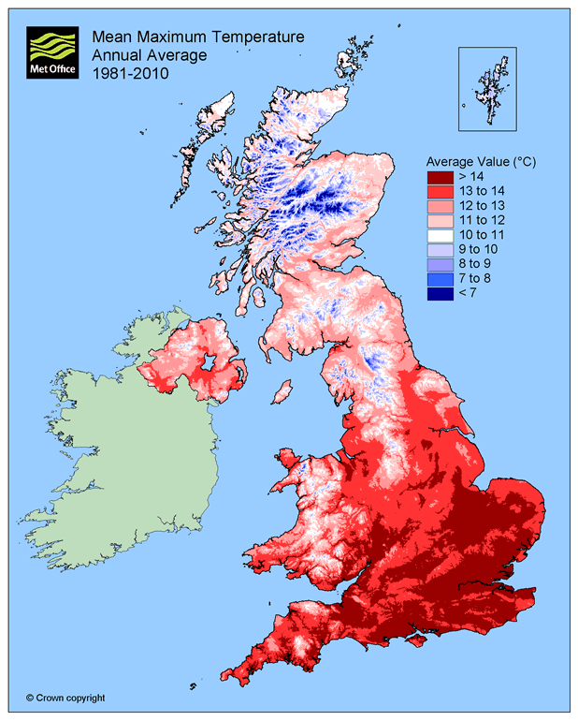
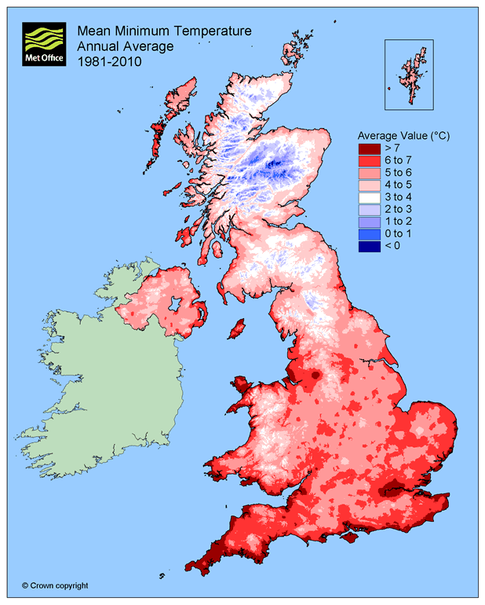
Climate characteristics for the UK
© Crown copyright, Met Office

Slide 7
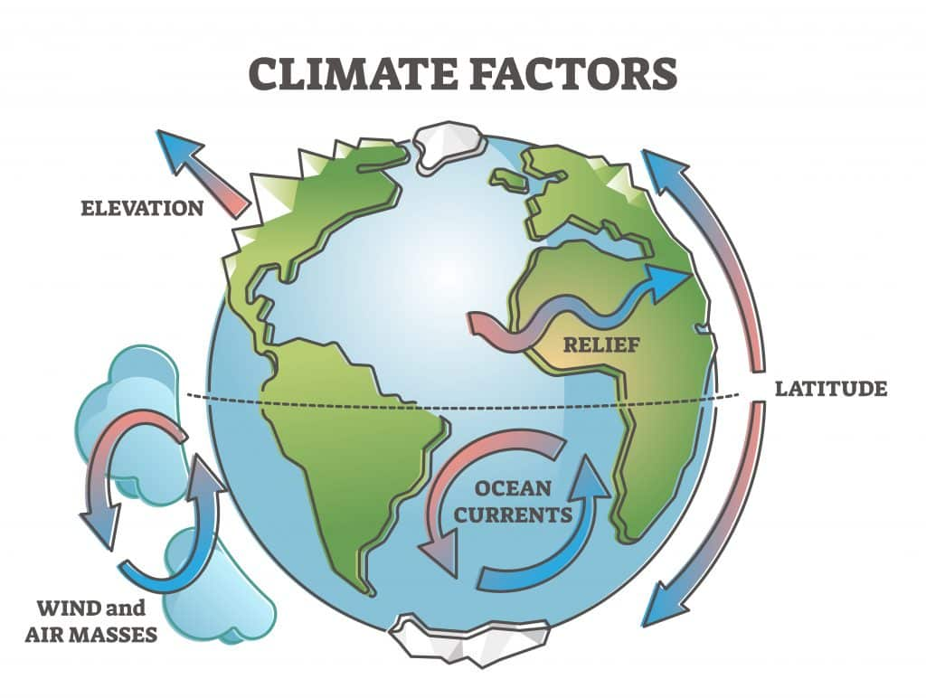
Why does climate vary?
Why does climate vary globally? https://www.youtube.com/watch?v=nlp_Gs-2bwE
Why does UK climate vary? https://www.youtube.com/watch?v=HrO7d18DRl8

Slide 8
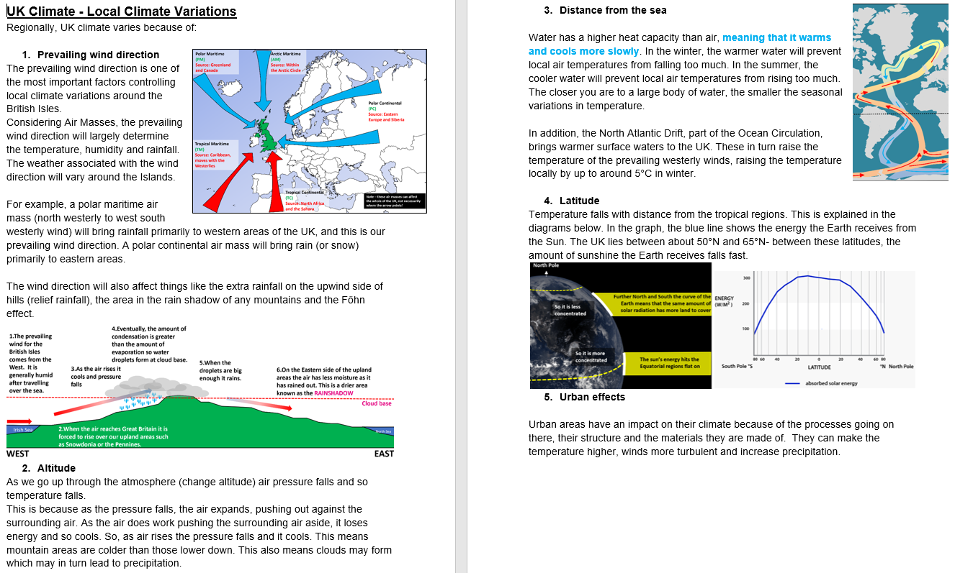

Slide 9
This shows us that UK climate is changing with temperatures rising. The average annual temperature has increased from 9.2ºC to 10ºC for these 2 time periods.

Slide 10
Changing UK Weather – the evidence for Precipitation Change
This shows us that UK extreme rainfall is overall increasing from 1960 to 2014 with some fluctuations.
The graph shows the 5% of days when there is most rain.
The rain on those days had to be above 9.4mm.
Original graph source - https://rmets.onlinelibrary.wiley.com/doi/epdf/10.1002/joc.6213

Slide 11
What impacts could a changing climate have on the UK in the FUTURE?
Classification of OPPORTUNITIES or RISKS from a changing UK climate
1. In cities heatwave temperatures will become a normal summer by 2040 | 2. There could be a move to electric vehicles which will also reduce urban air pollution | 3. Coastal regions will experience more tidal flooding and coastal erosion | 4. UK sea waters will become warmer and this will affect fish stocks
5. Hospitals, care homes and schools are not being adapted for warmer weather | 6. More variation in rainfall could lead to water shortages | 7. The area of urban greenspaces in the UK is no longer falling and could even increase | 8. There is evidence that plankton (the base of ocean food chains) is becoming less abundant in UK waters
9. 11,000 homes were protected against coastal erosion between 2010 and 2015 | 10. Climate change will increase the frequency and intensity of floods, with 4 million homes in England already at risk | 11. Sewerage networks lack the capacity for heavier rainfall | 12. Fewer people will die from cold related deaths and fuel poverty
13. £15 million has been given for natural flood management projects | 14. Extreme rainfall will bring more flooding to our rivers | 15. Habitats and natural flood protection will be lost to sea level rise | 16. There are opportunities to use more sustainable energy such as solar and wind. These could provide local energy rather than imports of fossil fuels.
17. More coastal storms threaten coastal infrastructure such as power stations and ports | 18. There could be more water borne pathogens, pests and diseases | 19. Coastal areas will see an increase in tourism and leisure visitors | 20. New species will colonise our seas and our land
21. Some crops will see an increase in productivity | 22. Moving away from coal and oil to wind and solar energy also improves air quality. | 23. There will be more heat related health impacts for people | 24. There will be more wildfire risks to farming and forestry

Slide 12
Further sources of help
Weather – https://www.bbc.co.uk/bitesize/topics/zx38q6f/articles/zqnb3j6
Climate – https://www.bbc.co.uk/bitesize/topics/zx38q6f/articles/zqqvf82
Climate change – https://www.bbc.co.uk/bitesize/topics/zx38q6f/articles/z773ydm

Slide 13
Questions to test yourself
What is the difference between weather and climate?
Name 3 instruments to measure weather and what they are used to measure.
Which climate zone is this a description for – ‘home to the world's rainforests, where rainfall and humidity are high. Temperatures are generally 25-35 °C and vary little through the year’?
Describe one other global climate zone.
How does latitude affect climate?
Which part of the UK has higher temperatures?
Which part of the UK has the highest rainfall?
Why does temperature vary in the UK?
Why does rainfall vary in the UK?
What is happening to UK climate over time?
Assess the potential impacts of climate change on the UK (cover the opportunities and risks and decide whether there are more opportunities or risks)?

