Slide 1
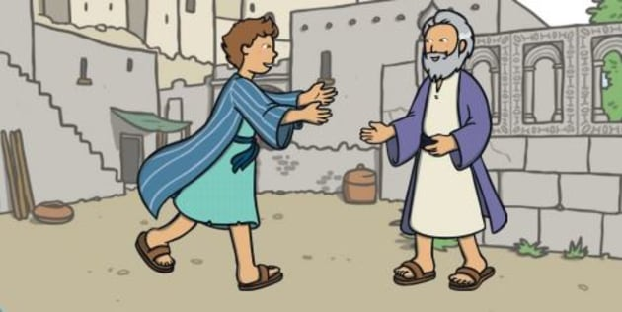
THOUGHTS AND PRAYERS 31st of March–4th of April
THEME OF THE WEEK: Lost and Found
“Your brother was dead and has come to life; he was lost and is found." (Luke 15:11-31)

Slide 2


MORNING PRAYER IN THE CHAPEL THIS WEEK
Monday 31st March - 7R
Tuesday 1st April - 7Y
Wednesday 2nd April - 8S
Thursday 3rd April - 12M
Friday 4th April - 8A

Slide 3
On this week...
Monday | Tuesday | Wednesday | Thursday | Friday
Fr Jonathon is in every Monday lunchtime. Come and say hello. Uno club in the Chapel Year 8 Lenten Fayre in the Activities Studio | Christian Union G16 12:20pm – 12:55pm Year 9 Lenten Fayre in the Activities Studio | Rosary in the Chapel 12:15pm – 12:25pm. Year 12 Lenten Fayre in the Activities Studio | Debate club 12:15-1:00 G15 Year 7 Lenten Fayre in the Activities Studio | Re-Wilding Group 12:15pm – 1:00pm G12
Keep an eye out for even more events going on in the following weeks!

Slide 4
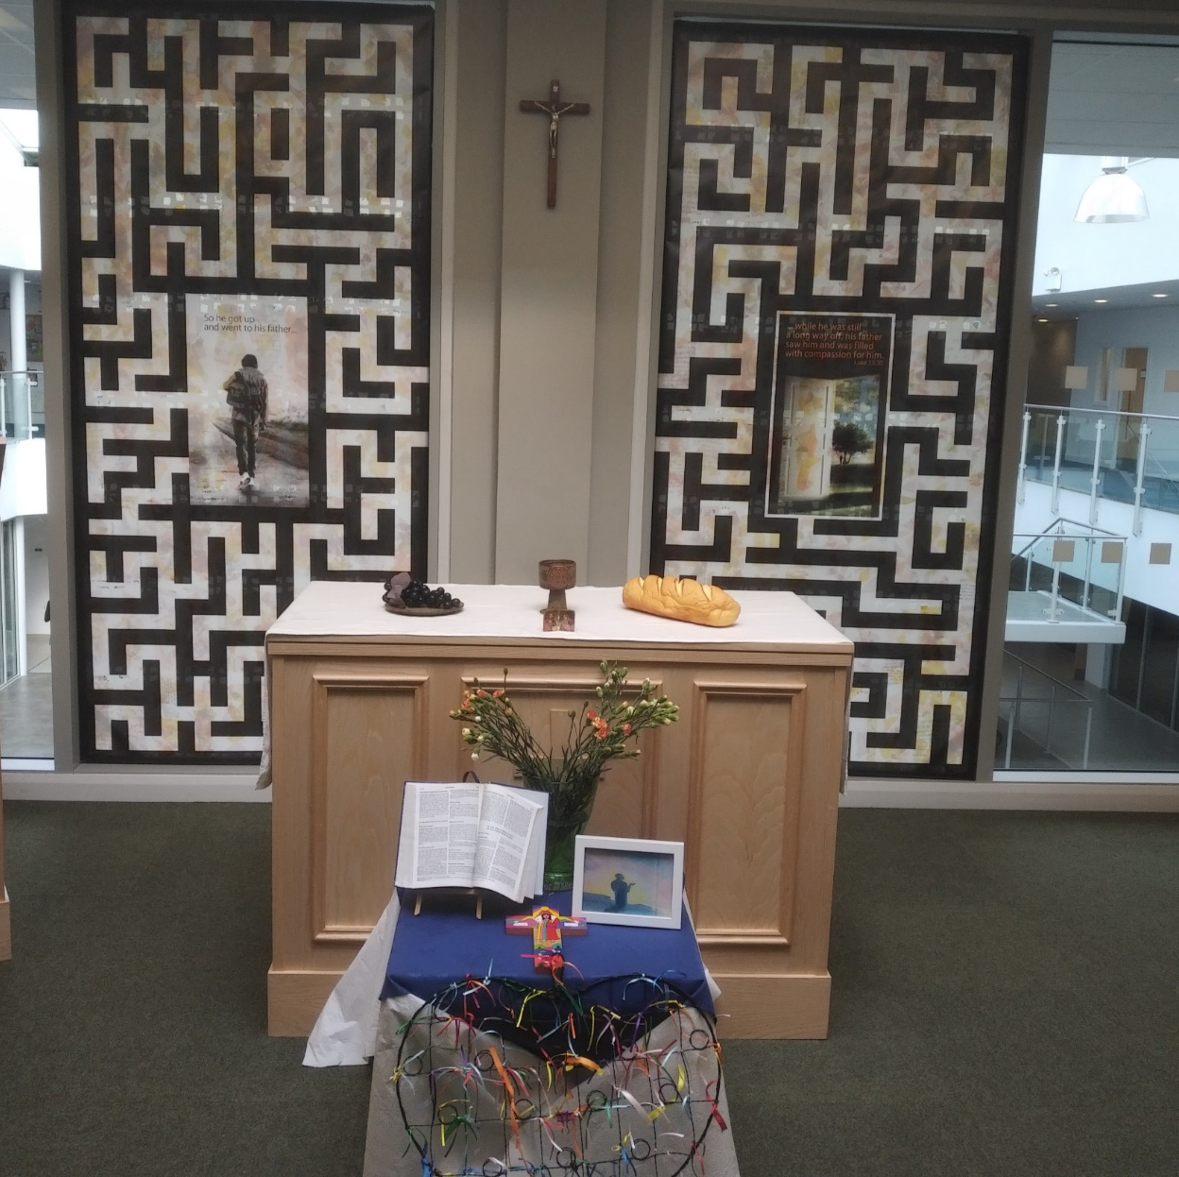
Mass at 8:20am on Friday Morning in the Chapel.
Everyone is welcome.
This week Friday Mass will be led by 13R & 13Y.

Slide 5

What does the theme of our week mean?
What is lost and found box?
Have you ever had to go and collect anything from lost and found?
What was it? How did you lose it in the first place?

Slide 6

What does the theme of our week mean?
Lost and found boxes are designed to reunite lost property with its rightful owner.
The most commonly lost items include phones, keys, wallets and sunglasses.
Did you know?
On average, people spend 2.5 days a year searching for misplaced items!

Slide 7
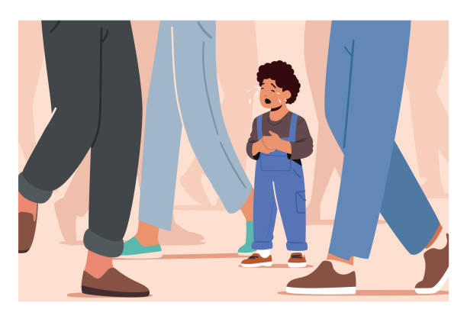
How does this theme link to us?
Sometimes in our busy and confusing lives we can feel lost and unsure about where we are heading. We might sometimes choose the wrong path but we can always be found. We can make the right choices and there are always people who want to find us and love us no matter what.

Slide 8

Lord,
When we feel lost and don’t know where to turn, help us remember that You are always there, guiding us with Your love and light. When we lose our way or our hope seems small, show us that we can always find our way back to You.
Amen

Slide 9
THOUGHTS AND PRAYERS 31st of March–4th of April
THEME OF THE WEEK: Lost and Found
“Your brother was dead and has come to life; he was lost and is found." (Luke 15:11-31)

Slide 10
Where does our quote of the week come from?
The quote of the week is from the Gospel of Luke and is from a parable that Jesus taught.
A parable is a story with a hidden meaning. Jesus used parables to teach people valuable lessons in a way that might be easier to understand.
“Your brother was dead and has come to life; he was lost and is found." (Luke 15:11-31)

Slide 11
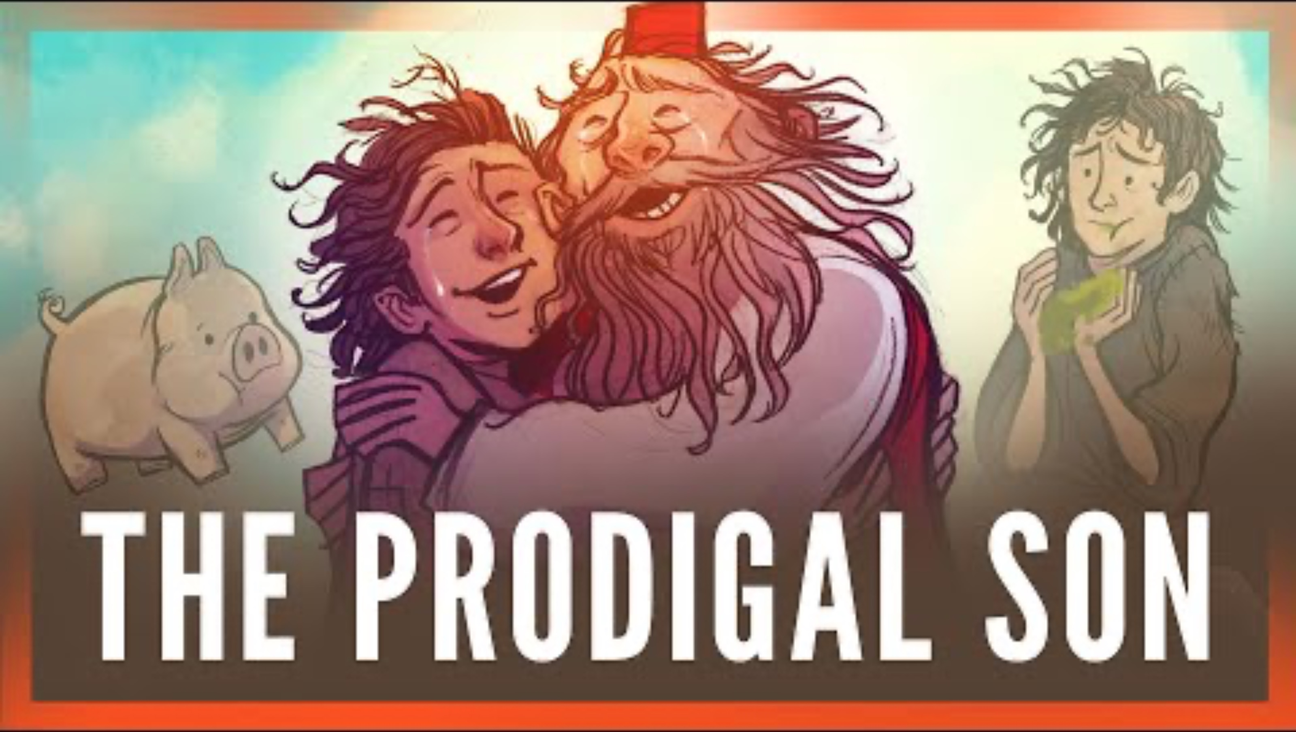
The Parable of the Lost Son
After the video discuss the following questions:
-What did the son do?
-How did the father react?
-Would you have reacted the same? Why?

Slide 12

The importance of this parable to Christians today
In the parable the son makes some unwise choices, later realises this and returns home into the joyful arms of his father.
In the same way, Christians believe that we are all human and make mistakes. We might turn away from God, but God is forgiving and will always accept us back if we return to him.

Slide 13
Lord,
Thank You for teaching us that no matter how far we stray, You always welcome us back with open arms. Help us to be kind and forgiving like You, and to show love and understanding when others make mistakes.
Amen

Slide 14
THOUGHTS AND PRAYERS 31st of March–4th of April
THEME OF THE WEEK: Lost and Found
“Your brother was dead and has come to life; he was lost and is found." (Luke 15:11-31)

Slide 15

The Forgiveness of God
Christians believe that God will forgive us no matter what we do?
Do you think this is true?
Do you think there is anything that God shouldn't forgive us for?

Slide 16
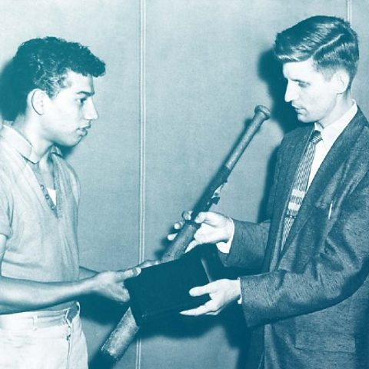
Nicky Cruz
Nicky Cruz is someone who experienced a religious experience that converted him.
Conversion means to change. Nicky changed both in his faith and in his actions.

Slide 17
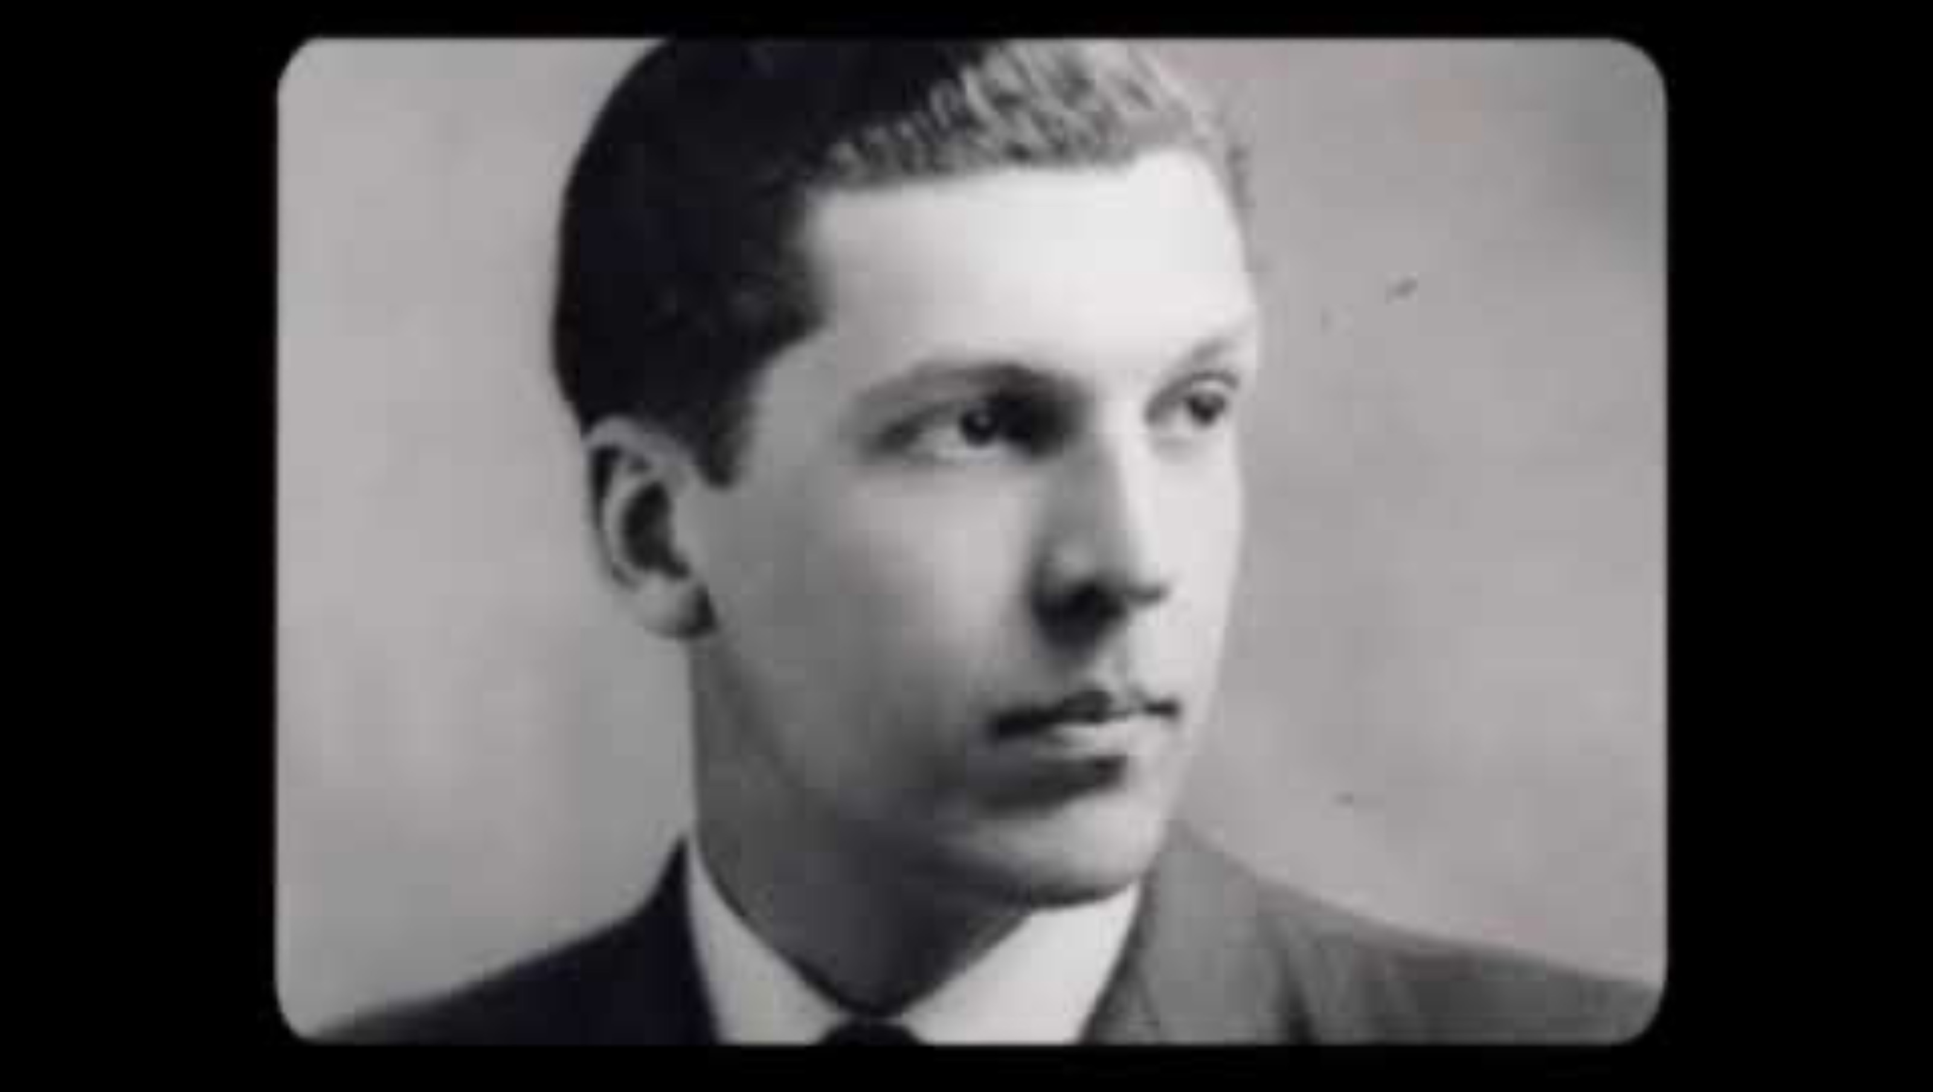
Nicky Cruz
Discuss the following questions after watching the video:
-What was Nicky like before his conversion?
-What was he like after?
-What changed him?

Slide 18
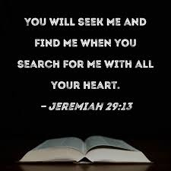
What does this example teach us?
In his early life, Nicky was lost—lost in anger, hatred, and a sense of hopelessness. He felt disconnected from love and purpose, much like the "lost son" in the parable. But through God's love and the persistence of Pastor David Wilkerson, Nicky was found—he was shown forgiveness, grace, and the opportunity to start anew.
Just like the lost son who returned home and was embraced with open arms, Nicky found his way back to God's love and healing. His story is a powerful reminder that no one is ever too lost to be found, and through forgiveness, we can change and find our true purpose.

Slide 19
Lord,
Thank You for teaching us that no matter how far we stray, You always welcome us back with open arms. Help us to be kind and forgiving like You, and to show love and understanding when others make mistakes.
Amen

Slide 20
THOUGHTS AND PRAYERS 31st of March–4th of April
THEME OF THE WEEK: Lost and Found
“Your brother was dead and has come to life; he was lost and is found." (Luke 15:11-31)

Slide 21
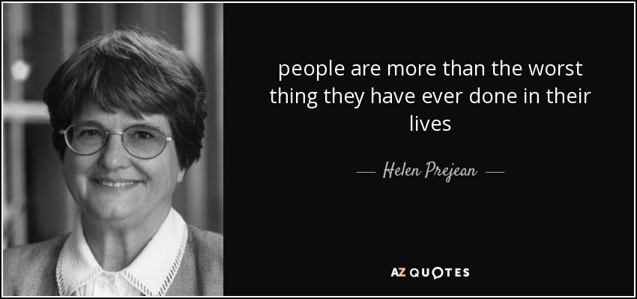
Do you agree with this? Why?

Slide 22
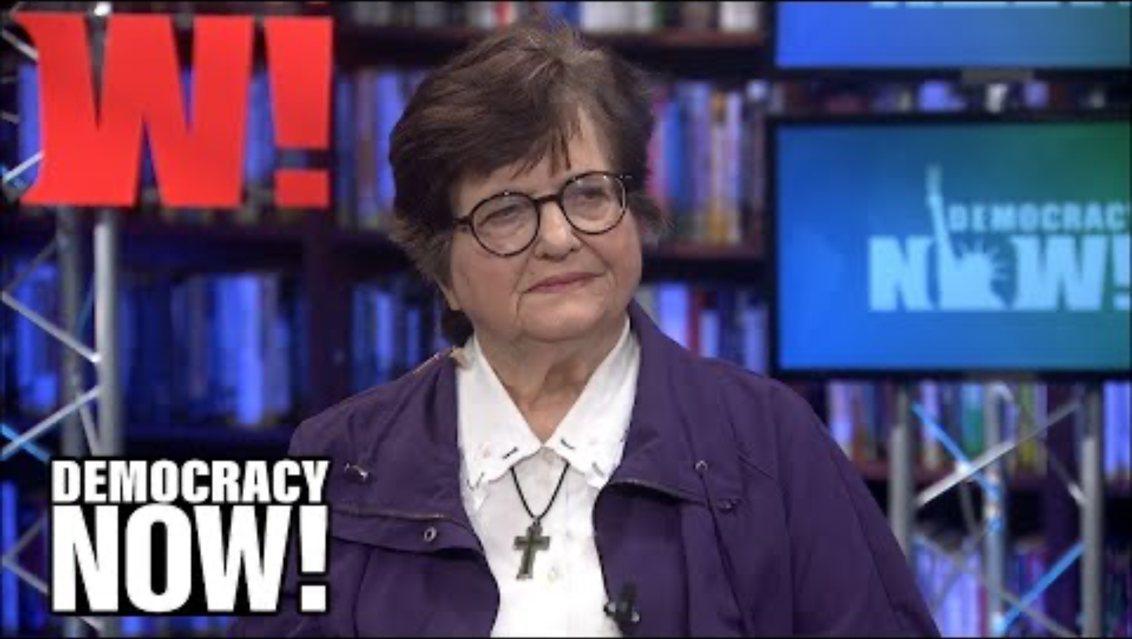
Sister Helen Prejean
Watch this video about what Sister Helen Prejean thinks.
What are your views?
Why might some people find it hard to forgive others?

Slide 23
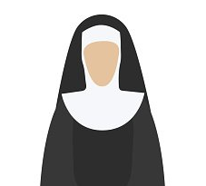


How could this apply to us?
Sister Helen Prejean is a Catholic nun who believes in the power of compassion, forgiveness, and the dignity of every person, no matter what they've done. She is known for working with people on death row, helping them find peace and understanding. Sister Helen believes that everyone deserves a chance to change and be treated with kindness, even those who have made terrible mistakes.​
Her views teach us that we should never judge others too harshly and should try to understand their pain. We can show love and forgiveness, just like Jesus did. Whether it’s a friend who’s hurt us or someone we don’t understand, Sister Helen’s example helps us remember that showing mercy and kindness can bring healing and hope to everyone. It reminds us that God’s love is for all people, and we should try to share that love in our own lives, no matter the situation.​

Slide 24


Competition Reminder – Designing a poster
We would also like to add a student made poster which reflects on the theme of the Jubilee which is hope. Most effective entries will explore what hope is, what it means to our school and how we could bring hope to those in our local area through activities done in school.
You have until the end of the day, 11th of April to submit your entries!

Slide 25
Lord,
Thank You for Sister Helen Prejean, who shows us the power of love and forgiveness. Help us to remember that everyone, no matter their mistakes, deserves a chance to be found and forgiven. Like Sister Helen, help us to show kindness to others, even when it’s hard, and to offer love when we might want to judge.
Amen

