Slide 1
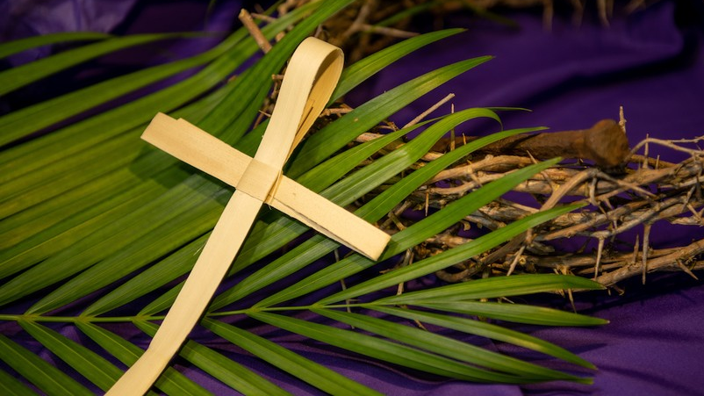
An Example To Others
Thoughts and Prayers
Monday 24th March – Friday 28th March

Slide 2
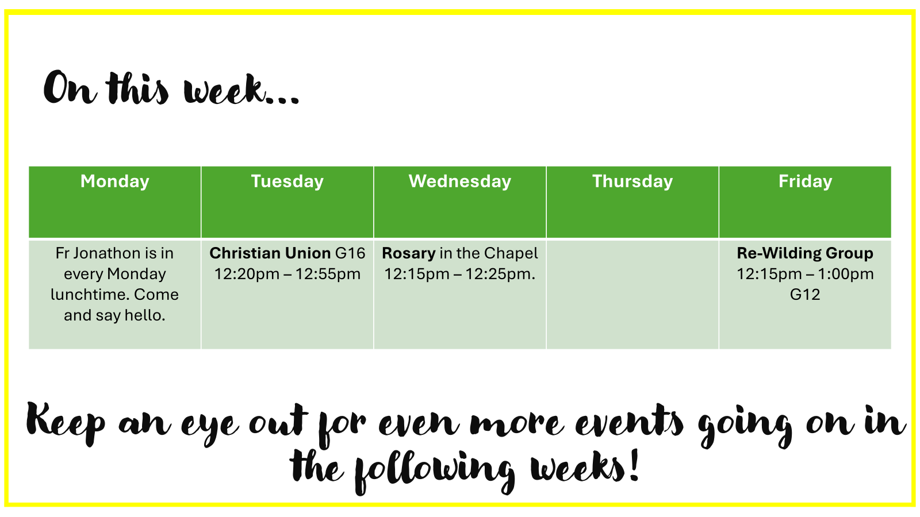

Slide 3

Every Friday Lunchtime in G16 starting at 12.30pm
Everyone is welcome!

Slide 4
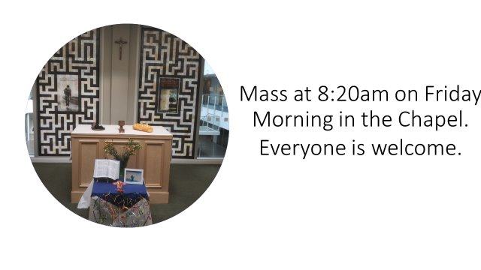

Slide 5
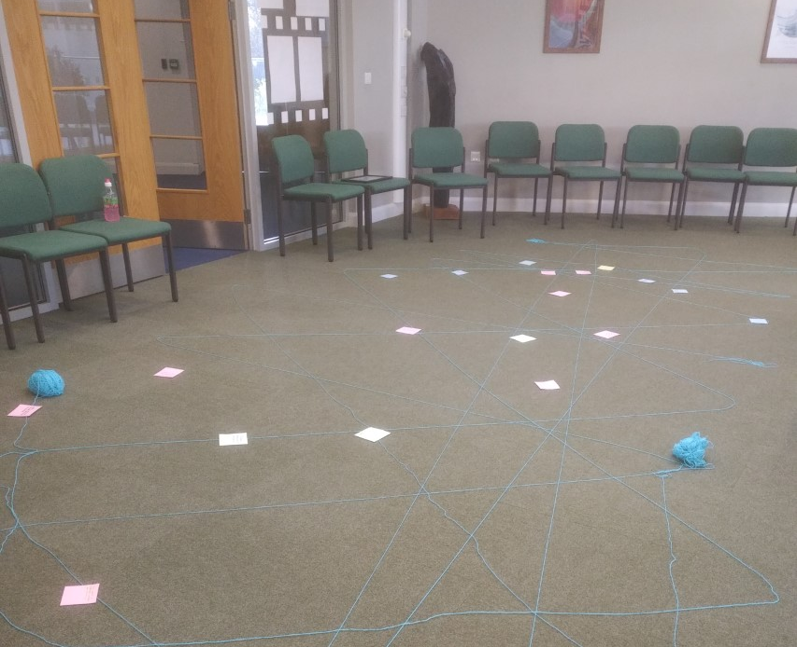
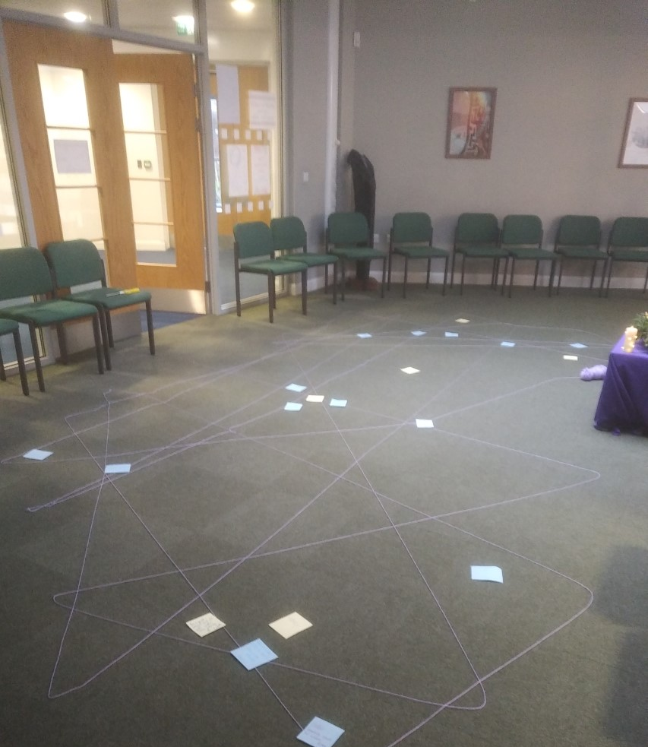
MORNING PRAYER IN THE CHAPEL THIS WEEK
Monday 24th March – 7I
Tuesday 25th March – 7N
Wednesday 26th March - 7T
Thursday 27th March - 7M
Friday 28th March - 12T

Slide 6
An Example To Others
Thoughts and Prayers
Monday 24th March – Friday 28th March

Slide 7

Class Discussion
What Does IT Mean to be an example?

Slide 8

Individually
Write down three people you admire and why. What qualities do they show that others could follow?
With a Partner
Share your lists and discuss:
Are these qualities hard or easy to show every day?
Which quality would you like to develop more in yourself?

Slide 9
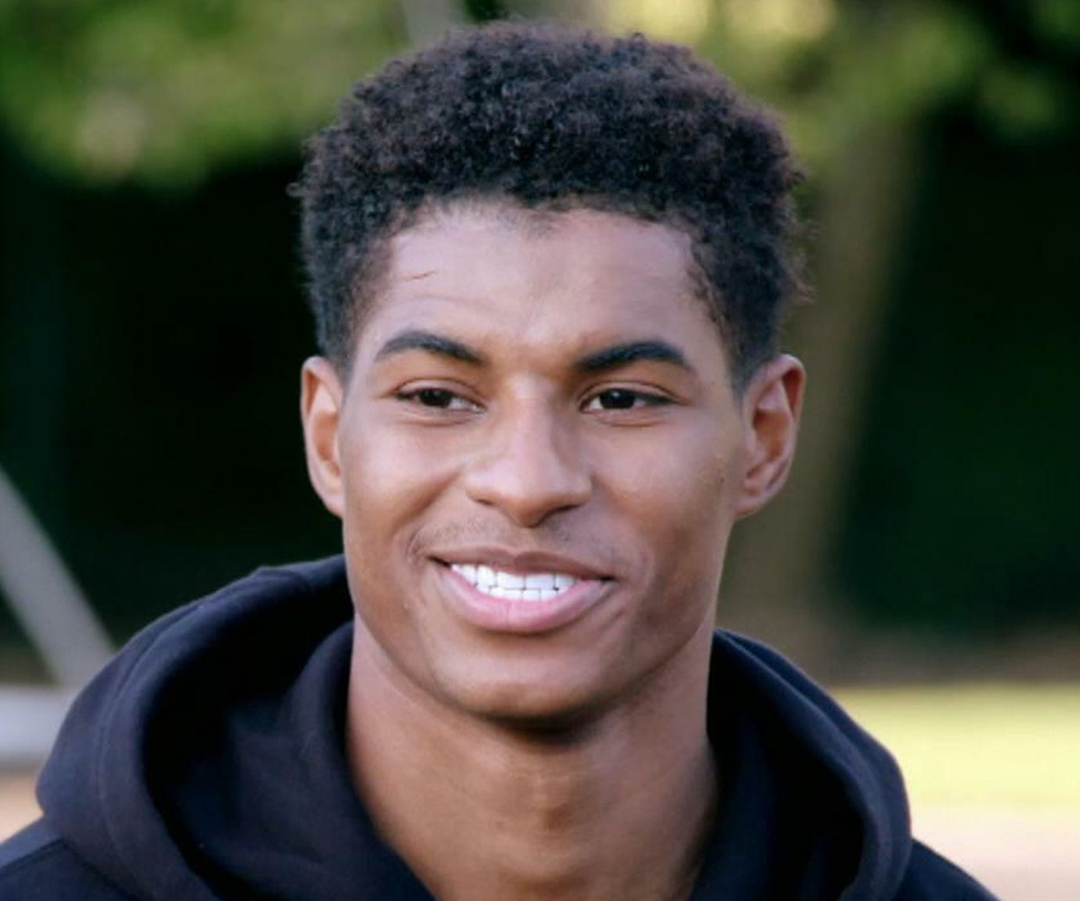
Marcus Rashford
One person that used his platform to set an excellent example is professional footballer, Marcus Rashford.
During the COVID-19 pandemic, Marcus Rashford set an example by helping vulnerable children and families. Concerned that school closures would leave children without free school meals, he wrote an open letter to the UK government, urging them to provide food vouchers during the holidays. His efforts led to a government policy change, ensuring children in need received support.

Slide 10
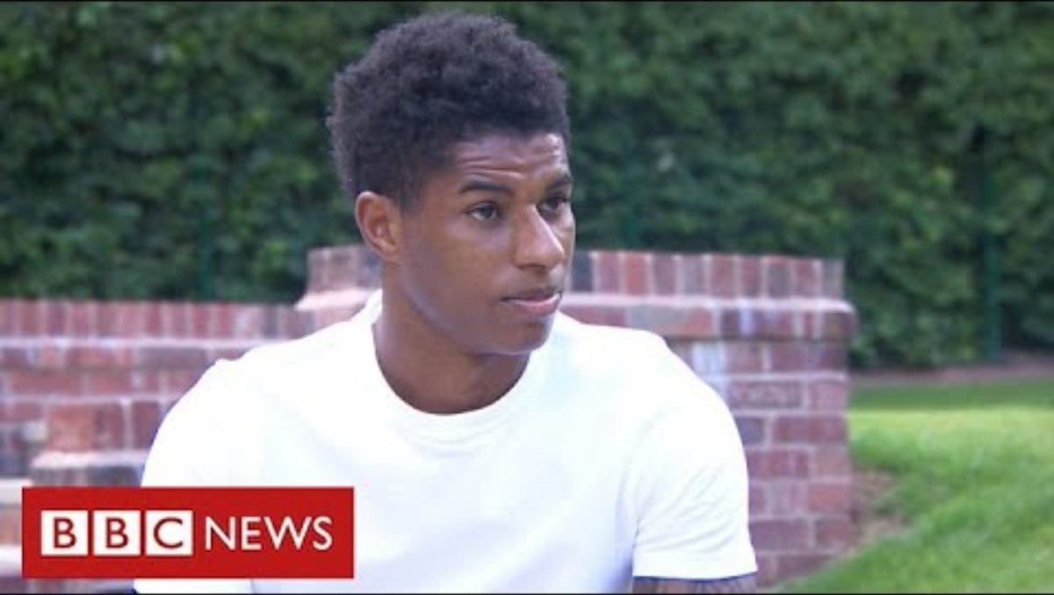

Slide 11
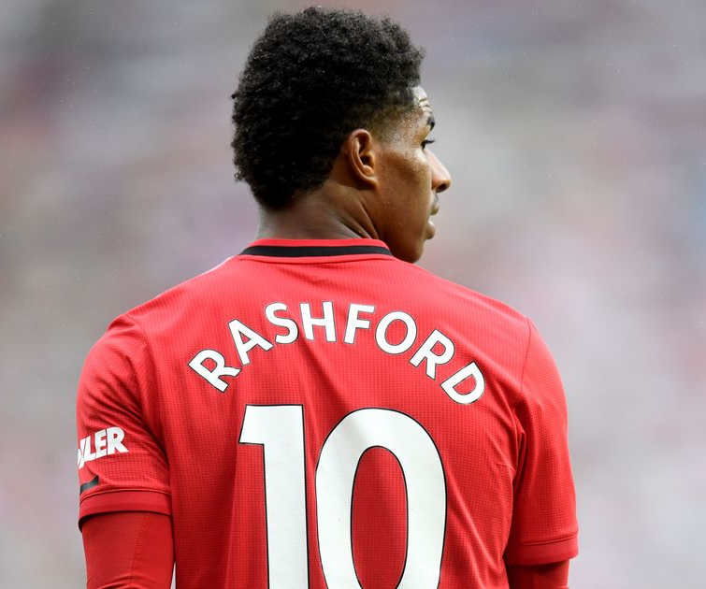
An Example To Others
Rashford continued his work by creating a task force to fight child food poverty and launching a book club to promote literacy. His actions showed how using your voice and platform can make a real difference, inspiring others to stand up for those in need

Slide 12
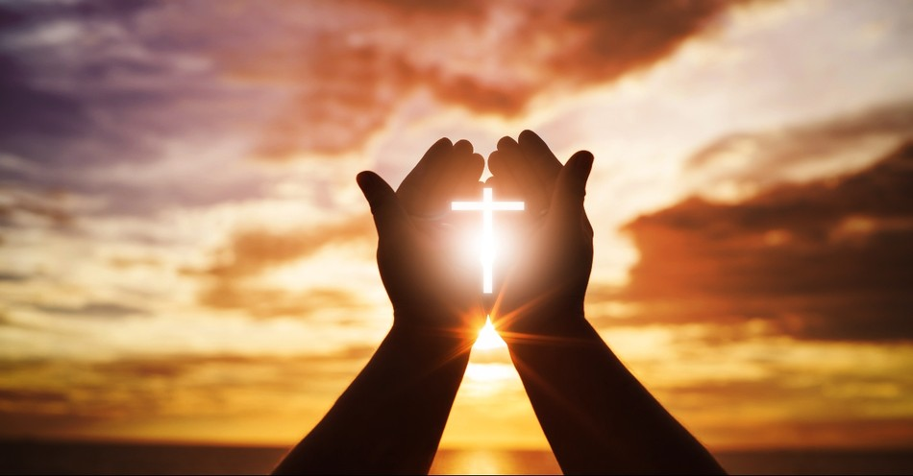
Let US Pray
Dear God,
Thank You for the gifts and opportunities You have given me. Help me to use what I have—my voice, my actions, and my heart—to set a good example for others. Teach me to be kind, to stand up for those in need, and to share what I can to make the world a better place. May I follow the example of those who use their blessings to serve others and reflect Your love in all I do.
Amen

Slide 13
An Example To Others
Thoughts and Prayers
Monday 24th March – Friday 28th March

Slide 14
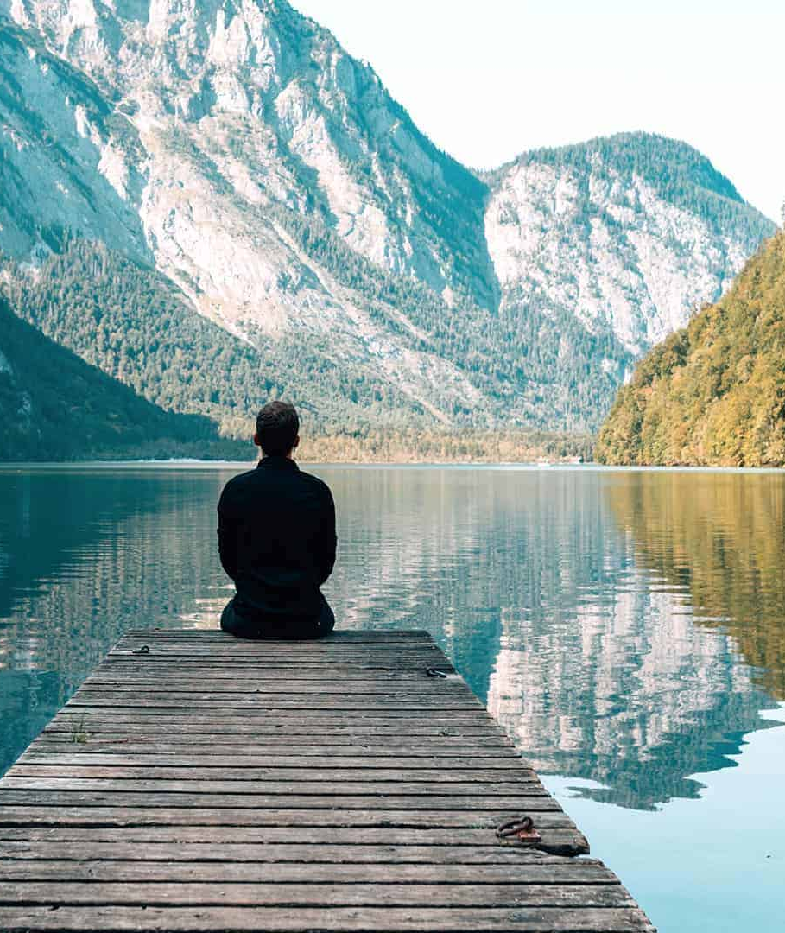
Let's Reflect
Imagine yourself many years from now—what kind of person do you want to be? The choices you make today shape the example you set for others. In this activity, you will write a letter to your future self, describing the values you want to live by and how you hope to inspire those around you. Think about the qualities of people you admire—kindness, fairness, courage—and reflect on how you can show these in your daily life. This letter will be a reminder of the person you are becoming and the positive impact you can have on others

Slide 15
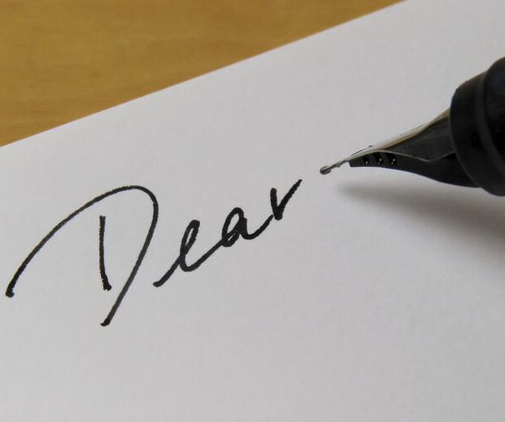
"Dear Me..."
This morning, as we listen to the music, write a letter to your future self. Describe the kind of person you want to be and how you will set an example.
Music

Slide 16
Let US PRay
Dear God,
Help me to become a person who inspires others through kindness, honesty, and love. Guide my words and actions so that I can be a positive example, today and in the future. Give me the courage to make choices that reflect Your goodness and the wisdom to lead others by showing care and compassion.
Amen.

Slide 17
An Example To Others
Thoughts and Prayers
Monday 24th March – Friday 28th March

Slide 18
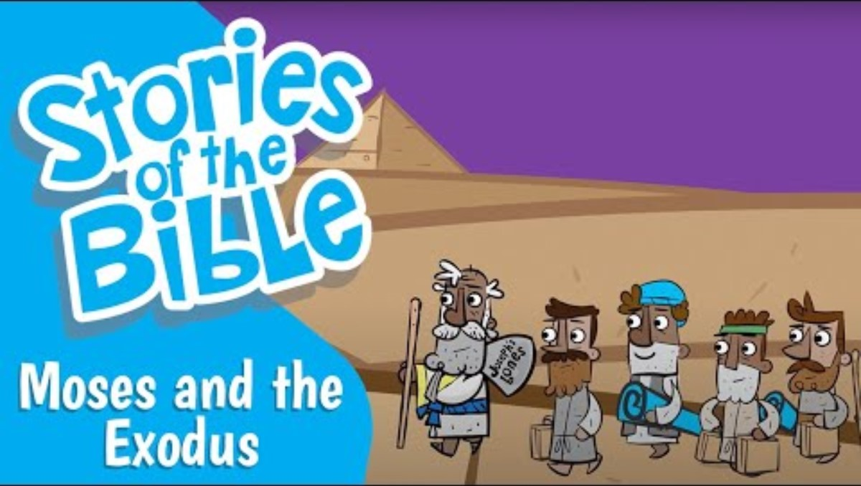
Our Scripture this week

Slide 19
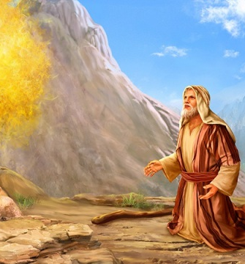
Exodus 3:15
Reader 1 - This verse from Exodus 3:15 is part of God’s powerful message to Moses at the burning bush. In this moment, God reveals His eternal identity, telling Moses to declare to the Israelites that "The Lord, the God of your fathers—the God of Abraham, the God of Isaac, and the God of Jacob" has sent him. This emphasizes that God is faithful across generations and is actively present in their lives.
Reader 2 - It also highlights that the same God who guided and provided for their ancestors is still working and will lead them to freedom. This verse reminds us that God’s promises are unchanging, and He continues to call people to be examples of His love and truth in the world.

Slide 20

Let's Reflect
How has God shown His faithfulness in your life, just as He was faithful to Abraham, Isaac, and Jacob?
What does it mean to you that God is the same “yesterday, today, and forever”?
In what areas of your life do you feel God is calling you to be an example to others?
How can you trust God more in your everyday decisions, knowing that He has been faithful to generations before you?

Slide 21
Let US Pray
Dear God,
Thank You for being faithful throughout generations, from Abraham to Isaac to Jacob, and to us today. Help me to trust in Your constant presence and to follow Your calling to be a positive example for others. May I reflect Your love and mercy in my actions, just as You have been faithful to me. Guide me in using my gifts to serve others and to share the hope I have in You.
Amen.

Slide 22
An Example To Others
Thoughts and Prayers
Monday 24th March – Friday 28th March

Slide 23
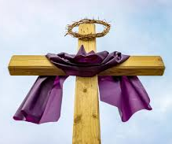
An Example To Others During Lent
Lent is a time of reflection, sacrifice, and spiritual growth, offering us a chance to become better examples to others. During these 40 days, many people give up something or take on new habits to draw closer to God.
This practice is not just about personal discipline—it is also a way to reflect Christ’s love through our actions. When we choose kindness, forgiveness, and generosity during Lent, we set a positive example for those around us.
Just as Jesus showed compassion and selflessness, Lent invites us to follow His example by serving others and living out our faith in everyday life

Slide 24


Slide 25
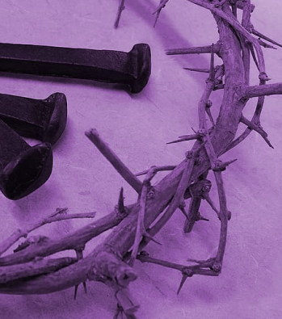
Letting Go at Lent
Individually, think of one habit or attitude you could "let go" of during Lent to be a better example (e.g., complaining, gossiping)
With a partner, discuss one action you could take during Lent to serve others (e.g., writing kind notes, helping at home, charity..).

Slide 26
Let US PRay
Dear God,
As I walk through this season of Lent, help me to follow Jesus' example of love and kindness. Teach me to be patient, generous, and forgiving, so that my actions reflect Your grace. May the choices I make during this time inspire others and bring me closer to You.
Amen

