Slide 1

THOUGHTS AND PRAYERS 17th – 21st of March
THEME OF THE WEEK: Affirmation
“And a voice came from the cloud saying, "This is my Son, the Chosen One. Listen to him."
(Luke 9:35)

Slide 2


MORNING PRAYER IN THE CHAPEL THIS WEEK
Monday 17th March - 10I
Tuesday 18th March - 7A
Wednesday 19th March - 10R
Thursday 20th March - 10Y
Friday 21th March - 12S

Slide 3
On this week...
Monday | Tuesday | Wednesday | Thursday | Friday
Fr Jonathon is in every Monday lunchtime. Come and say hello. Uno club in the Chapel | Christian Union G16 12:20pm – 12:55pm | Rosary in the Chapel 12:15pm – 12:25pm. | Debate club 12:15-1:00 G15 | Re-Wilding Group 12:15pm – 1:00pm G12
Keep an eye out for even more events going on in the following weeks!

Slide 4
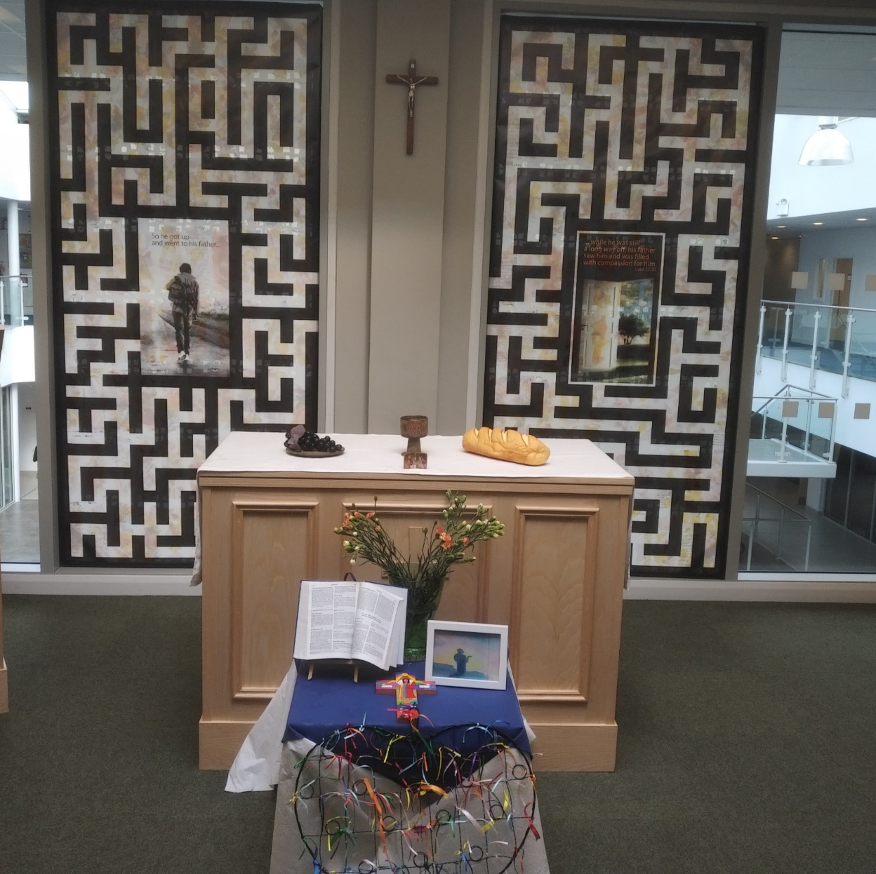
Mass at 8:20am on Friday Morning in the Chapel.
Everyone is welcome.
This week Friday Mass will be led by 11S & 11Y.

Slide 5



What does the theme of our week mean?
What does the word affirmation mean?

Slide 6
Affirmation
The word affirmation can have two meanings...
The act of confirming, declaring or promising that something is correct or true.
Emotional support or encouragement.

Slide 7
Where does our quote of the week come from?
The quote of the week is from the Gospel of Luke and is from the story of the Transfiguration – an event where Jesus' appearance changes so a glimpse is given of his full heavenly glory.
'The appearance of his face changed, and his clothes became as bright as a flash of lightning.'
“And a voice came from the cloud saying, "This is my Son, the Chosen One. Listen to him."
(Luke 9:35)

Slide 8
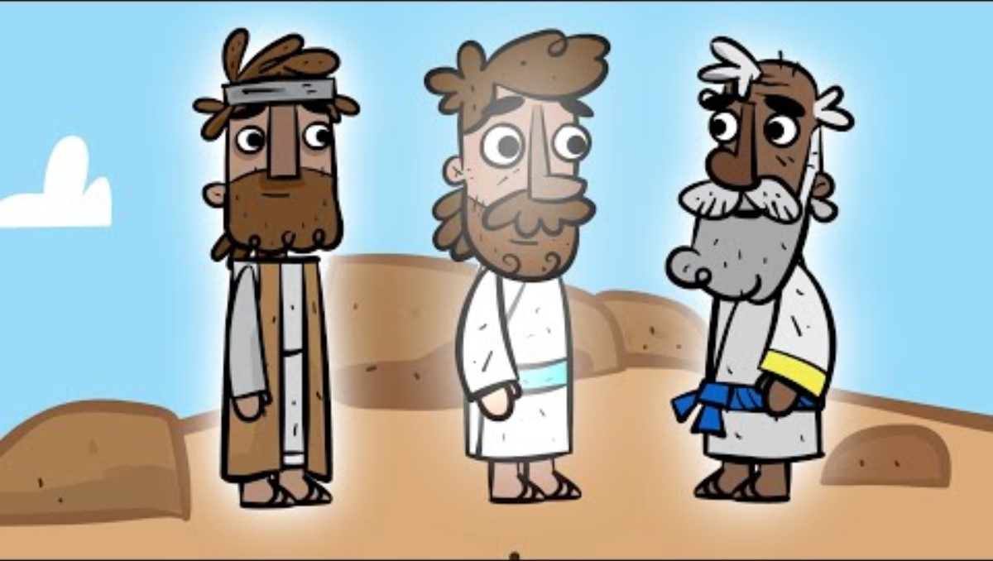
The Transfiguration
After the video discuss the following questions:
-Who else appeared in the story? Why are they important figures?
-Who is speaking from the clouds? Why is what the voice says important?
-How would you feel if you were at this event?
Why?

Slide 9

The importance of the Transfiguration
The Transfiguration is really important to Christians because the story acts as proof of Jesus divine identity. God confirms that Jesus is special and that we should listen to him.

Slide 10

Lord,
Thank You for showing us how amazing Jesus is during the Transfiguration. Help us to always remember that Jesus is Your Son, and that He came to show us Your love. Remind us that we are loved by You, just like Jesus, and that we can follow Him with all our hearts.
Amen

Slide 11
THOUGHTS AND PRAYERS 17th – 21st of March
THEME OF THE WEEK: Affirmation
“And a voice came from the cloud saying, "This is my Son, the Chosen One. Listen to him."
(Luke 9:35)

Slide 12

Affirmations
God confirmed the importance of Jesus and showed love towards Jesus in our reading this week. Jesus also showed love towards all of us by dying on the cross for us.
We are so loved. It is however also important that we show love to ourselves.

Slide 13

How can we show love to ourselves?
There are many different ways that we can show love to ourselves...
How many different ways can you think of as a form?

Slide 14

Saying affirmations
Affirmations are phrases that you can say to yourself that move your thoughts in a positive direction. They can be used to remind you of all of the good things about yourself.

Slide 15

Write your own...
Have a go at writing your own affirmations on your planner. This way you can keep these and go back to these later when you might need a boost!
Examples of affirmations:
My efforts help me succeed.
I have faith in my abilities.
My hard work will pay off.
I am strong.

Slide 16
Lord,
Thank You for creating us so wonderfully and for making us exactly who we are. Help us to remember that we are loved, we are enough, and we are worthy of kindness and respect. Teach us to love ourselves the way You love us, with patience and grace.
Amen

Slide 17
THOUGHTS AND PRAYERS 17th – 21st of March
THEME OF THE WEEK: Affirmation
“And a voice came from the cloud saying, "This is my Son, the Chosen One. Listen to him."
(Luke 9:35)

Slide 18

Mental health
Our mental health is really important and sometimes in our busy world we don't have time to focus on this. Take a moment of calm this morning to focus on yourself. Spend some time this morning in form listening to a guided meditation session that includes affirmations.
If you are worried about your own mental health or any of your friends, please speak to a member of staff. Nobody has to struggle on their own.

Slide 19

Guided meditation
Guidance:
Sit in a sensible and comfortable position
Listen in silence so that everyone has the opportunity to engage
Do not laugh or make fun of others

Slide 20
Lord,
Help us to remember that our minds and hearts are just as important as our bodies, and teach us to take care of them. When we feel worried, sad, or stressed, help us to talk to You, and know that it's okay to ask for help when we need it. Please give us the strength to look out for our friends and family, too, and to be kind and understanding when they need support.
Amen

Slide 21
THOUGHTS AND PRAYERS 17th – 21st of March
THEME OF THE WEEK: Affirmation
“And a voice came from the cloud saying, "This is my Son, the Chosen One. Listen to him."
(Luke 9:35)

Slide 22

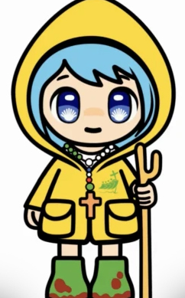
Jubilee Mascot Competition
We recently challenged you to create a St Mary's pilgrim mascot.
All entries submitted were amazing so thank you for everyone who put time and effort into their entries!
Let's have a look at the entries and see who our winners are...

Slide 23
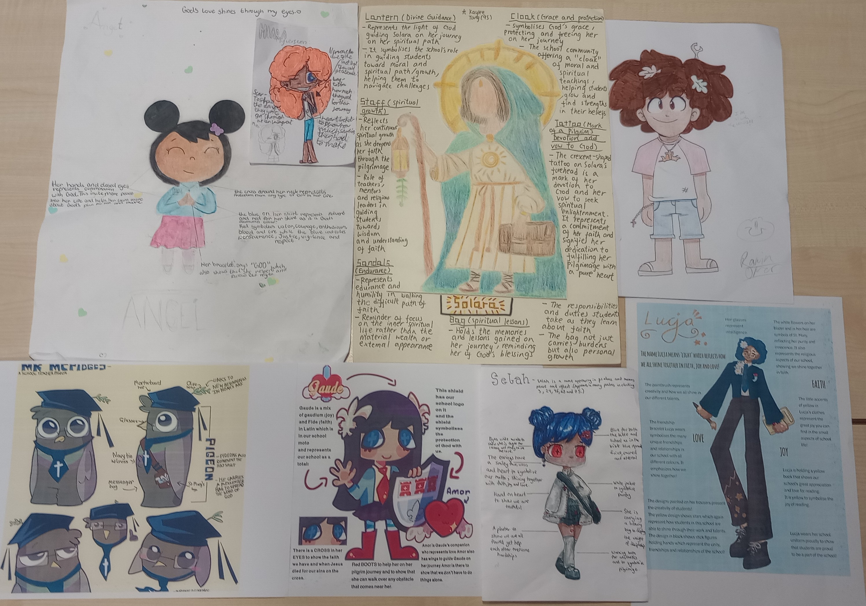
Honourable mentions

Slide 24
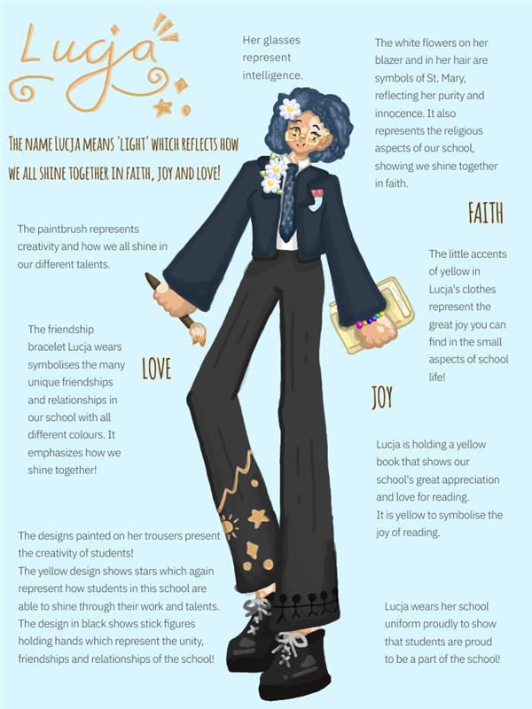
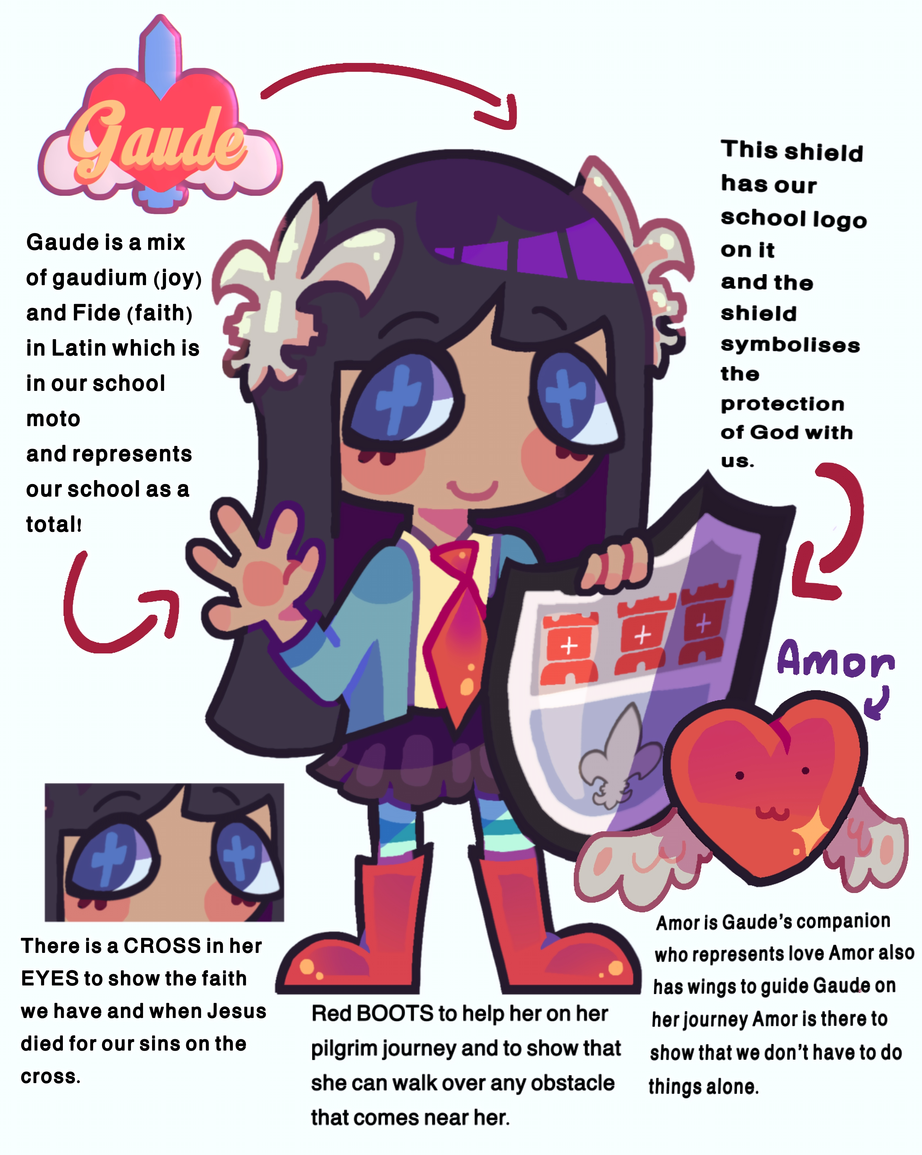
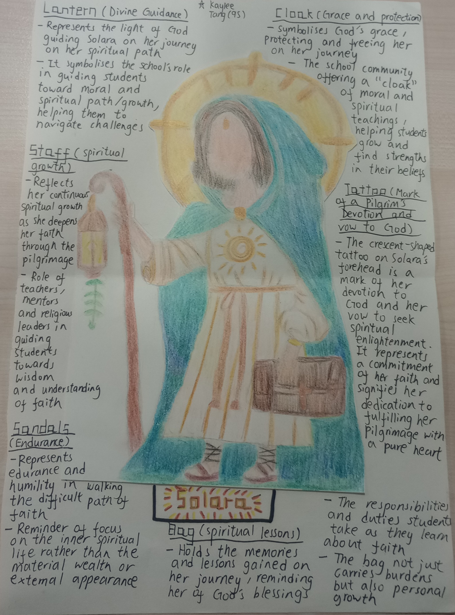
Winners
Please come and collect your prizes from Mrs Blackburn's office. Well done!

Slide 25
Winner!
Matylda 8S

Slide 26
Winner!
Glory 8R

Slide 27
Winner!
Kaylee 9S

Slide 28

Competition 2 – Designing a poster
You already have a poster of Luce in your form rooms to get us thinking more about the Church Jubilee. We would also like to add a student made poster which reflects on the theme of the Jubilee which is hope.
You can be as creative as you like but the most effective entries will explore what hope is, what it means to our school and how we could bring hope to those in our local area through activities done in school.

Slide 29
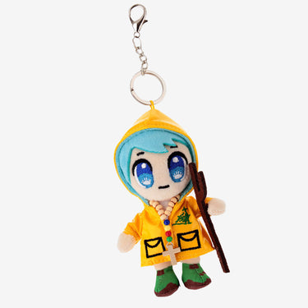
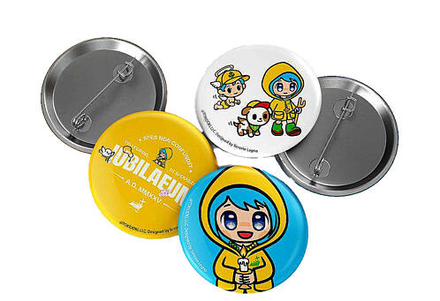
Competition 2 – Designing a poster
All entries should be submitted to Miss Thirlwall in F24 (or Mrs Blackburn's office if you can't find her) and should be clearly labelled with your full name and form group. You can work alone or in small groups if you wish.
Winners will then be selected from all the entries received. Winning posters will be put on all form display boards and winners will receive some Luce themed merch!

Slide 30

Get creative
Start designing your poster now.
You have until the end of the day, 11th of April to submit your entries!
Good luck!

Slide 31
Lord,
Thank You for the beauty of art and creativity. Help us to see the value in the things we create and appreciate the gifts You’ve given us. Teach us to love and care for our talents, knowing they are part of who we are.
Amen

