Slide 1

Thoughts and Prayers - Monday 20th January – Friday 24th January

Slide 2
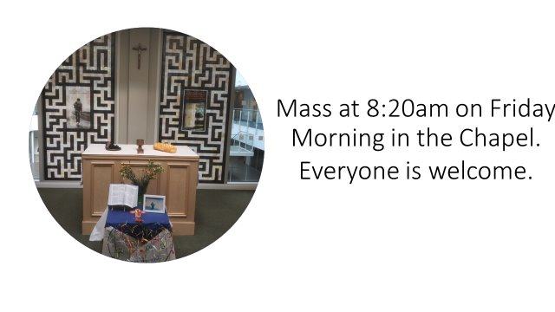

Slide 3
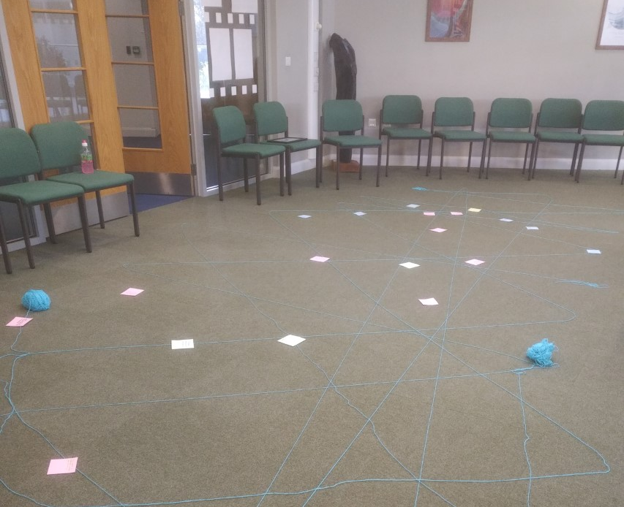
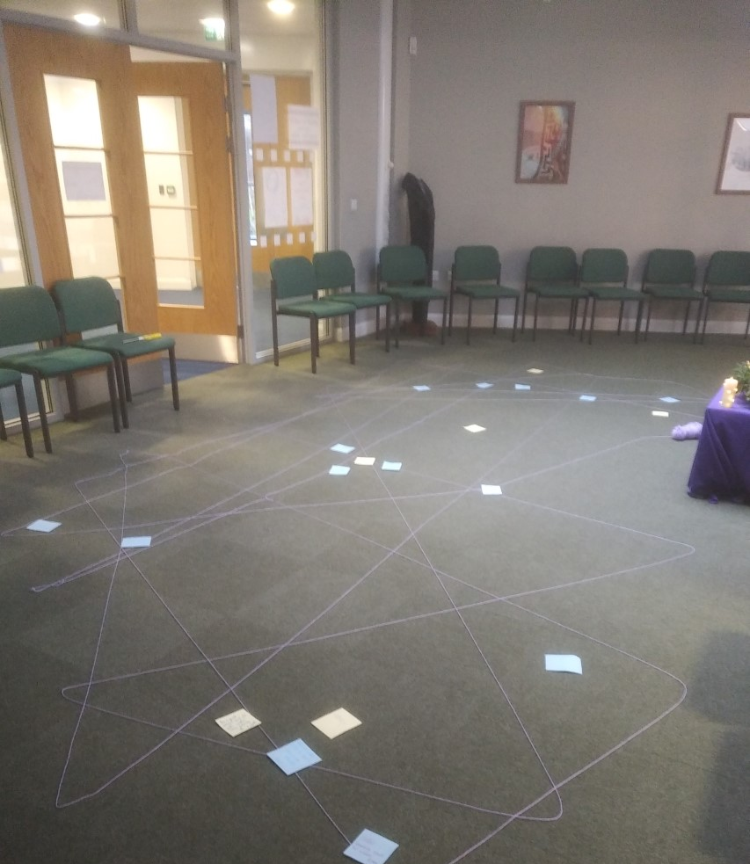
MORNING PRAYER IN THE CHAPEL THIS WEEK
Monday 20th January - 8N
Tuesday 21st January - 8T
Wednesday 22nd January – 8M
Thursday 23rd January – 13S
Friday 24th January - 8R

Slide 4

2025 is a Jubilee Year in the Catholic Church
In the Catholic Church, a Jubilee or Holy Year is a special year of forgiveness and reconciliation, in which people are invited to come back into right relationship with God, with one another, and with all of creation.
The theme is Pilgrims of Hope. Pope Francis has invited Catholics to renew our hope and discover a vision that can "restore access to the fruits of the earth to everyone". We are also invited to rediscover a spirituality of God's creation in which we understand ourselves as "pilgrims on the earth" rather than masters of the world.

Slide 5


Slide 6
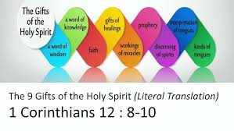
What does our theme mean?
The Gifts of the Spirit are special spiritual gifts given by the Holy Spirit to help us grow in faith, live holy lives, and serve others. These gifts help us live as followers of Christ and make a positive impact in the world around us.
This week in our thoughts and prayers we will be exploring some of the Gifts and reflecting on how we can recognise and use these gifts in our own lives

Slide 7

Wisdom
Definition: The ability to give wise counsel and make decisions that reflect God's will and guidance.
What it Looks Like: Offering advice that helps others navigate difficult situations with faith and integrity.
"To one there is given through the Spirit a message of wisdom..." — 1 Corinthians 12:8

Slide 8
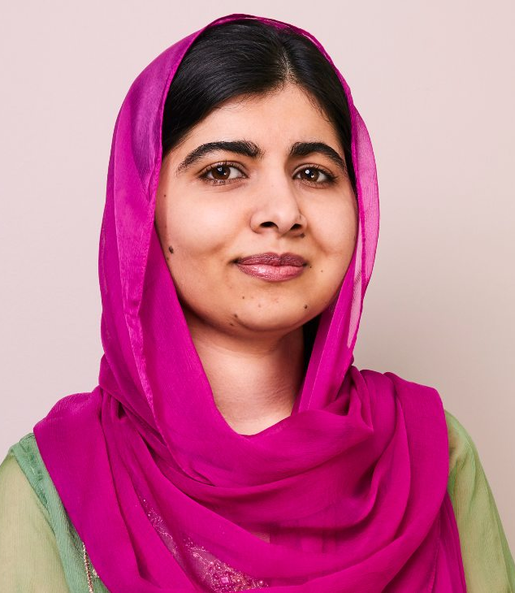
Malala Yousafzai
Malala Yousafzai is a powerful example of wisdom. After surviving a brutal attack by the Taliban for advocating girls' education in Pakistan, she chose not to seek revenge but instead focused on peace and education reform.
Her decision to use her voice to promote the importance of education on a global scale shows remarkable wisdom and courage. She became the youngest-ever Nobel Peace Prize laureate at just 17 years old, demonstrating how wise choices can create a lasting impact.

Slide 9
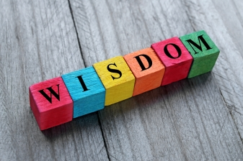
Questions to ask yourself
How can you offer wisdom to those around you?
Think of a recent situation where you shared advice that helped someone. How did it reflect God’s guidance?

Slide 10
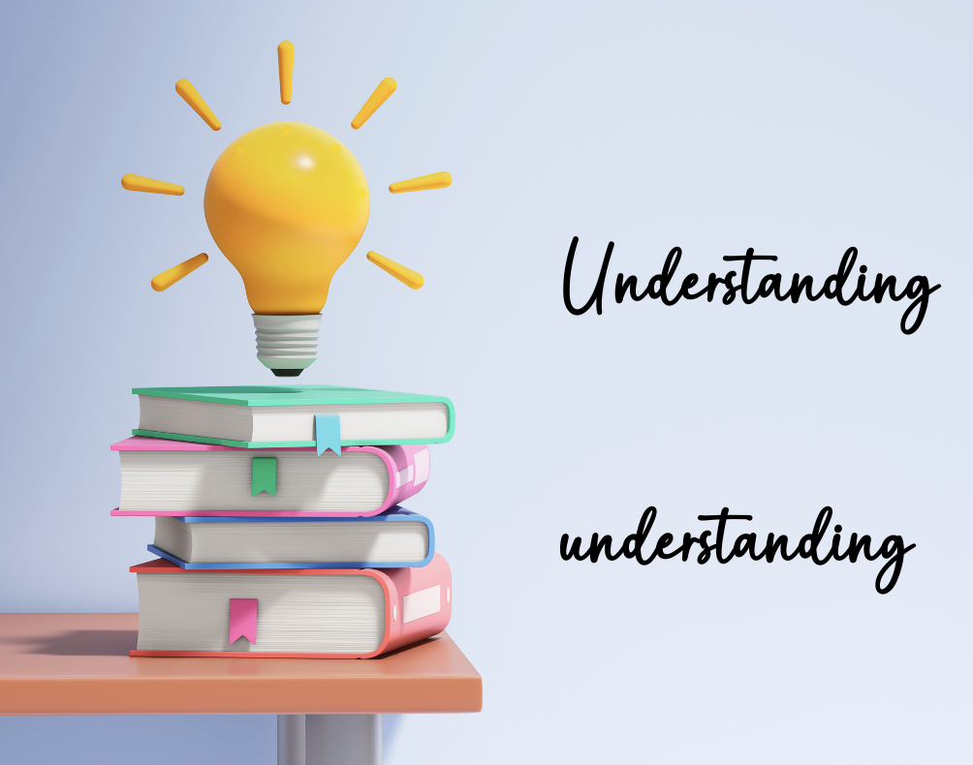
Knowledge
Definition: The ability to understand deep truths about God and share them with others.
What it Looks Like: Recognising God’s presence and purpose in everyday life and sharing insights with others to help them grow in faith.
"...to another a message of knowledge by means of the same Spirit." — 1 Corinthians 12:8

Slide 11
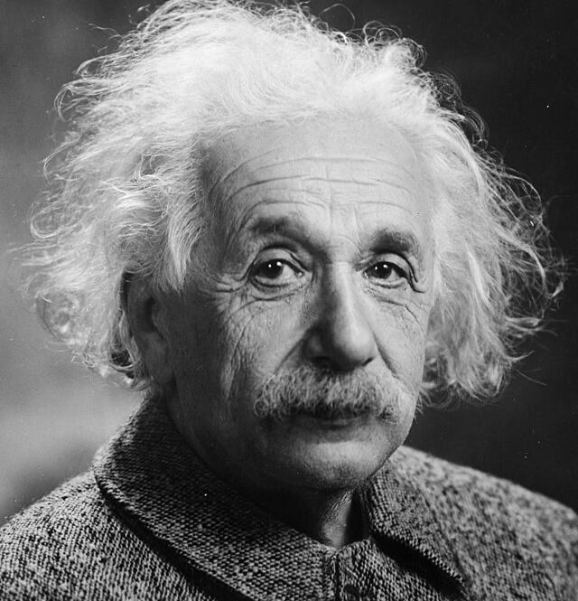
Albert Einstein
Albert Einstein demonstrated profound knowledge and understanding in several ways, particularly through his deep insights into the universe. One example of his gift of knowledge is his development of the theory of relativity, which transformed our understanding of space, time, and gravity. Beyond his scientific contributions, Einstein often spoke about the connection between science and spirituality. He famously said, "Science without religion is lame, religion without science is blind," reflecting his belief that true knowledge involves both intellectual understanding and spiritual awareness

Slide 12

Questions to discuss in pairs
How can you grow in your knowledge of God’s Word?
Think of a time when you shared an insight about faith that helped someone else.

Slide 13
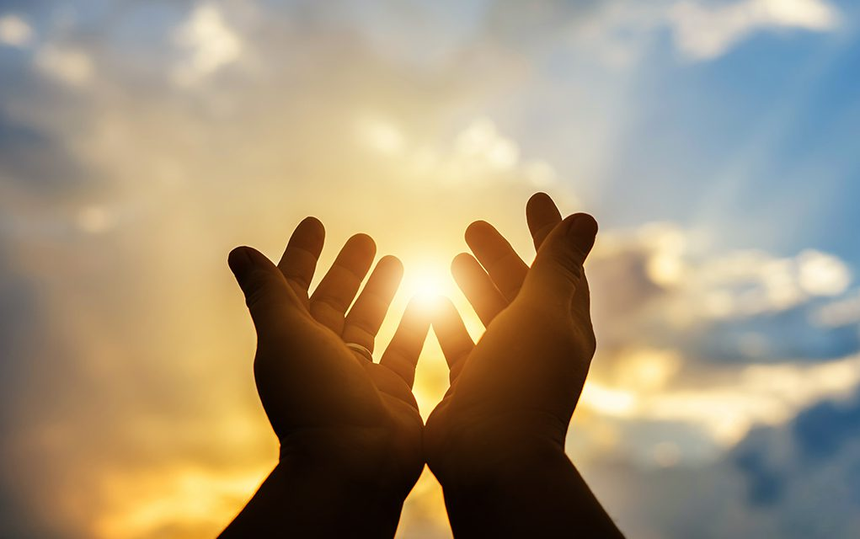
Let Us Pray
Dear Lord,
Grant me wisdom to understand,
knowledge to grow,
and the humility to seek truth.
Guide my thoughts and actions,
that I may use what I learn for good.
Amen

Slide 14
Thoughts and Prayers - Monday 20th January – Friday 24th January

Slide 15
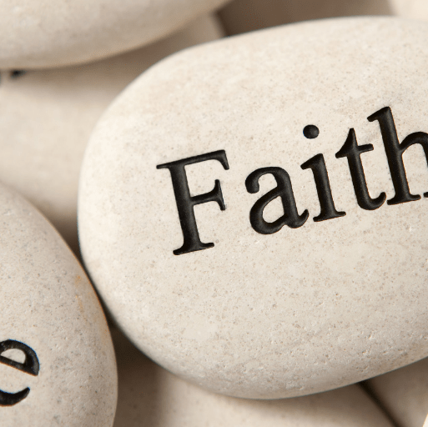
Faith
Definition: The ability to trust God deeply and inspire others to do the same.
What it Looks Like: Remaining steadfast in difficult times and encouraging others to put their trust in God.
"...to another faith by the same Spirit..." — 1 Corinthians 12:9

Slide 16
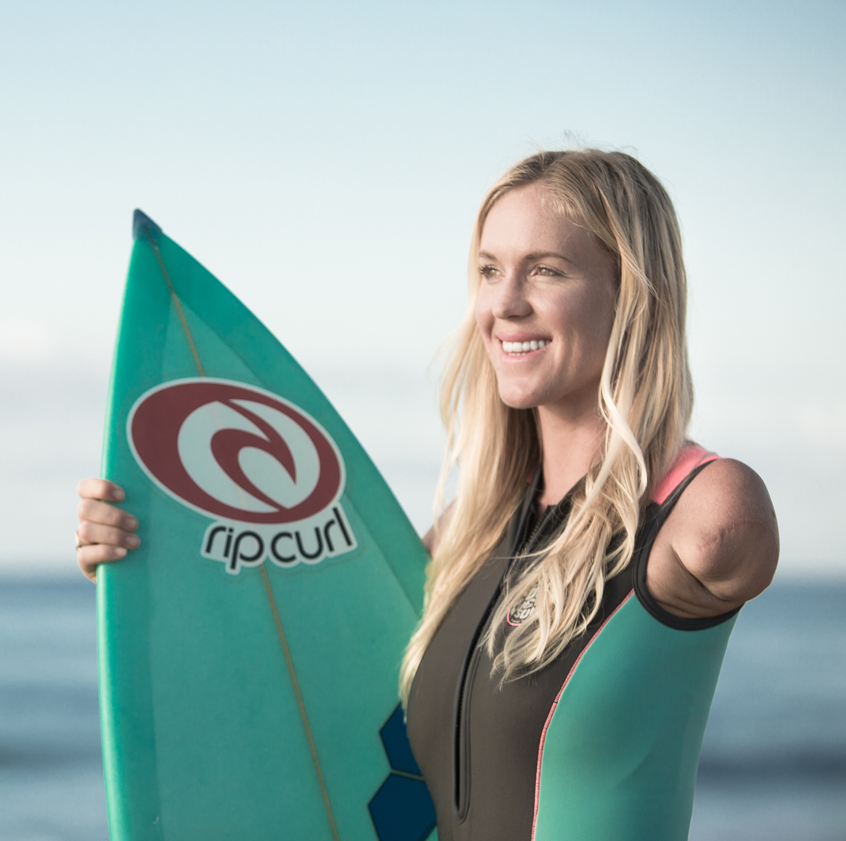
Bethany Hamilton
Bethany Hamilton is a professional surfer who gained widespread fame after surviving a shark attack in 2003. At just 13 years old, she was surfing off the coast of Kauai, Hawaii, when a 14-foot tiger shark attacked her, severing her left arm just below the shoulder. Despite the traumatic incident, Hamilton's story of resilience and faith is one that has inspired many
"Christ died on a cross for MY sins. He forgives me as I am and accepts me and loves me. This is the foundation of the Christian faith and is what brings me peace when others harm me, when the world is chaotic, or when I'm being tested in life"

Slide 17
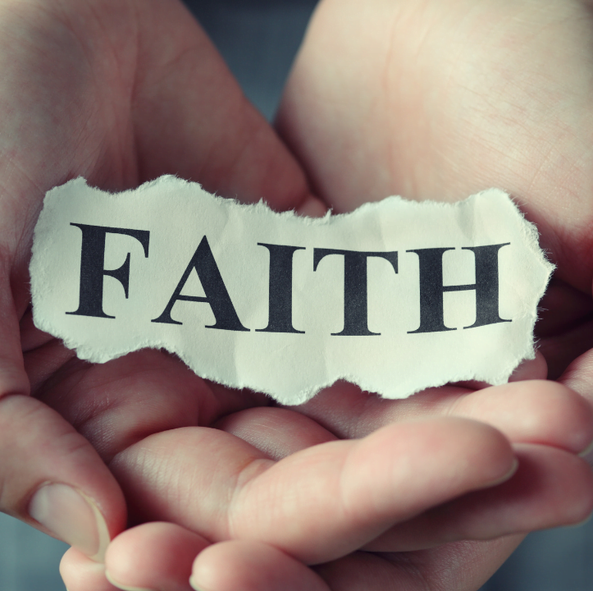
Questions to ask yourself
When has your faith helped you through a difficult situation?
How can you inspire others to trust in God more deeply?

Slide 18
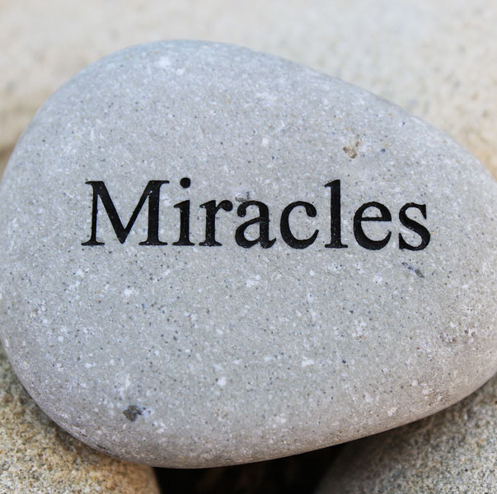
Miracles
Definition: The ability to perform extraordinary acts that reveal God’s power.
What it Looks Like: Witnessing or being part of events that have no natural explanation, demonstrating God’s intervention.
"...to another miraculous powers..." — 1 Corinthians 12:10

Slide 19
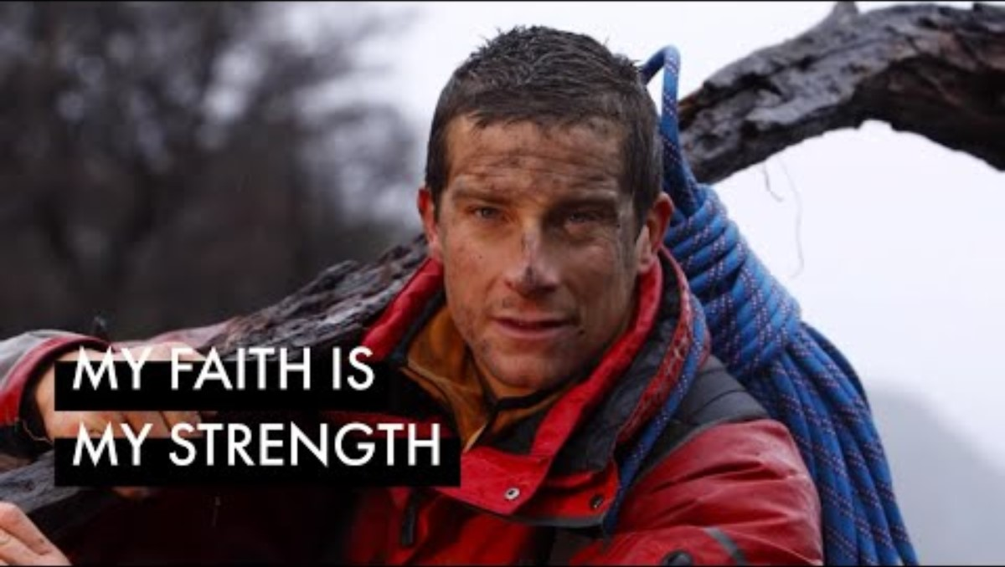
Bear Grylls, the adventurer, often shares stories of miraculous survival experiences, attributing his strength and success to God’s guidance and intervention.

Slide 20
Let Us Pray
Dear Lord,
We come before You with hearts full of hope
Strengthen our faith, especially in times of doubt and fear.
Help us to see Your hand at work in our lives and to trust in Your perfect plan.
May Your peace, which surpasses all understanding, fill our hearts and comfort us in our struggles.
Guide us to be instruments of Your healing and faith in the lives of those around us. We place our burdens in Your hands, knowing You are our refuge and strength.
In Jesus' name,
Amen

Slide 21
Thoughts and Prayers - Monday 20th January – Friday 24th January

Slide 22
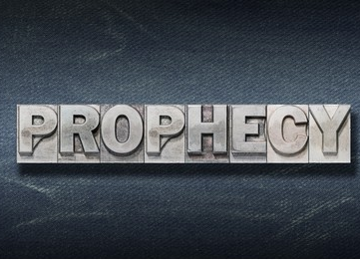
Prophecy
Definition: The ability to share messages from God to encourage, guide, and strengthen others.
What it Looks Like: Speaking words of truth and encouragement that align with God’s will.
"...to another prophecy..." — 1 Corinthians 12:10

Slide 23
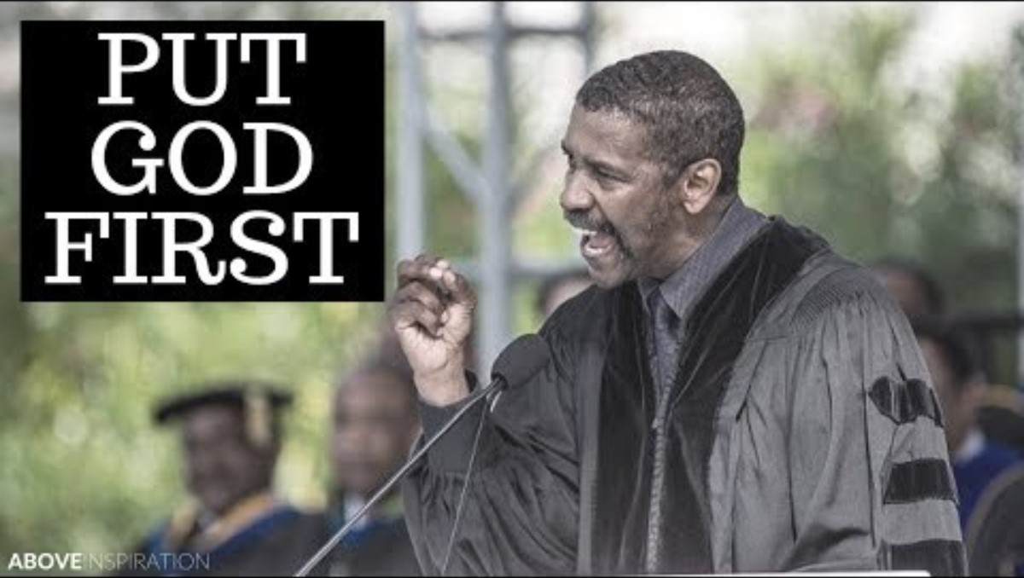
Denzel Washington has often spoken about how he feels called to share God’s message with others, encouraging young people to live with purpose and faith.

Slide 24
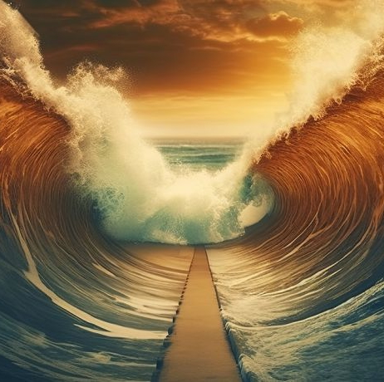
Let's Reflect
Have you ever experienced something that felt like a miracle?
How can you recognise God’s power in everyday life?
Have you ever felt led to speak words of encouragement or guidance to someone?
How can you listen more closely for God’s messages in your life?

Slide 25
Let Us Pray
Heavenly Father,
Help us to have the faith to believe in Your miraculous interventions in our lives and in the lives of those we love.
May we never doubt Your ability to do the impossible.
Give us the courage to proclaim Your truth boldly through the gift of prophecy, sharing Your messages of hope, guidance, and encouragement with others.
May we always seek to align our words with Your will, bringing light and wisdom to those who need it most.
In Jesus' name, Amen

Slide 26
Thoughts and Prayers - Monday 20th January – Friday 24th January

Slide 27

A message from Bishop Stephen Wright about the Jubilee Year

Slide 28
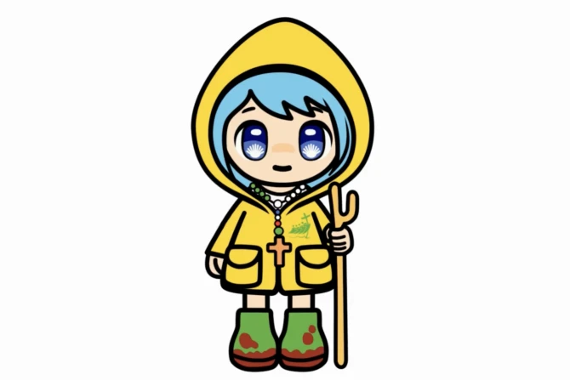
Meet ‘Luce’: The Vatican’s cartoon mascot for Jubilee 2025
Ahead of the 2025 Jubilee, the Vatican has launched a cartoon mascot unveiled Monday as the cheerful face of the Catholic Church’s upcoming holy year.​
The mascot, named Luce — which means “light” in Italian — is intended to engage a younger audience and guide visitors through the holy year.​
Archbishop Rino Fisichella, the Vatican’s chief organizer for the jubilee, described the mascot as part of the Vatican’s goal to engage with “the pop culture so beloved by our young people.”​
The mascot will debut this week at the Lucca Comics and Games, Italy’s celebrated convention for all things comics, video games, and fantasy, where the Vatican’s Dicastery for Evangelization will host a space dedicated to “Luce and Friends.”

Slide 29
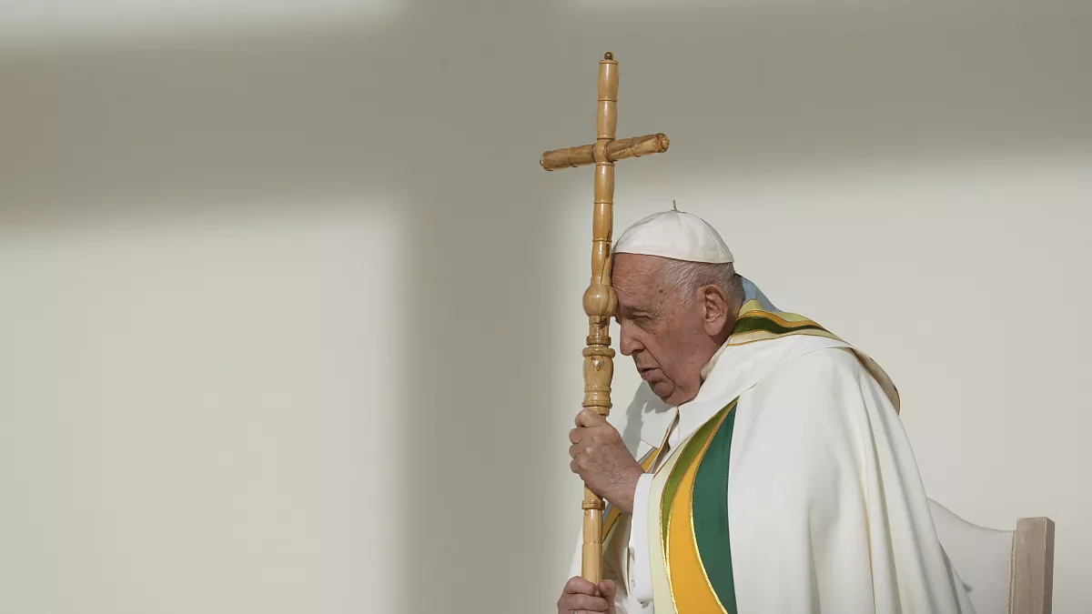
Father in heaven,
may the faith you have given us
in your son, Jesus Christ, our brother,
and the flame of charity enkindled
in our hearts by the Holy Spirit,
reawaken in us the blessed hope
for the coming of your Kingdom.
May your grace transform us
into tireless cultivators of the seeds of the Gospel.
May those seeds transform from within both humanity and the whole cosmos
in the sure expectation
of a new heaven and a new earth,
when, with the powers of Evil vanquished,
your glory will shine eternally.
May the grace of the Jubilee
reawaken in us, Pilgrims of Hope,
a yearning for the treasures of heaven.
May that same grace spread
the joy and peace of our Redeemer
throughout the earth.
To you our God, eternally blessed,
be glory and praise for ever.
Amen.

