Slide 1
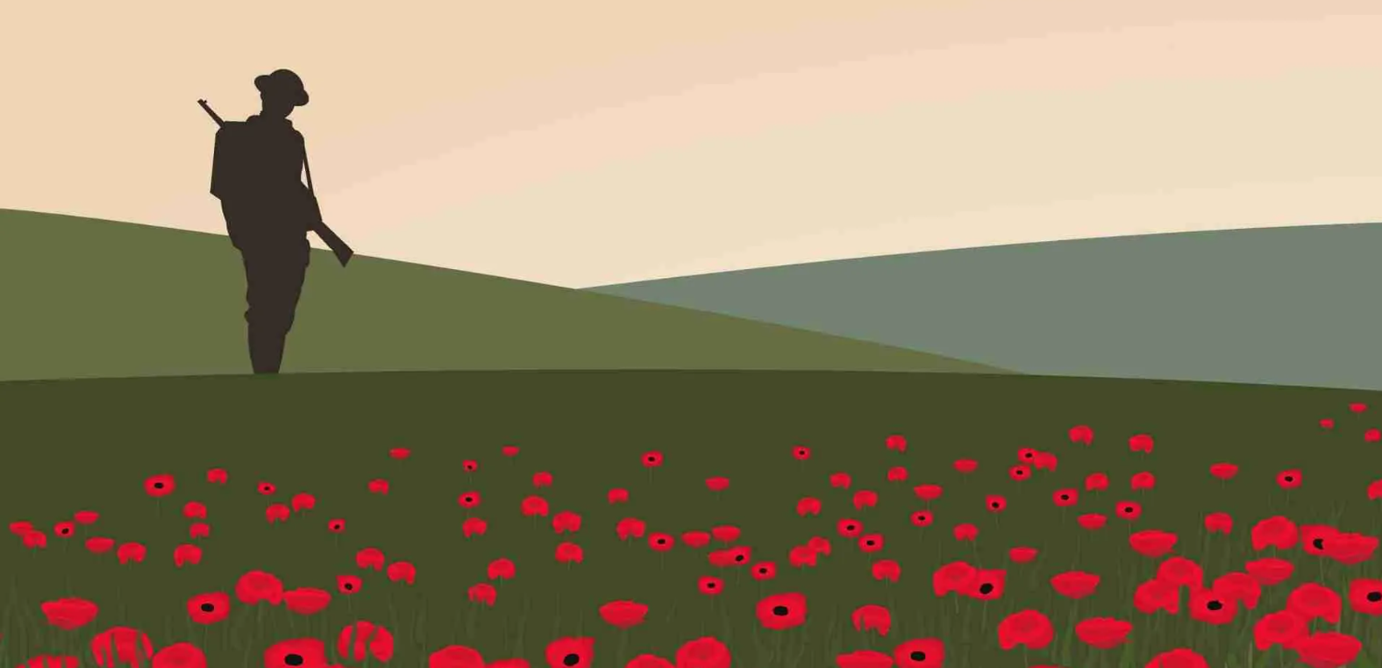
THOUGHTS AND PRAYERS 4th of November – 8th of November
THEME OF THE WEEK: Remembrance
“Greater love hath no man than this, that one man lay down his life for his friends." (John 15:13)

Slide 2


MORNING PRAYER IN THE CHAPEL THIS WEEK
Monday 4th November - 13A
Tuesday 5th November - 11I
Wednesday 6th November - 11N
Thursday 7th of November- 13R
Friday 8th of November - 13Y

Slide 3
On this week...
Monday | Tuesday | Wednesday | Thursday | Friday
Fr Jonathon is in every Monday lunchtime. Come and say hello. | Christian Union G16 12:20pm – 12:55pm | Rosary in the Chapel 12:15pm – 12:25pm. | Debate club 12:15-1:00 G15 | Re-Wilding Group 12:15pm – 1:00pm G12 Christmas club 12:15-1:00 G14 Remembrance Services Atrium
Keep an eye out for even more events going on in the following weeks!

Slide 4
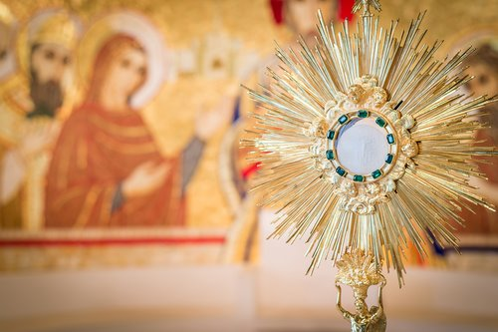
Exposition of the Blessed Sacrament
Where? The Chapel
When? Monday Lunchtime 12.15pm - 12.40pm

Slide 5
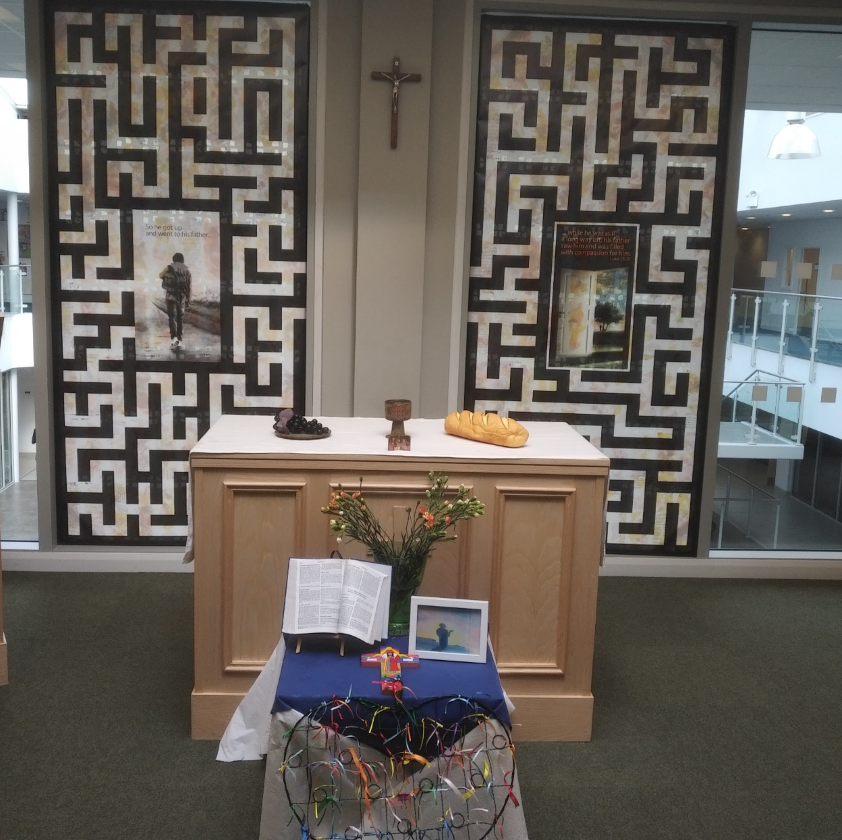
Mass at 8:20am on Friday Morning in the Chapel.
Everyone is welcome.
This week Friday Mass will be led by 8N

Slide 6
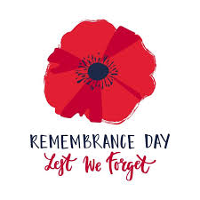
Remembrance
Y
Take some time as a form to respond to the following questions:
-What are we remembering?
-Why is it important to remember these things?
-How do we remember these things as a school?

Slide 7
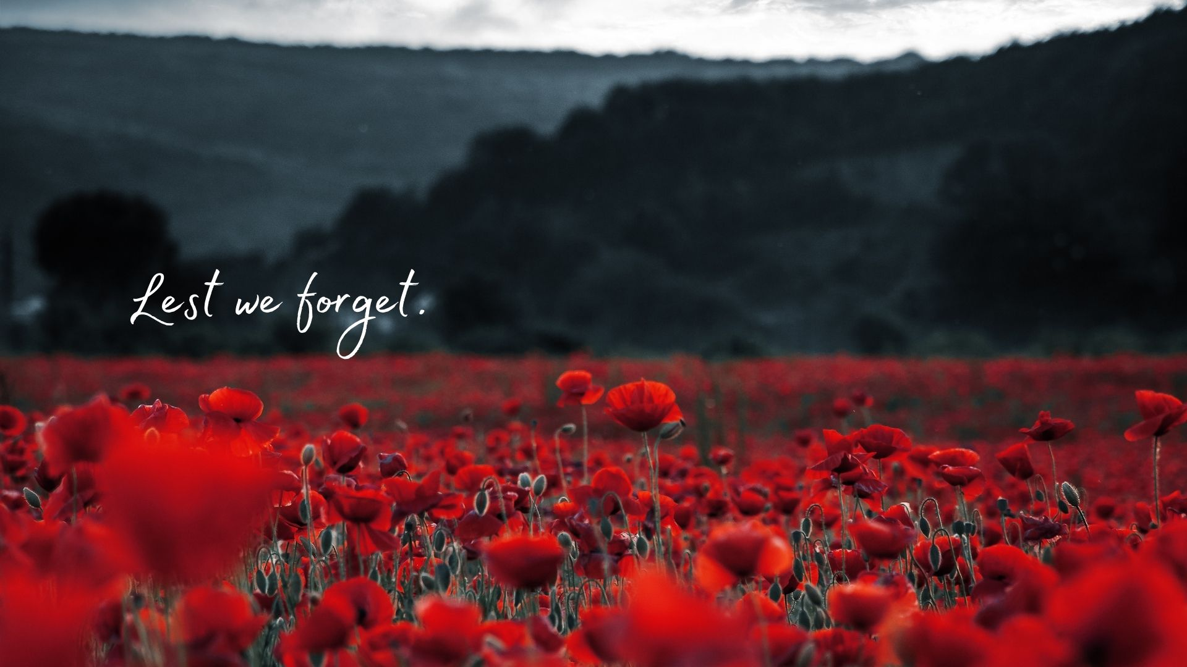
Remembrance Services...
On Friday of this week every year group will attend a Remembrance Service.
These services are held to honor and remember the people who have lost their lives in wars and conflicts, both past and present. It's a way of showing respect for their sacrifice and reflecting on the importance of peace. These services also give us a chance to think about how we can make the world a better place by learning from history and understanding the impact of violence. By observing Remembrance, we help ensure that the lessons of the past are not forgotten and that future generations can strive for a more peaceful world.

Slide 8

Lord,
Let us remember those who gave their lives so that we can live in peace and freedom. We thank You for their courage and sacrifice. Help us never to forget the cost of war, and teach us how to be kind, understanding and peaceful in our own lives. We also pray for those who are still affected by conflict today - that they may find hope, healing, and peace.
Amen

Slide 9
THOUGHTS AND PRAYERS 4th of November – 8th of November
THEME OF THE WEEK: Remembrance
“Greater love hath no man than this, that one man lay down his life for his friends." (John 15:13)

Slide 10
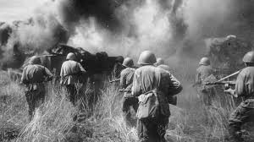
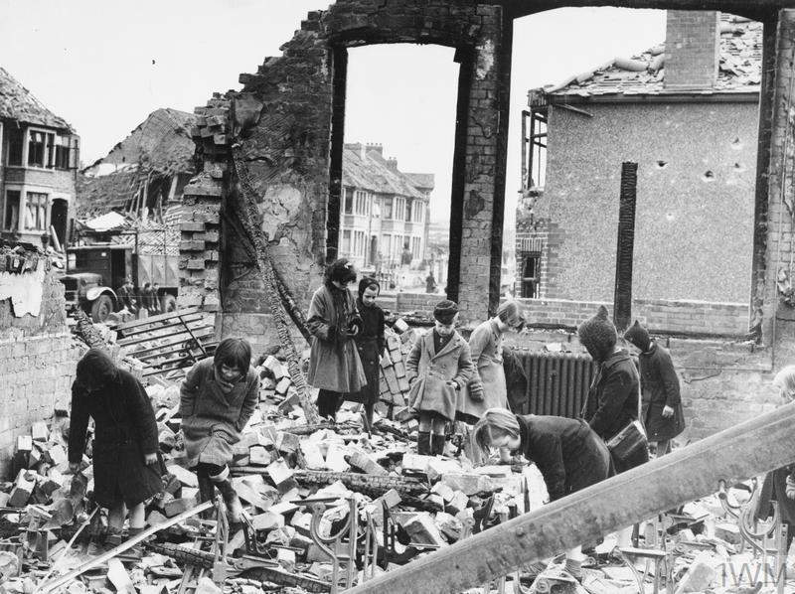
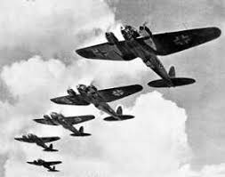
Suffering
Y
Who suffers as a result of war and conflict?
Create a list of all of the people that you think are impacted by war and conflict.

Slide 11
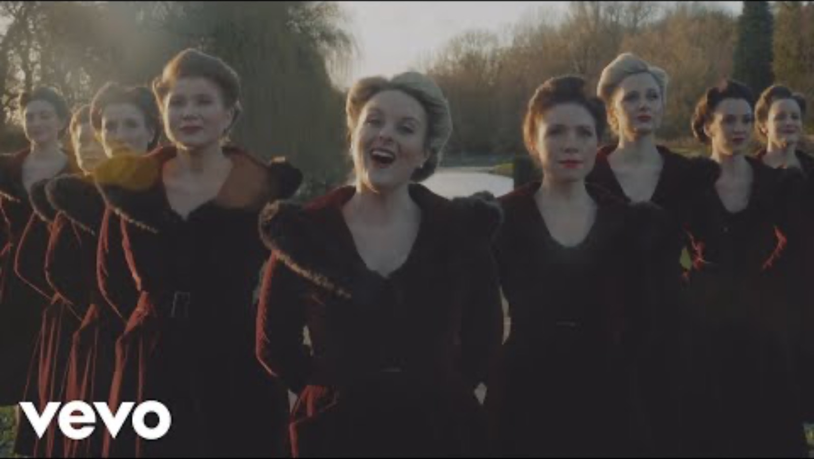
Listen to this song...
Who else suffers as a result of conflict?
What does it mean to 'keep the home fires burning'?
How does this song make you feel? Why?

Slide 12
Lord,
Let us remember the families and loved ones who are left behind when soldiers go to war. We pray for those who miss them, for the empty chairs at the dinner table and the quiet moments of longing in their hearts. Wrap them in Your comfort and strength and help them feel Your presence with them. Help us remember that no matter how far apart we are, your love connects us all.
Amen

Slide 13
THOUGHTS AND PRAYERS 4th of November – 8th of November
THEME OF THE WEEK: Remembrance
“Greater love hath no man than this, that one man lay down his life for his friends." (John 15:13)

Slide 14
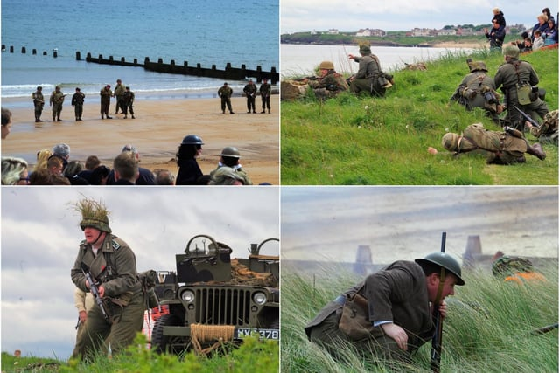
The importance of remembering history...
Jamie in 13Y takes part in WWII re-enactments. For example, as part of his work experience he took part in a D-Day re-enactment which took place at Blyth Battery.

Slide 15
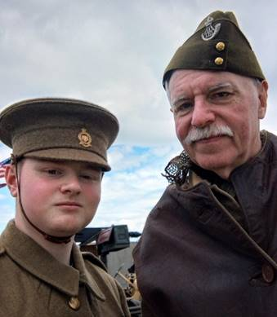
An interview with Jamie
How long have you been doing this as a hobby?
I have been doing Re-enacting as a hobby for 5 month now.
Why do you do this as a hobby?
I do this hobby for two main reasons, firstly because I have always held a deep passion for this period of history and re-enactment allows me to celebrate that passion with other like-minded people as well as hopefully providing that spark of interest in other people. Secondly, I think it is a much better method for teaching history. If a person can see history in action, they are more likely to remember the facts mentioned within.

Slide 16
An interview with Jamie
Why do you think it is important to remember these events?
There is a very famous quote by George Santayana that those who fail to learn from history are doomed to repeat it, and to a certain extent, this is the main drive behind why I think it is important to remember the people and events of this period. Millions of people died, in effect because of the death of one man and the hubris of nations and their governments. Remembering what they went through and why preserves the memory of all those who never lived to see the sunset glow, as well as giving meaning to their sacrifice. That no one would ever again have their lives thrown away for such meaningless concepts as a nation's honour or glory. But it is also important to understand these events as despite 100 years having passed these events still greatly affect the world we live in today. By commemorating these events we better understand the world we live in now and how to improve it.

Slide 17
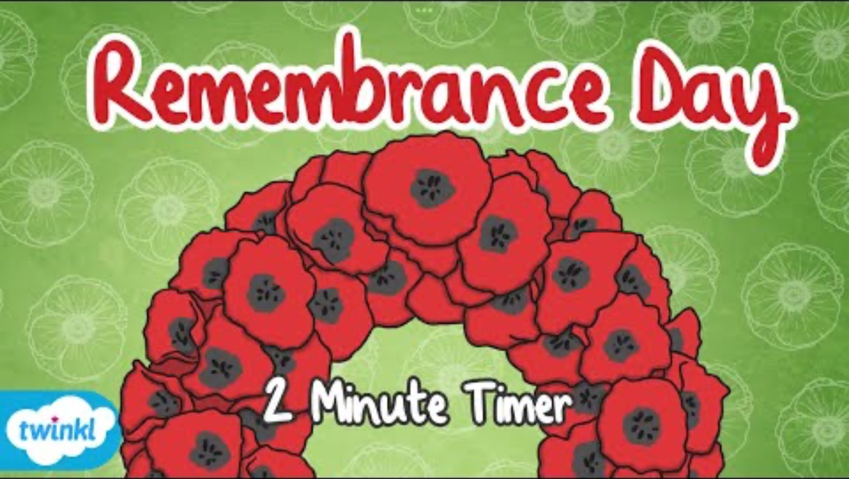
Take some time to remember
Monday the 11th of November is Remembrance day. On this day, a two minutes silence is observed at 11am.
Take two minutes in silence now to reflect and think on your own about the sacrifices of others.
You can do this with or without the included video.

Slide 18
Lord,
Today we remember the sacrifices of those who gave everything in war and we thank you for their courage. Help us to live in peace and to never forget the cost of freedom. May we strive to make the world a kinder and safer place for everyone.
Amen

Slide 19
THOUGHTS AND PRAYERS 4th of November – 8th of November
THEME OF THE WEEK: Remembrance
“Greater love hath no man than this, that one man lay down his life for his friends." (John 15:13)

Slide 20
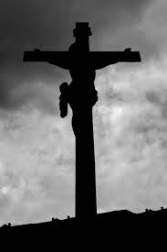
How does this link to our quote of the week?
Here Jesus refers to his Disciples — and by extension, all believers — as His friends. Jesus literally laid down His own life for His friends. He exhibited the most remarkable display of love when He died on the cross for our sins, showing what true, selfless love looks like.​
​
“Greater love hath no man than this, that one man lay down his life for his friends." (John 15:13)

Slide 21
How does this link to our quote of the week?
Y
“Greater love hath no man than this, that one man lay down his life for his friends." (John 15:13)
Laying down our lives means putting others first by our actions. We have to give something. We can give of our time, talents or treasures. But we have to give. And, when we do so, we are showing that we are putting others ahead of our reputation, comfort, and self-centeredness.

Slide 22

How could we live this out?
Y
As a form, discuss the following:
How could we make sacrifices for others?
How could we put others before ourselves?
What do we do in school to put others in our local community first?

Slide 23
Lord,
Help us to be kind and thoughtful, putting others before ourselves just like You taught us to. Give us the strength to make sacrifices for our friends and to show love and care in all we do. Teach us to be patient and understanding to all and to help others when they need us most.
Amen

