Slide 1
A – LEVEL CHEMISTRY
July 2024
Dr Jankowski

Slide 2
YEAR 12 ASSESSMENT [MOCKS]

Slide 3
TEACHING
2 TEACHERS
5/4 SPLIT [1 ADDITIONAL HOUR OWN STUDY]
KERBOODLE DIGITAL PLATFORM
TEACHING SPLIT INTO 29 CHAPTERS OCR CHEMISTRY TEXTBOOK
RELEVANT PRACTICAL SKILLS TAUGHT [PRACTICAL ENDORSEMENT]

Slide 4
ASSESSMENT
SUMMARY QUESTIONS
PRACTICE QUESTIONS [A – LEVEL STYLE Qs]
CHAPTER/TOPIC TESTS
MULTI-CHOICE STYLE TESTS
MODULAR TESTS [MOD. 2 – 6]
YEAR 12 MOCK AS STYLE EXAMS
YEAR 13 2x MOCK EXAMS [P1 – 3]

Slide 5
SUMMER TRANSITION WORK
COMPLETE THE CGP “HEAD START TO A – LEVEL CHEMISTRY” IN THE WORK BOOKS PROVIDED. SELF ASSESS USING MARK SCHEME IN BACK OF GUIDE.
Optional to complete some/all of the week 1 - 3 in the teams tile.

Slide 6
PRACTICAL ENDORSEMENT [PAG’s]
12 practical's carried out over course of the 2 years

Slide 7
PAG1.2 Determination of the relative atomic mass of magnesium
PAG 1.2 Determination of the relative atomic mass of magnesium LEARNER
Introduction
Magnesium is a reactive group 2 metal that readily reacts with an excess of aqueous hydrochloric acid, evolving hydrogen gas. By collecting and accurately measuring the volume of gas, and the mass of magnesium used, the relative atomic mass of magnesium can be determined.
magnesium + sulfuric acid → magnesium sulfate + hydrogen
Aims and skills
To determine the relative atomic mass of magnesium
To accurately measure and record the mass of a solid and volume of a gas
To safely and carefully handle an irritant liquid and flammable solid
Intended class time
1-2 hours

Slide 8


Chemicals
Equipment
access to a balance reading to at least two decimal places
measuring cylinder (10 cm³)
pipette (10 cm³) and filler
dropping pipette
conical flask
stopper and delivery tube
measuring cylinder (250 cm³)
stands, bosses and clamps
trough
evaporating basin
Bunsen burner
tripod
heat-proof mat
clay pipe triangle
filter and filter paper
Label | Identity | Hazard information
1.0 mol dm⁻³ H₂SO₄(aq) | 1.0 mol dm^{–3} aqueous sulfuric(VI) acid, H₂SO₄(aq) |  | WARNING Causes skin irritation and serious eye irritation
0.25 mol dm⁻³ H₂SO₄(aq) | 0.25 mol dm^{–3} aqueous sulfuric(VI) acid, H₂SO₄(aq) | Currently not classified as hazardous at this concentration
Mg(s) | magnesium ribbon |  | DANGER
MgO(s) | magnesium oxide, MgO(s) | Currently not classified as hazardous
Health and Safety
Wear eye protection at all times.
Flammable gas is evolved – ensure there are no naked flames in the laboratory during Method 1.

Slide 9
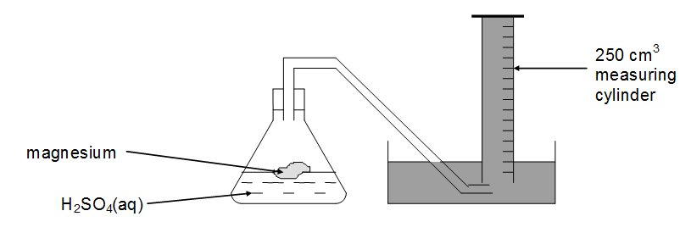
Procedure
Before starting your practical work, read the information below.
Decide how you will organise your practical work, and which observations you need to make and/or which measurements you need to take. Ensure that you record all of your results in a suitable format.
Method 1
Set up the apparatus as shown above. Clamp the conical flask and 250cm³ measuring cylinder in place.
Using a measuring cylinder, add 20.0 cm³ of 1.00 mol dm^{–3} aqueous sulfuric acid (an excess) to the conical flask.
Weigh accurately between 0.12 g and 0.16 g of magnesium. Record the exact mass of magnesium using an appropriate format.
Remove the stopper, add the magnesium to the flask and quickly replace the stopper.
Collect the gas and record the final volume of hydrogen.

Slide 10
Analysis of results : Method 1
Assuming room temperature and pressure, calculate the amount, in mol, of hydrogen gas that you collected.
Using the equation below, deduce the amount, in mol, of magnesium that was reacted:
Mg(s) + H₂SO₄(aq) → MgSO₄(aq) + H₂(g)
Using the measured mass of magnesium that was reacted, calculate the relative atomic mass of magnesium.
RESULTS
ANALYSIS
Mass of magnesium (g)
Volume of hydrogen END (cm³)
Volume of hydrogen START (cm³)
Volume of hydrogen PRODUCED (cm³)

