Slide 1
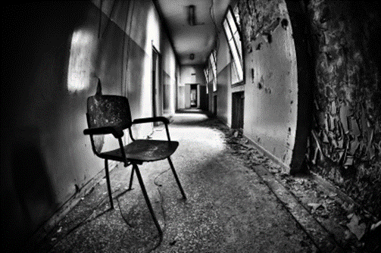
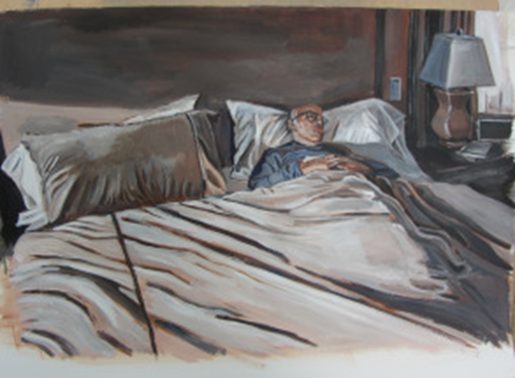
Recap
WHAT IS THE STRONGEST IDEA FROM YOUR MIND MAP FROM WEEK 1? Which strand of your mind map interests you most? Is there anything from this week’s news you could add to your mind map? Remember you are documenting the theme Structures
Photography Challenge Last week you focused on photographing your subject from different angles & using a variety of light sources. Look at the artist examples. How have the painter and photographer used: Light Space Composition What do you think the artists are trying to say with their images? Do they create a mood in their work?

Slide 2
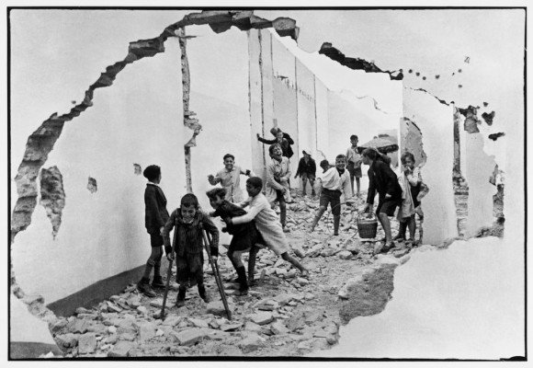
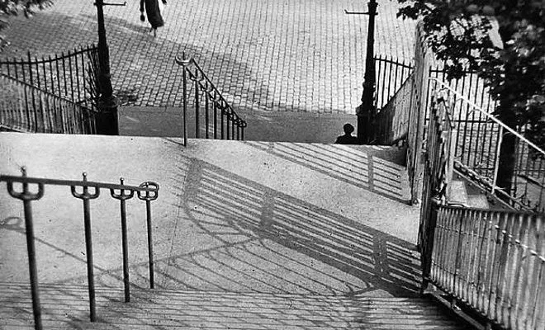
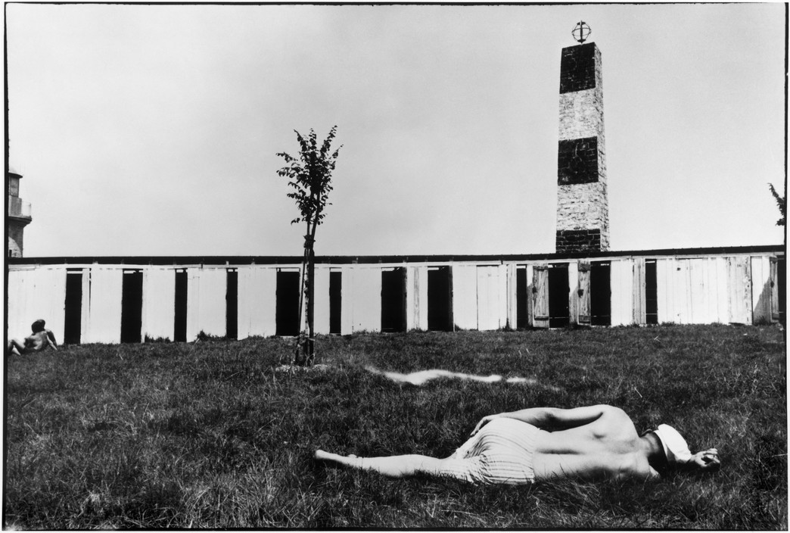
Recap Continued
What do you notice about the photograph? Make a comment on the following features: Composition & Space Viewpoint Line (How has the photographer used line in their images?) Lighting (natural, artificial, spot light) Angle
Henri Cartier-Bresson
Street Photography
Andre Kertesz

Slide 3
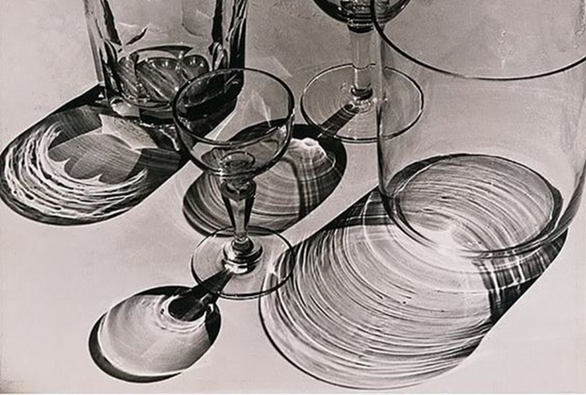
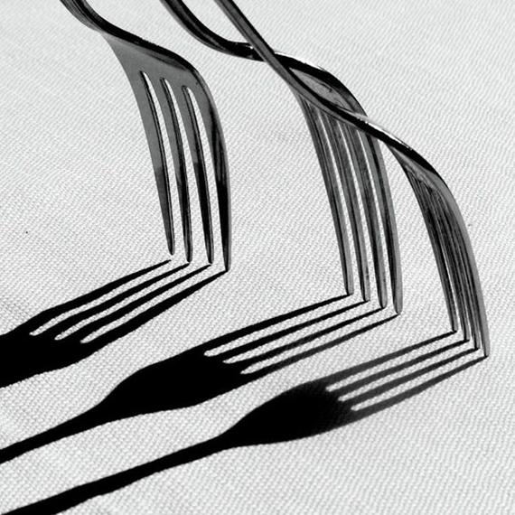
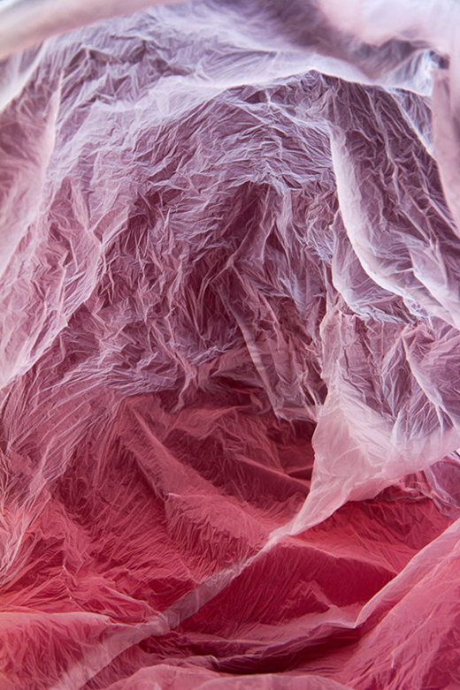
WEEK 2 OUTLINE
This week you will experiment with light sources and use it to create mood in your work. You will consider the position of a light source, time of day and artificial vs natural light. You will explore the use of light to create shadow and highlight within your compositions through your own photoshoots. You will create your own typologies experiments, categorising objects, shapes, textures and colour. You will begin to develop ideas around the theme Structures .

Slide 4

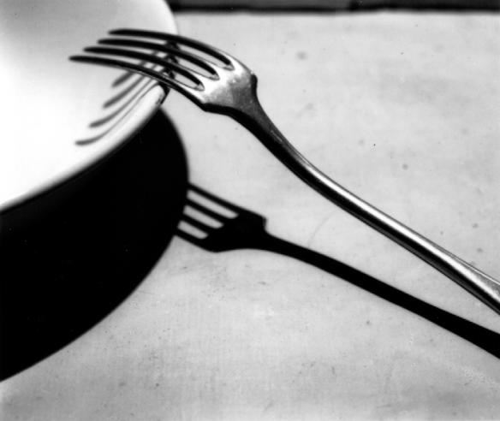
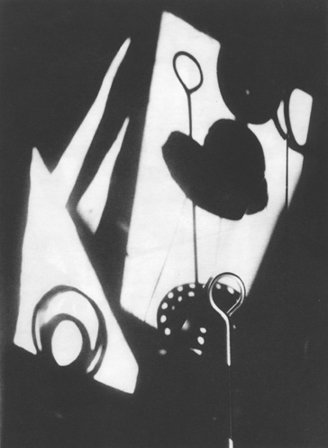
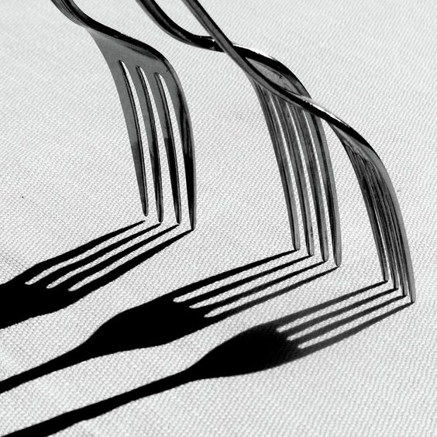
SHADOW & LIGHT
© Andre Kertesz
Forks With Shadows is a photograph by Photo By Daniela Nobili which was uploaded on January 17th, 2019.
Jaromir Funke - the play of light

Slide 5
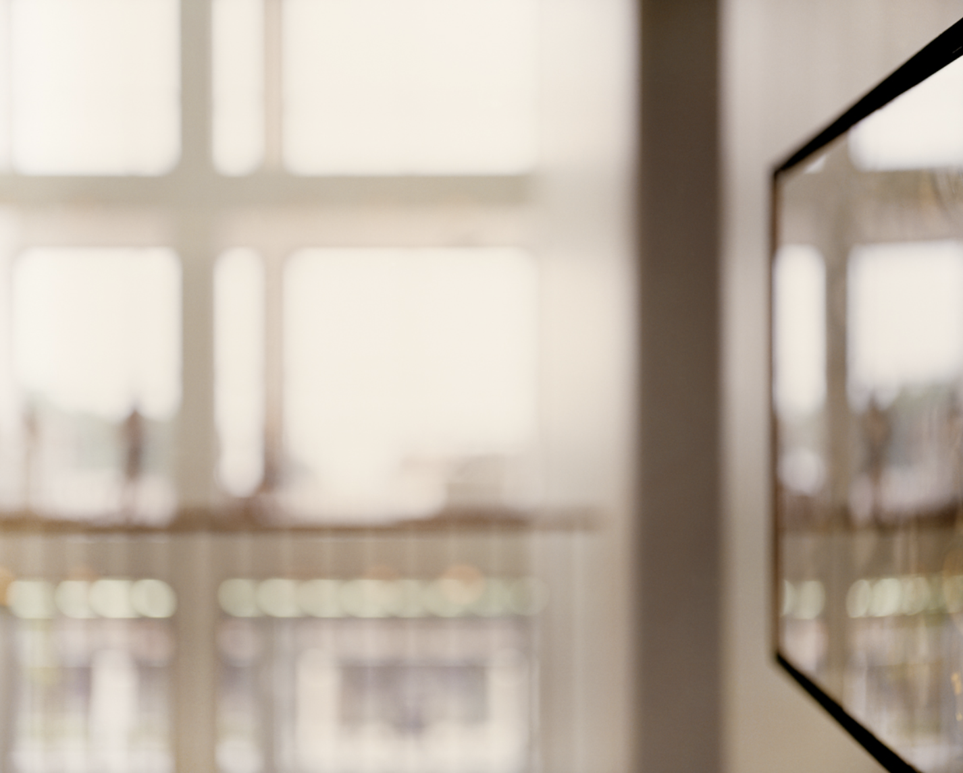
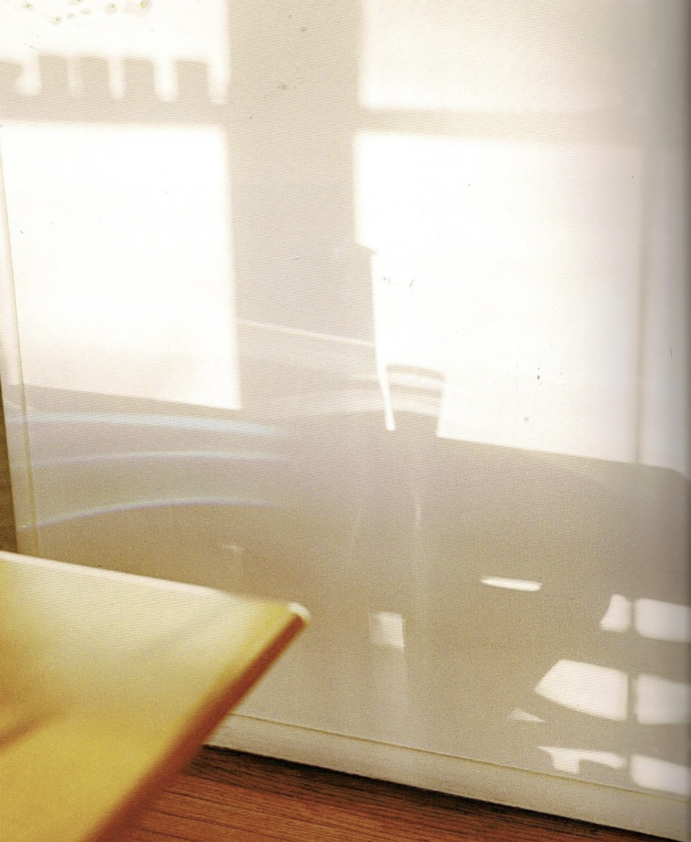
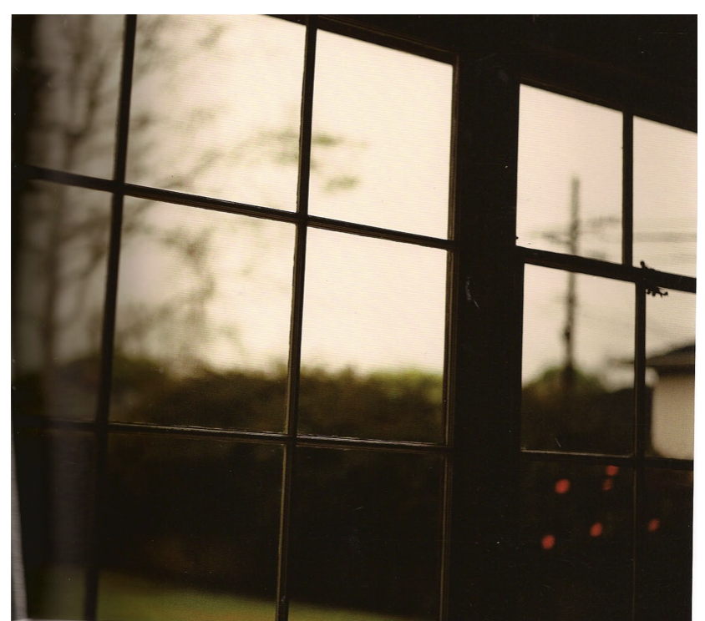
UTA BARTH
(b. 1958)
Task 1
Take photographs of shadows.
This could be done out on a shoot/ location if the light is right. However, if you need to complete this task in the house try the following:
1/ Position objects e.g. on a plain surface.
2/ Photograph the object near a window with lots of natural light.
3/Photograph again using a torch/lamp to create the shadows.
Make sure you capture some of the object and the shadow.
Rather than showing us a recognisable image, Barth’s works depicts her perception of her surroundings. It often has painterly qualities and abstract features due to her deliberate use of blur.
“THE CAMERA WAS TEACHING ME HOW TO SEE.”.
https://www.youtube.com/watch?v=xxYcpPDq5iQ&feature=emb_logo

Slide 6
UTA BARTH - PHOTOGRAPHY CHALLENGES
Photograph shadows made by light coming through a window.
Photograph the movement of fabric in the wind.
Set up a still life of glass and glass bottles. Create shadows by shining light through and photograph. You could fill the glasses with water!

Slide 7
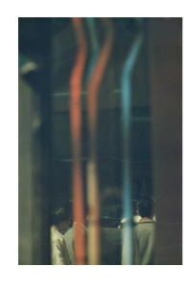
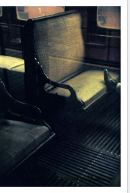
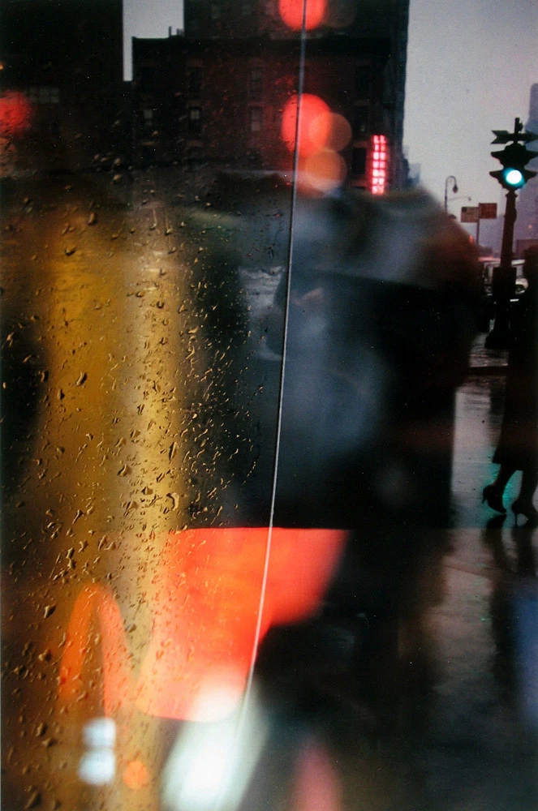
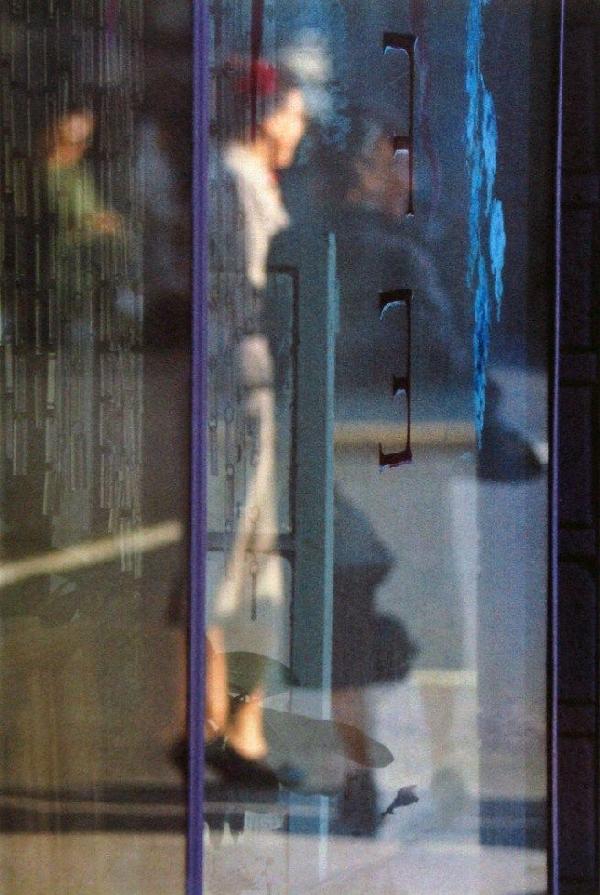
SAUL LEITER
(1923-2013)
Saul Leiter was foremost a painter who discovered the possibilities of colour photography. He created an extraordinary body of work, beginning in the 1940s. His images explore colour harmonies and often exploit unusual framing devices - shop signs, umbrellas, curtains, car doors, windows dripping with condensation - to create abstract compositions of everyday street life in the city.
Many of his images use negative space, with large out of focus areas, drawing our eye to a particular detail or splash of colour.

Slide 8

TASK 2 SAUL LEITER - PHOTOGRAPHY CHALLENGES
Cover your lense in cling film to create a deliberate blurred effect. Photograph different parts of a journey.
Explore different lighting. Natural Lighting or artificial lighting.
This is an experiment. Don’t worry if your photographs don’t come out as you expected ☺
Photograph through a shop windows or bus stop glass.

Slide 9
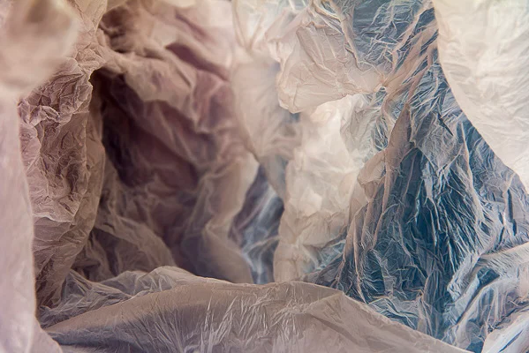

Task 3 : Plastic Bags
Vilde Rolfsen’s PLASTIC BAG LANDSCAPES
Norwegian photographer Vilde Rolfsen extracts beauty from discarded plastic bags while raising awareness about throw-away culture. She took inspiration from the Norwegian mountains and glaciers.
Task 3
1/ Take Large plastic bags, crinkle the plastic.
2/ Put your camera/phone inside of the bag
3/ Light your plastic bags with torches. Try lighting the bag from the inside and outside.
Don’t worry if your photographs don’t work, this is an experimental piece.

Slide 10
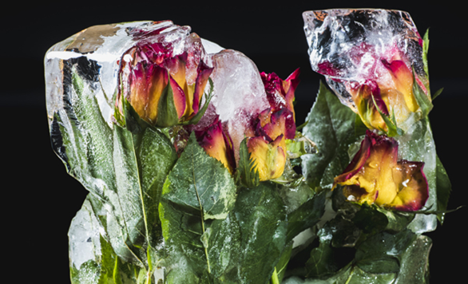
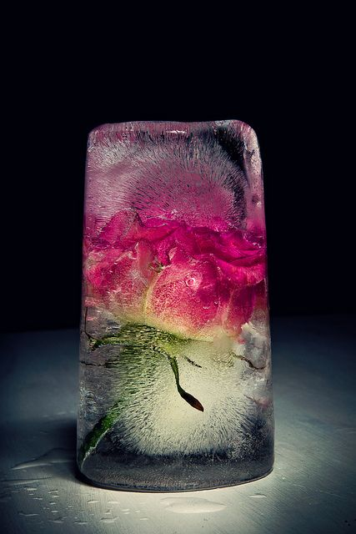
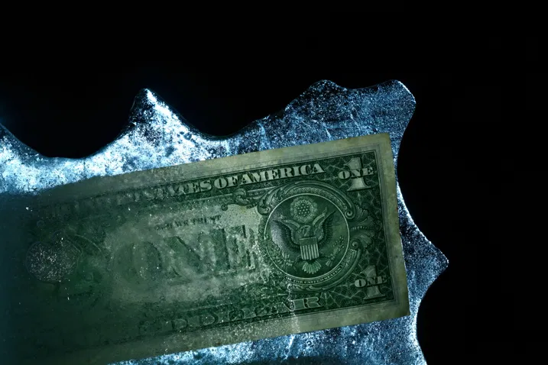
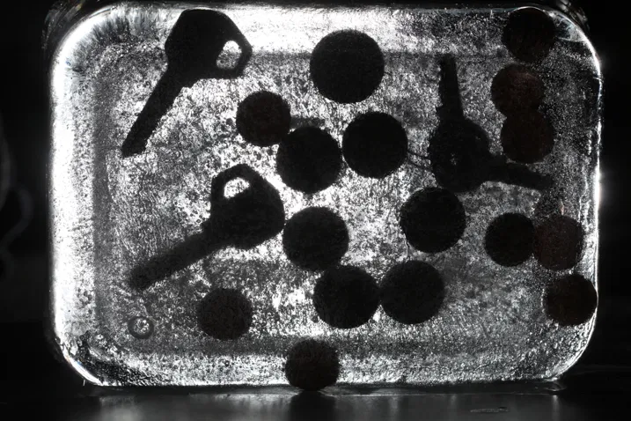
Task 4: Ice Photoshoot
1/ Be prepared for this shoot.
Use food containers or ice cube trays to freeze objects in water over night.
2/ Once frozen remove the block of ice and place it on a plain background (a sheet or paper) to make sure the background does not distract from the ice.
3/Shine a torch from a phone onto the ice and photograph repeatedly as the ice melts. You can light the ice from behind for a different effect.
Try to capture the highlights on the ice surface.
Food – Raid the freezer for things to freeze! Fish works great, you can get some from a fish market and then freeze them.
Money – Both coins and paper money can work well when frozen, though if the value of the paper money is high freeze at your own risk.
Metal objects – The way ice freezes around metal, especially things like metal screws can create great patterns in the ice.
Flowers – Another still life favourite, this time frozen for some ice photography for a different twist.
https://digital-photography-school.com/frozen-object-photography-home/

Slide 11
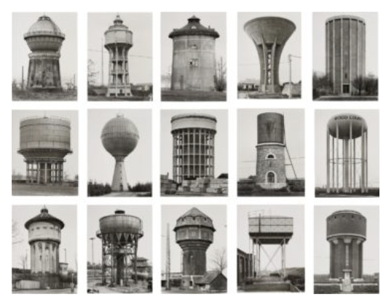
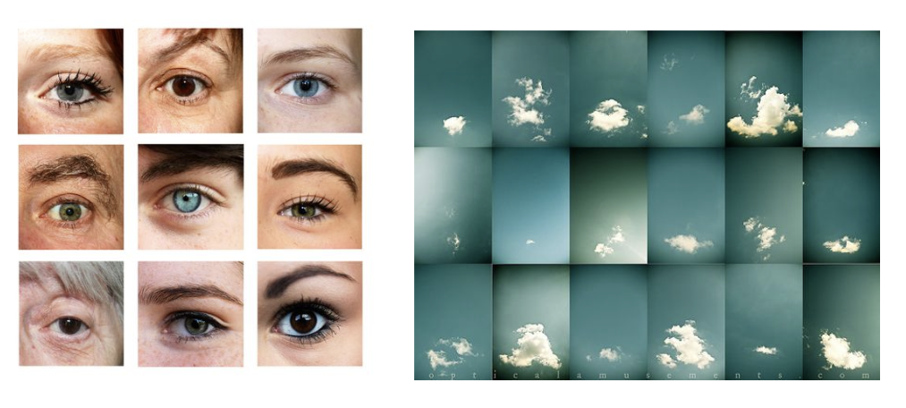
Typologies
TASK 5
Step 1:
Create your own typology using objects that can be all placed into one category. Think about your image being part of a series.
If you are photographing objects, place them on a plain background and photograph them from above.
There are examples of typologies on the following slides.
Step 2:
Arrange your set of images into a typology arrangement e.g. grid.
Print them out to present or present them on a powerpoint slide. Title your work TYPOLOGIES.
Photography is often used as a tool to document or classify objects.
A typology is described as a study or analysis using a classification according to general type.
In photography this means a series of photographs related by form - this could mean:
Shape
Colour
Texture
Form
Texture
Pattern
Line
BERND BECHER (1931-2007)
HILLA BECHER (1934-2015)
Were German conceptual artists and photographers who worked as a creative duo.
They met as students and married in 1961.
They are best known for their extensive series or typologies of industrial structures.
These are often displayed in a grid formation.

Slide 12
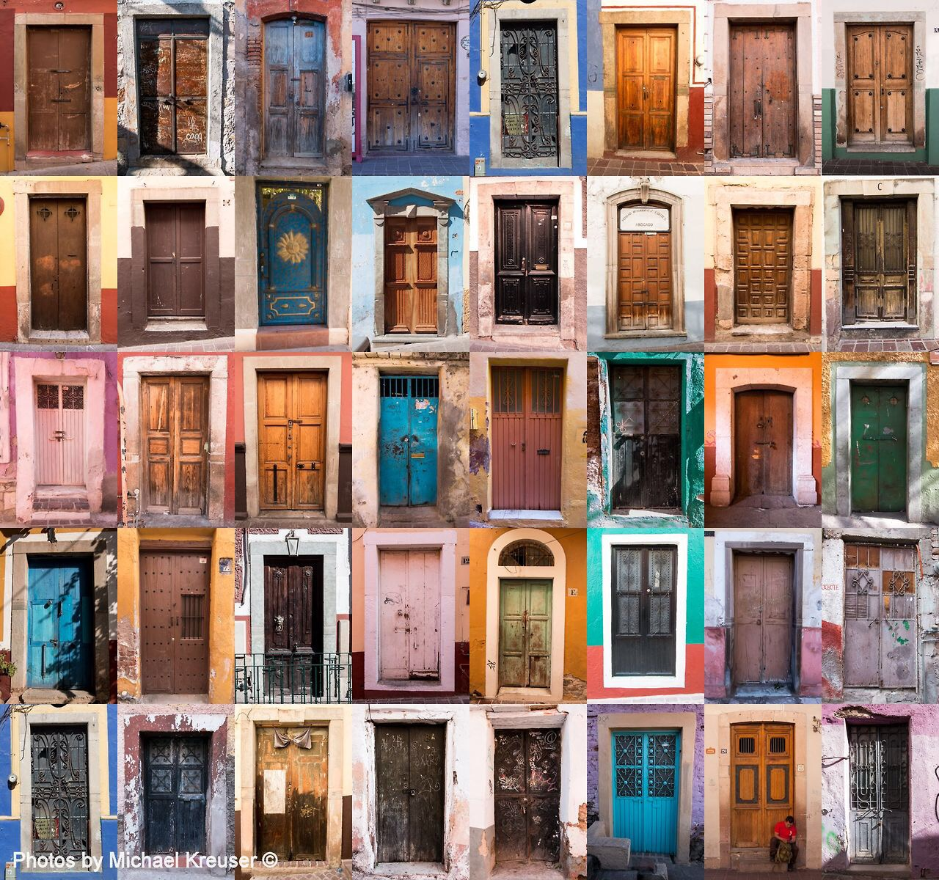
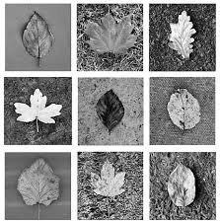
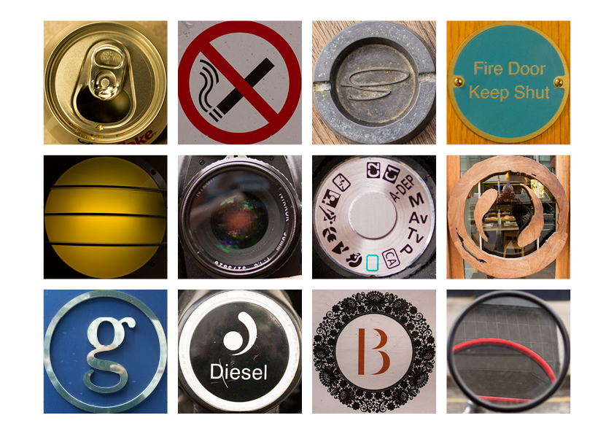
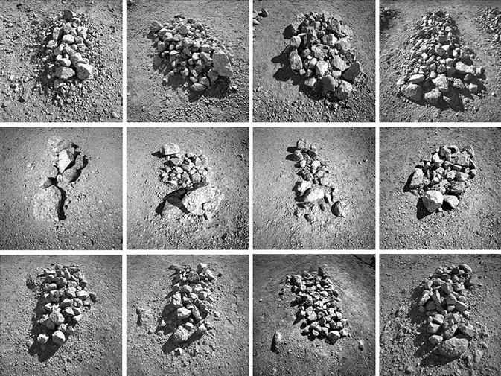
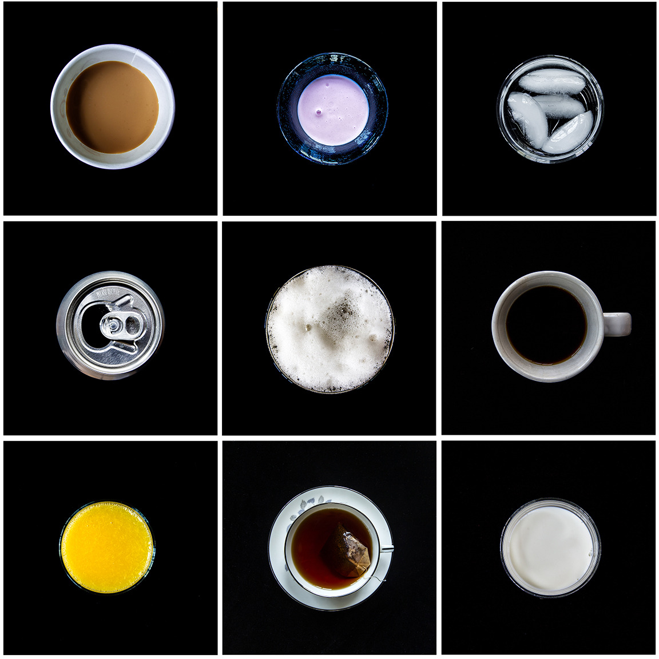
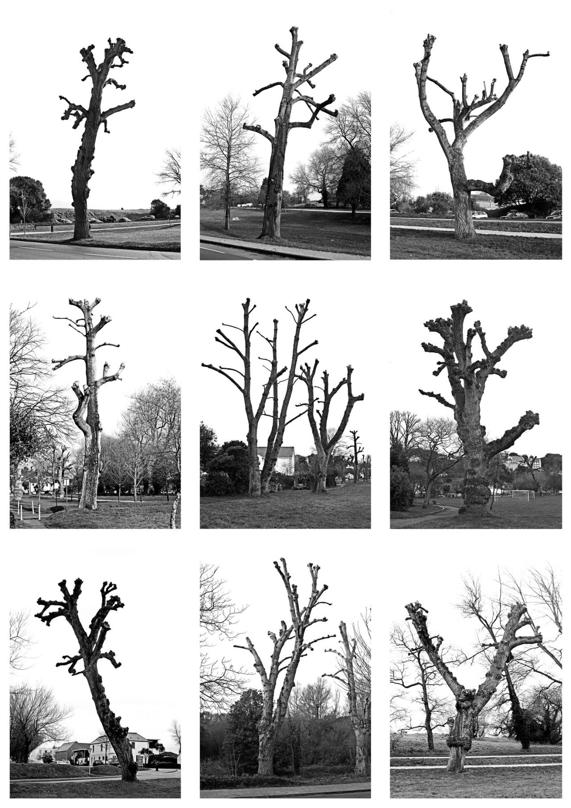
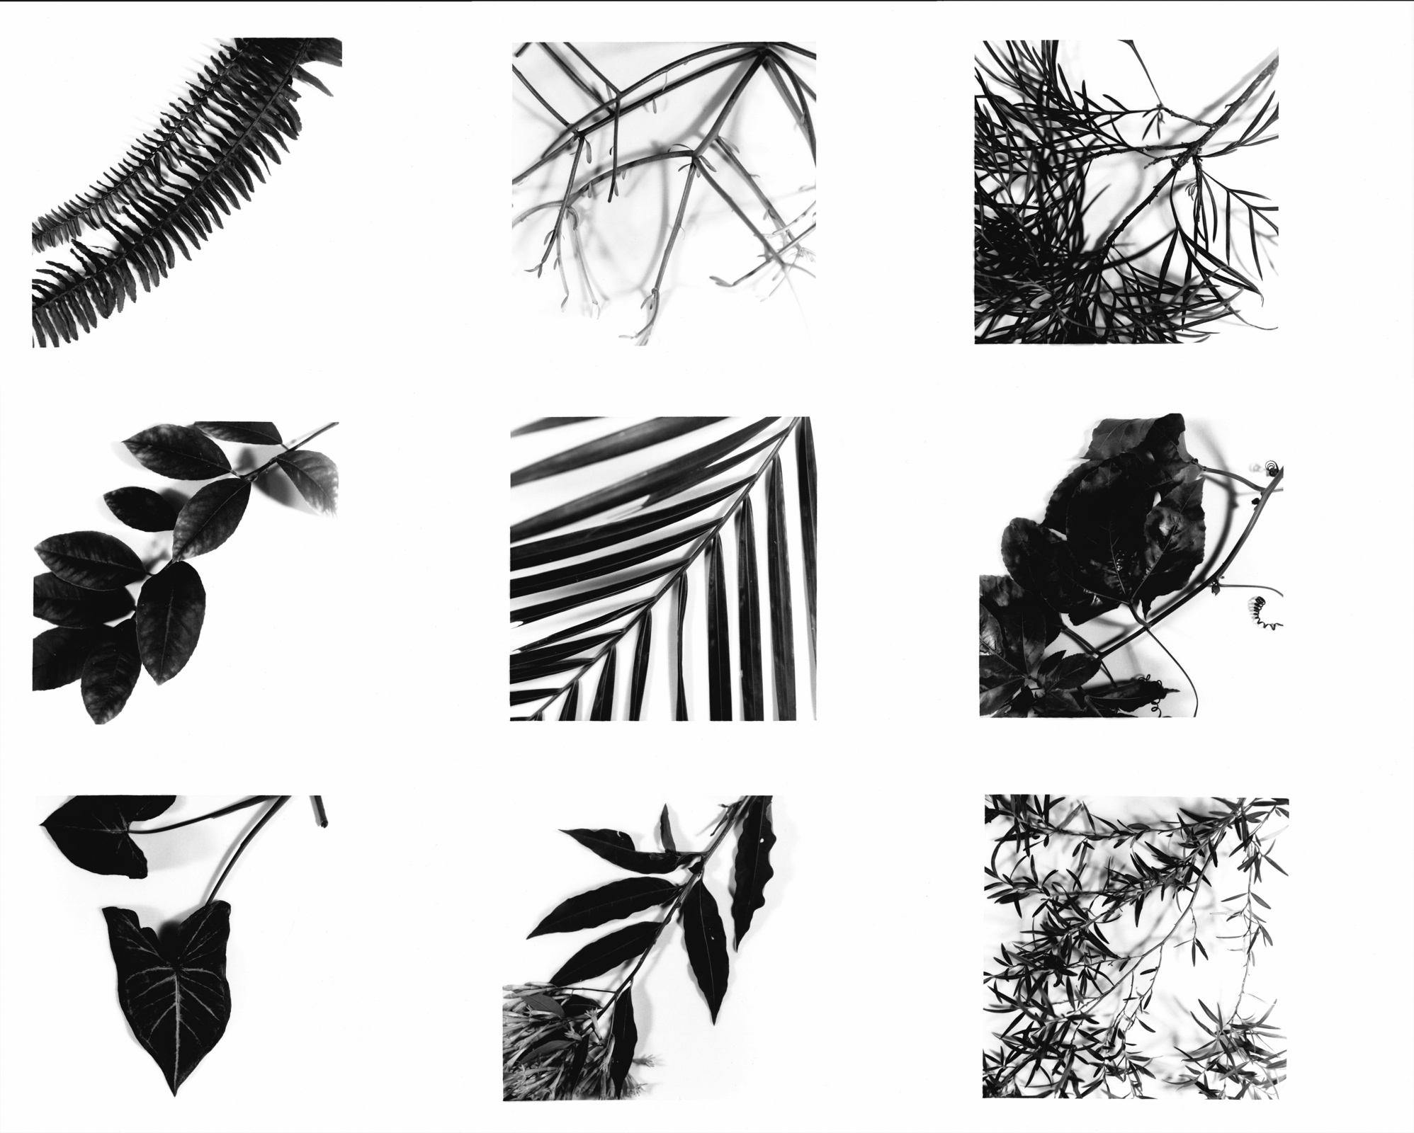
Shape

Slide 13
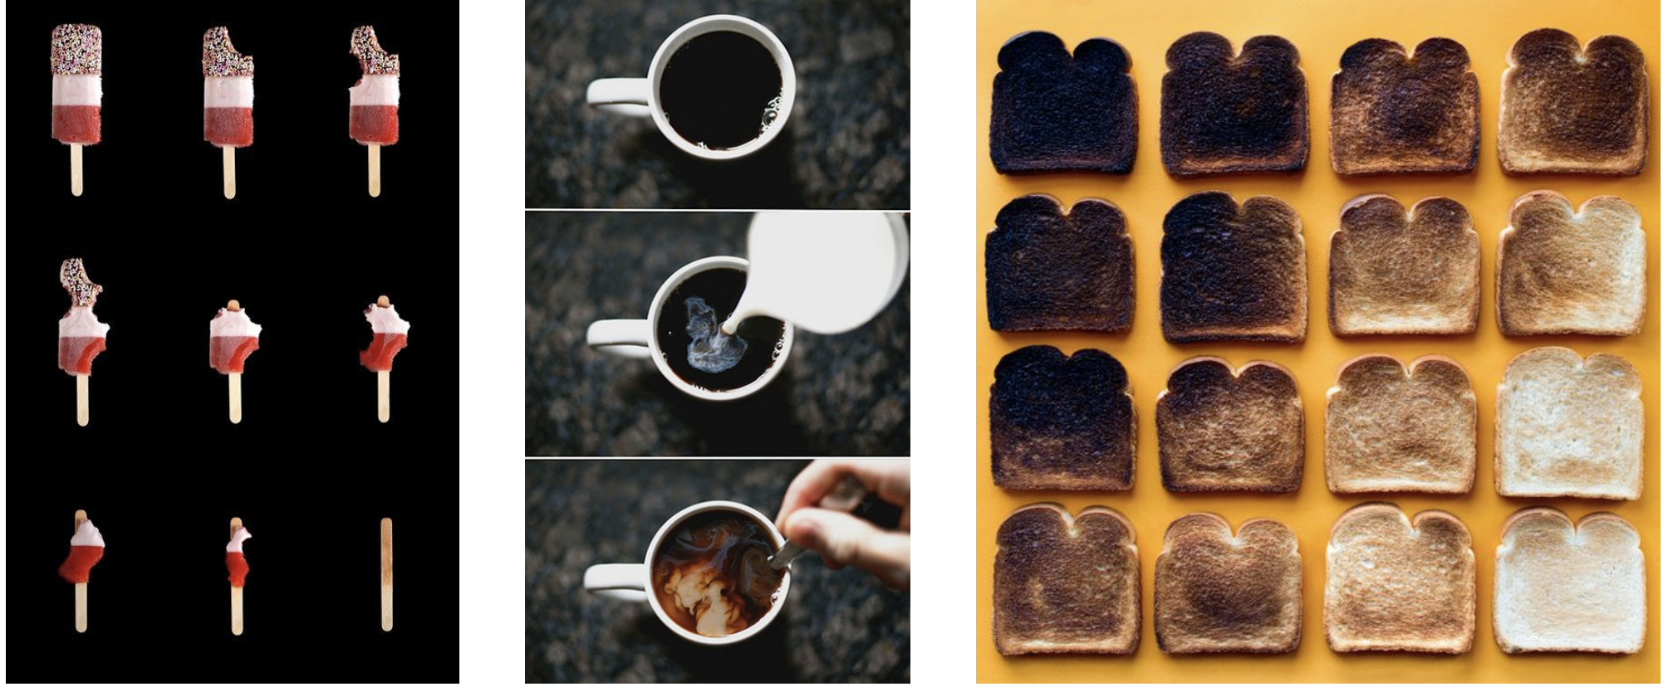
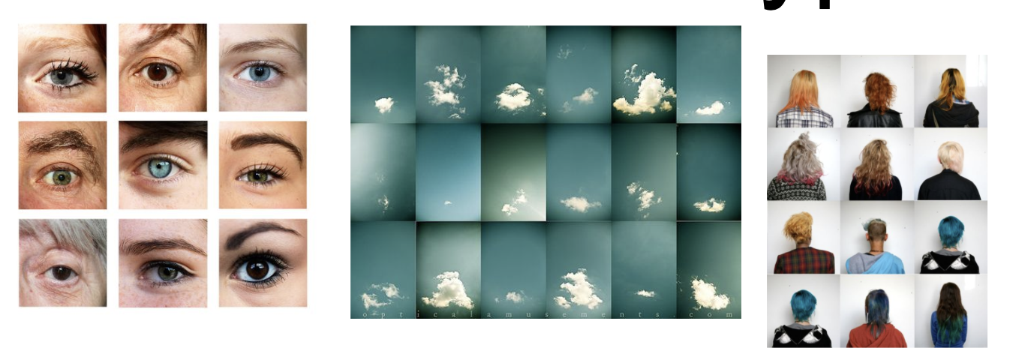
EXAMPLES
Take photographs to create a sequence using food
It could be the eating, molding, cooking, peeling etc.
Take a photograph of your plate everytime you eat dinner and/ or finish dinner.
Take photographs from a view of your window every hour of the day.
Take photographs of facial features.
Take photographs of a collection (Shoes, Nail varnishes etc.)
Take photographs of items that are the same colour or shape.

Slide 14
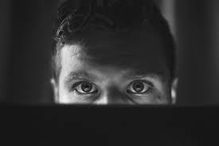
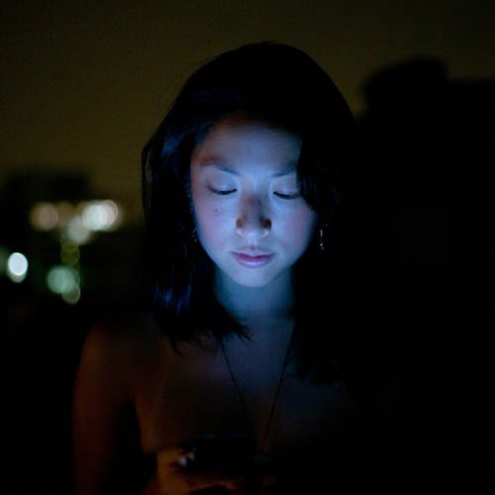
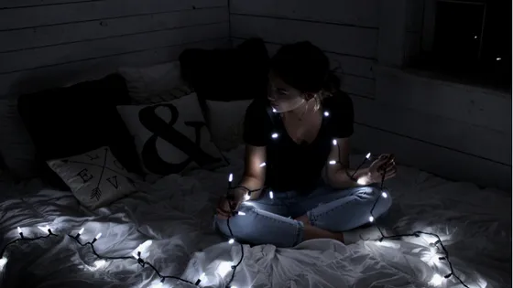
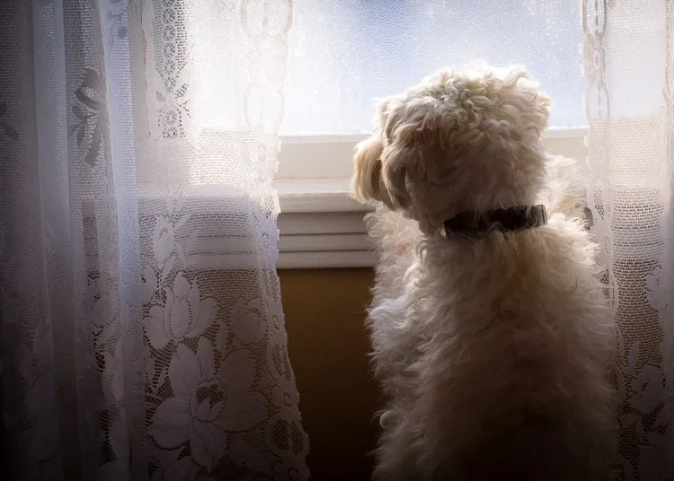
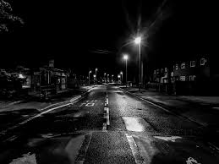
Experiment with lighting.
Could you use natural light, torches, candles, fairy lights, lamps, street light, light from a phone or laptop screen, window light? What time of day will you take your photographs?
WEEK 2 FINAL SHOOT
Now you have experimented with different ways of lighting your subject, it is time to experiment with lighting your chosen subject.
The theme for this shoot is Structures.
Take around 15 shots
Try to get out on location. It is an important part of the photography course.

Slide 15
Organise your photographs from this week with your week 1 photoshoot.
You could arrange your most successful images onto powerpoint slides or if you prefer you can print out your images and arrange them in a sketchbook or notebook.
Make sure you save your images.

Slide 16
Extra Reading & Inspiration
https://www.bjp-online.com/ British Journal Of Photography
https://monovisions.com (tab at the top Black & White masters)
https://expertphotography.com/
https://digital-photography-school.com/ (Photography Hacks and ideas with useful tutorials for taking photographs and editing)
EXTRA RESOURCES & READING
PH LEARN WEBSITE
https://www.photopedagogy.com/
Pixlr Editing videos on YOUTUBE.
https://www.bjp-online.com/ British Journal Of Photography

