Slide 1

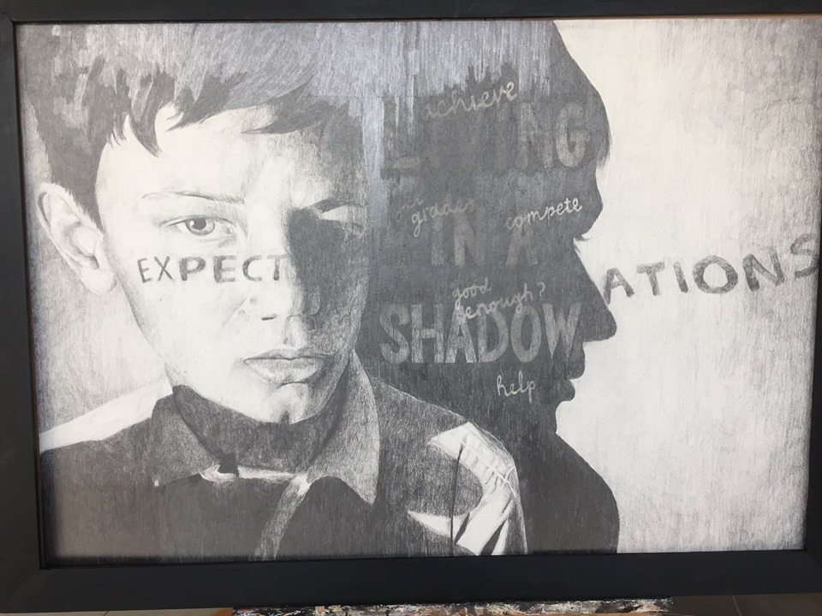
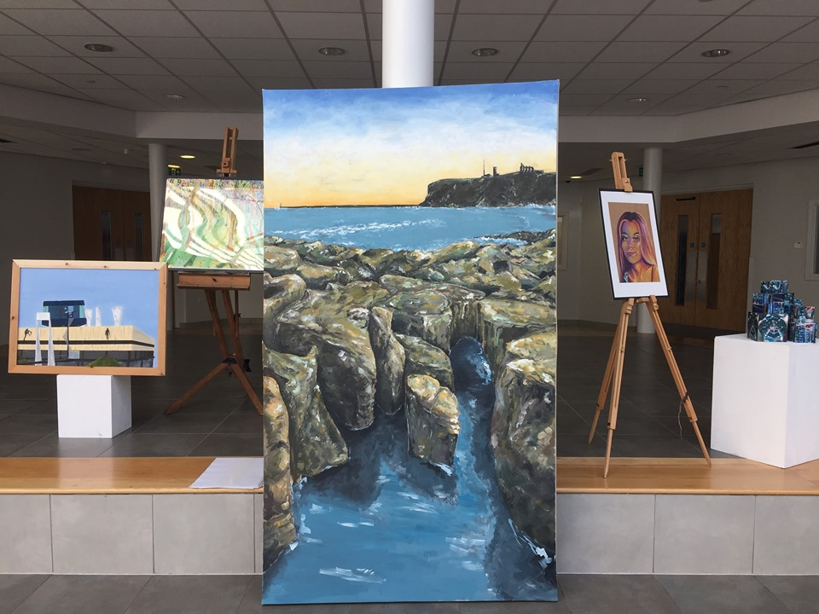
A Level Fine Art Bridging Project Week 1
Art enables us to find ourselves and lose ourselves at the same time.
Thomas Merton

Slide 2
Entry Requirements for Studying A-level Fine Art
Students who are expected to achieve at least a grade 5 in GCSE Art and a grade 5 in one of their GCSE English courses.
Students who have enjoyed their GCSE Art course, and who enjoy going to galleries and learning about artworks.
Students who enjoy working with new materials and developing different techniques.
Students who relish the opportunity to work in new ways and take risks within their art work.
Students who enjoy working to a broad theme and gathering research through visual and written form.
What to expect from A-level Fine Art.
The A-level Fine Art course allows students to develop their own chosen themes, encouraging them to really stamp their personality on their projects from day one. You will be asked to research your theme and chosen artists in greater depth and push your ideas to more ambitious scales than you have been used to. We begin Year 12 with a short introductory project to challenge you with materials and scales, while giving you the chance to brush up on your recording skills after a long break. You will regularly share your artwork with your peers and teachers in group critiques, which allow you to organise your ideas and gather ideas from others. We also offer visits from artists and opportunities to work with local universities through skills workshops led by university lecturers. The broadness of the course and themes allow you to use your artwork as a powerful tool to communicate messages to an audience, as escapism, documentation or immersing yourself in the pure aesthetics. Our sixth form students benefit and value the extra space we offer them to work on weekly tasks outside of lesson time. If you are thinking about studying A-level Art, then attempt some of this work to give you a flavour of the demand of the subject. If you decide that Art is the A-level you want to study, remember this bridging course should be completed in full.
Component 1 Coursework Portfolio worth 60% | Component 2 Externally Set Exam – worth 40%
This is a personal investigation chosen by you. It will comprise of sketchbooks, boards and final pieces. This portfolio of art work should be an exciting and in depth investigation. A written essay between 1,000-3,000 words is required to support your personal investigation artwork. Lessons will be dedicated to coursework until the exam papers are given out. | The theme for exam project is set by the AQA exam board around 1st Feb. There are 8 starting points to choose from. You have approx. 10 weeks to produce a sketchbook/boards to respond to your chosen theme. During the exam lasting 15 hours, across 3 days in the art room you will create your final pieces. Sketchbooks/boards/research for the exam MUST be present in the exam room and should be referred to during the exam.

Slide 3
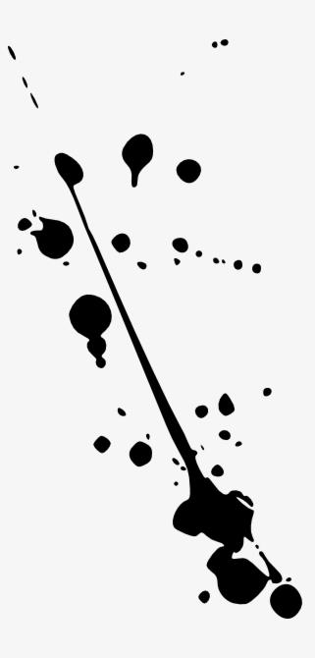


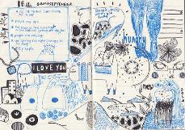
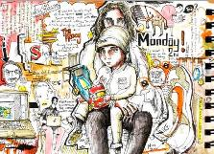
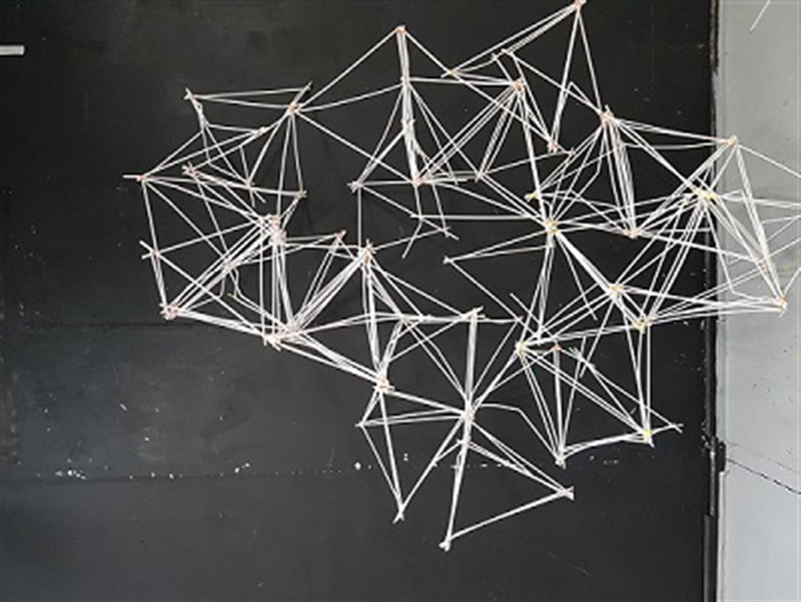
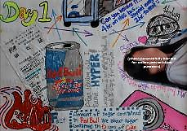
Theme: Structures 2024
Your FINE ART transition work will allow you to go outside and create work wherever you go! You can complete this work in any time of sketchbook/notepad/jotter, but please make sure it’s small enough for you to take on your journey.

Slide 4
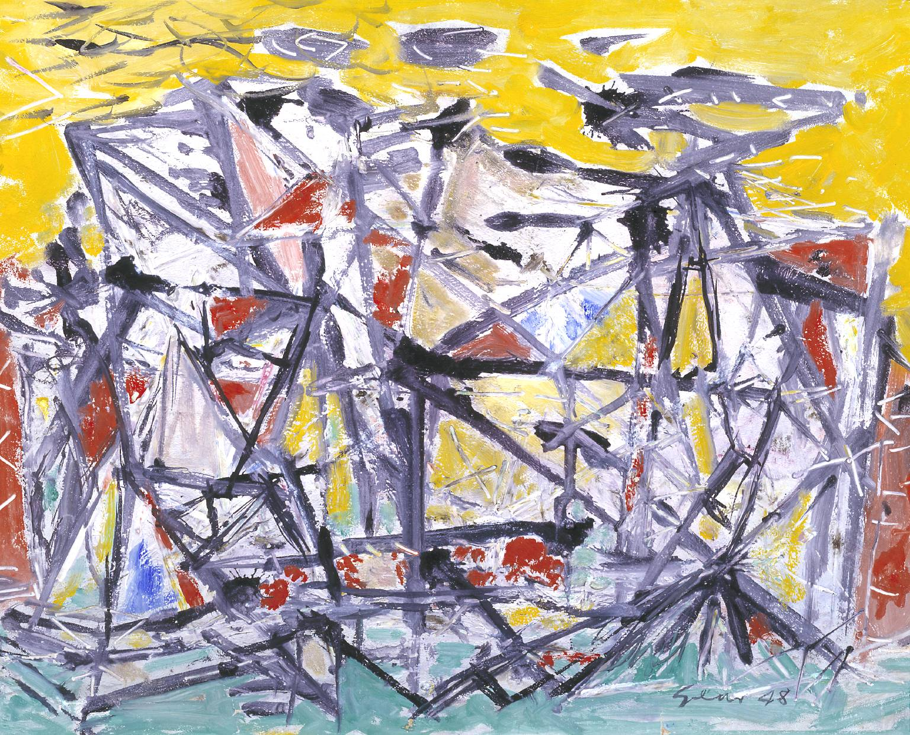
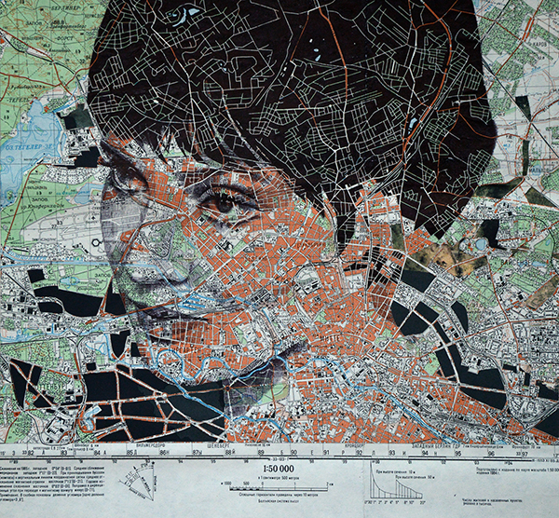
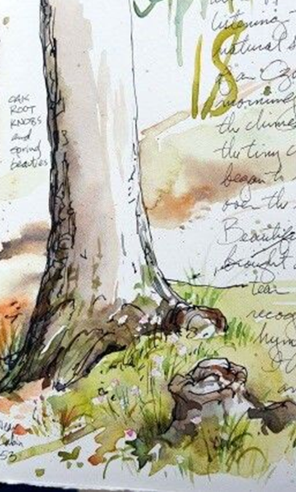
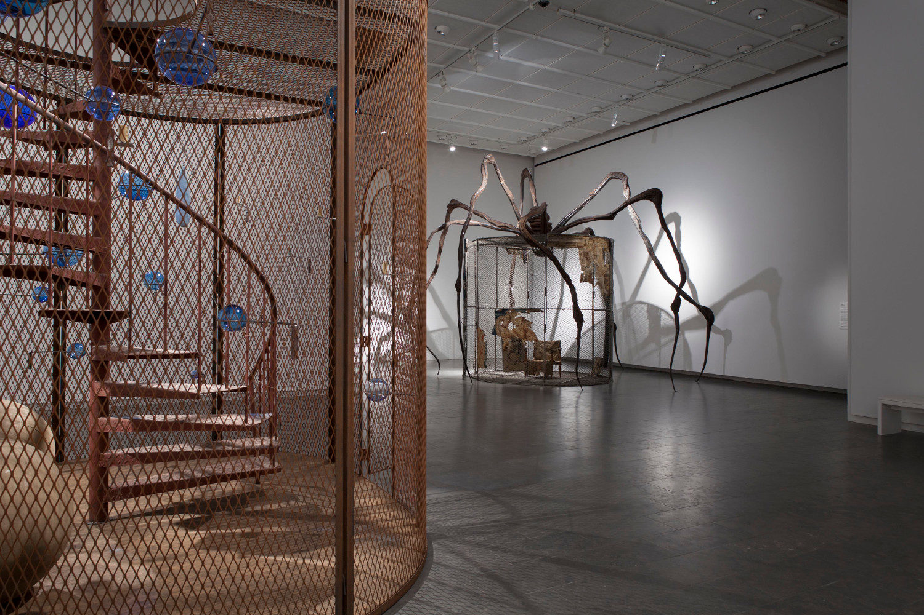
Week 1 Outline
This week you will gather research to create a visual diary/mindmap of Structures.
You will practise recording your ideas creatively with a camera. This is an important skills to develop for your future A Level projects.
You will begin collecting ideas through drawing in a range of materials. Considering space in and around the subject and a range of mark making techniques.
Please don’t worry if you have to swap materials around depending on what you have available at home. The most important thing is to keep up your drawing skills by practising. ☺

Slide 5
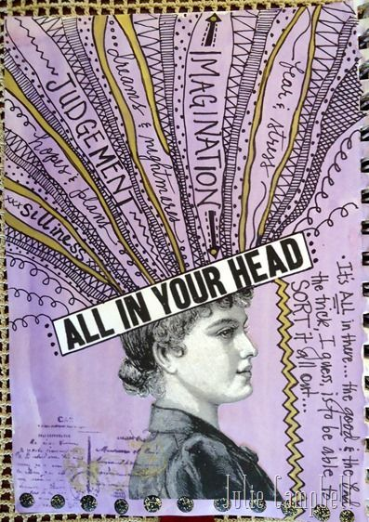
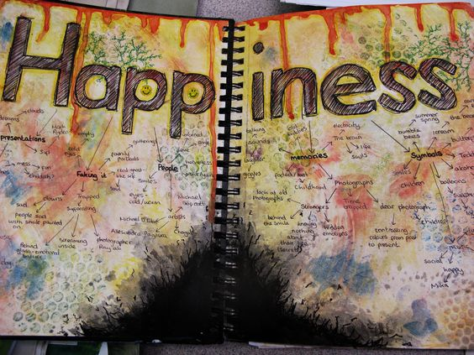
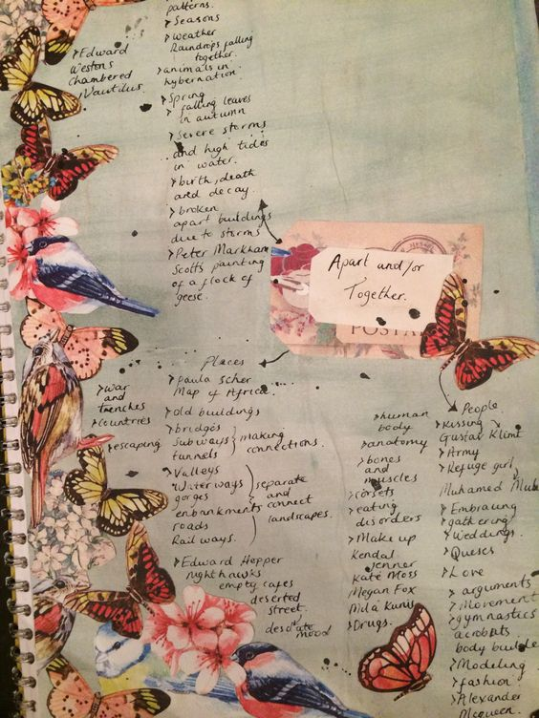
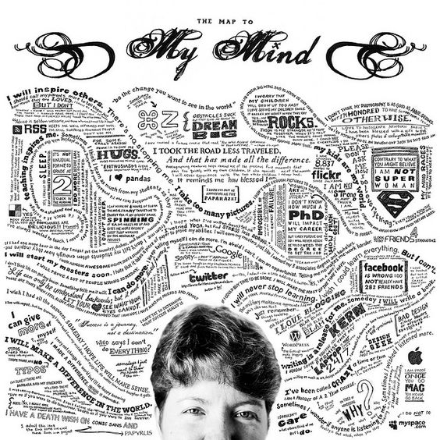
Task 1 Creative Mind Mapping (approx. 2 hours)
Collect and presenting initial ideas for the theme, Structures (Urban, Natural)
Include words/thoughts/brief sketches around the theme.
Think carefully about how you present your collection of research.
Concentrate on visual images with a few notes to illustrate your ideas.
There are examples of creative mind maps on the next slides.

Slide 6
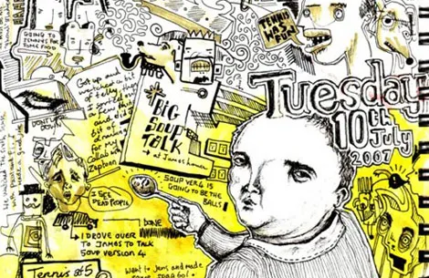
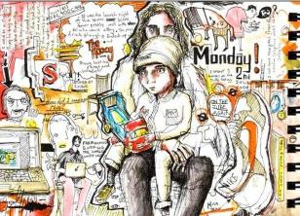
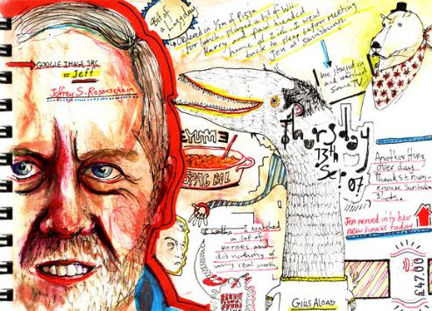

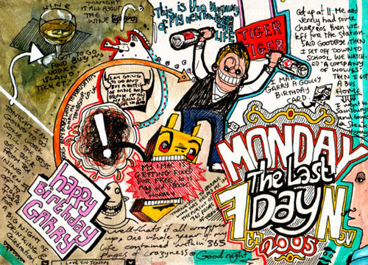
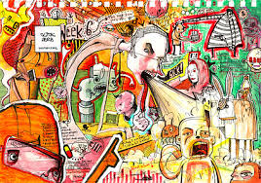
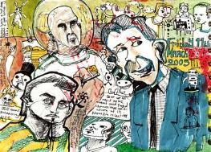
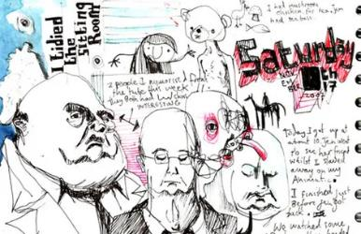
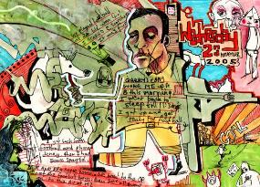
Royal College of Art student Tom Judd has finished the mammoth challenge of drawing everyday for a year in what looks like the same sketchbook. Even more remarkably this isn’t the first time Tom has completed the task having decided to maintain this year-on year-off schedule throughout his entire life.
TOM
JUDD

Slide 7
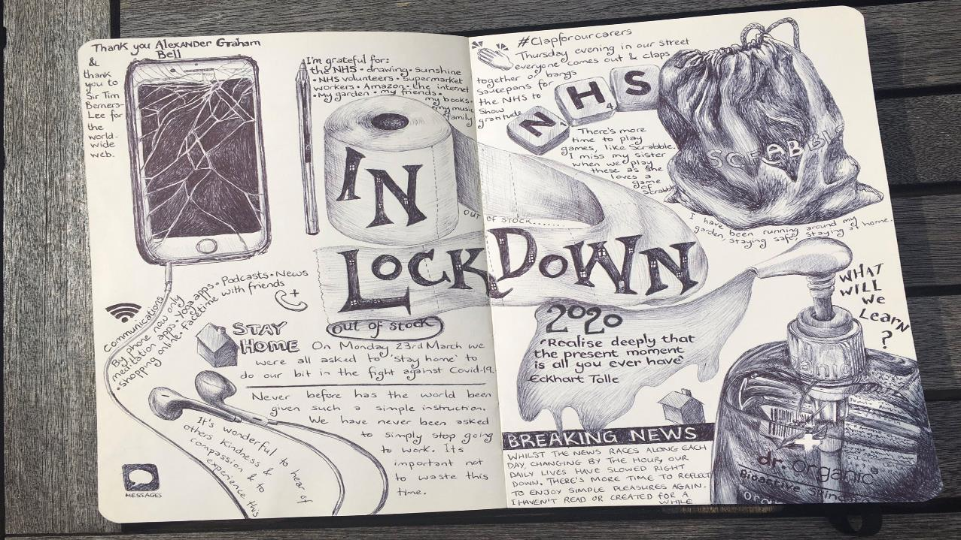
How cool is this example?!
And it’s all done using ONLY a Biro pen…

Slide 8

Don’t worry if you have not completed your creative mind map, you can continue to add ideas and images as your project moves on.

Slide 9
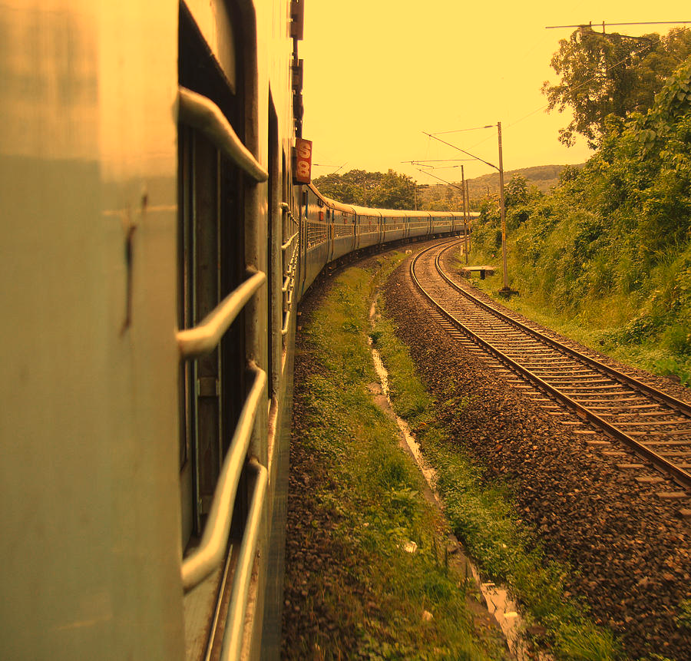
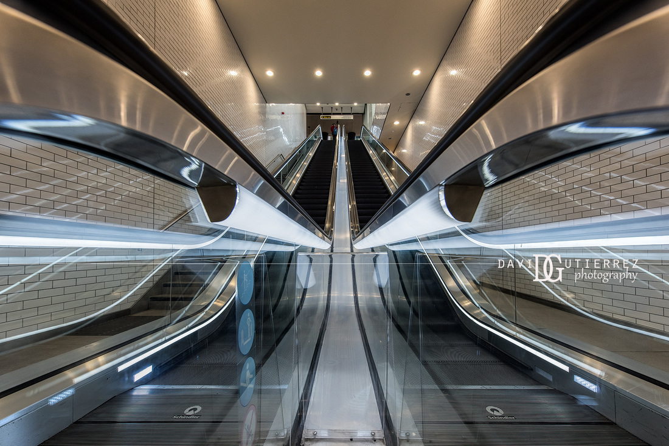
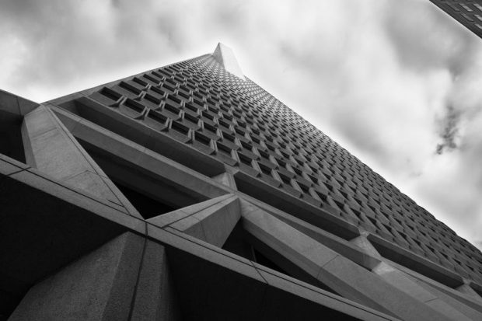
Task 2 Photoshoot (Approx 1 hour)
Task: Once you have collected your research, you will now start to create your own images through photography.
Use your photo/tablet/camera to take a series of 15 photographs to go with the theme Structures.
Take your series of photographs. Where will you go? This could simply be a journey on the bus! You don’t need to go too far.
The most successful A Level projects start with a strong set of photographs to illustrate your initial ideas. At A Level it is more important to personalise your work early on, rather than relying on found images for too long.
IMPORTANT: Your first theme in Year 12 will be Structures (Natural & Urban so make sure you take some photographs for this theme too)
Aim to be imaginative with the way you set up your photographs. The sample images and suggestions on the next slides should help you.

Slide 10
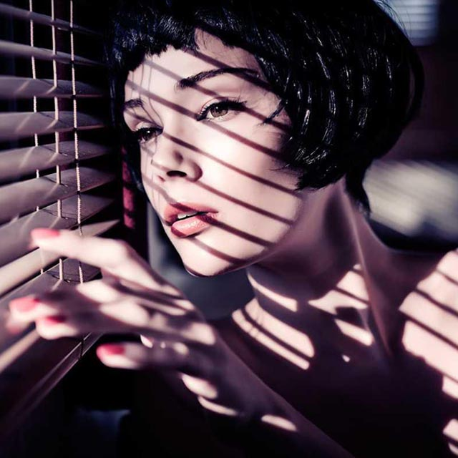
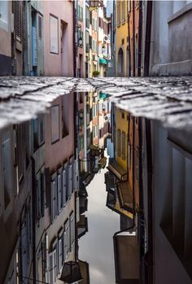

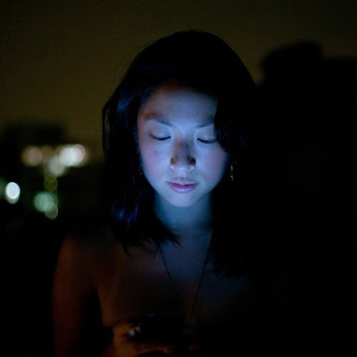
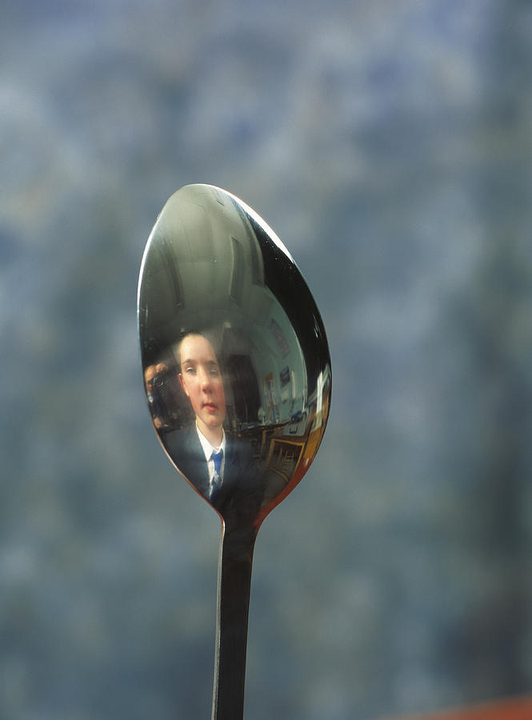
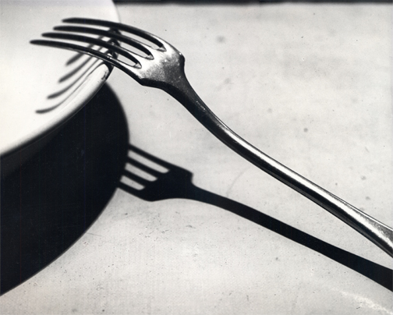
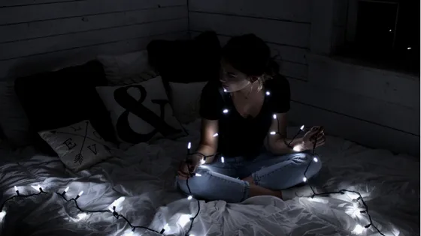
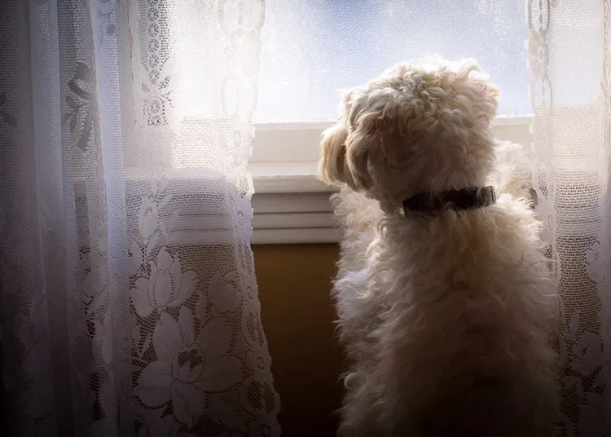
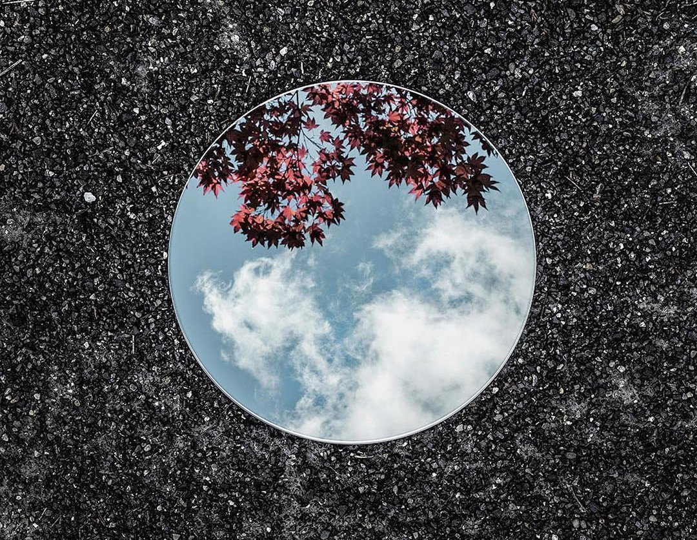
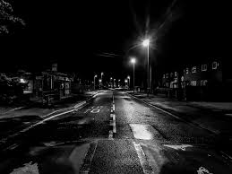
Experiment with lighting.
Could you use natural light, torches, candles, fairy lights, lamps, street light, light from a phone or laptop screen, window light? What time of day will you take your photographs?
Dramatic Shadows & Reflective objects can add depth to your photographs and change the mood of your work.

Slide 11
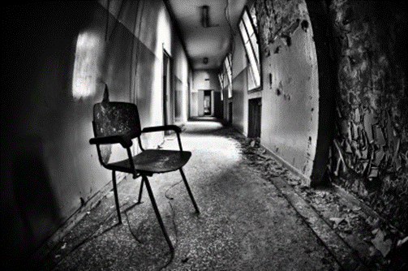
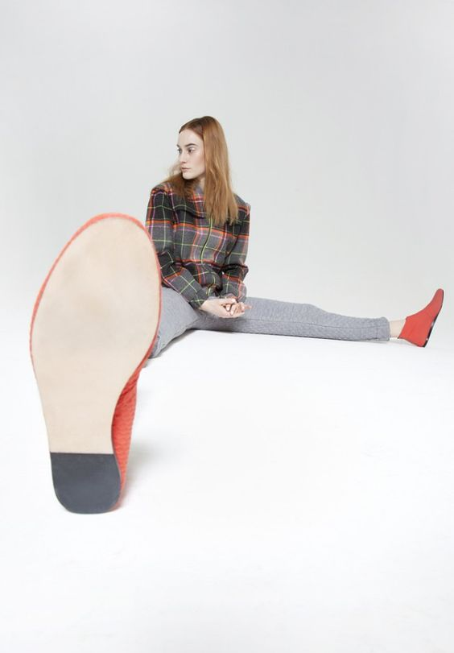
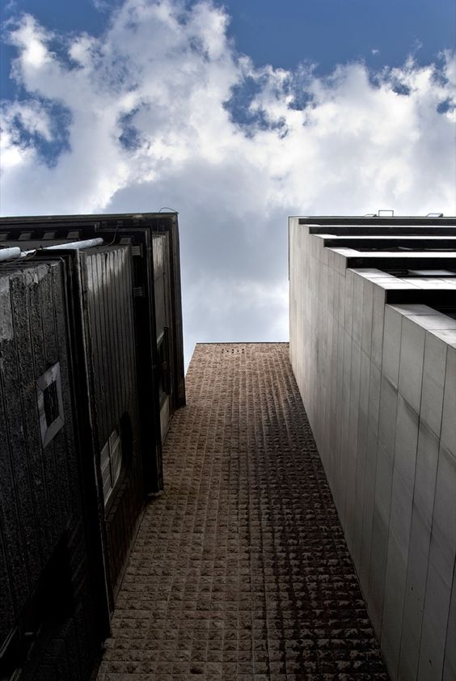
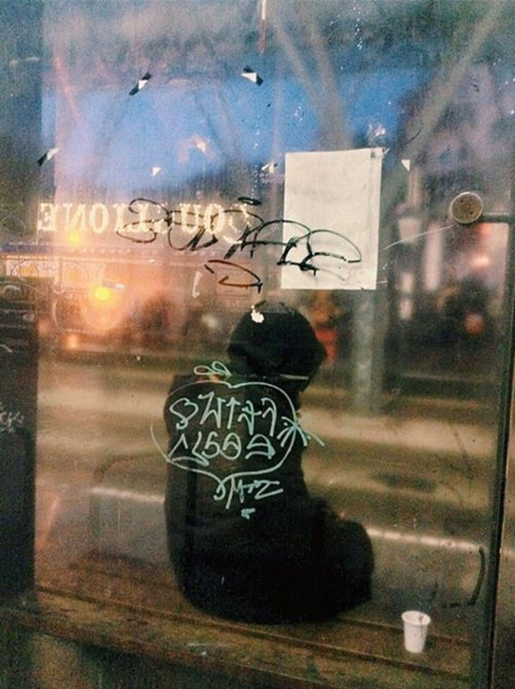
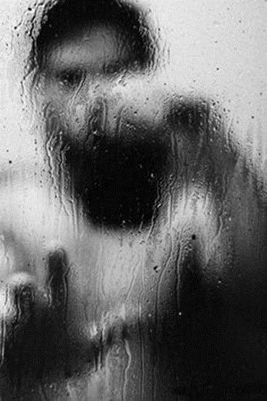
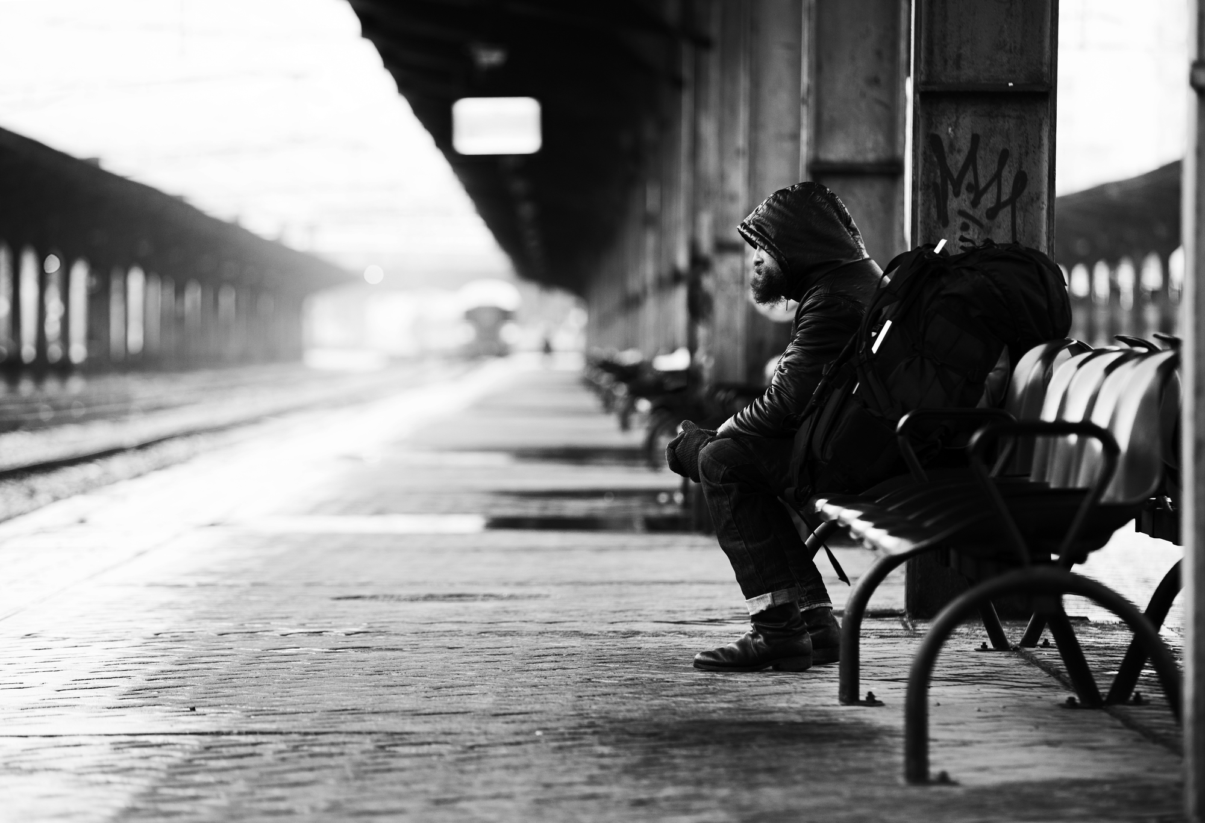
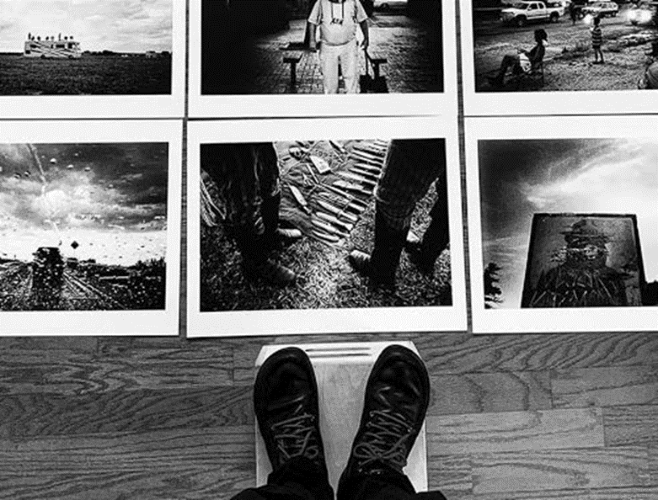
Changing the viewpoint from where you take your image. Get down on the floor or higher than your subject. This will help you capture exciting unusual angles in your work.
Change the angle that you shoot from
Lie down on the floor
Shoot under or below things
Birds eye view
Zoom right in on something
Take a photograph from a reflection

Slide 12

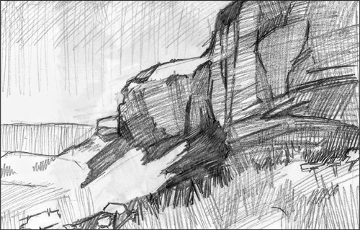
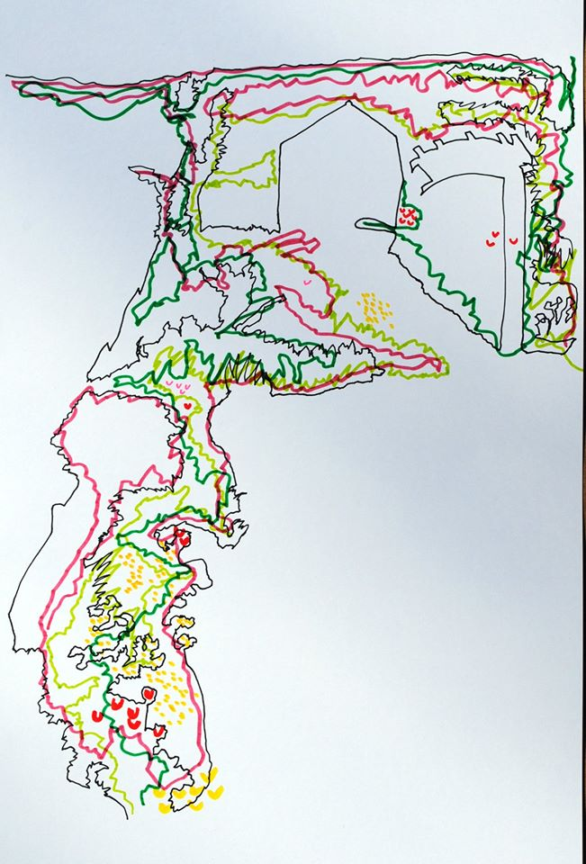
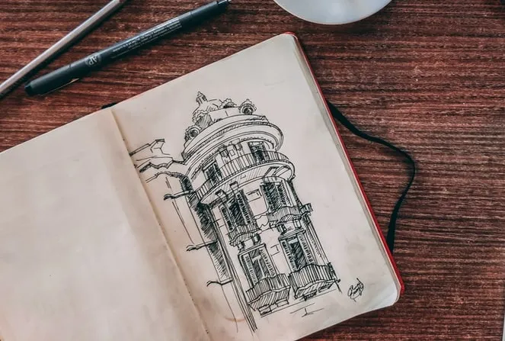
TASK 3: DRAWING FROM LIFE
TAKE YOUR SKETCHBOOK OUT WITH YOU. Create lively Sketches and drawings, but instead of working from images work from things that are in front you, draw from life. E.g. A drawing in your garden; a drawing on the bus; a fantastic view, buildings, architecture. (approx. 2 hours)
Consider the following:
Experimenting with the way you use LINE in your drawings (looser lines/tight lines/heavy/light)
Building up layers of pencil and pen.
You can add washes of watercolour/coffee/watered down acrylic to add a suitable background to your drawings if you have them available.
Don’t be too precious about your drawings. Drawing from life has to be quicker to capture what’s in front of you. It’s a tricky skill to practise, but does make you more confident and observant in the long run!

