Slide 1
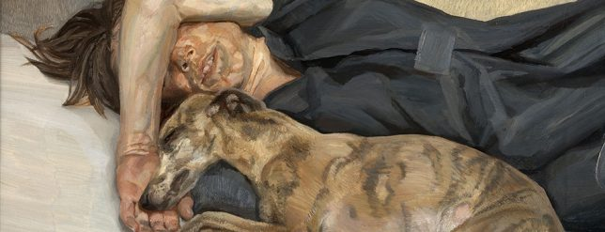
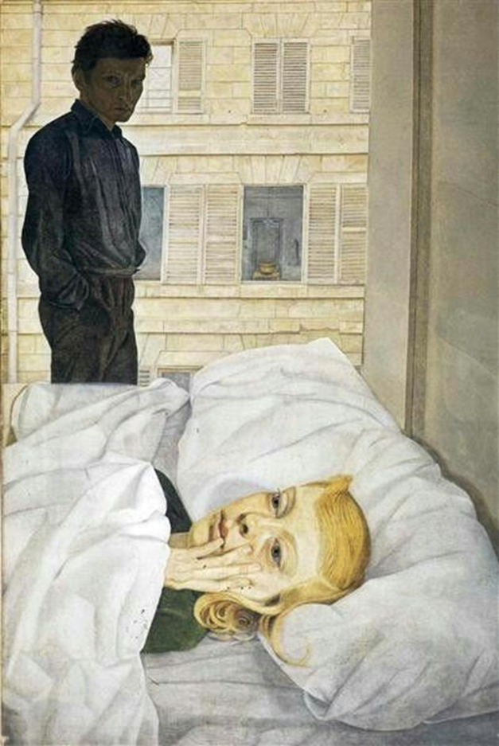
Recap
What decisions has Lucien Freud made about his compositions?
And what messages do they portray to the viewer?

Slide 2

Recap
Hotel Bedroom, 1954, shows Lucien Freud with Caroline Blackwood, the newly-weds not enjoying their poky, shared accommodation in the Hotel La Louisiane, rue de Seine, she shivering in bed, he standing over her, his darkening presence transposed from the image he studied in the bevelled mirror on an unseen wardrobe door. Caroline complained about being made to look older than she was, but the bitten nails and the little finger lodged on her lower lip are telling. The marriage was soon over.
The angle Freud has painted from makes the viewer feel like they are in the room standing over the models.
The natural light from the window creates highlight.
You get the impression the subjects are a little fed up!

Slide 3
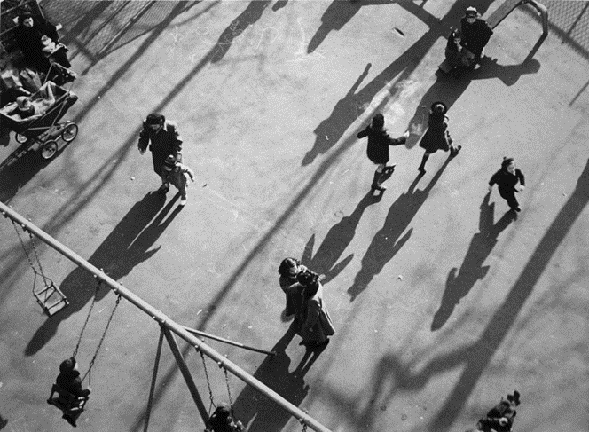
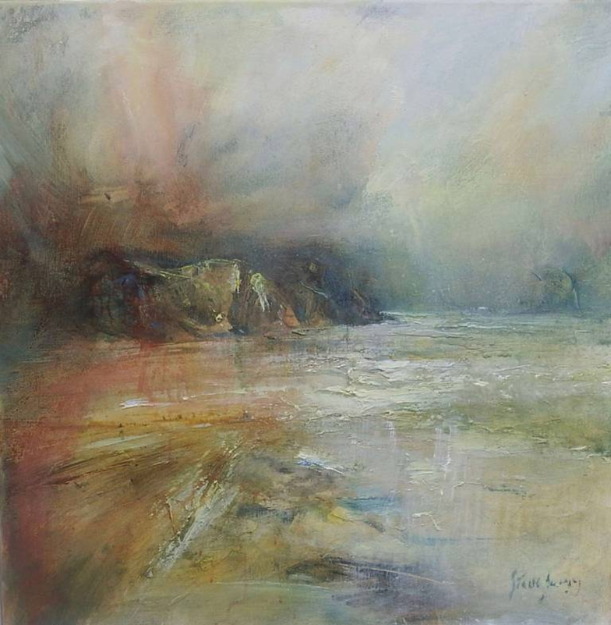
Week 3 FINE ART Outline
This week you will analyse the work of artists/photographers and craftspeople who are responding to a similar theme . You will make a personal response to your chosen artist’s work and create a series of drawings/paintings in response to the artworks.

Slide 4
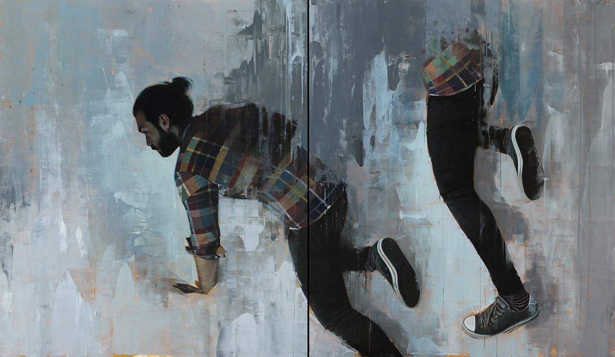
What is Fine Art?
https://www.youtube.com/watch?v=sIsN9_TsQgI
It is so much bigger than we think!

Slide 5
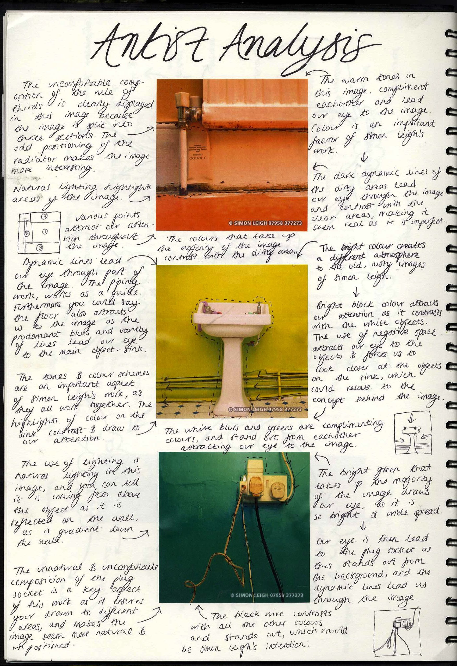
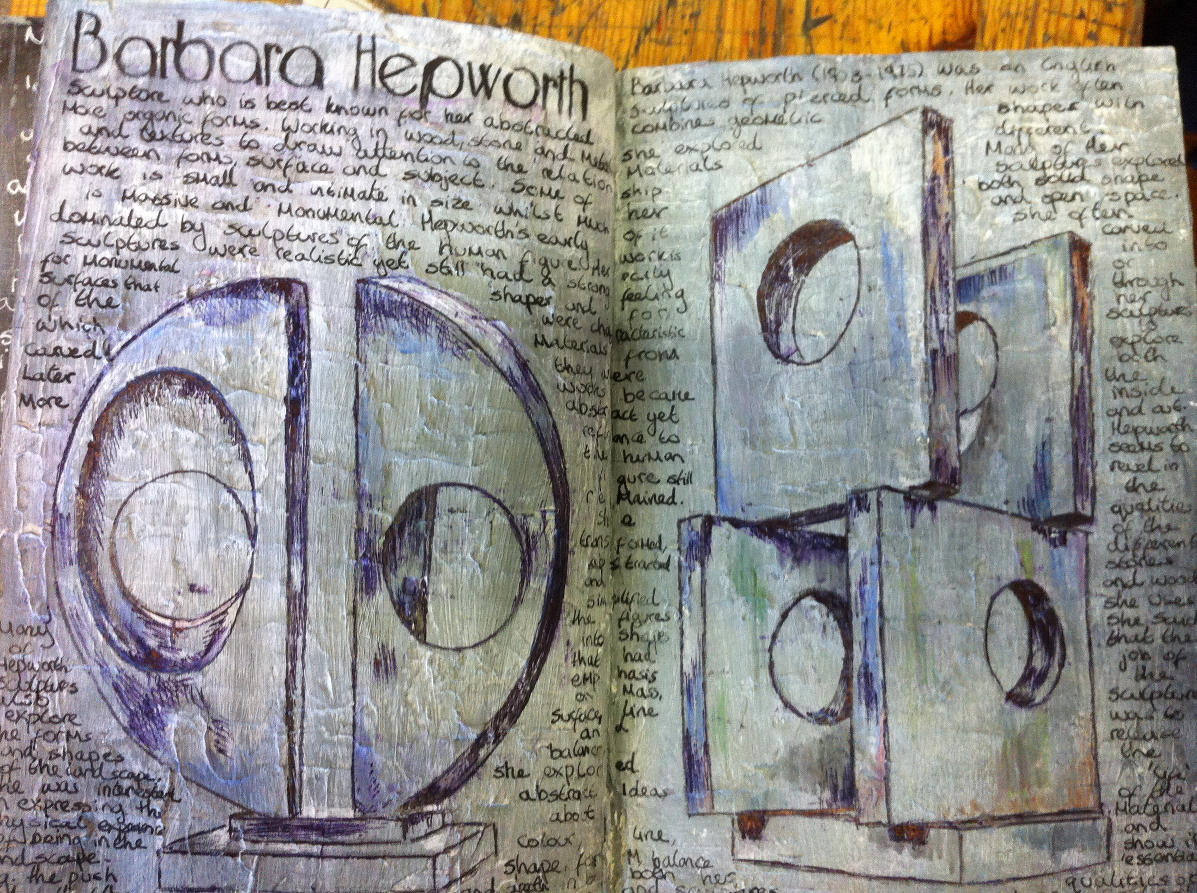
Task 1
Select one of the artists from the following slides or find your own who respond to the theme STRUCTURES
Carry out extra reading about your chosen artists. Finding interviews with your chosen artist is always useful to have.

Slide 6
WRITING ABOUT ARTISTS
Who is the artist?
Where are they from?
When were they making their artwork?
Are they a contemporary artist?
Are the associated with any particular art movement?
Are they linked with other artist?
Why are you looking at this artist? Why does this interest you? What do you think?
How do they relate to your theme?
How do they relate to your work?
What materials, techniques/ processes do they use?
How do they use them?
Remember always to include the name of the artwork, the date it was made and the materials used.
Lines, tones, textures, colours, shapes, marks, composition, quality of light, viewpoint, composition, scale, proportion, movement.
Meaning & Mood
Message What do you think the work is about? How does it make you feel? What is the mood? Calm, sad, happy, confused? Does the work mean many things to you? What are they? What does the work remind you of? Does it link with other images, objects you have seen? What is the artist trying to say through their work? Is there a message?

Slide 7
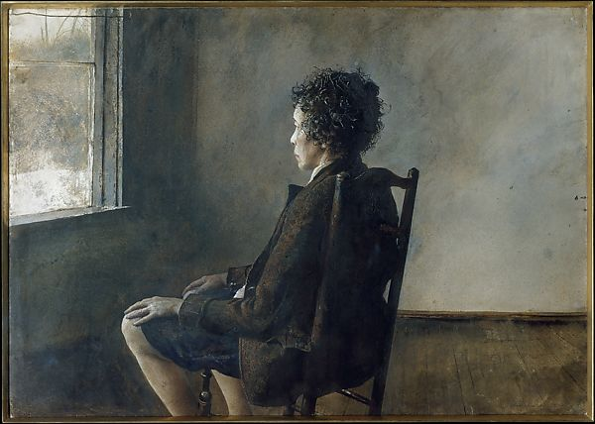
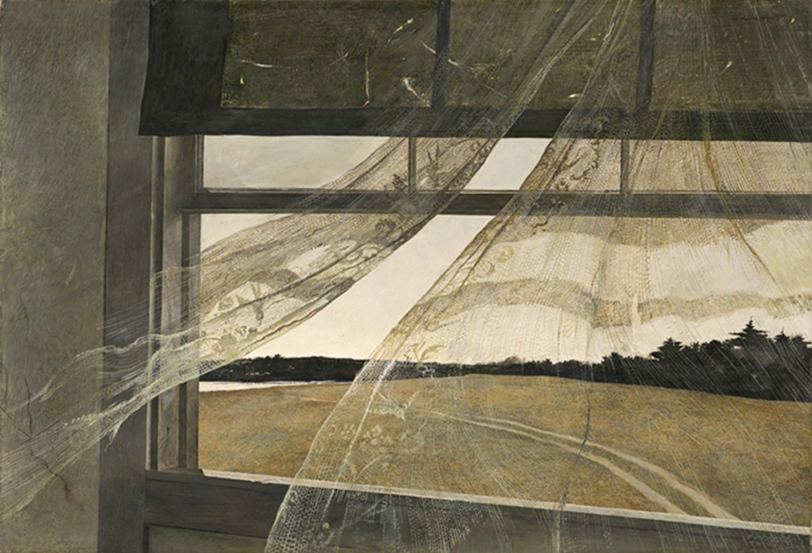
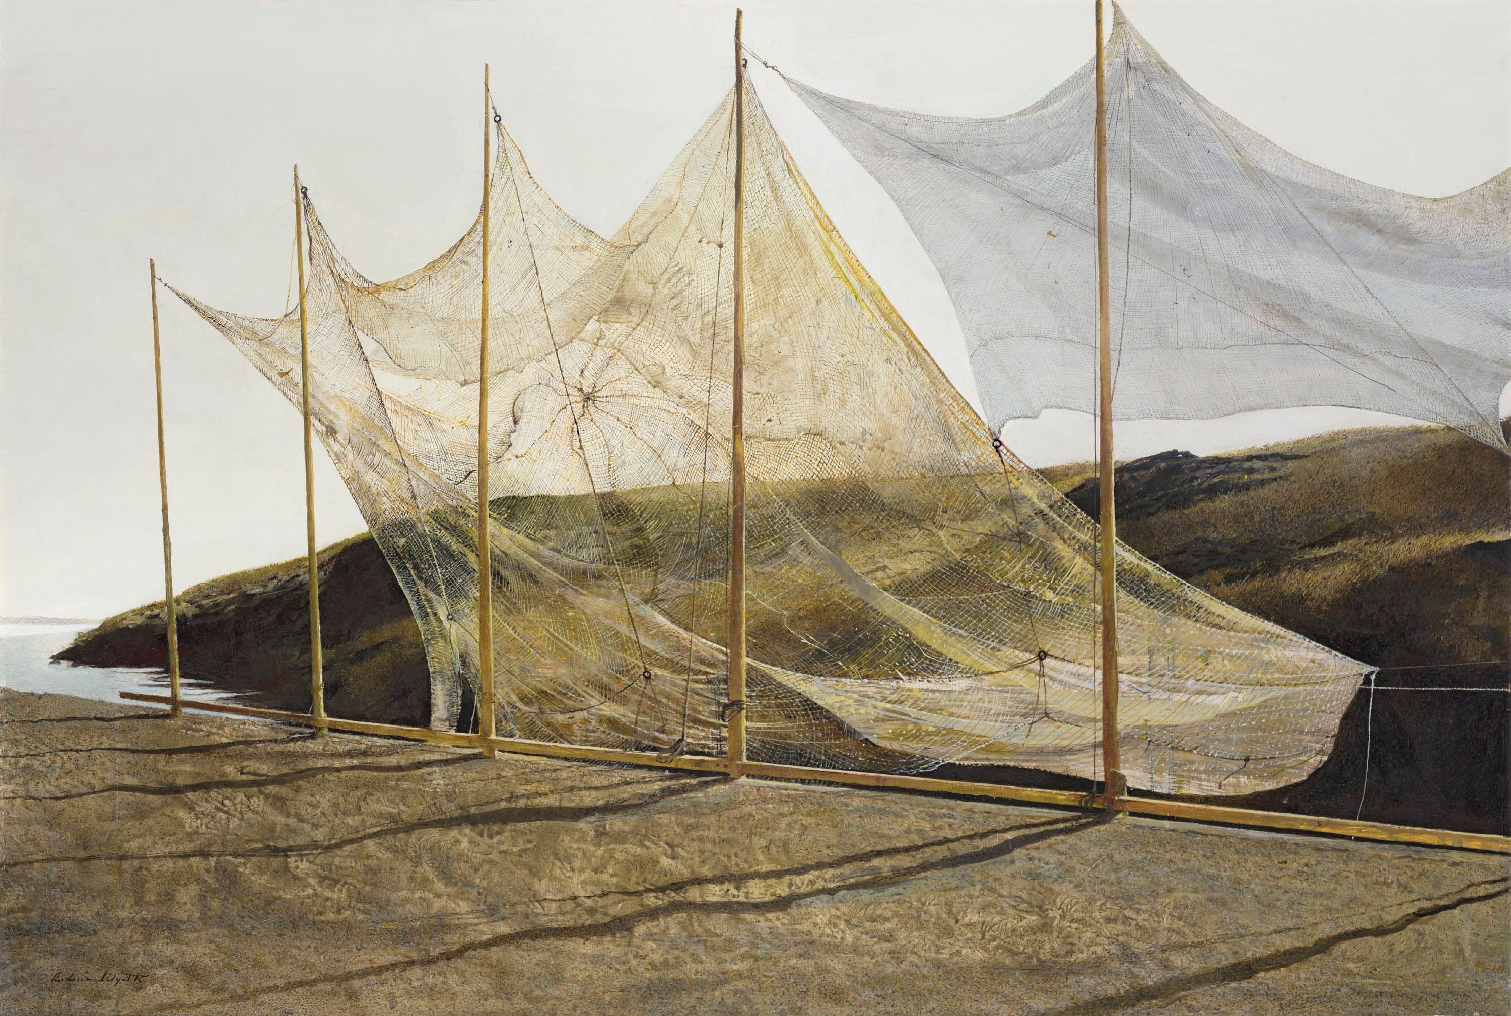
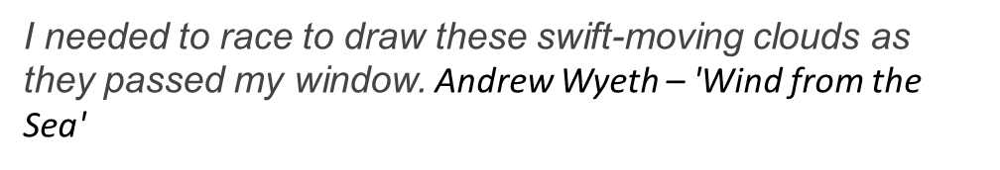

Slide 8
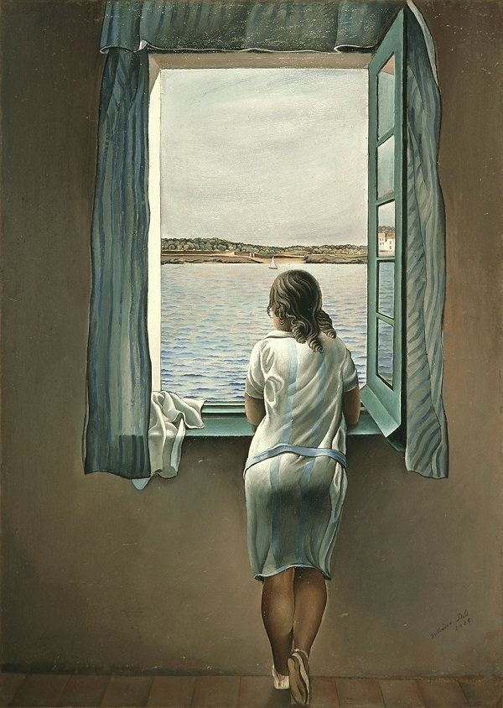
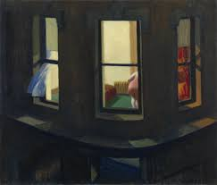
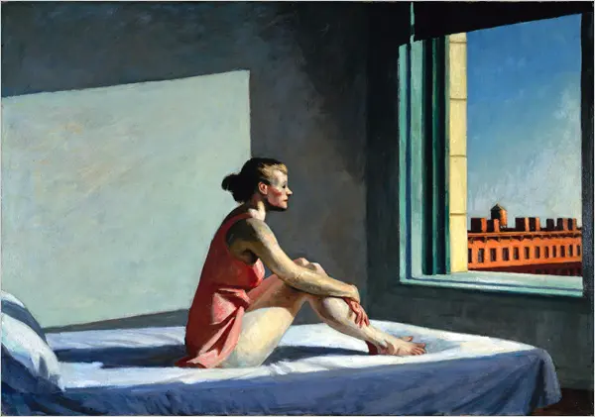
Artists Using Windows
Edward Hopper
1928
Night Windows
Classic Salvador Dali – Figure at the Window

Slide 9

Steve Slimm is from The Black Country in West Midlands. He later lived in the Cotswolds and attended Cheltenham Grammar School. Moving to Cornwall, in 1970, he joined an art group under John Miller for a brief period. Painting began to feature as a main interest in his life, with periodic encouragement from John through the next two decades.
Steve has been producing and exhibiting paintings in Cornwall since 1979 and has developed his art along very personal lines that both absorb and transcend tradition. He has become recognised as a noteworthy Cornish landscape painter, especially for his use of light. For this reason he was featured in the national UK art a-level syllabus for 2009-2010.
Turner was an obvious influence during the early years. Many atmospheric watercolours found their way into collections worldwide. The Landscape of Cornwall remains the prime inspiration for his work which is now far from realism, with an emotional intensity that is self-evident. He now works mainly in mixed media - emulsions, acrylic and oils.

Slide 10
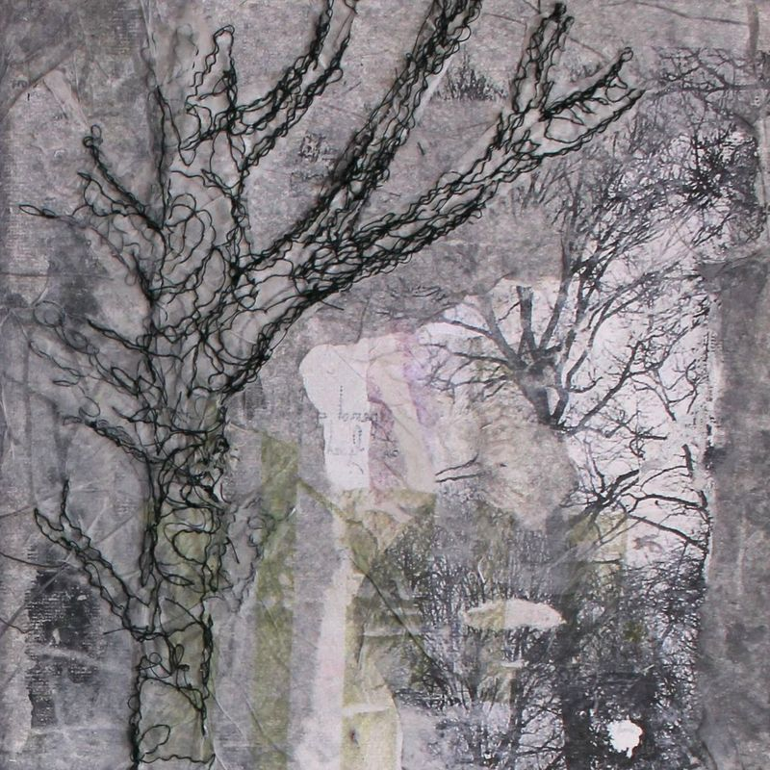
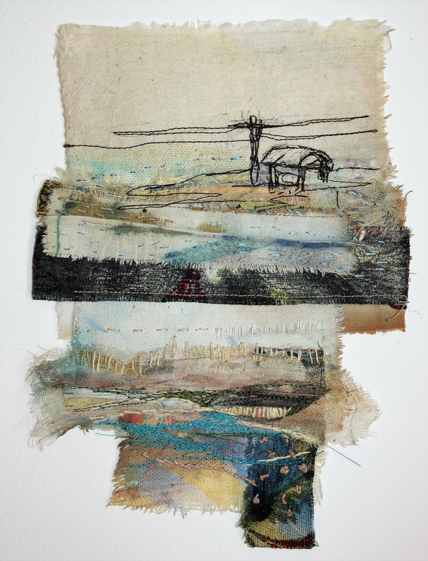
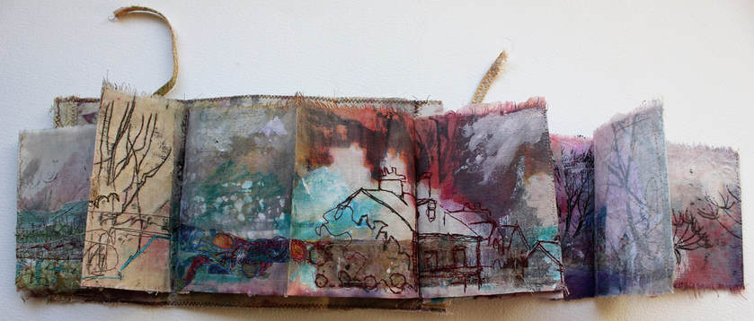
Cas Holmes
I trained in fine arts and work between the disciplines of painting, drawing and textiles. Salvaged materials are torn, cut and re-assembled to create mixed media pieces which draw their inspiration from 'hidden' or 'overlooked' observations of daily life.
I like to use the 'remnants' of domestic life, rags and cloths, pieces of old clothing which are handled and worn, evidencing 'human contact.'
I make reference to the views from our windows, the weeds and flora on the verges of our roadsides, and field edges, and the places where our gardens meet the 'greater landscape.
www.casholmestextiles.co.uk

Slide 11
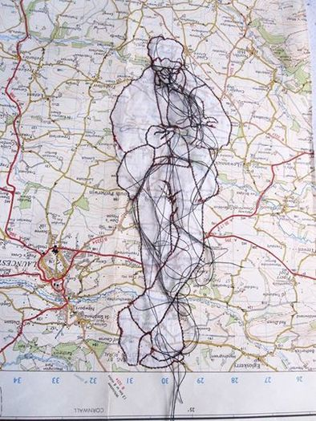
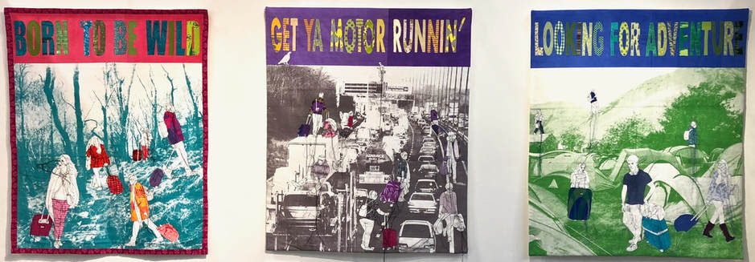
Rosie James
My work involves using the sewing machine as a drawing tool. As I stitch I leave threads loose to create a scribbly style of drawing. I also use hand stitched elements to piece together the images and to create a grid surrounding the figures.
Drawing and mark making is developed from photographs taken of groups of people out and about. The camera can still the movement and allow a more detailed look at the individual.
Stitch is used as the medium with which to explore these images because it has a connection to craft and the hand made. It gives the work a texture and movement, which is very different to anything you can get with a pencil. The marks created by the thread have a soft slightly fluffy texture, which can only be created by thread on cloth. The loose threads create links between the figures and bring a kind of movement to the work.
Stitches created by the machine create a never ceasing line and it is this line which interests me. When forced to stop, loops and loose ends are left. My current explorations involve the consideration of the separation of this line from its surface. So far this has lead to large-scale figurative drawings on transparent cloth, in which the stitched line seems to float above us.

Slide 12
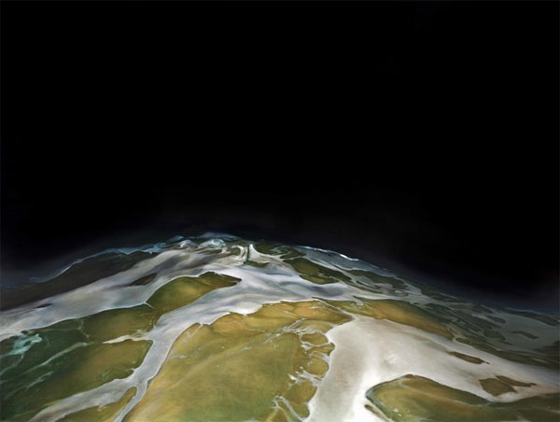
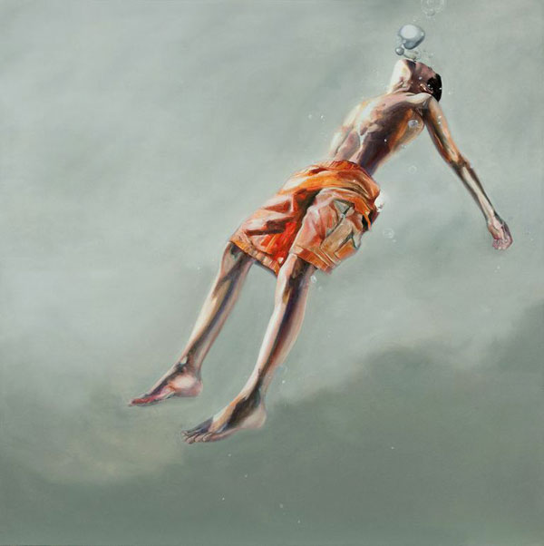
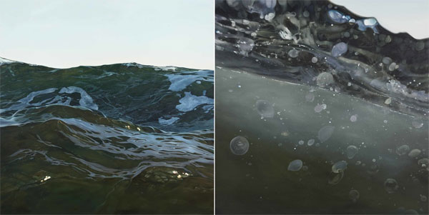
Charles Williams often depicts unique moments in nature like the liquid fluidity and raw power of water. A selection of his paintings can be seen in his current show “Swim: An Artist’s Journey” from January 15 – April 23, 2015 at Franklin G. Burroughs-Simeon B. Chapin Art Museum in Myrtle Beach, South Carolina.
Oil on canvas

Slide 13
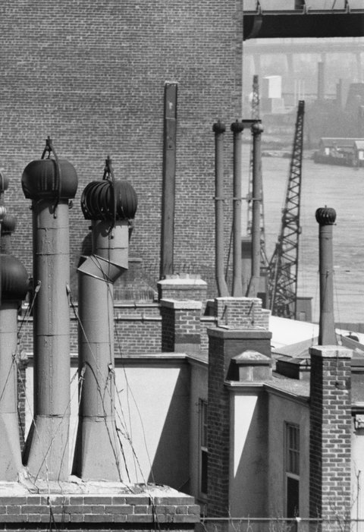

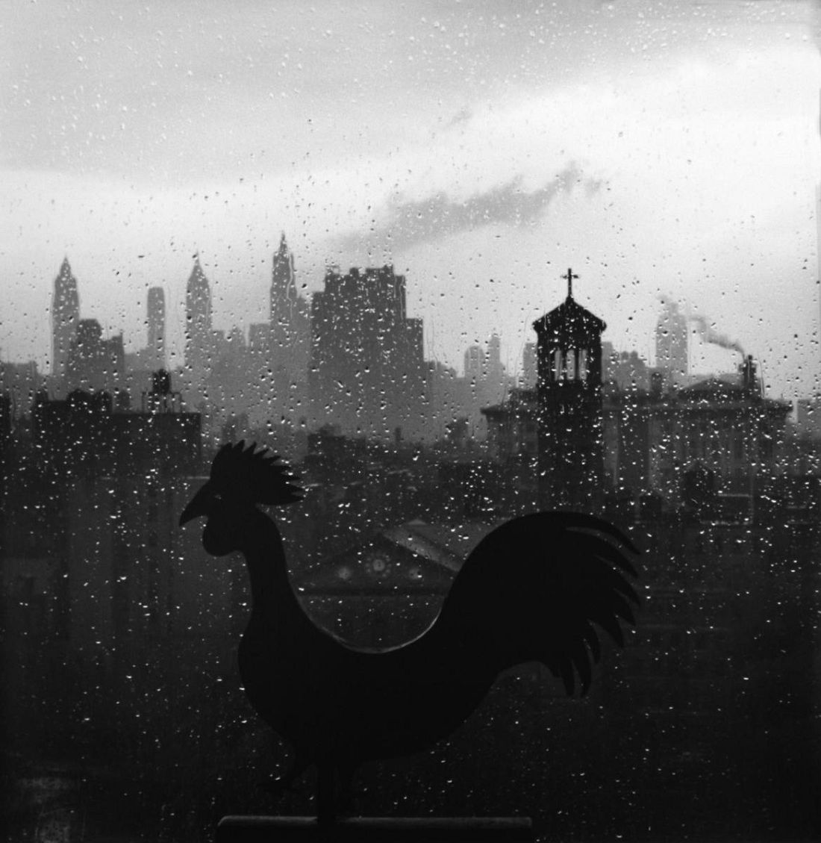
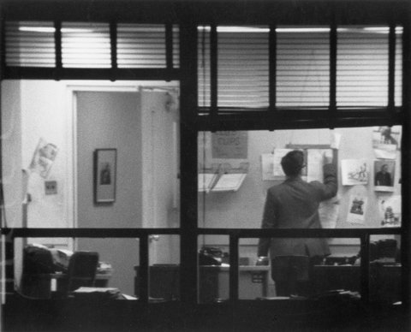
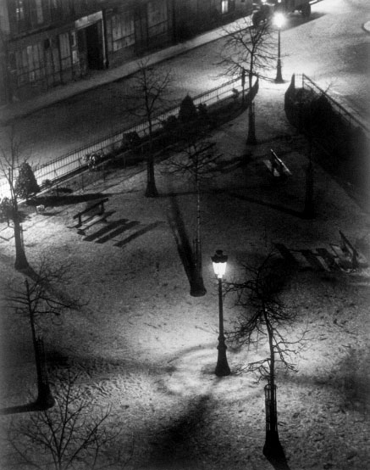
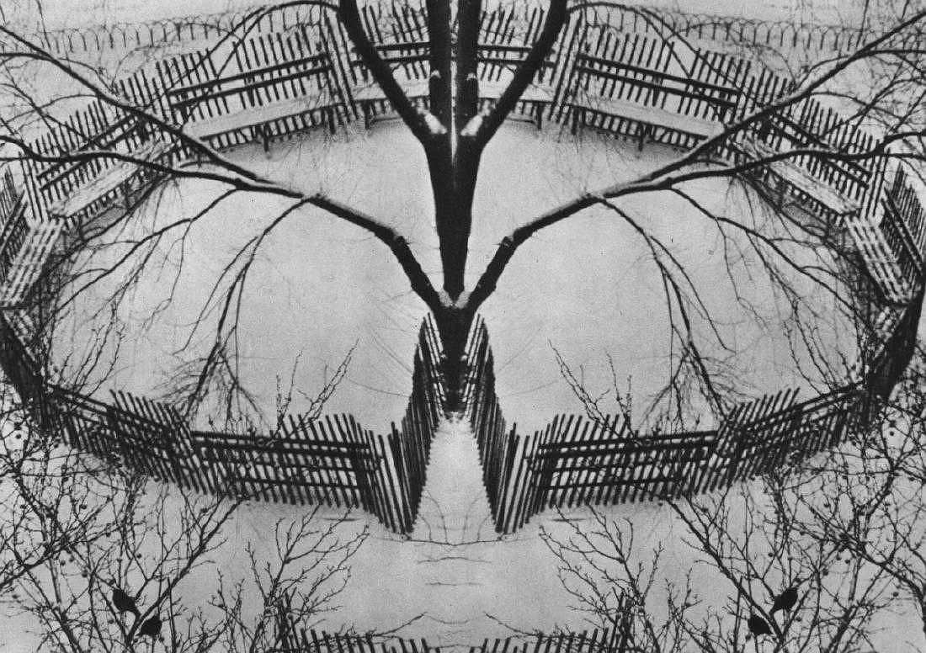
MASTERS OF PHOTOGRAPHY
Andre Kertesz BBC Master Photographers (1983)
Capturing the world around him, often photographing subjects from his window or front door.
The camera was a sketchbook to him. Shooting with the camera and making mistakes. Learning from each mistake.
André Kertész: Window Views

Slide 14
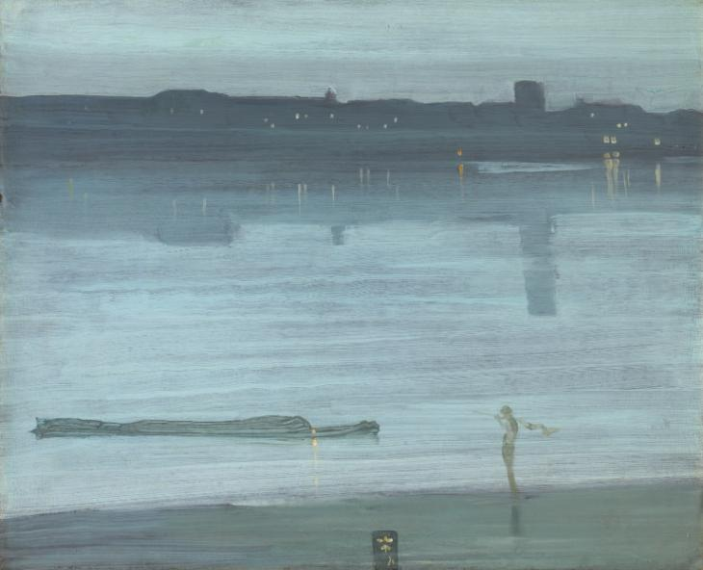
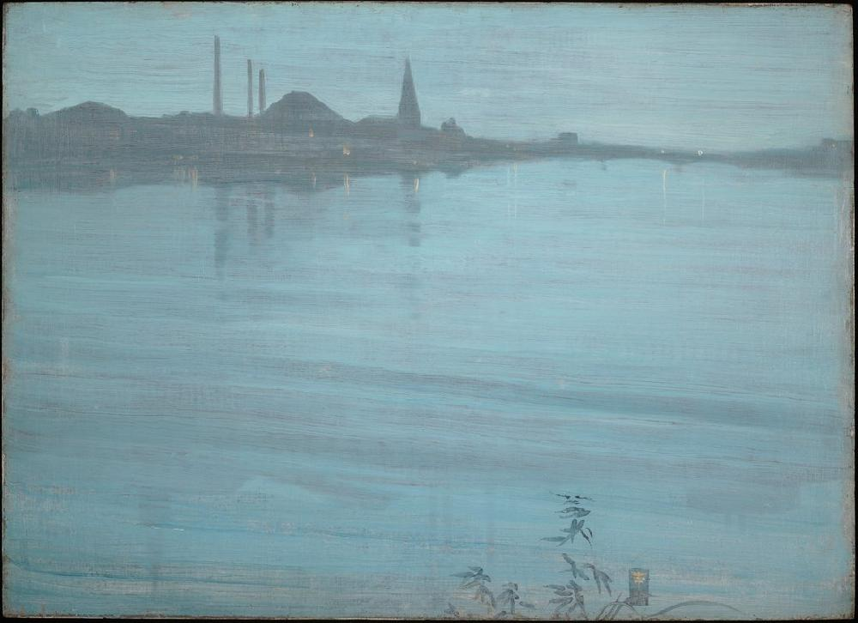
James Abbott McNeill Whistler (; July 11, 1834 – July 17, 1903) was an American artist active during the American Gilded Age and based primarily in the United Kingdom. He eschewed sentimentality and moral allusion in painting and was a leading proponent of the credo "art for art's sake". His signature for his paintings took the shape of a stylized butterfly possessing a long stinger for a tail. The symbol combined both aspects of his personality: his art is marked by a subtle delicacy, while his public persona was combative. He found a parallel between painting and music, and entitled many of his paintings "arrangements", "harmonies", and "nocturnes", emphasizing the primacy of tonal harmony. His most famous painting, Arrangement in Grey and Black No. 1 (1871), commonly known as Whistler's Mother, is a revered and often parodied portrait of motherhood. Whistler influenced the art world and the broader culture of his time with his theories and his friendships with other leading artists and writers.

Slide 15
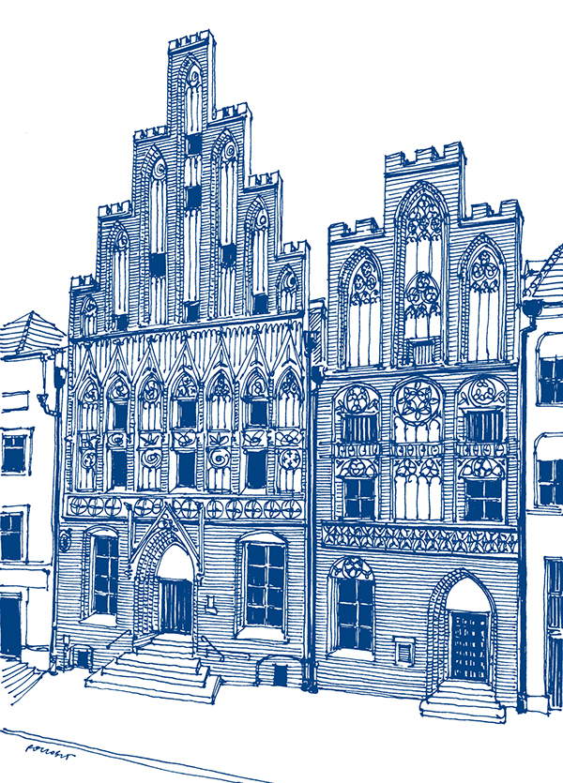
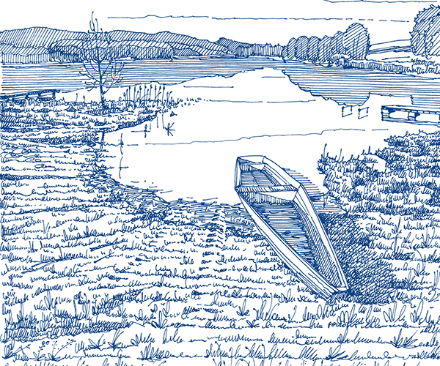
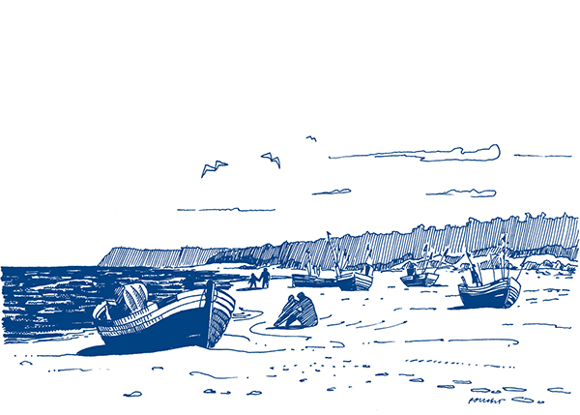
Polskie Regiony

Slide 16
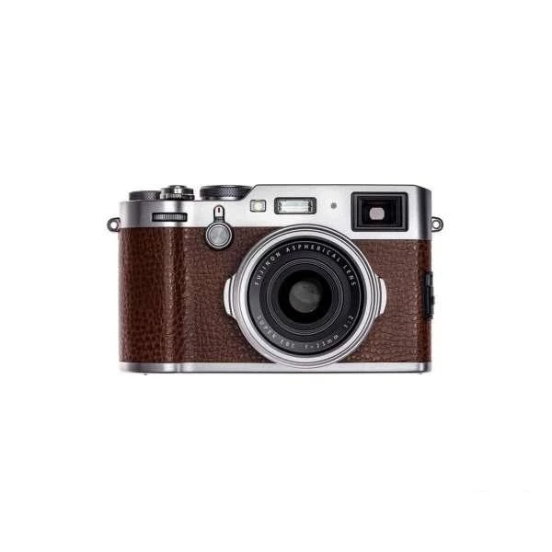
Task 2
Photography Response
Take a selection of photographs in the style of your artist. You will use this set of photographs to create a series of paintings/drawings.
Remember, everything you know about photography from week 1.

Slide 17
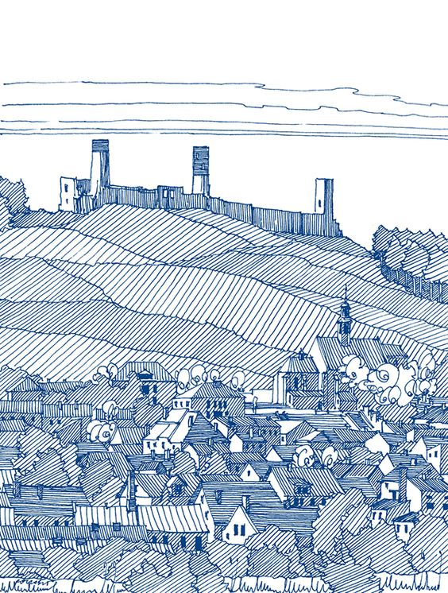
Task 3
TOP TIP
The studies could be sketches/paintings/drawings. If possible use similar materials to your chosen artists.
You should use your photographs from Task 2 to carry out this task.
Visual Response
It is important to push your own ideas further, rather than making copies of an artwork. Create a SERIES of studies responding to the artist’s work as well as your own.
Aim for 3-4 high quality pieces to make your series. They could be created outside of your sketchbook/notebook if you want to change the scale.

