Slide 1

FAMILY
Thoughts and Prayers
Monday 10th June – Friday 14th June

Slide 2


MORNING PRAYER IN THE CHAPEL THIS WEEK
Monday 10th June - 8S
Tuesday 11th June - 8A
Wednesday 12th June - 8I
Friday 14th June - 8N

Slide 3

Friday Mass
Who?
Mass this week will be led by 7S
When?
Friday Morning at 8.20am
Where?
In the School Chapel. See you there!
ALL ARE MOST WELCOME.
ALL WORDS ARE DISPLAYED ON THE SCREEN.

Slide 4
Lunchtime events: All are welcome..
Crafts and Mindfulness
(Mondays in the chapel)
Islamic Union
(Tuesday G15)
Christian Union
(Tuesdays in G16)

Slide 5
FAMILY
Thoughts and Prayers
Monday 10th June – Friday 14th June

Slide 6

Is there such a thing as a perfect family?
For some of us, a secure, happy, home life may be what we are privileged to enjoy. That is wonderful and perhaps we need to remind ourselves how fortunate we are!
But sadly, the reality is often very different. Some of us have to live with the realities of sibling rivalry, marriage break-up and unrealistic parental expectations. Some of us have to live with the consequences of illness, emotional stress and financial concerns. Some of us do not live with our birth families.
All of our experiences of family life are important and valid. They shape us and form us.

Slide 7
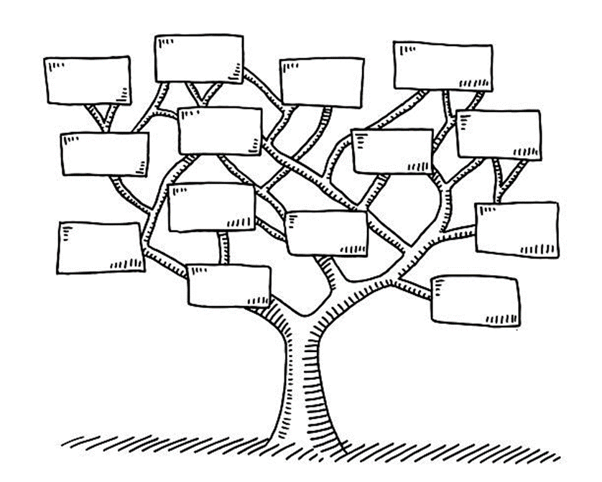
Family Tree
Draw a simple outline of a tree and write down every name that you consider to be family. This could be people that are unrelated to you.
As you write each name, pray for them

Slide 8
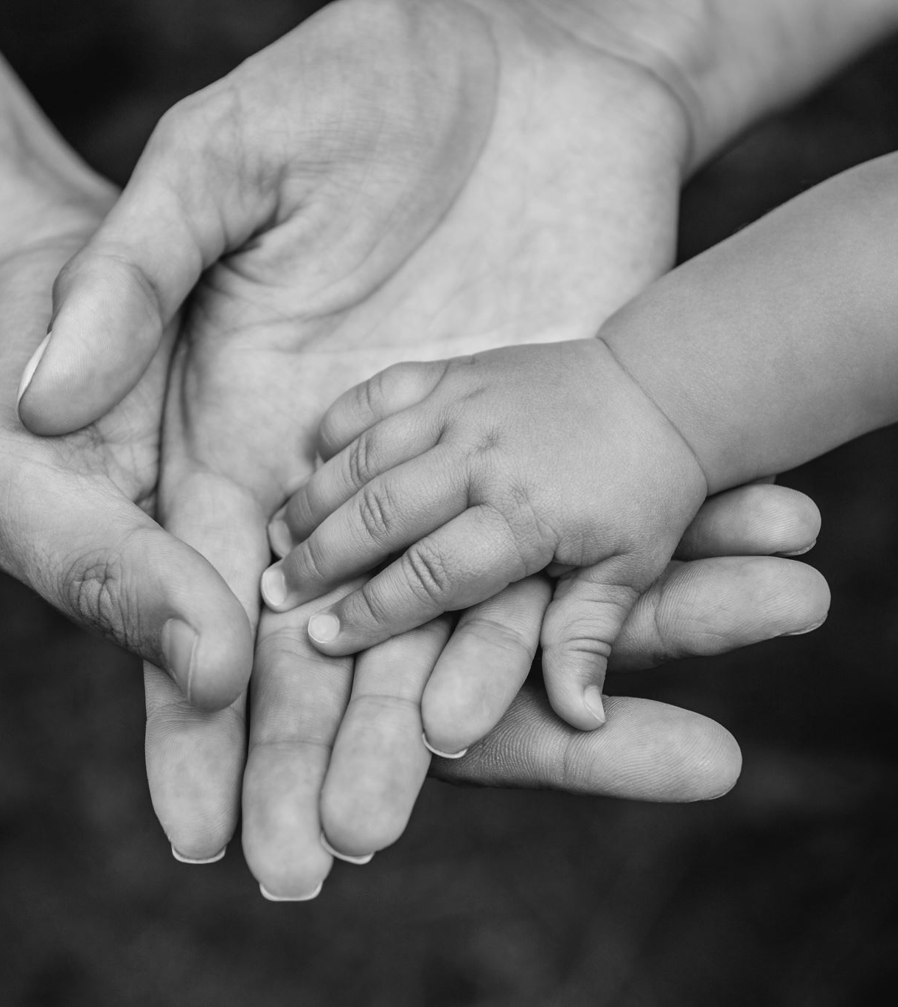
Let Us Pray
Dear God,
We ask for Your blessings upon all families, in every form they take.
For traditional families, may they be bound by love and understanding.
For single-parent families, grant strength and resilience.
For blended families, foster unity and harmony.
For extended families, ensure connection and support.
For chosen families, bless them with acceptance and unwavering support.
May every family feel Your presence, find joy in togetherness, and grow in love.
Amen.

Slide 9
FAMILY
Thoughts and Prayers
Monday 10th June – Friday 14th June

Slide 10
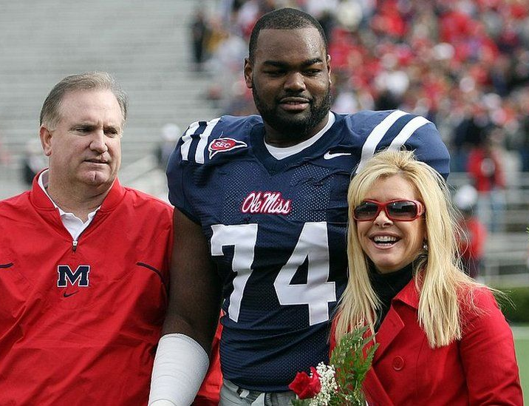
Michael Oher
Michael Oher is a former American football offensive tackle who played in the National Football League (NFL). His life story was popularized by the 2009 movie "The Blind Side," which is based on the 2006 book "The Blind Side: Evolution of a Game" by Michael Lewis.

Slide 11
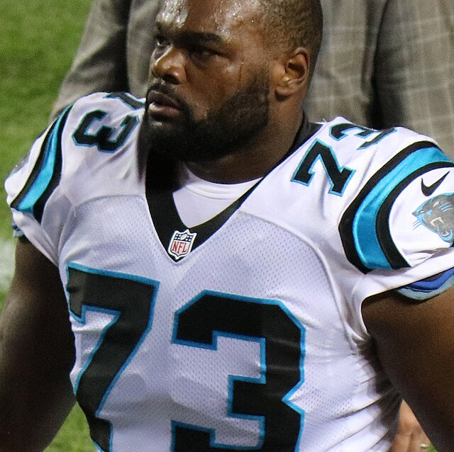
Michael's Story
Michael Oher was born on May 28, 1986, in Memphis, Tennessee. He faced numerous challenges in his early life. His mother struggled with addiction, and his father was frequently in prison. As a result, he spent much of his childhood in and out of foster care and was often homeless.​
Michael Oher's life took a significant turn when he was taken in by Leigh Anne and Sean Tuohy. The Tuohy family eventually adopted him, providing him with the stability and support he needed to succeed. They helped him with his education and provided a nurturing environment that allowed him to excel in football.

Slide 12
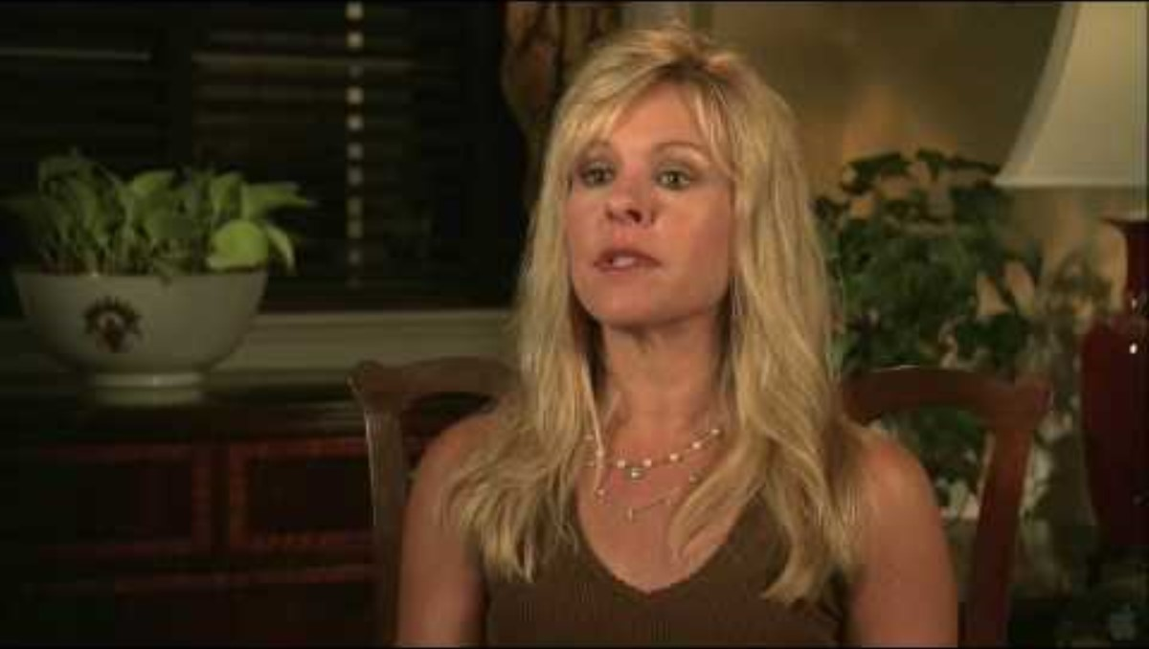

Slide 13

Time To Reflect
How important is it to have a support system in your life? Can you give an example of a time when a support system helped you?
In what ways did the Tuohy family provide support to Michael Oher? How did this support help him succeed?
  What does it mean to accept someone unconditionally? How important is this in a family setting?
  How did the Tuohy family's unconditional acceptance impact Michael's life?
How important is it to
  What does it mean to accept someone unconditionally? How important is this in a family setting?
  How did the Tuohy family's unconditional acceptance impact Michael's life?

Slide 14

Dear Heavenly Father,​
We come before You today with hearts full of gratitude for the gift of family. We thank You for the support, love, and strength that families provide, and for the diverse ways in which You bring people together to form bonds that transcend biological ties.​
Lord, we lift up all those who, like Michael Oher, face challenges and adversities. We ask that You provide them with the support and love they need to overcome their difficulties.
Help us to see the value in every person we meet and to extend kindness and generosity, just as the Tuohy family did for Michael. Grant us the wisdom to be positive role models for those around us and the compassion to support others in their times of need.​
Lord, teach us to cherish and nurture the relationships we have, and to always seek to build each other up in love and faith. May our homes be places of safety, growth, and inspiration, where every member feels valued and supported.​
In Your holy name, we pray.​
Amen.

Slide 15
FAMILY
Thoughts and Prayers
Monday 10th June – Friday 14th June

Slide 16
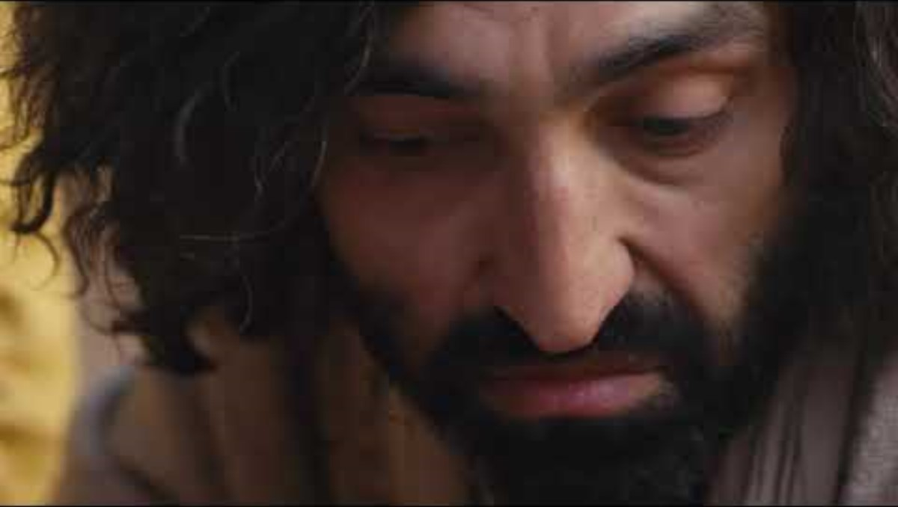
Our Scripture This Week
Mark 3:20-35 is a passage in the Gospel of Mark that explores the themes of family, belonging, and the nature of true discipleship.

Slide 17

Summary Of The Story
Reader 1 - Jesus is surrounded by a large crowd, and his family hears about it and comes to take him away, thinking he is out of his mind. Meanwhile, religious leaders accuse Jesus of using demonic power to cast out demons. Jesus refutes their accusation, explaining that a divided kingdom cannot stand, and warns against blaspheming the Holy Spirit.
Reader 2 - When Jesus' mother and brothers arrive and call for him, Jesus takes the opportunity to teach that true family is not just about biological ties but about those who do God's will. He redefines family as those who follow God's teachings, emphasizing the importance of spiritual bonds over blood relations.

Slide 18

Reflective Questions To Discuss As A Class
How do you define family? How does Jesus' definition of family differ from or align with your own?
What do you think it means to do God's will in your daily life?
Are there times when following your faith has put you at odds with your family or friends? How did you handle it?
How do you react when people, including those close to you, misunderstand your actions or beliefs?
What can we learn from Jesus’ response to his family and the religious leaders about dealing with misunderstanding and conflict?

Slide 19

Let Us Pray
Heavenly Father,
Thank you for the gift of family, both biological and spiritual. Help us to understand that true family is found in those who follow your will and walk in your ways.
Grant us the wisdom to discern your will in our lives and the courage to follow it, even when it may lead to misunderstanding or conflict with those we love.
May we embrace inclusivity and build a community where all feel welcomed and valued, regardless of background or status.
Guide us in prioritizing our relationship with you above all else, so that our actions and decisions align with your purposes.
In moments of doubt or struggle, may we find strength in the support of our spiritual family and the assurance of your presence.
As we reflect on these teachings, inspire us to live as faithful disciples, growing ever closer to you and to one another.
In Jesus' name, Amen

Slide 20
FAMILY
Thoughts and Prayers
Monday 10th June – Friday 14th June

Slide 21

Family traditions vary widely across different cultures, reflecting unique values, beliefs, and customs. Here are some examples from various cultures around the world
Chinese New Year (China): Families come together for a reunion dinner on New Year's Eve, exchange red envelopes with money for good luck, and set off firecrackers to ward off evil spirits.
Diwali (India): Families decorate their homes with colorful rangoli patterns, light oil lamps known as diyas, exchange sweets and gifts, and celebrate the victory of light over darkness.
Hanami (Japan): Families gather to enjoy cherry blossom viewing picnics under the blooming trees, often accompanied by traditional foods and drinks like bento boxes and sake.
Thanksgiving (United States): Families come together to share a meal centered around roasted turkey, stuffing, cranberry sauce, and pumpkin pie, expressing gratitude for blessings and spending quality time together.
Ramadan (Islamic culture): Families gather for pre-dawn meals (suhoor) and break their fast together at sunset (iftar), often with special foods like dates and traditional dishes, fostering a sense of community and spiritual reflection.
Quinceañera (Latin America): Families celebrate a girl's 15th birthday with a lavish party, symbolizing her transition from childhood to womanhood, often including a religious ceremony, formal dances, and feasting.
Holi (India): Families and communities come together to celebrate the arrival of spring by throwing colored powders and water at each other, symbolizing the victory of good over evil and the arrival of spring.
Matariki (New Zealand): Maori families celebrate the Māori New Year with gatherings, storytelling, and feasting, honoring ancestors and acknowledging new beginnings.
Día de los Muertos (Mexico): Families create elaborate altars (ofrendas) adorned with photos, candles, and favorite foods of deceased loved ones, to honor and remember them during this annual celebration of life and death.

Slide 22
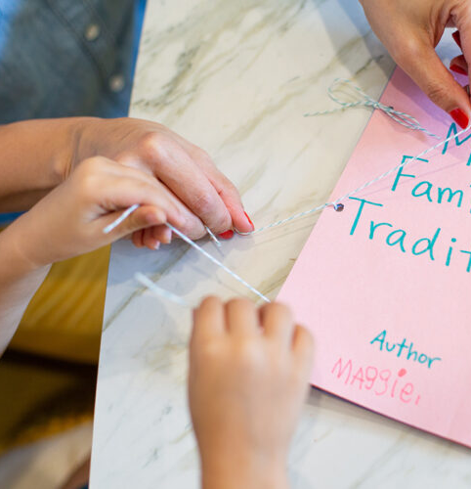
Family Traditions
Understanding and respecting different cultures and family traditions is fundamental for building a more inclusive, harmonious, and interconnected global society. It acknowledges the beauty and value of cultural diversity while fostering empathy, mutual respect, and cooperation among all people.
With a partner
What are some of the most meaningful family traditions you participate in, and how do they contribute to your sense of identity and belonging within your family and community?

Slide 23

Let Us Pray
Dear Lord,
Bless us with hearts open to cultural diversity and traditions. Help us honour and respect each other's heritage, showing understanding and harmony in our communities. Guide us to embrace the beauty of our differences and celebrate our shared humanity.
Amen.

