Slide 1
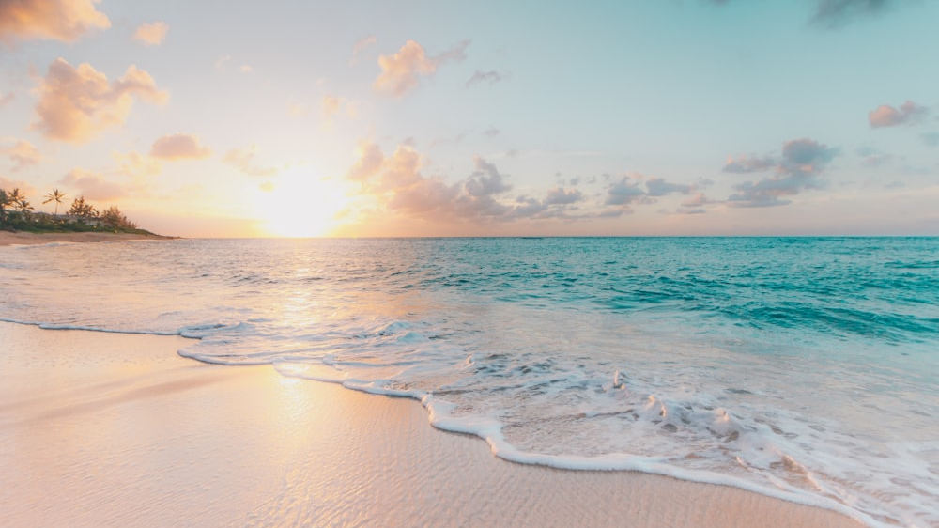
THOUGHTS AND PRAYERS 3RD – 7TH JUNE
“What shall I return to the Lord for all his goodness to me?”
THEME OF THE WEEK: GOODNESS

Slide 2


MORNING PRAYER IN THE CHAPEL THIS WEEK
Monday 3rd June - 9N
Tuesday 4th June - 9T
Thursday 6th June - 9R
Friday 7th June - 9Y

Slide 3

Friday Mass
Who?
Mass this week will be led by 10Y & 10T
When?
Friday Morning at 8.20am
Where?
In the School Chapel. See you there!
ALL ARE MOST WELCOME.
ALL WORDS ARE DISPLAYED ON THE SCREEN.

Slide 4
Lunchtime events: All are welcome..
Crafts and Mindfulness
(Mondays in the chapel)
Islamic Union
(Tuesday G15)
Christian Union
(Tuesdays in G16)

Slide 5
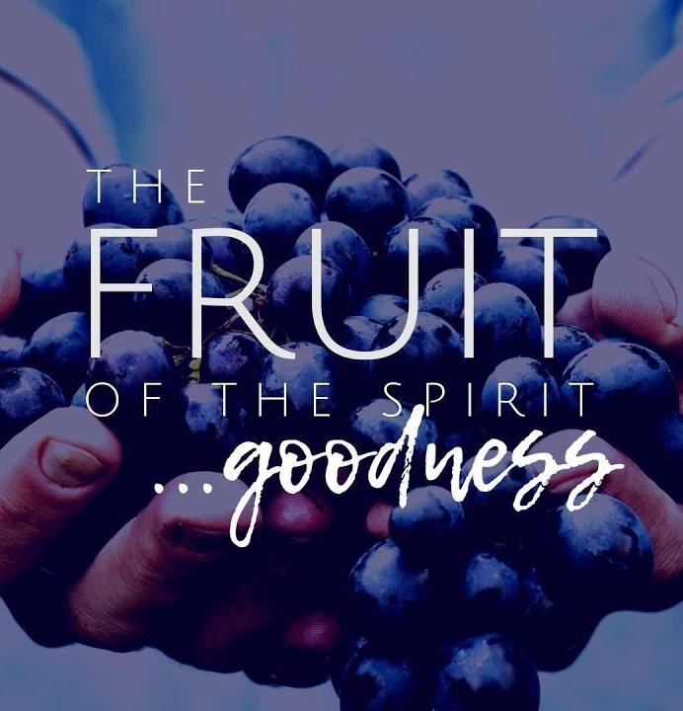
What is 'goodness'?
Goodness is a fundamental virtue in our lives, embodying kindness, generosity, and moral integrity. As Catholics, we are called to reflect God’s goodness through our actions and words.
DISCUSS: Reflect on what it means to be good and how you can exhibit goodness in your daily life. Think about small acts of kindness, honesty, and compassion that you can incorporate into your interactions with others.
ACTIVITY: Write down three acts of goodness you have witnessed or performed in the past week. Share one of these acts with a partner and discuss how it made you feel and how it impacted others.

Slide 6
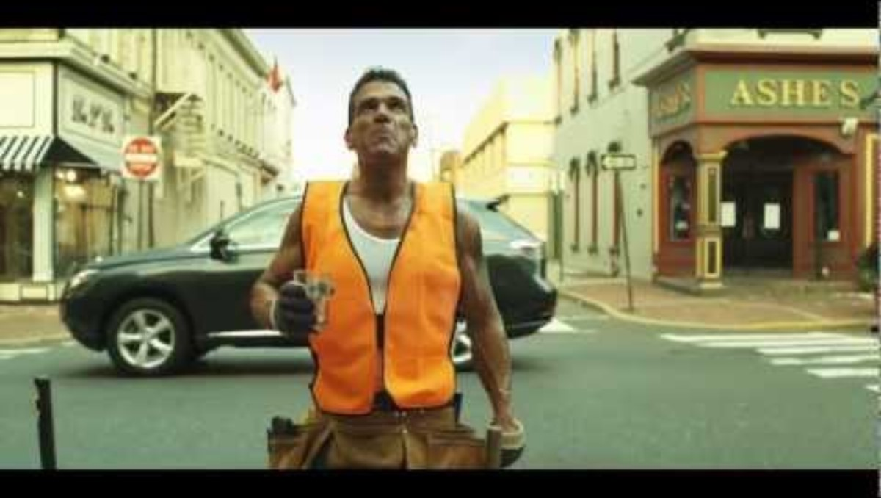
HOW DO THESE RANDOM ACTS OF KINDNESS IMPACT EACH PERSON? HOW DOES THE END OF THIS VIDEO SUGGEST THAT IF WE ACT IN GOODNESS AND KINDNESS, WE WILL IN TURN RECEIVE GOODNESS?

Slide 7

Lord,
Thank you for the gift of goodness that you have instilled in our hearts. Help us to reflect your goodness in our daily lives through acts of kindness, honesty, and love. May we always strive to be better versions of ourselves, following the example of Jesus Christ.
Amen

Slide 8
THOUGHTS AND PRAYERS 3RD – 7TH JUNE
“What shall I return to the Lord for all his goodness to me?”
THEME OF THE WEEK: GOODNESS

Slide 9

Goodness in Action: world environment day wednesday 5th june
Goodness is not just a feeling but an action. It involves making choices that reflect love, integrity, and generosity.
World Environment Day reminds us of our responsibility to care for God’s creation. Reflect on how goodness extends to our stewardship of the earth. Caring for the environment is an expression of gratitude for the goodness of God’s creation and a commitment to preserving it for future generations.

Slide 10
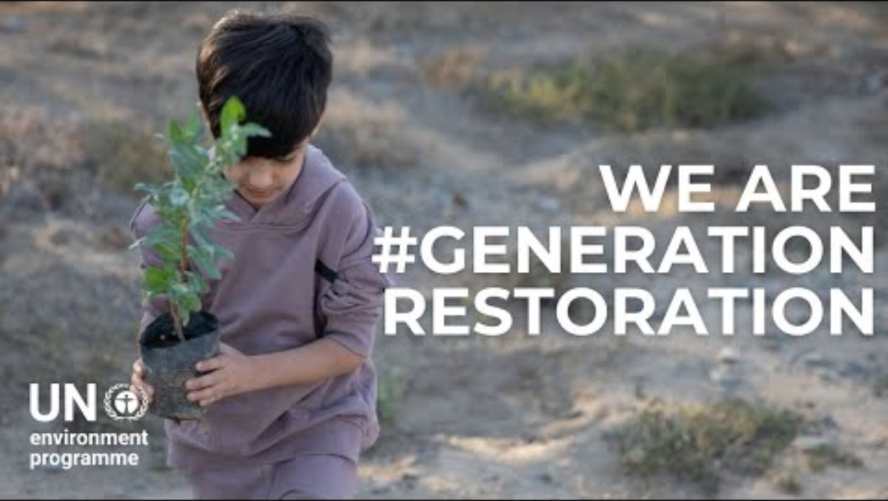

Slide 11
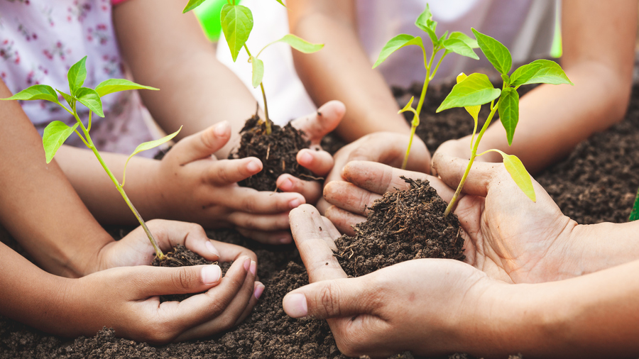
Generation restoration
Take a moment to identify one practical step you can take to care for the environment, such as reducing waste, conserving water, or participating in a local clean-up effort.
Write this commitment on a piece of paper and place it in a visible spot as a daily reminder.

Slide 12
PRAYER
Loving God,
We thank you for the goodness of your creation. Help us to be good stewards of the earth, caring for it with respect and love. May our actions reflect our gratitude for the beauty and bounty you have given us.
Amen

Slide 13
THOUGHTS AND PRAYERS 3RD – 7TH JUNE
“What shall I return to the Lord for all his goodness to me?”
THEME OF THE WEEK: GOODNESS

Slide 14
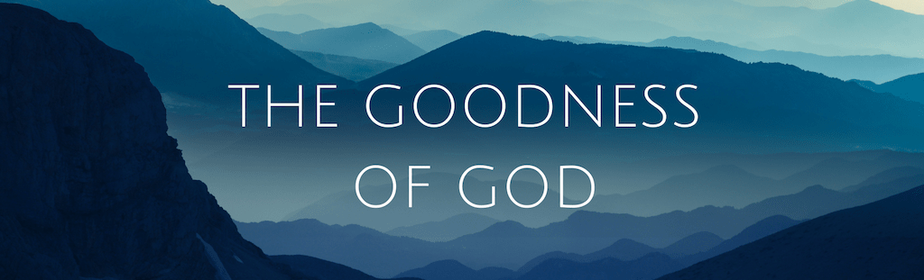
The verse from Psalm 116:12, “What shall I return to the Lord for all his goodness to me?” invites us to consider how we can respond to God's abundant goodness and blessings in our lives. This question encourages us to reflect on the many ways God has shown His love and goodness and challenges us to think about how we can give back.
To return something to the Lord means to live in gratitude and to use our blessings to do good in the world. This can involve acts of kindness, service to others, and living a life that reflects God’s love and goodness. It is about recognizing the gifts we have received and using them to bless others.

Slide 15

Acknowledging the goodness in our own lives
Write a short list of blessings and acts of goodness you have received from God.
Next to each item, jot down one way you can "return" this goodness to the Lord.
For example, if you are grateful for the gift of friendship, consider how you can be a better friend to others.
Share your reflections with the class or a small group.

Slide 16
Lord,
We are grateful for the countless ways you show your goodness to us. Help us to always remember your blessings and to express our gratitude through our actions. May our lives be a testament to your love and goodness.
Amen

Slide 17
THOUGHTS AND PRAYERS 3RD – 7TH JUNE
“What shall I return to the Lord for all his goodness to me?”
THEME OF THE WEEK: GOODNESS

Slide 18
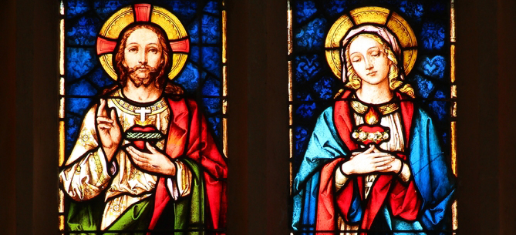
Discuss: WHO IS DEPICTED IN THESE IMAGES? WHAT DO YOU NOTICE ABOUT THEM?

Slide 19
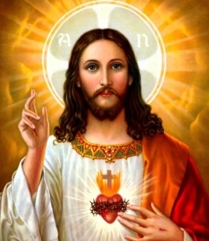
Feast of the Sacred Heart of Jesus (Friday, June 7th)
The Feast of the Sacred Heart of Jesus focuses on the boundless love and compassion of Christ. His heart symbolizes the infinite goodness of His love for humanity.
TASK: Reflect on how Jesus’ example of love and sacrifice calls us to show goodness through acts of compassion and mercy.

Slide 20
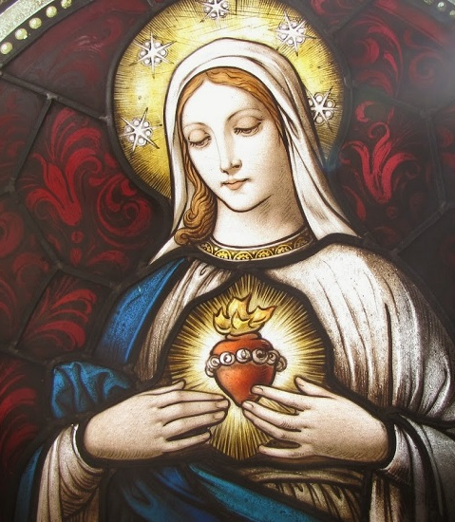
Feast of the Immaculate Heart of the Blessed Virgin Mary (Saturday, June 8th)
The Feast of the Immaculate Heart of Mary highlights her pure love and devotion to God. Her heart is a symbol of her goodness, humility, and faithfulness.
The church marks this feast with special services and activities that focus on the virtues of Mary.

Slide 21
How can we follow in the footsteps of Jesus and Mary, showing goodness in our hearts?
Daily Self-Reflection: Take a few minutes each day to reflect on your actions and thoughts. Ask yourself if they align with the values of goodness and love.
Acts of Kindness: Make a habit of performing small acts of kindness each day, such as helping a classmate, being polite, or offering a compliment.
Active Listening: Practice listening to others with attention and empathy. This shows respect and care for their feelings and experiences.
Mindfulness and Prayer: Spend time in prayer and mindfulness to stay connected with God’s presence and guidance, asking for strength to embody goodness.
Serve Others: Look for opportunities to serve others, whether through volunteer work, helping family members, or supporting friends in need.

Slide 22
Holy Spirit,
As we celebrate the Feast of the Immaculate Heart of the Blessed Virgin Mary and the Sacred Heart of Jesus, we invite you into our hearts and lives. Fill us with your presence and guide us to live out the goodness that reflects God’s love. Help us to be attentive to your promptings and to cultivate the fruits of the Spirit in all that we do.
Amen

