Slide 1
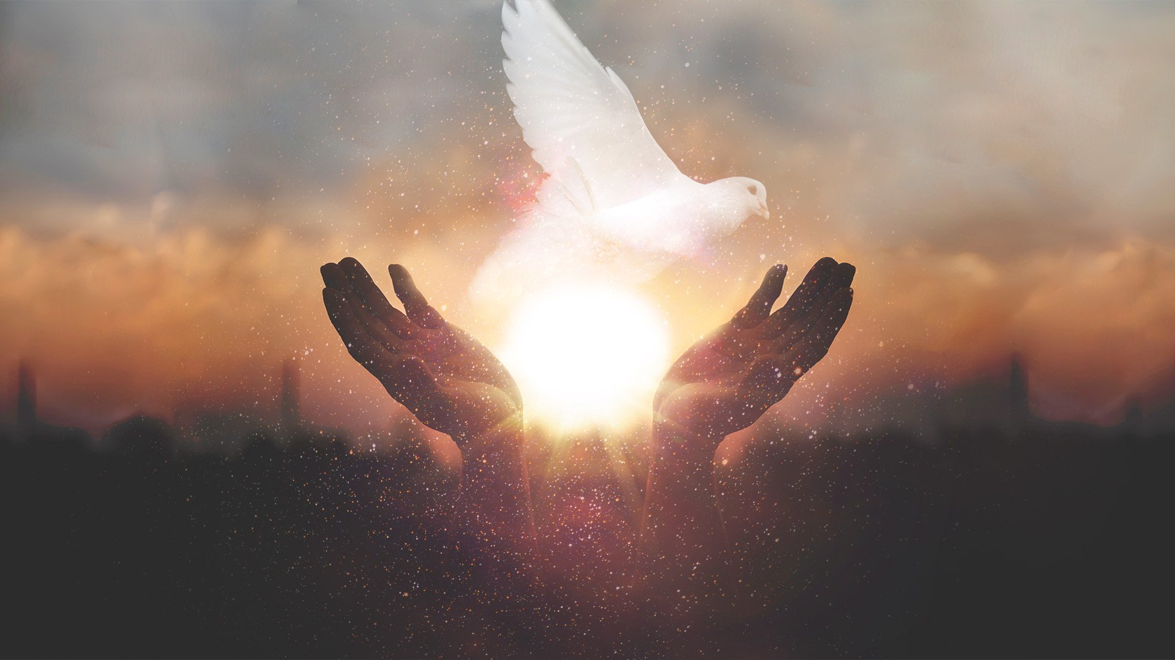
Theme of the week: SPIRIT
Thoughts and Prayers: 13th – 17th May

Slide 2


MORNING PRAYER IN THE CHAPEL THIS WEEK
Monday 13th May – 10R
Tuesday 14th May - 12T
Wednesday 15th May - 10Y
Thursday 16th May – 12M
Friday 17th May - 12A

Slide 3
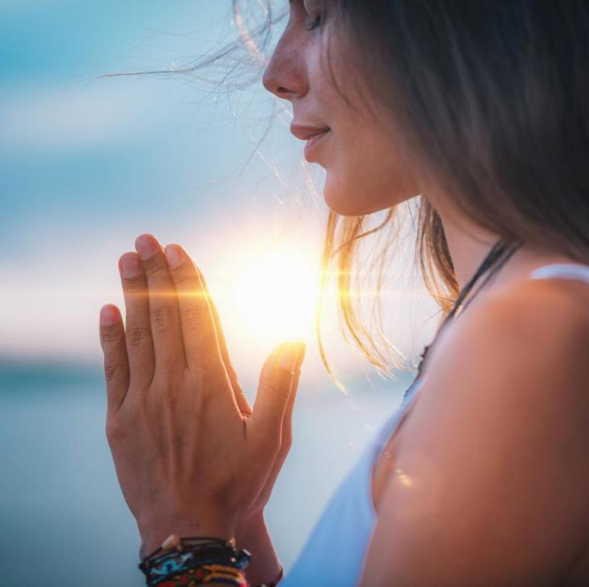
Spirit
The term 'spirit' encompasses aspects of faith, hope, and love, as well as the presence of the Holy Spirit in our lives. Spend some time this morning reflecting on how you personally experience and connect with your own spirit and spirituality.
What does the word "spirit" mean to me?
How do I connect with my own spirituality?
In what ways do I experience the presence of the Holy Spirit in my life?

Slide 4
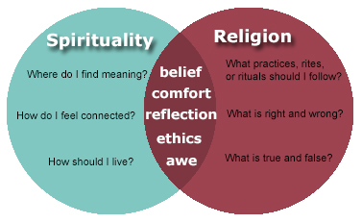
How does spirituality link to religion?

Slide 5

Lord,
We thank you for the gift of spirit that you have bestowed upon us. Help us to grow in our understanding and appreciation of our own spirituality, and guide us to recognize the presence of your Holy Spirit in our lives.
Amen

Slide 6
Theme of the week: SPIRIT
Thoughts and Prayers: 13th – 17th May

Slide 7

How to strengthen spiritual connections
How many ways can you think of to strengthen spirituality?
Prayer
Meditation
Acts of kindness
Participation in religious rituals
Spending time with loved ones
Spending time in nature
Listening to music
Playing music

Slide 8

The benefits of meditation
Meditation offers various benefits for nurturing the spirit:
Stress Reduction: Calming practices decrease stress hormones, creating space for spiritual connection.
Self-Awareness: Observing thoughts and emotions fosters understanding, aligning actions with spiritual goals.
Emotional Well-being: Positive emotions increase fulfillment, enabling deeper spiritual experiences.
Concentration: Improved focus aids in engaging deeply in spiritual practices.
Compassion: Cultivating empathy fosters unity and connection with others and the divine.

Slide 9


Slide 10
PRAYER
Loving God,
As we strive to cultivate our spirit, grant us the strength and guidance to deepen our connection with you. Help us to find peace and fulfillment in our spiritual practices, and may our hearts be open to receiving your love and grace.
Amen

Slide 11
Theme of the week: SPIRIT
Thoughts and Prayers: 13th – 17th May

Slide 12
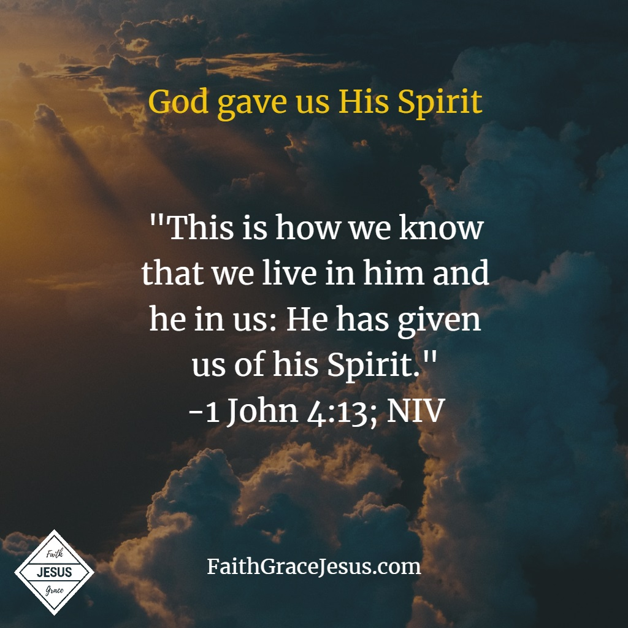
In 1 John 4:11-16, the scripture emphasizes the reciprocal relationship between believers and God. It states that by loving one another, we abide in God, and He in us. The verse highlights the presence and action of the Holy Spirit in our lives as evidence of our union with God.
The phrase "He has given us of his Spirit" signifies the indwelling of the Holy Spirit within believers, which serves as a tangible manifestation of God's presence and love. This indwelling Spirit not only confirms our relationship with God but also empowers us to love others selflessly, mirroring the love of God.
In essence, this scripture teaches that through love and the presence of the Holy Spirit, believers experience a deep spiritual union with God. It emphasizes the importance of love as the defining characteristic of a life lived in communion with God and encourages believers to abide in this love, knowing that God abides in them.

Slide 13
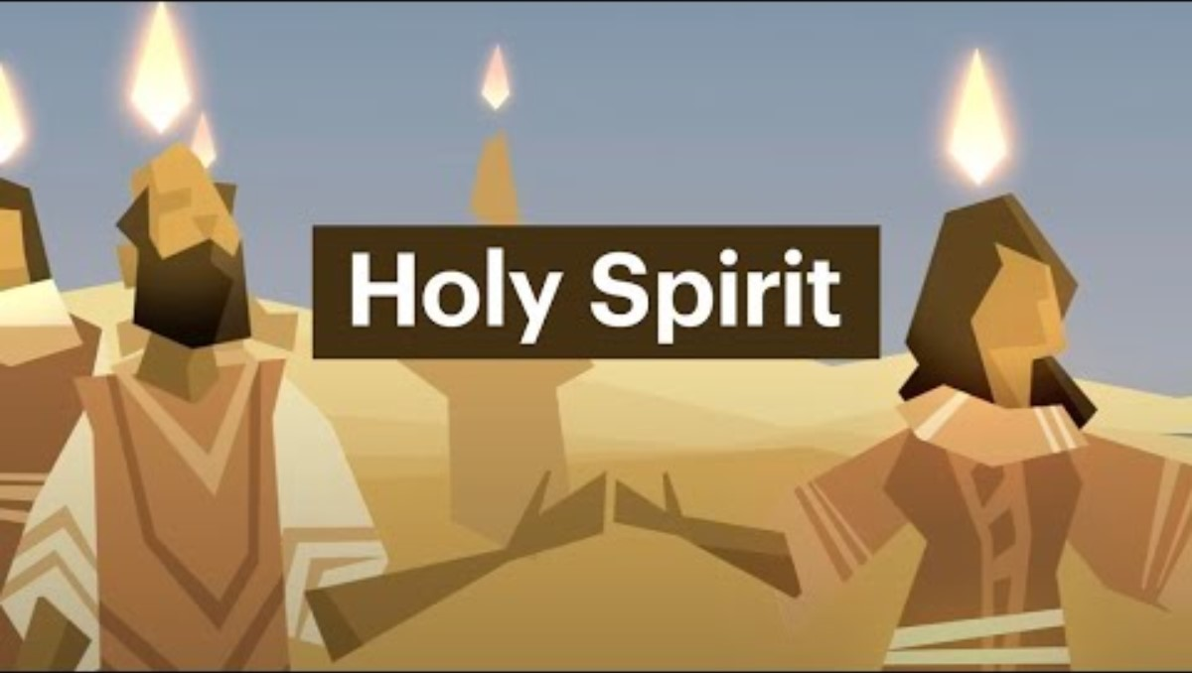
Watch this video and answer the questions
How does God's spirit work in the Bible?
Why was Jesus sent to us?
How can we live our lives following the spirit?

Slide 14
Lord,
Thank you for the gift of your Holy Spirit, which dwells within us and guides us in our journey of faith. Help us to always remain rooted in your love, knowing that you are with us every step of the way. May your Spirit continue to strengthen and sustain us, now and forevermore.
Amen

Slide 15
Theme of the week: SPIRIT
Thoughts and Prayers: 13th – 17th May

Slide 16
How can you 'have spirit'?
Vitality and Energy: Having spirit often refers to possessing vitality, energy, and enthusiasm for life. It involves being animated and passionate, approaching tasks and experiences with zest and vigor.
Resilience and Determination: Spirit also entails resilience and determination in the face of challenges. It is the inner strength that enables individuals to persevere through adversity, setbacks, and obstacles, refusing to be defeated by circumstances.
Character and Essence: Having spirit can also denote the core essence of a person's character or personality. It encompasses qualities such as courage, integrity, authenticity, and resilience, which define one's identity and guide their actions and decisions.
Spirituality and Connection: Spirituality plays a significant role in the concept of having spirit. It involves a deep connection with oneself, others, and the transcendent. Having spirit in this sense means being attuned to the spiritual dimension of existence, seeking meaning, purpose, and fulfillment beyond the material realm.
Creativity and Expression: Spirit often manifests in creativity, expression, and self-actualization. It involves tapping into one's unique talents, passions, and creativity to express oneself authentically and contribute positively to the world.
Community and Belonging: Having spirit can also refer to a sense of community, belonging, and interconnectedness with others. It involves fostering meaningful relationships, supporting others, and contributing to the collective well-being of society.

Slide 17
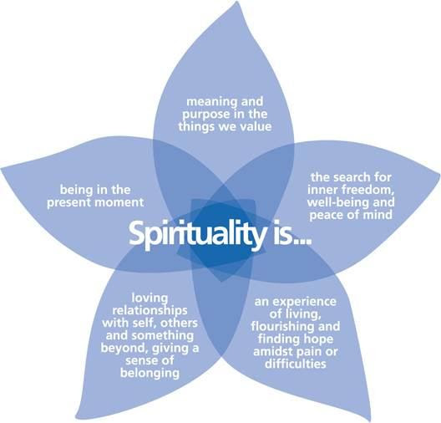
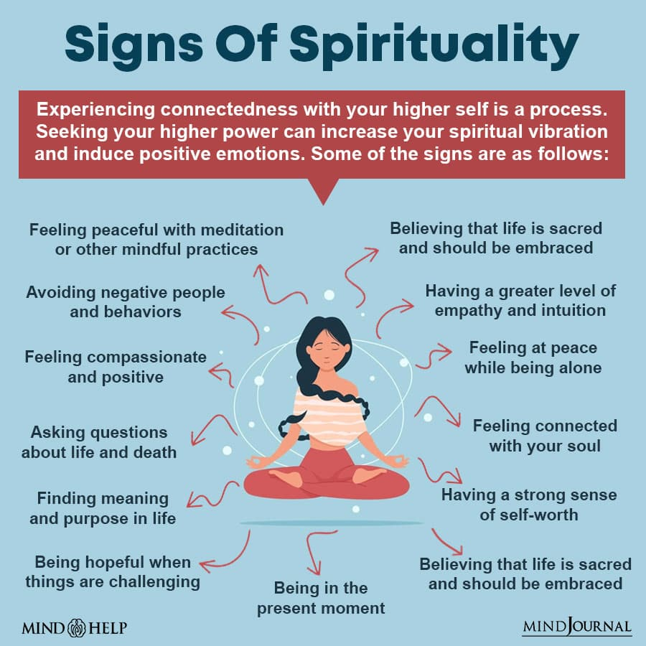

Slide 18

Key takeaways this week: discussion
How are spirituality and religion connected?
How does the Spirit work in the Bible?
What are the benefits of meditation?
What does the phrase "He has given us of his Spirit" mean?
What does it mean to 'have spirit'?
Finally, give ONE thing that you can do differently this week to ensure you live with the spirit in you.

Slide 19
Dear God,
Fill our hearts with courage and compassion as we seek to share our spiritual journey with others. Guide us in our words and actions so that we may be a light to those in need, and may our testimonies inspire faith and hope in those who hear them.
Amen

