Slide 1

Theme of the week: HOME
Thoughts and Prayers: 29th April – 3rd May

Slide 2


MORNING PRAYER IN THE CHAPEL THIS WEEK
Tuesday 30th April - 7M
Wednesday 1st May - 7R
Thursday 2nd May – 7Y
Friday 3rd May - 10I

Slide 3

Friday Mass
Who?
Mass this week will be led by 8M & 8Y
When?
Friday Morning at 8.20am
Where?
In the School Chapel. See you there!
ALL ARE MOST WELCOME.
ALL WORDS ARE DISPLAYED ON THE SCREEN.

Slide 4
Lunchtime events: All are welcome..
Crafts and Mindfulness
(Mondays in the chapel)
Islamic Union
(Tuesday G15)
Christian Union
(Tuesdays in G16)

Slide 5

What does home mean to you?
What do you think of when you think of the word 'home'?
Is it a building/place?
Can you place it geographically on a map?
Does home have to be a place?
Can home be a feeling?
What does the idea of home make you feel?

Slide 6

Being Home
Home can refer to both the physical space you inhabit as well as the emotional connections you have with your families, friends, and communities.
Activity: Create a collage or drawing representing your personal interpretation of home. You can include images, words, or symbols that reflect what makes you feel at home.

Slide 7

Lord,
We thank you for the gift of home, where we find comfort, security, and belonging. Help us to recognize the importance of creating spaces of love and hospitality wherever we go.
Amen

Slide 8
Theme of the week: HOME
Thoughts and Prayers: 29th April – 3rd May

Slide 9
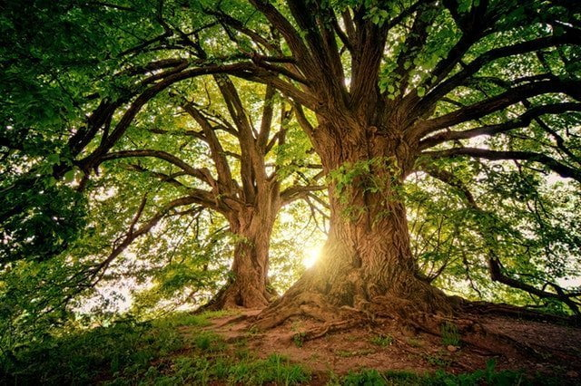
How does this image link to our theme of 'Home'?

Slide 10

Interconnectedness: Trees are part of ecosystems; similarly, our homes are woven into relationships, fostering belonging and connection.
Nourishment and Sustenance: Trees provide sustenance; similarly, our homes nourish us emotionally, spiritually, and physically.
Shelter and Protection: Trees offer sanctuary, mirroring the safety and love we find in our homes.
Growth and Change: Just as trees evolve through seasons, our homes adapt with us, reflecting our growth and experiences.
Roots and Foundation: Like a tree's roots provide stability, our family, culture, and history shape our sense of belonging.

Slide 11

This passage from John (15:1-8) discusses the metaphor of Jesus as the vine and believers as the branches.
During the Last Supper, just before his crucifixion, Jesus teaches his disciples about the importance of staying connected to him. He uses the metaphor of a vine and its branches to illustrate this relationship. Jesus is the vine, the source of life, while his disciples are the branches, drawing strength from him. Just as branches need to stay attached to the vine to bear fruit, Jesus emphasizes the necessity for his followers to remain in close communion with him. This metaphor highlights the intimate connection between Jesus and his disciples and underscores the significance of abiding in him for spiritual vitality and fruitfulness.
Reflect on how this imagery relates to the theme of being alive and connected.

Slide 12
PRAYER
Loving God,
Help us to abide in you as branches to the vine, drawing strength and nourishment from your love. May we bear fruit in our lives that reflects your goodness and grace.
Amen

Slide 13
Theme of the week: HOME
Thoughts and Prayers: 29th April – 3rd May

Slide 14
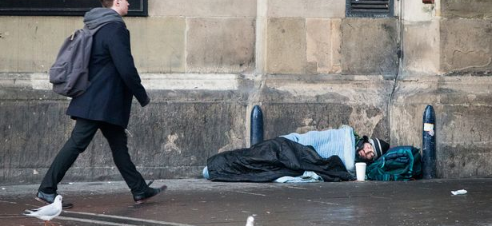
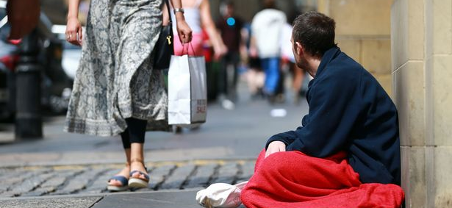
Homelessness
God teaches us to show compassion and kindness towards the needy and the poor. Jesus emphasized the importance of caring for those who are marginalized and in need of support.
This week, we have discussed the importance of 'home' but what does home mean to someone who has nowhere to live.
How does this image make you feel?
What kind of challenges might these people face in their lives?
How might their day look?
How can people help those who face homelessness?

Slide 15
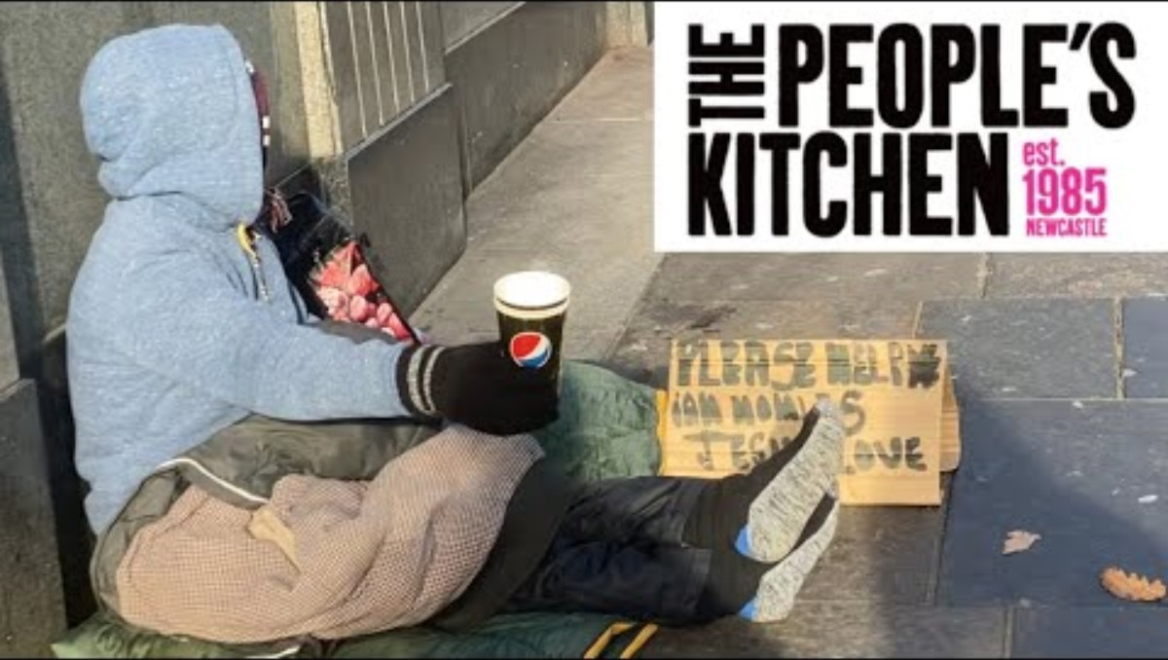

Slide 16
Bidding Prayers
Reader 1: We pray for those without a place to call home, may our communities open their hearts and resources to provide shelter, warmth, and safety.
Lord in your mercy,
ALL: Hear our prayer
Reader 2: We pray for organizations and individuals working tirelessly to support the homeless. May they be blessed with strength, compassion, and resources to continue their vital work.
Lord in your mercy,
ALL: Hear our prayer
Reader 3: Let us remember those who feel forgotten and marginalized, especially the homeless. May they find comfort in knowing that they are valued and loved by their community.
Lord in your mercy,
Lord,
ALL: Hear our prayer
Reader 4: As we gather in warmth and comfort, let us not forget our brothers and sisters who sleep on the streets. May we strive for a society where no one goes without a place to call home.
Lord in your mercy,
ALL: Hear our prayer
Lord, hear our prayers as we come before you humbly. Amen

Slide 17
Theme of the week: HOME
Thoughts and Prayers: 29th April – 3rd May

Slide 18

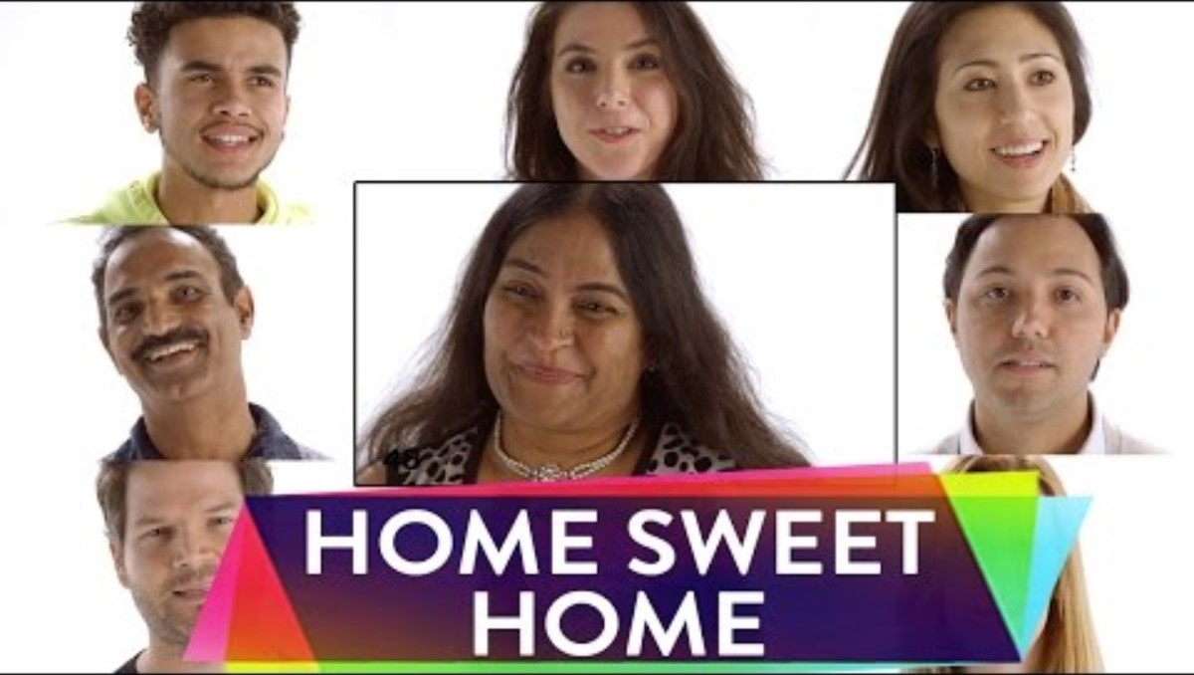
watch this
Think back to your discussions from earlier this week.
Has your idea of what home means changed?
While you watch this, make a note of any ideas that resonate with you. Which person do you align with? Is there anyone who you really agree with?

Slide 19
Write an acrostic poem about home.
Try to include some of the ideas we have discussed this week.
My home is a special place filled with love
Years pass by but it still stays the same
However far I travel, I can always return
Old and familiar, it never changes
Moments treasured and woven into walls
Everlasting sanctuary that always welcomes me

Slide 20
Dear God,
In the quiet moments of reflection, we acknowledge the profound significance of home. It is more than walls and a roof; it is a sanctuary for the soul, a harbor in life's storms.
Grant us the wisdom to understand that home is where love dwells, where laughter resounds, and where acceptance reigns. May we cultivate a spirit of hospitality, welcoming all who seek refuge and solace.
Guide us to cherish the memories made within these sacred spaces, and to nurture the bonds that tie us to our loved ones and communities.
In times of uncertainty, remind us that home is a beacon of hope, a constant reminder of your enduring presence in our lives.
Bless our homes with peace, abundance, and grace, that they may always be a reflection of your infinite love.
Amen

