Slide 1
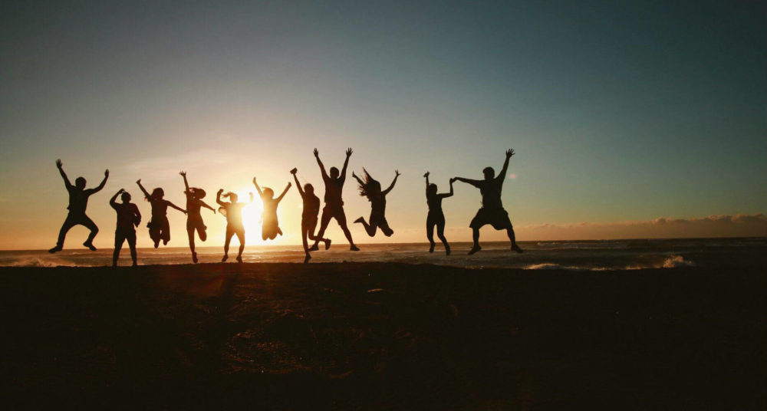
Theme of the week: Alive
Thoughts and Prayers 15th – 19th April

Slide 2


MORNING PRAYER IN THE CHAPEL THIS WEEK
Monday 15th April - 13R
Tuesday 16th April - 13Y
Wednesday 17th April - 12A
Thursday 18th April – 9S
Friday 19th April - 9A

Slide 3

Friday Mass
Who?
Mass this week will be led by 12M & 12Y
When?
Friday Morning at 8.20am
Where?
In the School Chapel. See you there!
ALL ARE MOST WELCOME.
ALL WORDS ARE DISPLAYED ON THE SCREEN.

Slide 4
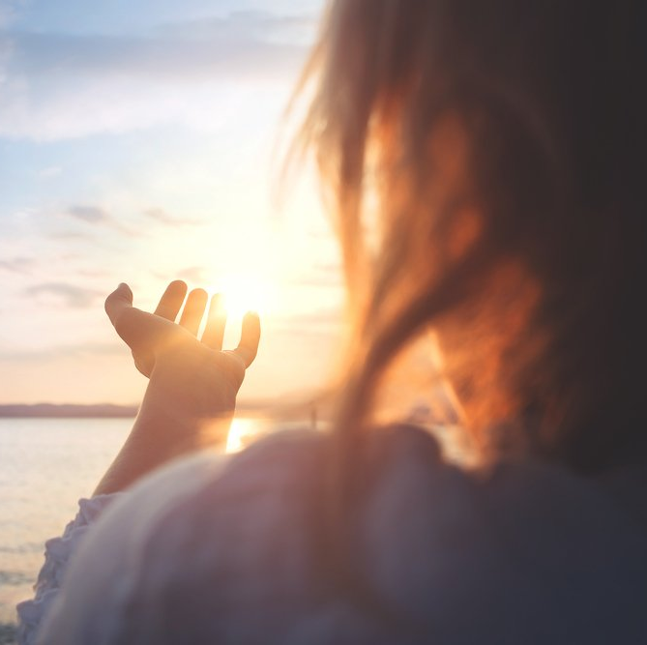
Welcome back!
Today, we reflect on the gift of life itself. Being alive means more than just existing; it means embracing every moment with gratitude and purpose.
Take a moment to think about what makes you feel truly alive. Is it spending time with loved ones, pursuing your passions, or witnessing the beauty of nature? How can you infuse more of these moments into your daily life?
Write down three things that make you feel alive and share them with a partner. Discuss why these experiences are meaningful to you.

Slide 5

Lord,
In gratitude we lift our praise, For the gift of life, in myriad ways. Each breath we take, each beat of our heart, A reminder of your love, never to depart.
In the gentle whispers of the morning breeze, In the golden hues of the sunset's ease, In the laughter shared among friends so dear, Your presence, O Lord, is always near.
Grant us the grace to cherish every day, To seek your will in all we do and say. May our lives be filled with purpose and light, Reflecting your love, pure and bright.
Guide us to walk the path you've laid, With faith and courage, never afraid. To spread love and joy wherever we roam, In every heart, may your light be known.
Dear God, in humble gratitude we pray, For the gift of life you bestow each day. Help us to live with purpose, true and clear, Forever in your presence, ever near.
Amen

Slide 6
Theme of the week: Alive
Thoughts and Prayers 15th – 19th April

Slide 7
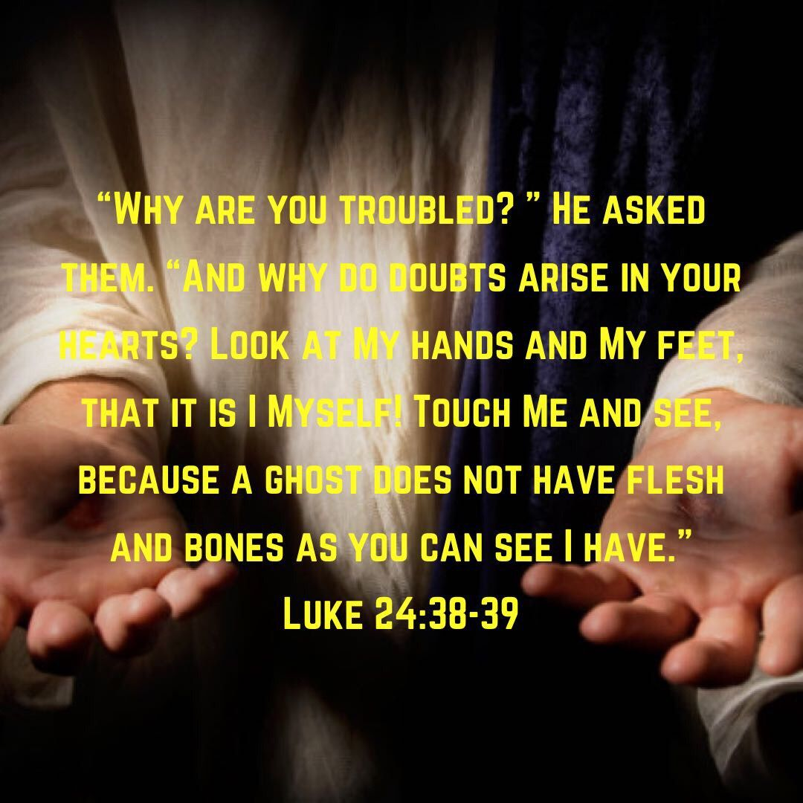
Our theme this week comes from Luke 24:35-48. In this verse, Jesus appears to his disciples after rising from the dead. They're scared, thinking he's a ghost. To prove he's alive, Jesus invites them to touch him, showing he has flesh and bones, not just a spirit.
This moment is crucial because it shows Jesus didn't just come back spiritually but physically too. It's like saying, "Look, I'm not a ghost; I'm really alive!" This emphasizes that being alive isn't just about our spirits but also our bodies.
It's a reminder that life is more than just existing; it's about fully embracing our physical selves and the world around us.
Just like Jesus' resurrection brings new life, we're encouraged to live each day fully, cherishing every moment and experience.

Slide 8

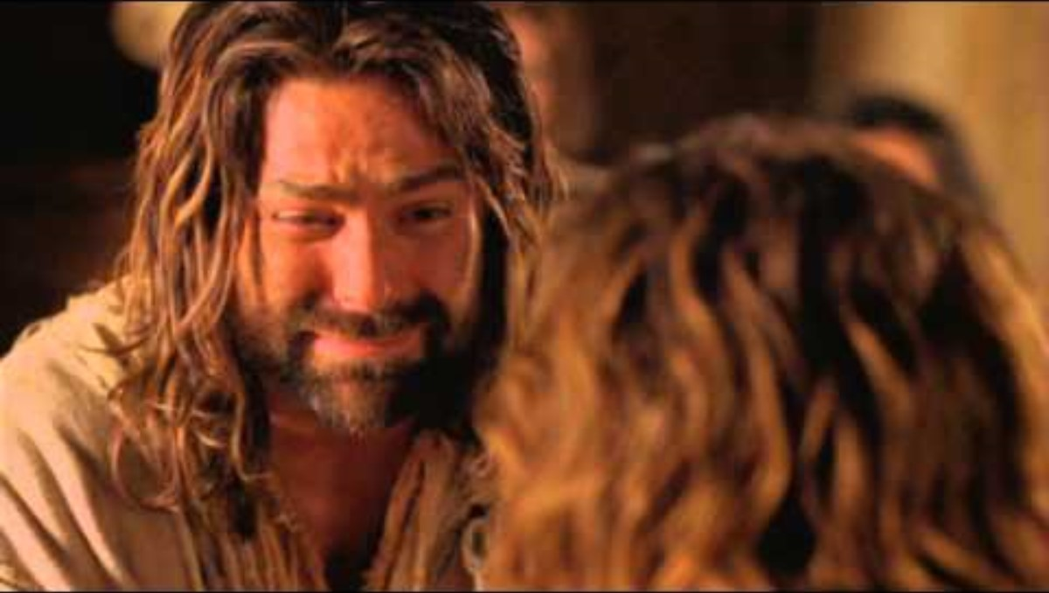
watch this

Slide 9
PRAYER
Almighty Father,
Thank you for the gift of our bodies and the ability to experience life through them. Help us to care for our physical selves and appreciate the beauty of embodiment.
Amen

Slide 10
Theme of the week: Alive
Thoughts and Prayers 15th – 19th April

Slide 11

What does it mean to live life to the fullest?
Today, we delve into the concept of living life to the fullest. Being alive is not just about existing; it's about embracing every opportunity and experiencing joy, growth, and fulfillment.
Reflect on what it means to you to live life to the fullest. Is it about pursuing your dreams, cultivating meaningful relationships, or making a positive impact in the world? How can you align your actions with this vision?
Create a "bucket list" of experiences and goals you want to have in your lifetime. Share one item from your list with a partner and discuss why it's important to you.

Slide 12

As we grow older, our goals might change.
What always remains, is the dream of being happy and living life to the fullest.
In the end, it is not about how much money you earn or how many followers you have on social media.
Being alive is about the experiences you have had with the people you love.

Slide 13
Bidding Prayers
Reader 1: We thank you for the gift of life we've been given, may we always cherish each moment with gratitude and joy.
Lord in your mercy,
ALL: Hear our prayer
Reader 2: Let us pray for those who are struggling to find meaning and purpose in their lives, that they may discover the beauty of being alive.
Lord in your mercy,
ALL: Hear our prayer
Reader 3: We ask for the strength and courage to embrace life's challenges and opportunities, trusting in God's guidance and love.
ALL: Hear our prayer
Reader 4: As we reflect on the miracle of existence, may we be inspired to live each day to the fullest, spreading love and kindness wherever we go.
Lord in your mercy,
ALL: Hear our prayer
Lord, hear our prayers as we come before you humbly. Amen

Slide 14
Theme of the week: Alive
Thoughts and Prayers 15th – 19th April

Slide 15
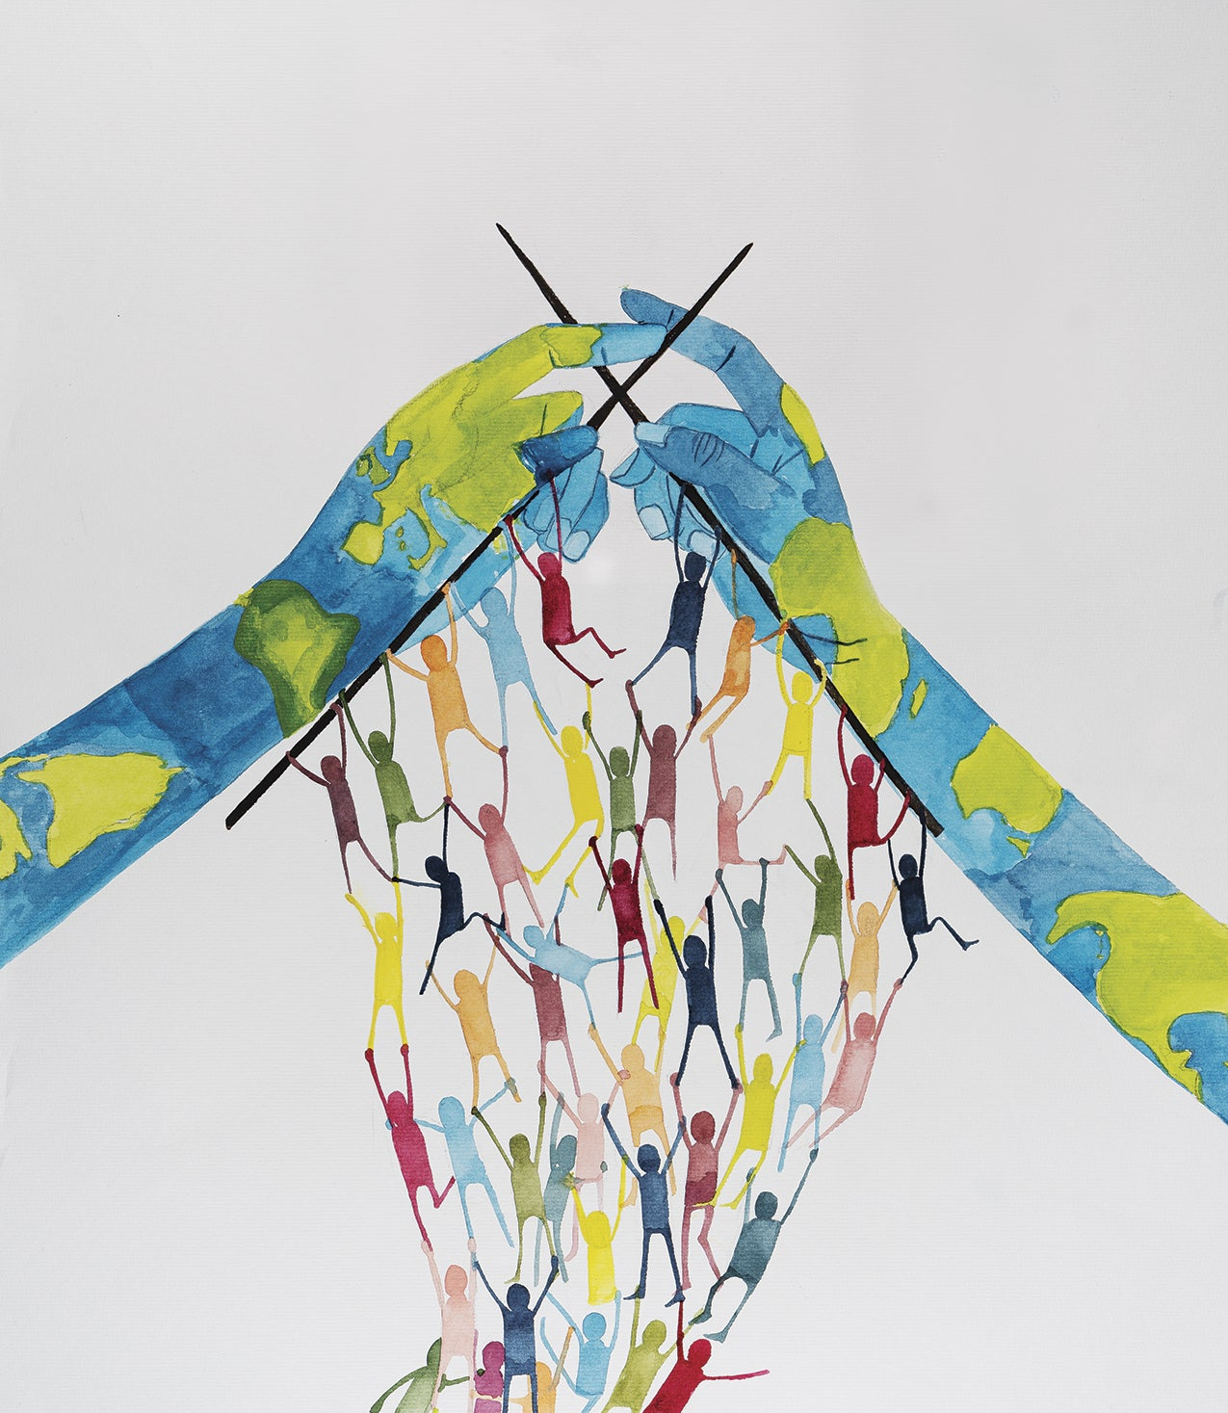
Living Together
Today, we explore the profound importance of respecting all living beings, not only for the well-being of our environment but also for the harmony and justice within society.
Reflect on the interconnectedness of all life forms and how our actions impact both the environment and society. Consider how respecting the dignity and rights of all living beings contributes to a more just and compassionate world.
What kind of steps can individuals and communities can take to foster a culture of respect and empathy towards both humans and the natural world.

Slide 16
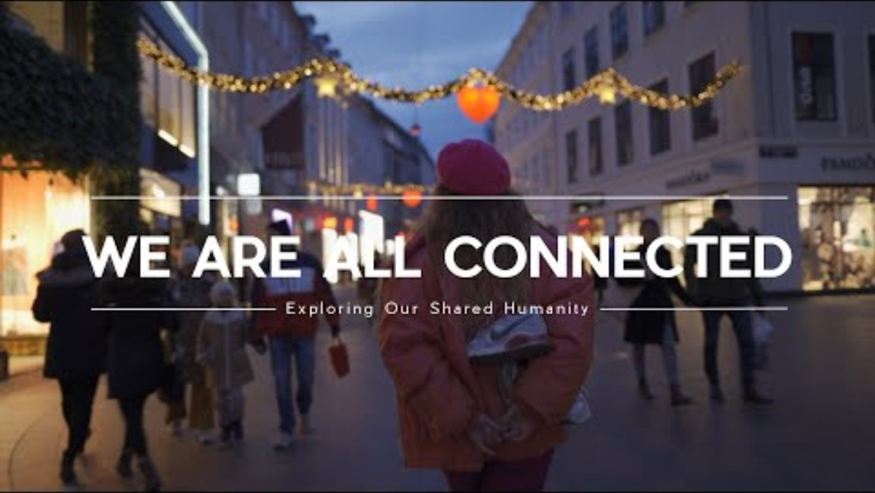

Slide 17
Dear God,
We are grateful for the diverse tapestry of life that surrounds us. Grant us the wisdom and courage to recognize the inherent worth of every living being, and inspire us to work towards a society where justice, compassion, and respect prevail. Help us to honor the sacredness of all life and to strive for harmony within ourselves, with others, and with the world around us.
Amen

