Slide 1
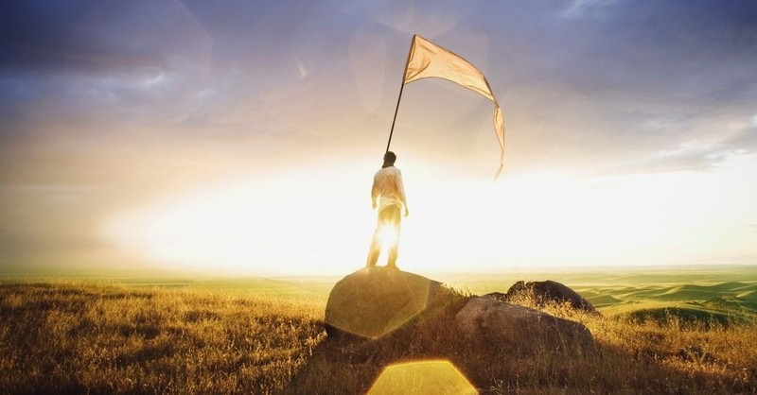
Theme of the week: Surrender
Thoughts and Prayers 18th - 22nd March

Slide 2
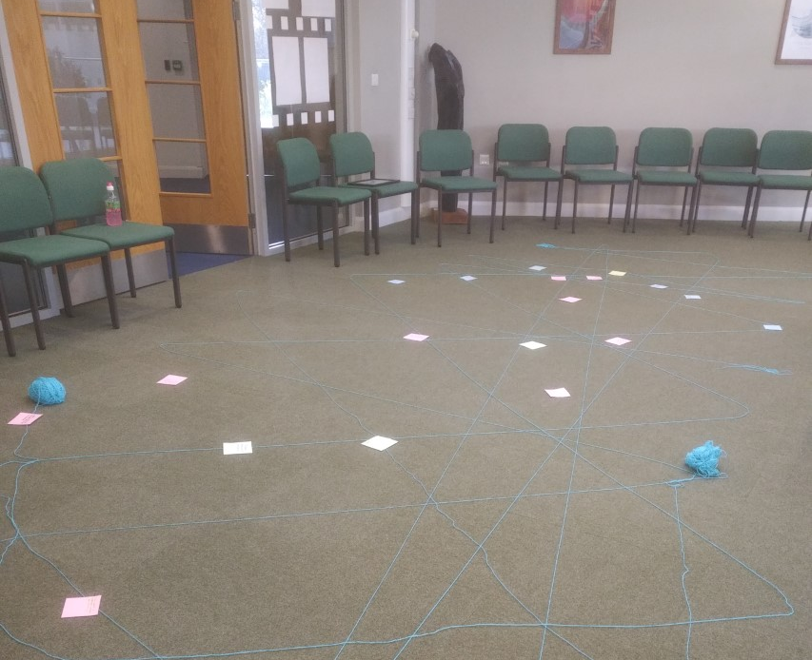
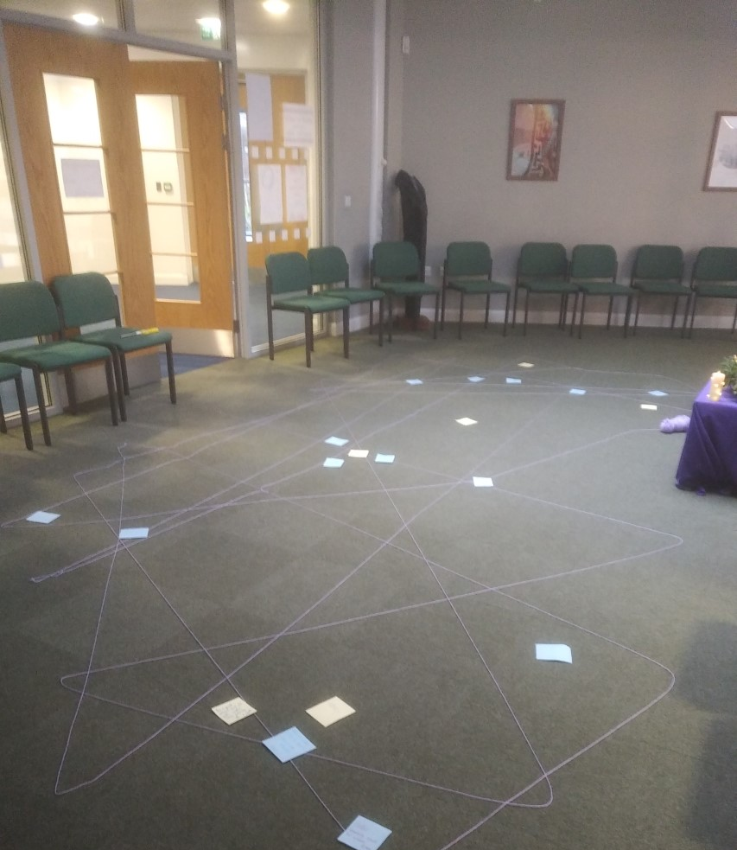
MORNING PRAYER IN THE CHAPEL THIS WEEK
Monday 18th March - 9T
Tuesday 19th March - 11T
Wednesday 20th March - 11M
Thursday 21st March – 11R
Friday 22nd March - 11Y

Slide 3
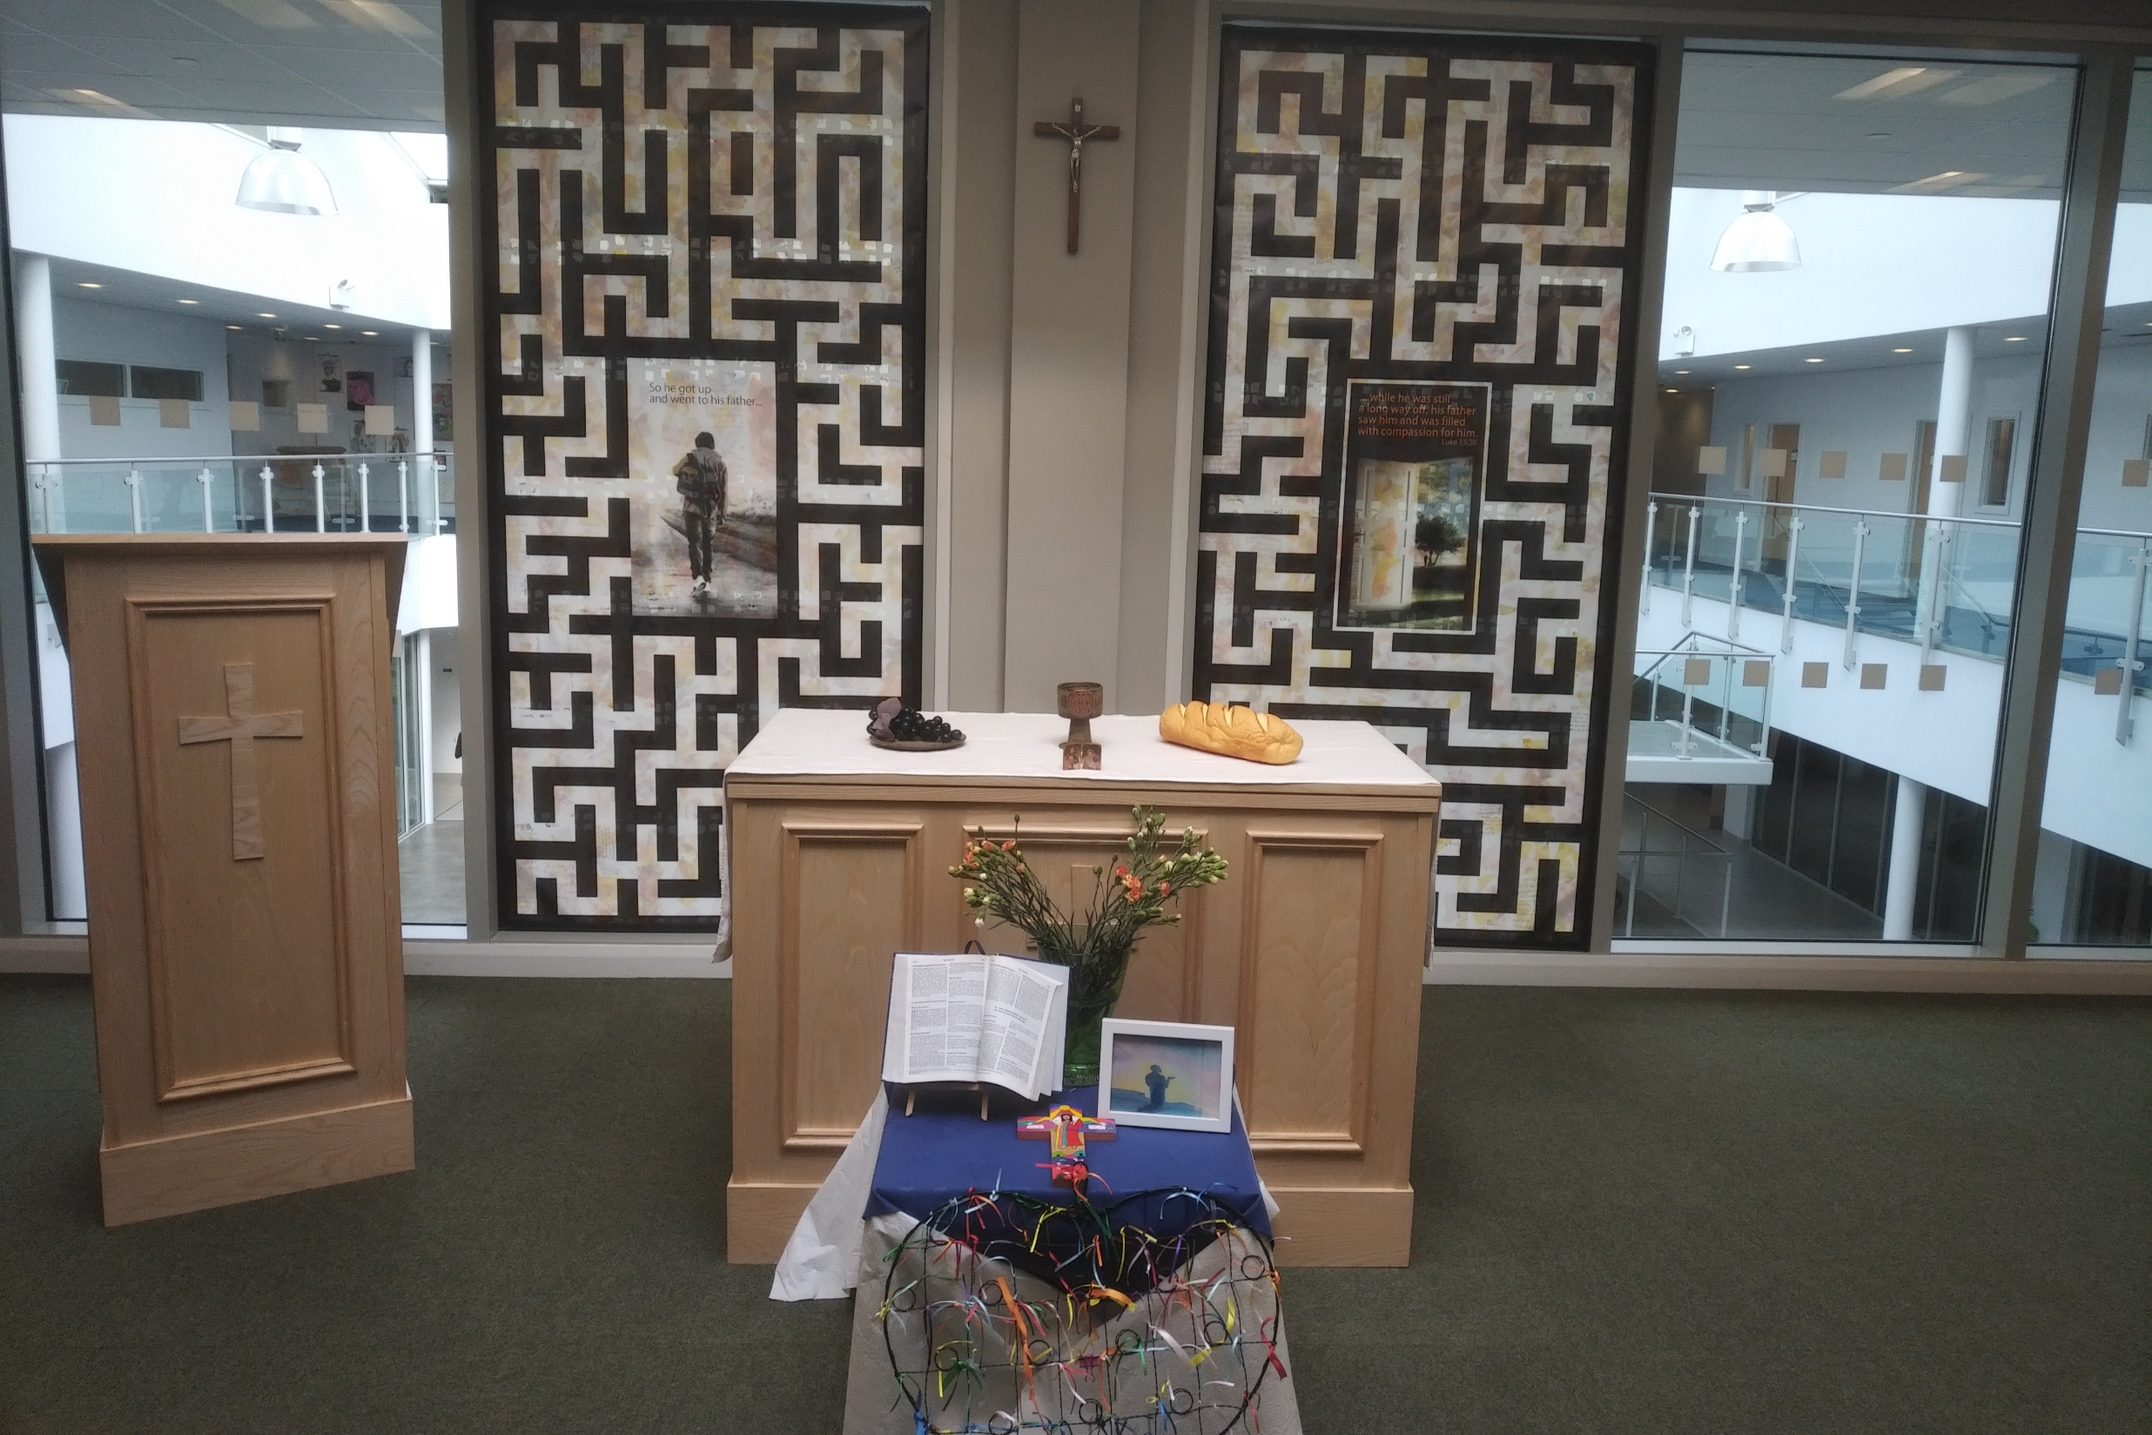
Friday Mass
Who?
Mass this week will be led by 12S & 12T
When?
Friday Morning at 8.20am
Where?
In the School Chapel. See you there!
ALL ARE MOST WELCOME.
ALL WORDS ARE DISPLAYED ON THE SCREEN.

Slide 4
Lunchtime events: All are welcome..
Crafts and Mindfulness
(Mondays in the chapel)
Islamic Union
(Tuesday G15)
Christian Union
(Tuesdays in G16)

Slide 5
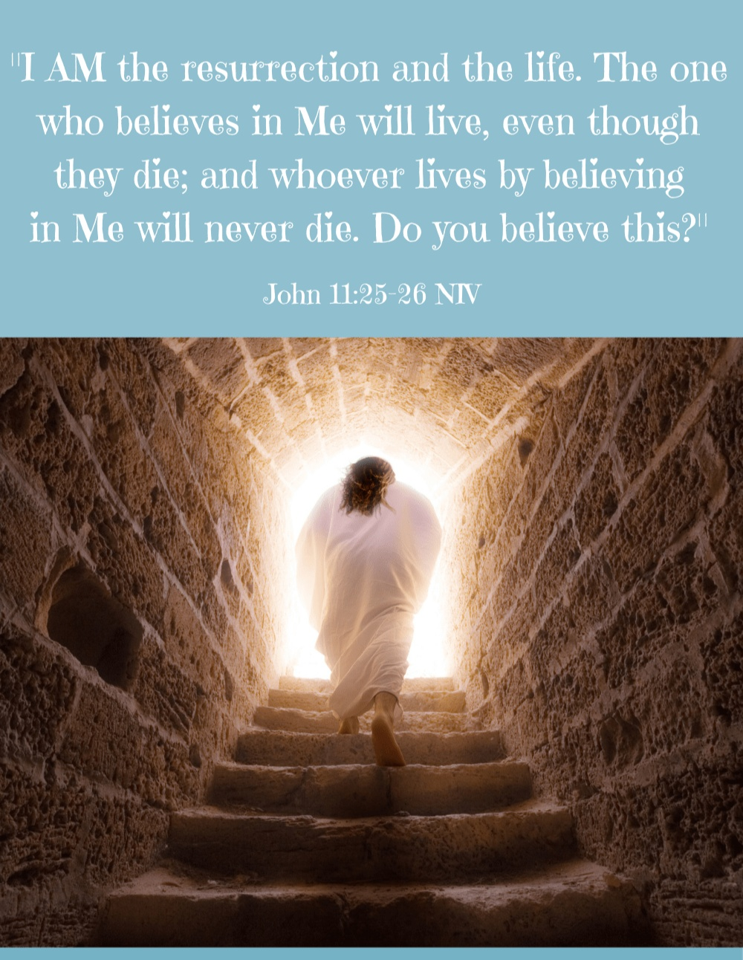
The verse "I am the resurrection and the life. Anyone who believes in me will live." (John 11:25) speaks to the profound promise of eternal life through faith in Jesus Christ. In this passage, Jesus is comforting Martha, the sister of Lazarus, who has just died. Martha expresses her belief in the resurrection at the last day, but Jesus responds with a profound revelation of his own identity and power.
If we consider this passage in relation to our theme of surrender, we find a powerful connection between surrendering to Christ and experiencing the fullness of life, both in this world and in eternity.
Surrendering to Christ means entrusting our lives entirely to Him, believing in His power to transform us and grant us eternal life.
By surrendering our doubts, fears, and desires to Christ, we open ourselves to His life-giving presence and grace. This surrender involves letting go of our own plans and trusting in God's divine plan for our lives, even when it may be difficult or uncertain.
In surrendering to Christ, we embrace the promise of resurrection and eternal life that He offers to all who believe in Him.
In essence, surrendering to Christ is not a passive resignation but an active choice to place our faith and trust in Him as the source of true life. Through surrender, we find hope, peace, and the assurance of eternal life in Christ, who is the resurrection and the life.

Slide 6
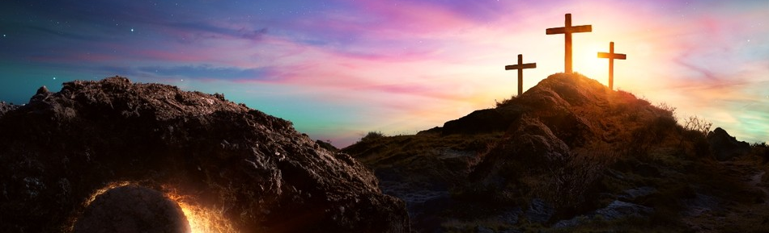
Lent and the resurrection
The resurrection is the pinnacle of Lent, symbolising hope and new life. As Christians journey through Lent, they surrender to Christ's transformative power, seeking spiritual renewal and alignment with His sacrifice. The resurrection offers victory over sin and death, inspiring believers to persevere in their Lenten disciplines and embrace the promise of transformation. The resurrection is celebrated on Easter Sunday.

Slide 7

Lord,
Help us, Lord, to surrender our doubts and fears, our desires and plans, at the foot of the cross. Grant us the courage to let go of our own understanding and to trust in Your divine plan for our lives. In surrendering to You, may we find the fullness of life that You promise to all who believe in Your Son.
May Your Spirit empower us to surrender our will to Yours each day, knowing that in doing so, we are embracing Your love, Your grace, and Your eternal promise of resurrection.
Amen

Slide 8

Take a few moments this morning to surrender yourself to the power of music.

Slide 9
Theme of the week: Surrender
Thoughts and Prayers 18th - 22nd March

Slide 10

Being in control
Do you like being in control?
Which aspects of your life do you like to be in control of and why?
How does it feel when you lose control and have to accept whatever happens?

Slide 11
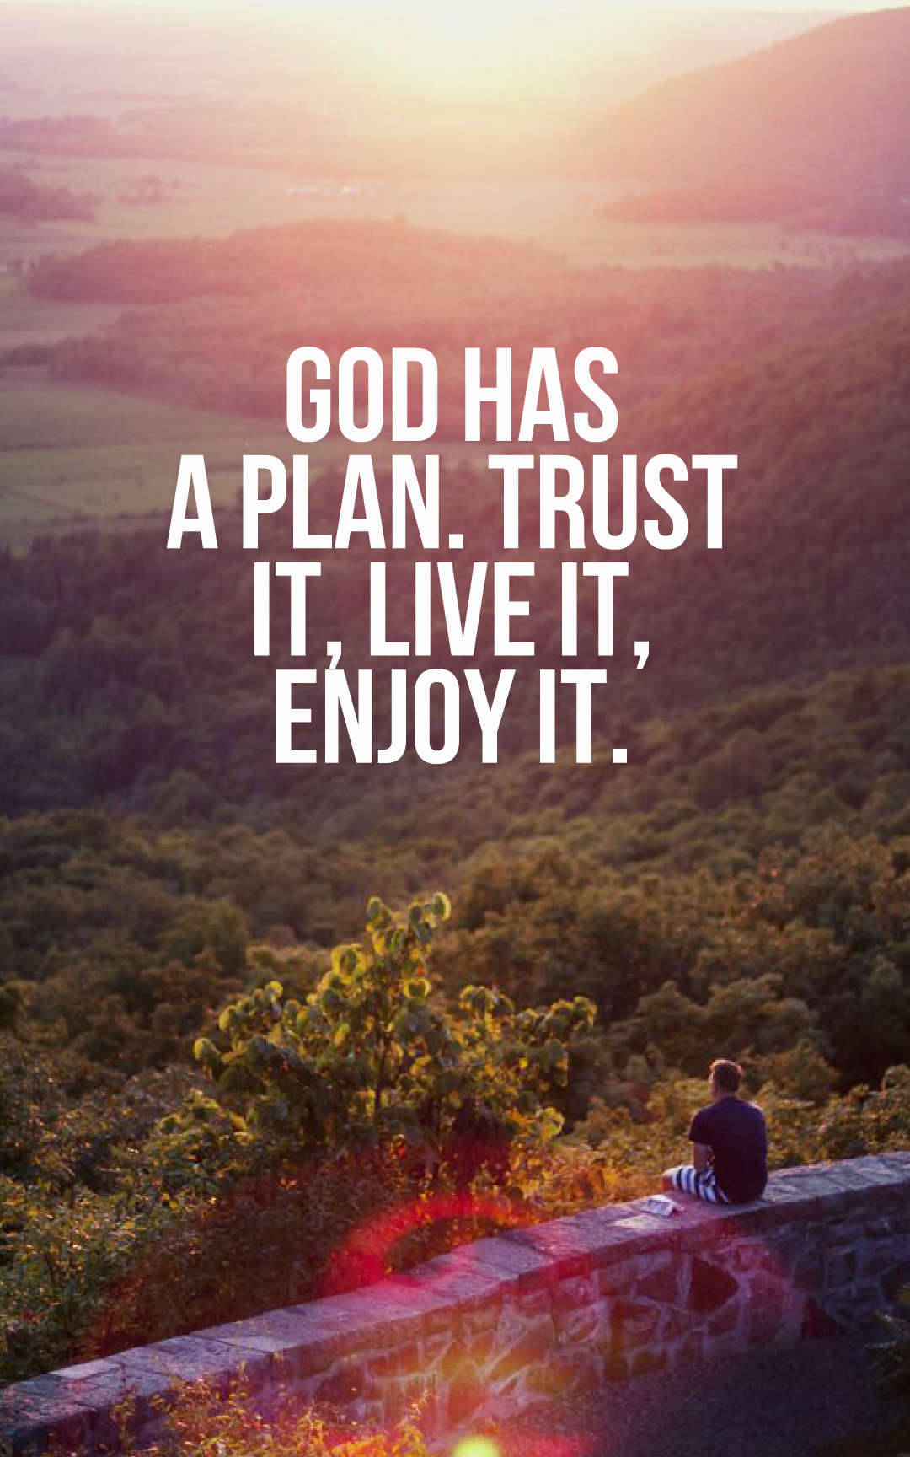
Surrendering to a higher plan
Being in control of your life sounds like a positive thing, and in most cases, it can be. But sometimes, the need to control everything can become all-consuming.
If you feel the need to control all things and events around you, you may consider yourself a perfectionist, holding yourself (and others) to very high standards.
Perhaps you tend to have trouble coping when things don’t go to plan or change unexpectedly.
The truth is, there are some aspects of life that we cannot control and sometimes trying to control them, can cause stress and anxiety.
Surrendering control of the uncontrollable can give us freedom and peace.
Putting our faith in God's plan for us all can give us serenity and release us from stress.

Slide 12
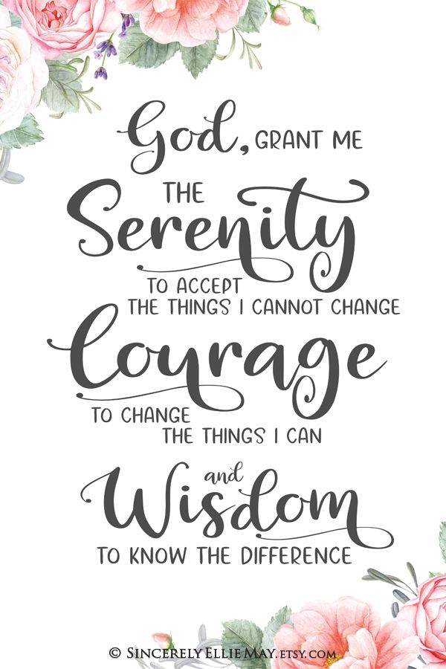
What do you think this means?
How might it link to our theme of surrender?
How might it link to the idea of control?

Slide 13
PRAYER
Almighty Father,
Help us to surrender our will to yours. Grant us the faith to trust in your plan, even when it differs from our own. May we find peace and strength in surrendering to your divine wisdom.
Amen

Slide 14
Theme of the week: Surrender
Thoughts and Prayers 18th - 22nd March

Slide 15

Surrendering to Creation
World Water Day
22nd March 2024
World Water Day reminds us of the vital importance of water, not only for sustaining life but also for the health of our planet. Surrendering to creation involves recognizing the interconnectedness of all life and sacrificing our comforts or conveniences for the greater good of preserving water resources. Reflect on how surrendering certain habits or practices that contribute to water waste can be an act of reverence towards God's creation and a commitment to environmental stewardship.

Slide 16



Slide 17
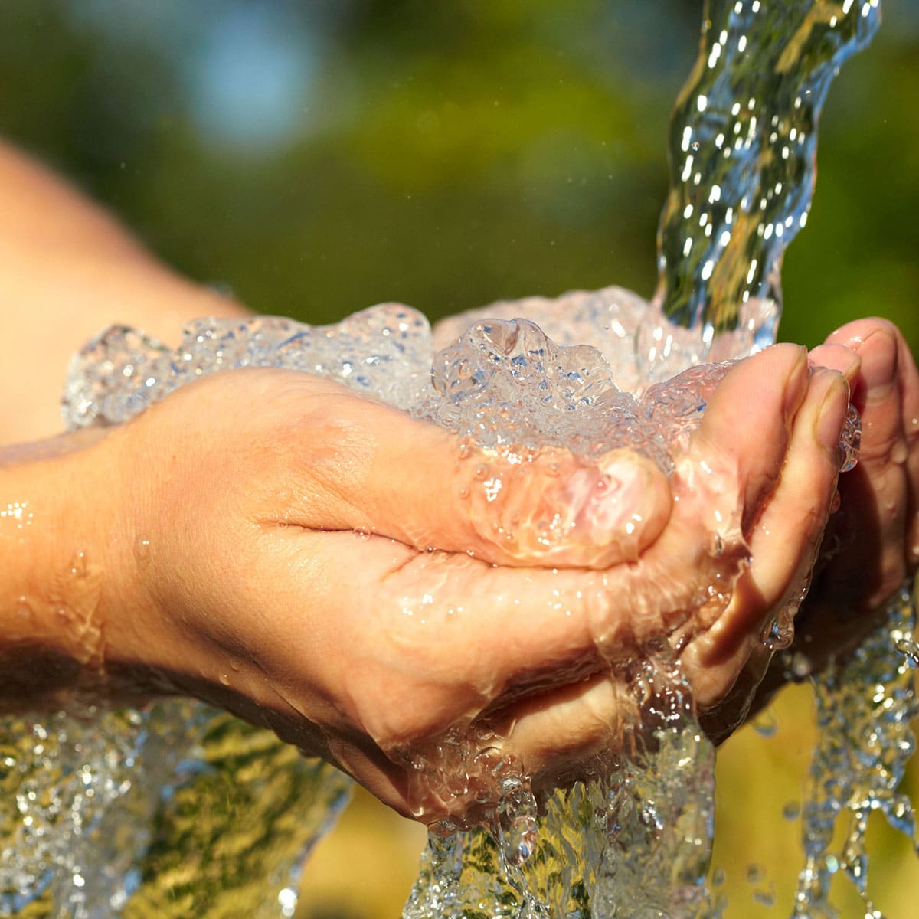
Surrender:
Giving up bad habits
Make a list of the ways you can help to save water every day at home and in school.
Can you pledge to commit to making these changes?
What kind of positive impact do you think it could have if you do?

Slide 18
Bidding Prayers
Reader 1: We thank you, Lord, for the beauty of our natural world. We give thanks for the abundance of life that pours from our oceans and rivers.
Lord in your mercy,
ALL: Hear our prayer
Reader 2: We pray for the protection of our rivers, lakes, and oceans. We pray that they may be preserved as sources of life and beauty for future generations,
Lord in your mercy,
ALL: Hear our prayer
Reader 3: We pray for those who lack access to clean water. May they be blessed with abundant and safe water sources.
Lord in your mercy,
ALL: Hear our prayer
Reader 4: We pray for the awareness and commitment of all people to conserve water and respect this precious resource, may we be mindful stewards of creation.
Lord in your mercy,
ALL: Hear our prayer
Lord, hear our prayers as we come before you humbly. Amen

Slide 19
Theme of the week: Surrender
Thoughts and Prayers 18th - 22nd March

Slide 20
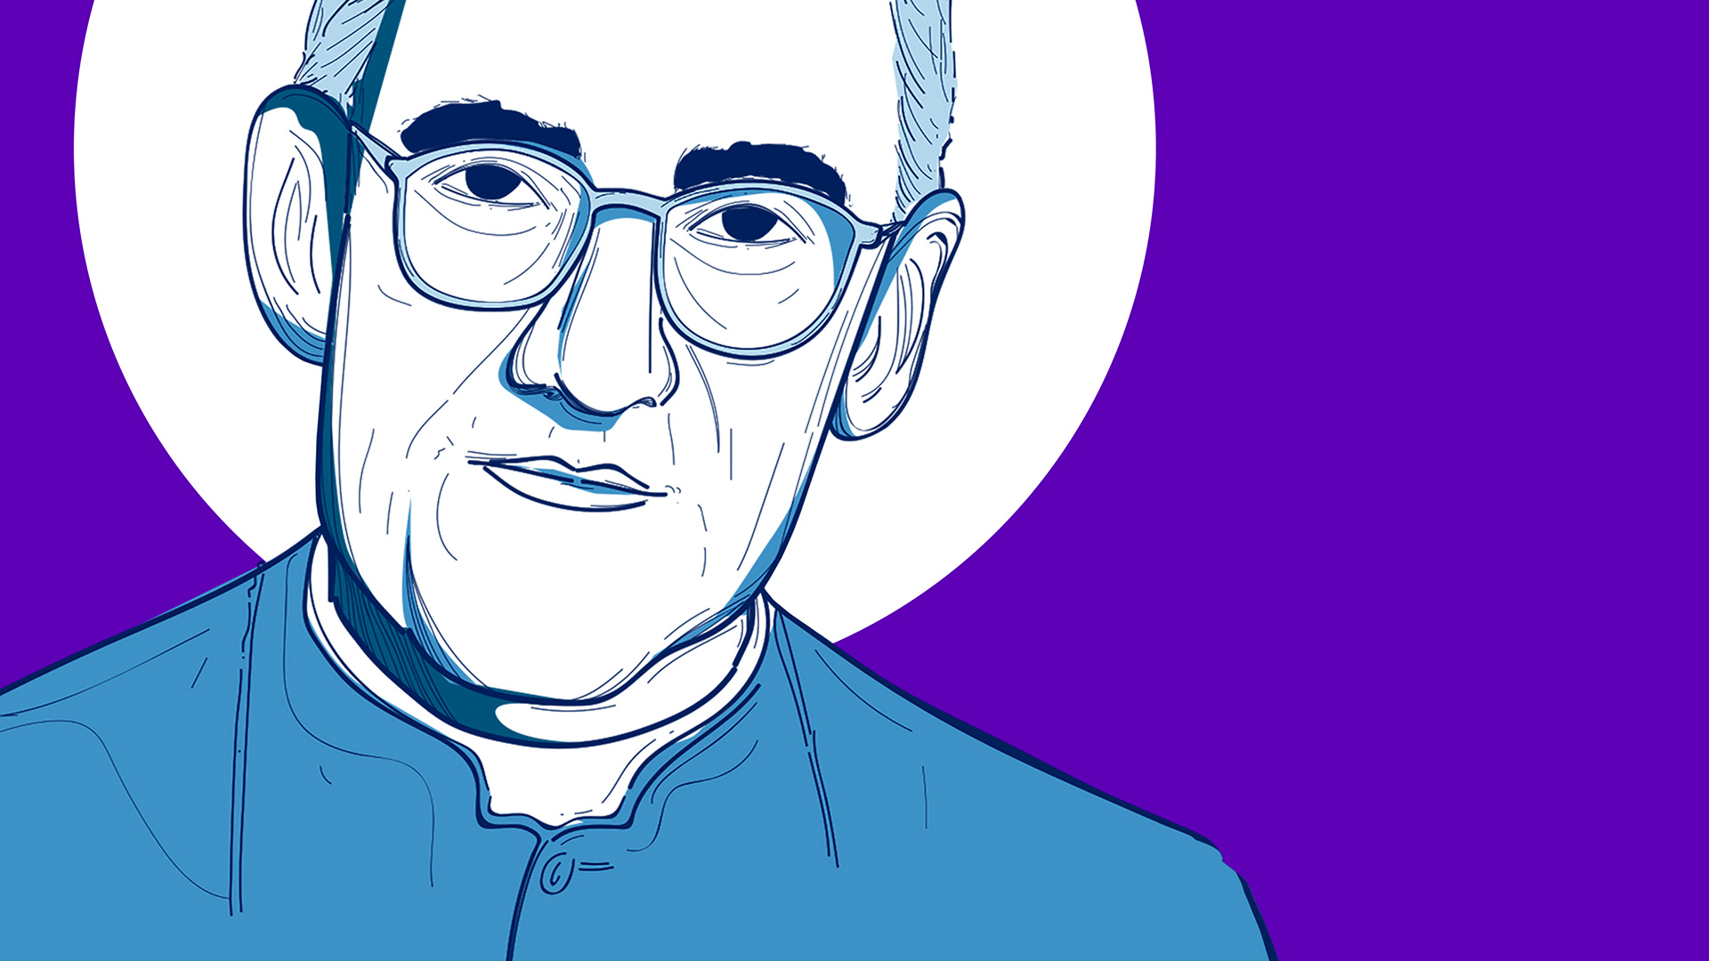
Friday is the Feast Day of Saint Oscar Romero
Oscar Romero is shows us the importance of having respect for all people. He was mostly concerned with social injustice and the treatment of the poor.
He surrendered to God's plan and calling, dedicating his entire life to improving conditions for all people, regardless of their beliefs or social status.
He was deeply compassionate and lost his life fighting for what he knew to be morally right and true.

Slide 21
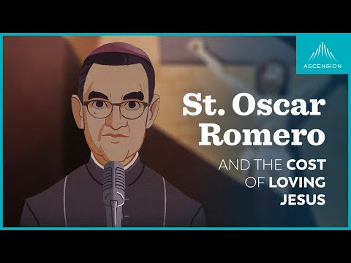
watch this
Note to teacher: stop video at 3.10

Slide 22
Dear God,
We pray today for Saint Oscar Romero on his Feast Day.
Fill us with the strength and compassion to treat all people with respect.
Give us the wisdom and courage to stand up against social inequality.
We give thanks for the sacrifice St Romero made in his life and the selflessness he displayed in the face of oppression and cruelty.
Amen

