Slide 1
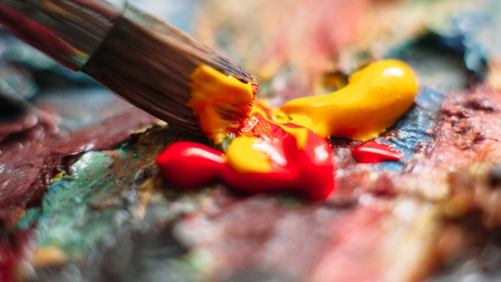
Works of Art
Thoughts and Prayers
Monday 11th March – Friday 15th March

Slide 2
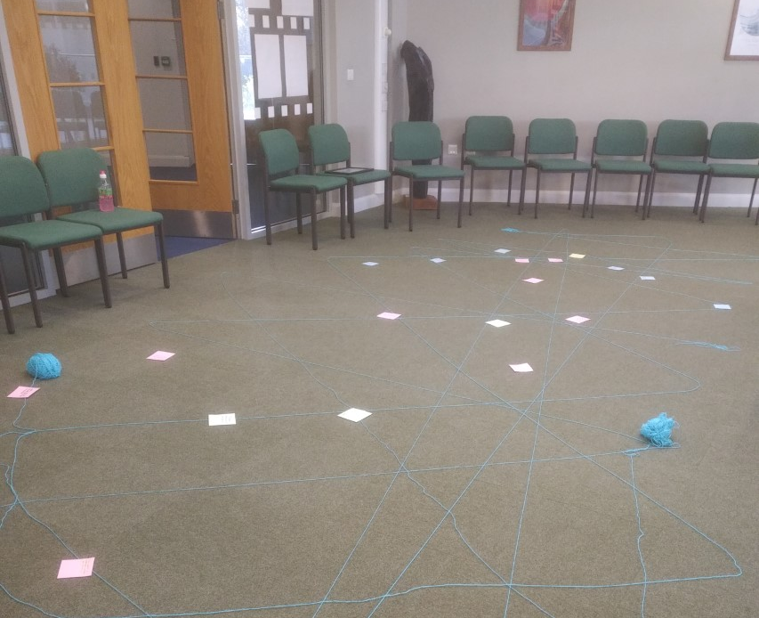

MORNING PRAYER IN THE CHAPEL THIS WEEK
Monday 11th March - 13A
Tuesday 12th March - 11S
Wednesday 13th March - 11A
Thursday 14th March - 11I
Friday 15th March - 11N

Slide 3
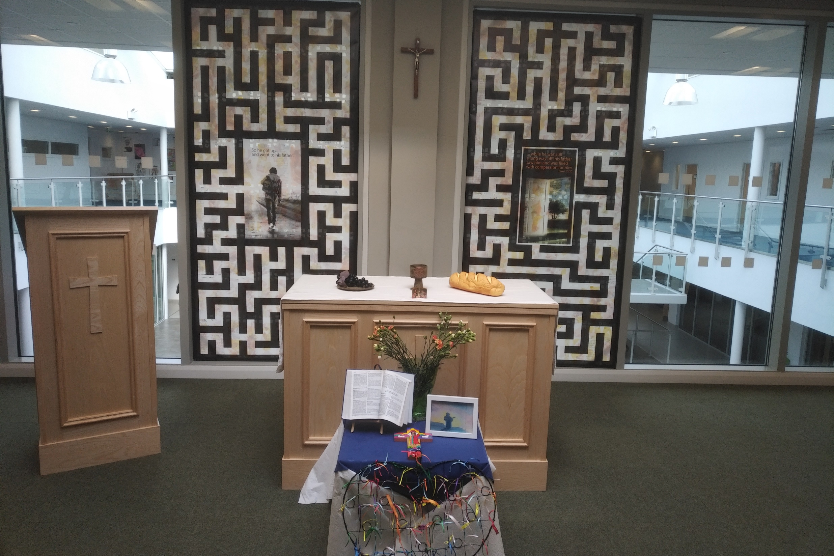
Friday Mass
Who?
Mass this week will be led by 8S
When?
Friday Morning at 8.20am
Where?
In the School Chapel. See you there!
ALL ARE MOST WELCOME.
ALL WORDS ARE DISPLAYED ON THE SCREEN.

Slide 4
Works of Art
Thoughts and Prayers
Monday 11th March – Friday 15th March

Slide 5
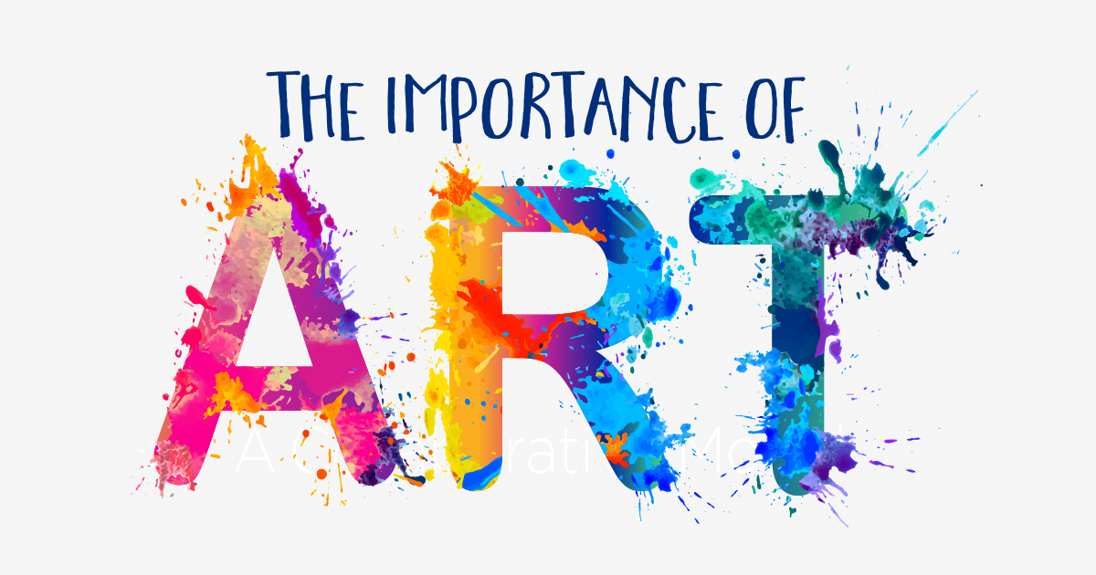
Art serves as a powerful means of self-expression, allowing individuals to convey their thoughts, emotions, and experiences in unique and creative ways.
Engaging with art stimulates creativity and fosters innovation. Artists often push boundaries, challenge conventions, and explore new techniques, materials, and concepts.
Art has the ability to evoke a wide range of emotions. By engaging with art, we can develop empathy, compassion, and a deeper understanding of themselves and the world around them.
Art serves as a record of human history and culture, Through paintings, sculptures, literature, music, and other forms, we can learn about the beliefs, values, traditions, and experiences of past and present societies

Slide 6
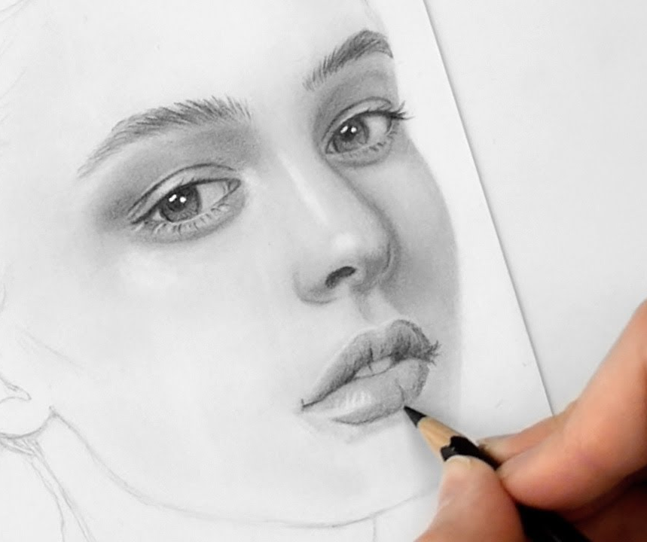
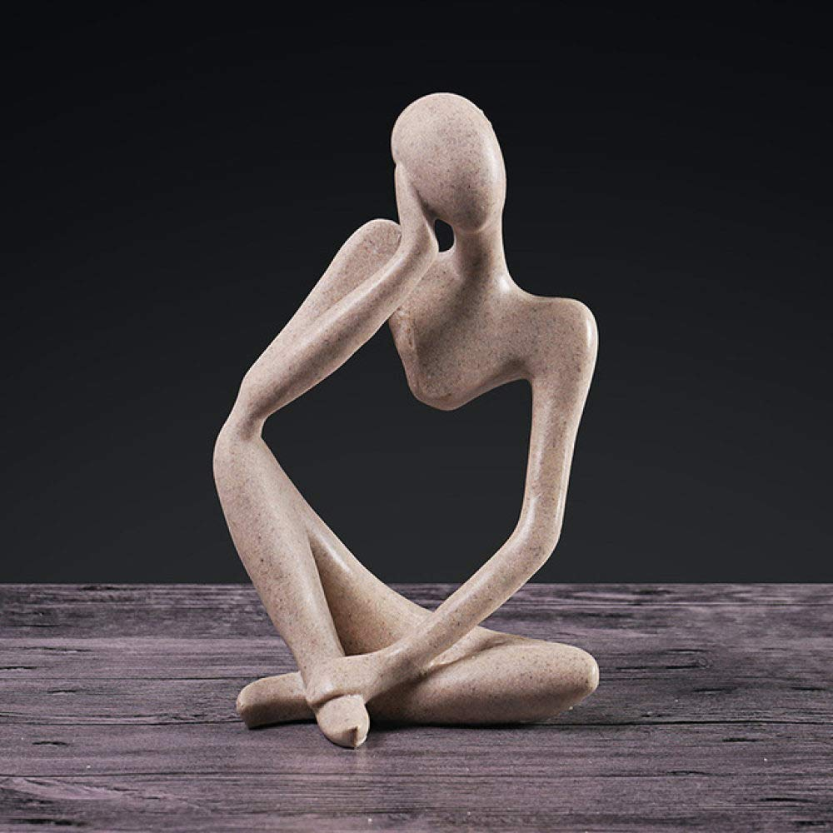

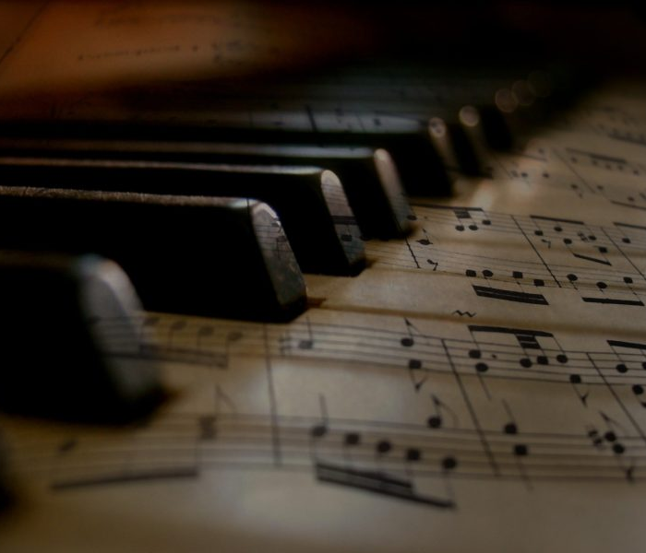
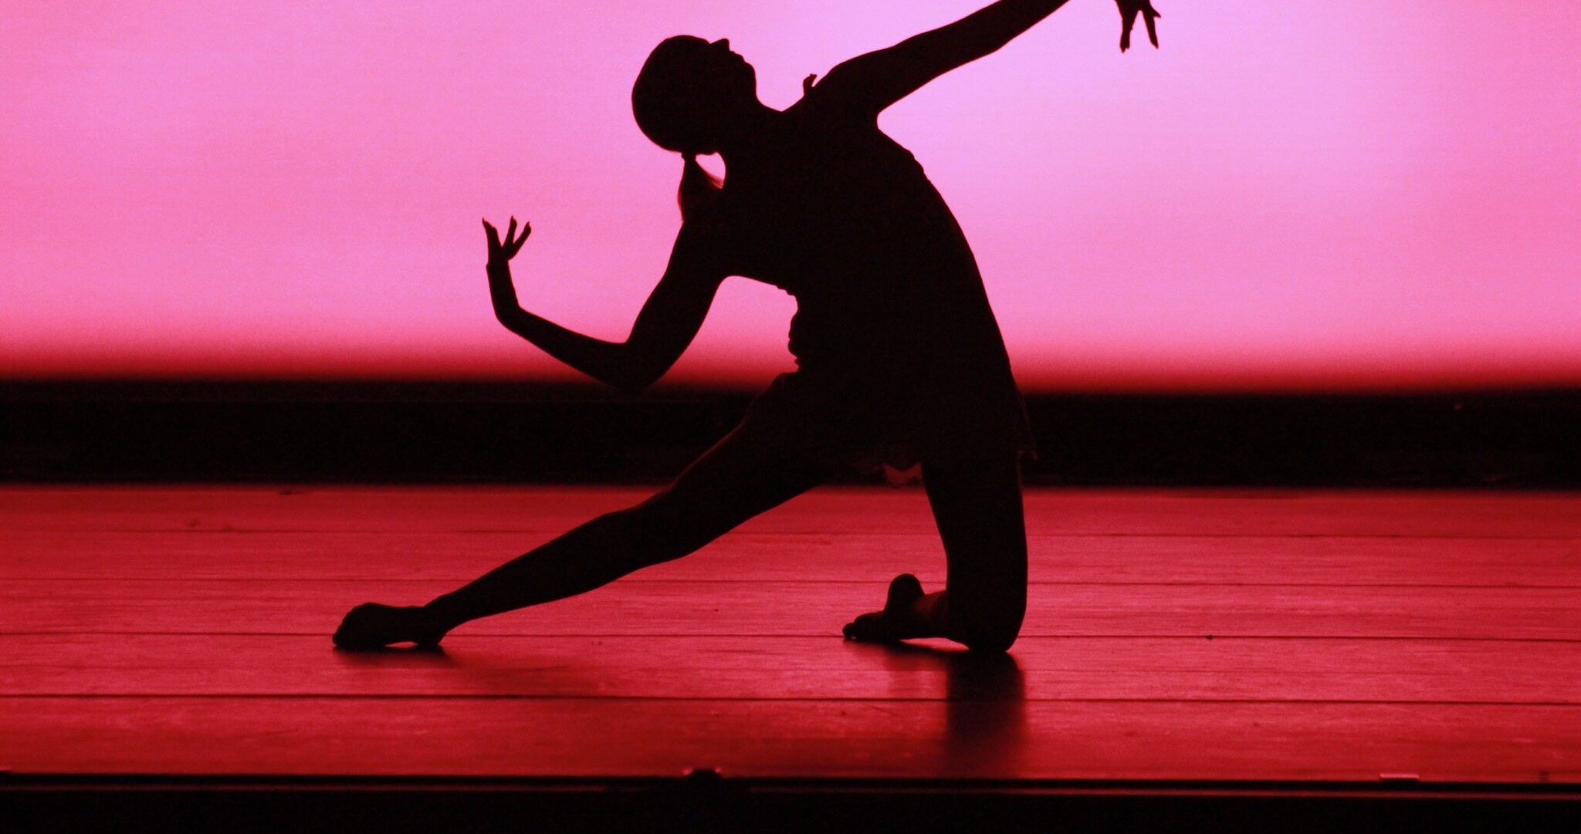
In pairs
Share and reflect on a work of art that has had a significant impact on you. It could be a painting, a song, a poem, or any other form of art
Why have you chosen this particular work of art? How does it make you feel, and what message or meaning do you think it conveys?

Slide 7
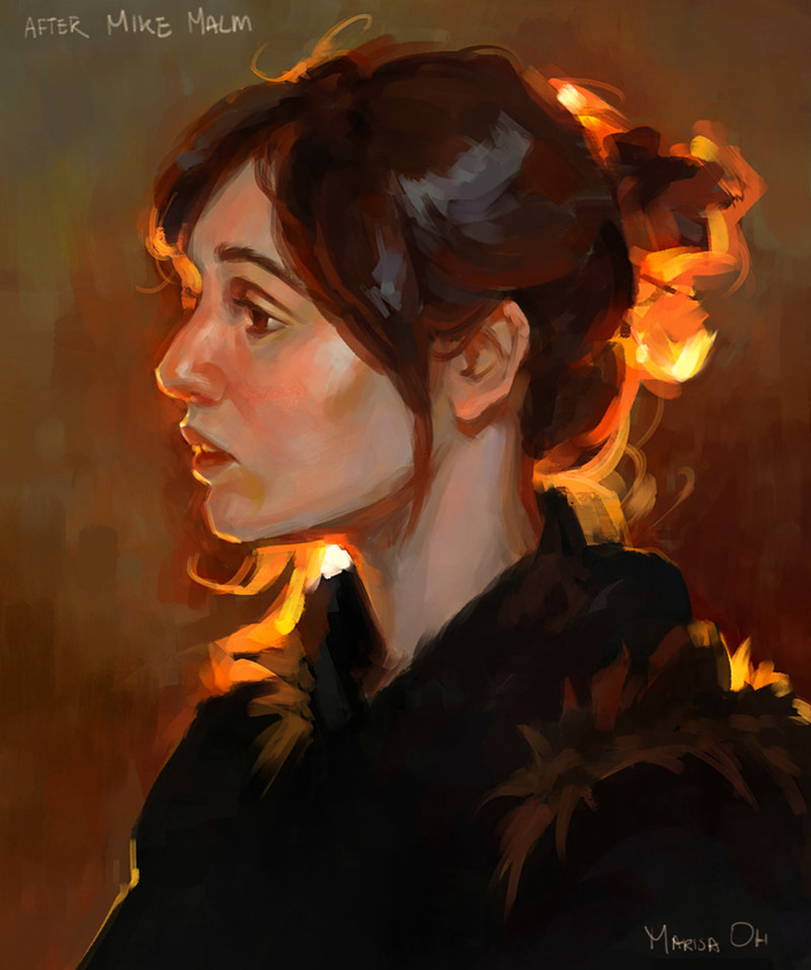
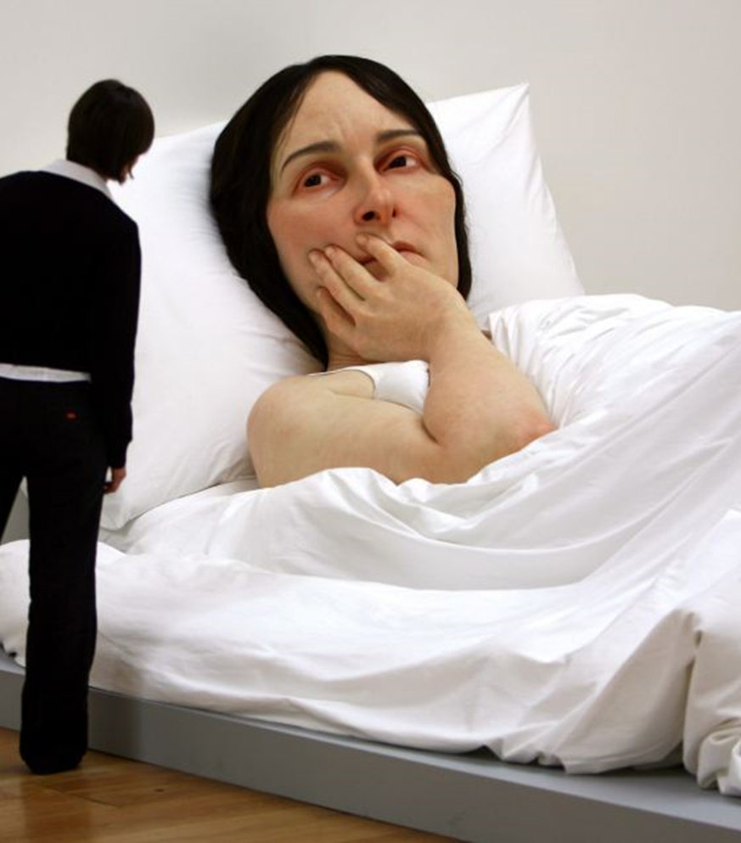
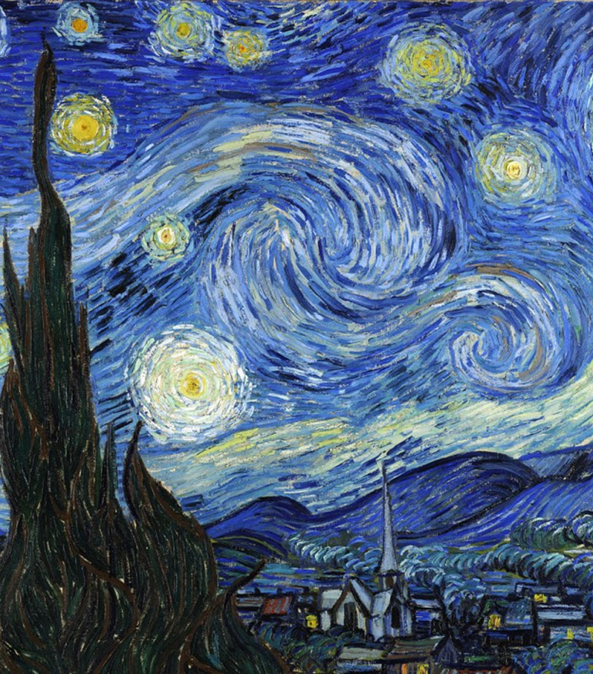
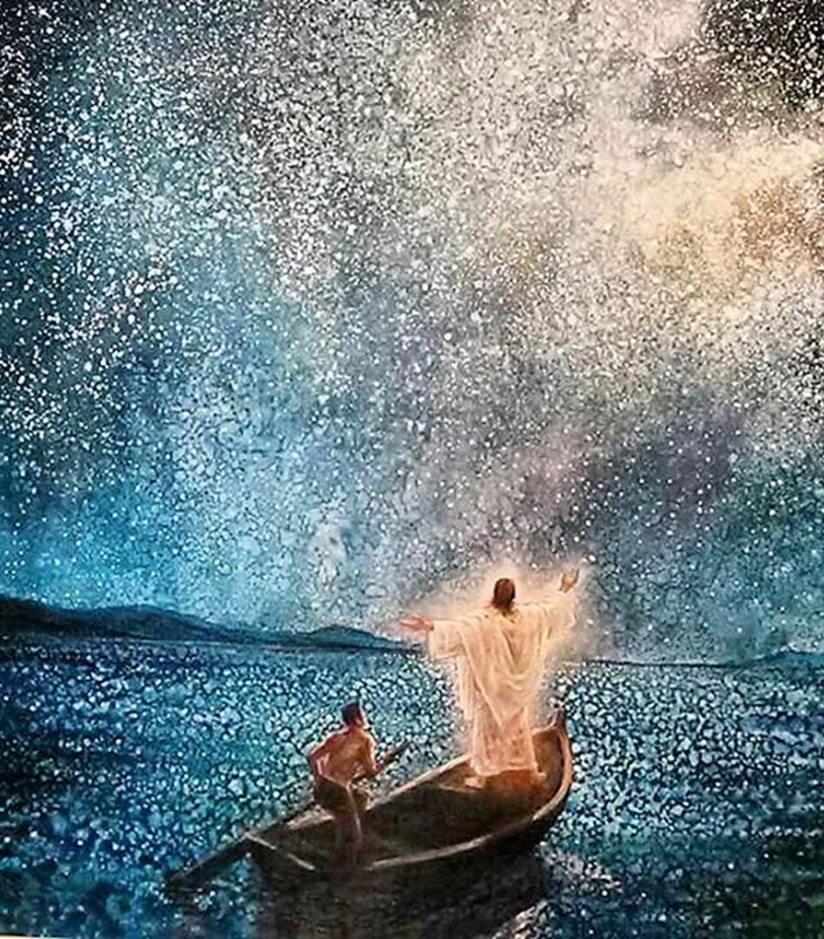
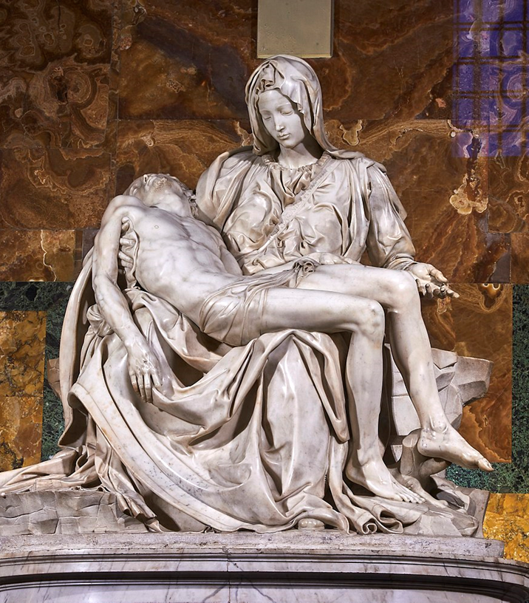
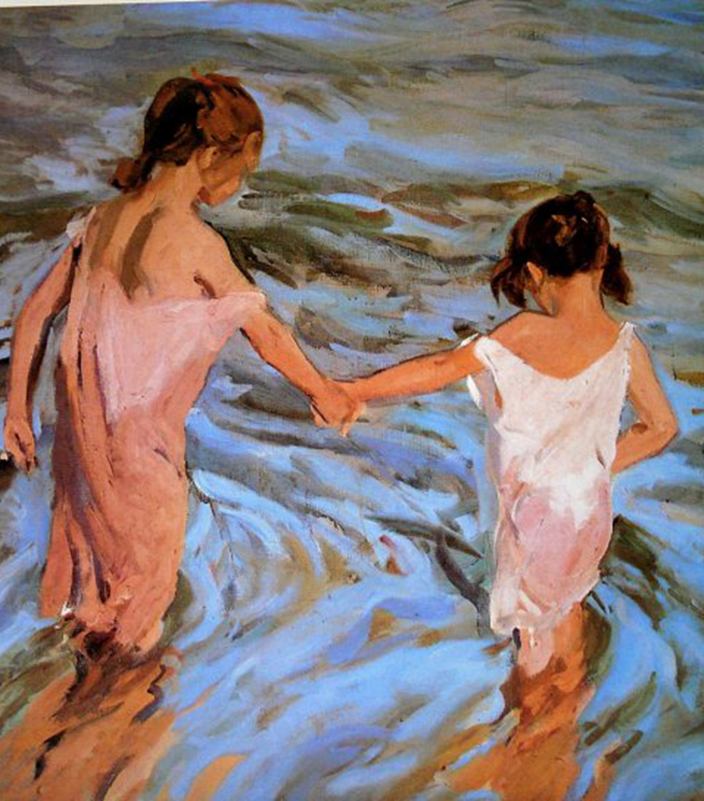
Famous Works Of Art
How do you feel about these famous pieces of art?
Why do you feel the way you do about them?

Slide 8
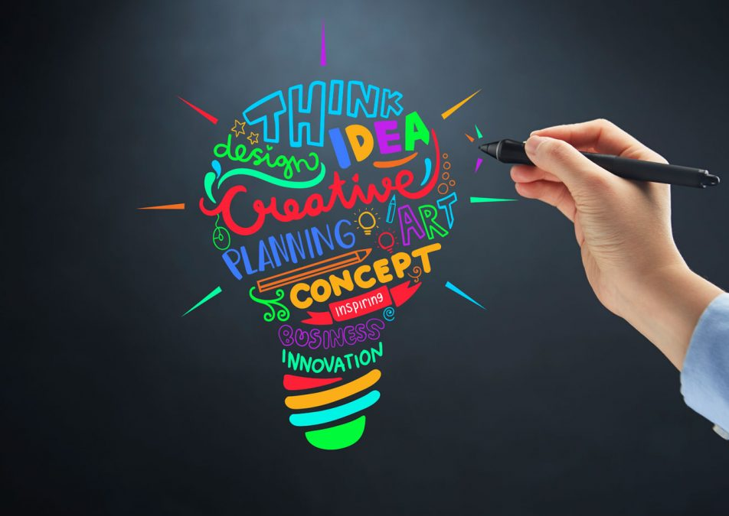
Personal Reflection
What role does art play in your life?
Can you recall a specific artwork that has left a lasting impression on you? What was it about this artwork that resonated with you?
How does engaging with art contribute to your emotional well-being and personal growth?

Slide 9
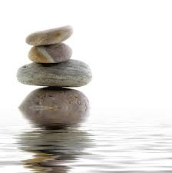
Let Us Pray
Lord,
As we gather in the presence of beauty and creativity, we offer our gratitude for the gift of art. We recognise that through art, we are able to glimpse the beauty of your creation and the depth of human expression.
Grant us the eyes to see beyond the surface, to perceive the stories and emotions woven into every stroke of the brush, every note of music, and every word of poetry. Help us to approach art with open hearts and open minds, ready to be moved, challenged, and inspired.
In Your name we pray,
Amen

Slide 10
Works of Art
Thoughts and Prayers
Monday 11th March – Friday 15th March

Slide 11

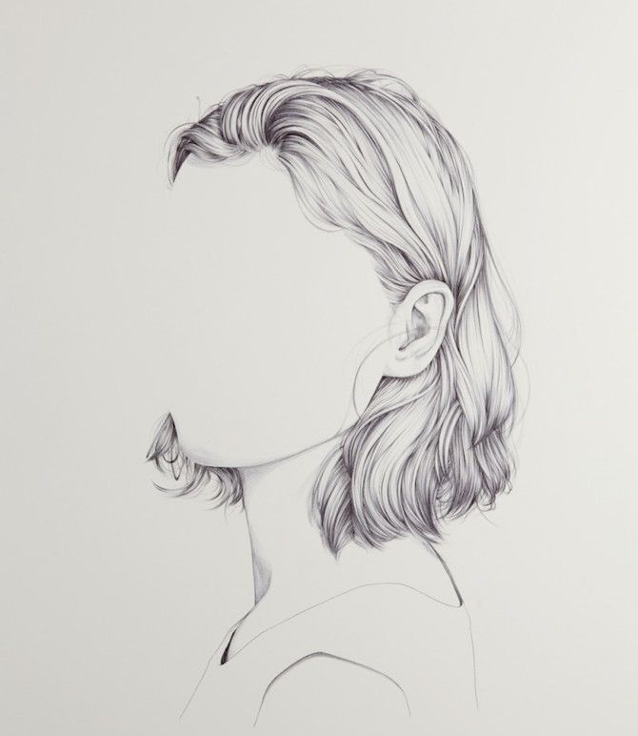
Work In Progress
A work in progress refers to something that is not yet completed but is still being actively worked on or developed. This term is commonly used across various fields, including art, literature and music
In the context of art, a work in progress could be a painting, sculpture, or any other artistic creation that is still being worked on by the artist. Similarly, in literature, a work in progress could be a manuscript or draft of a book that is still undergoing revisions and edits.

Slide 12

Work In Progress
What does "work in progress" mean to you personally?
How do you approach tasks or projects that are still in progress? What strategies do you use to keep yourself motivated and focused?
Can you think of a time when you faced challenges or setbacks in a project that was still ongoing? How did you deal with them?
In your opinion, is it better to strive for perfection or to embrace the idea of "work in progress"? Why?
What role does feedback play in your work in progress? How do you seek and incorporate feedback effectively?
How do you manage feelings of uncertainty or doubt when working on something that is still evolving?
Do you believe there is value in sharing your work in progress with others, or is it better to wait until it's finished? Why?

Slide 13
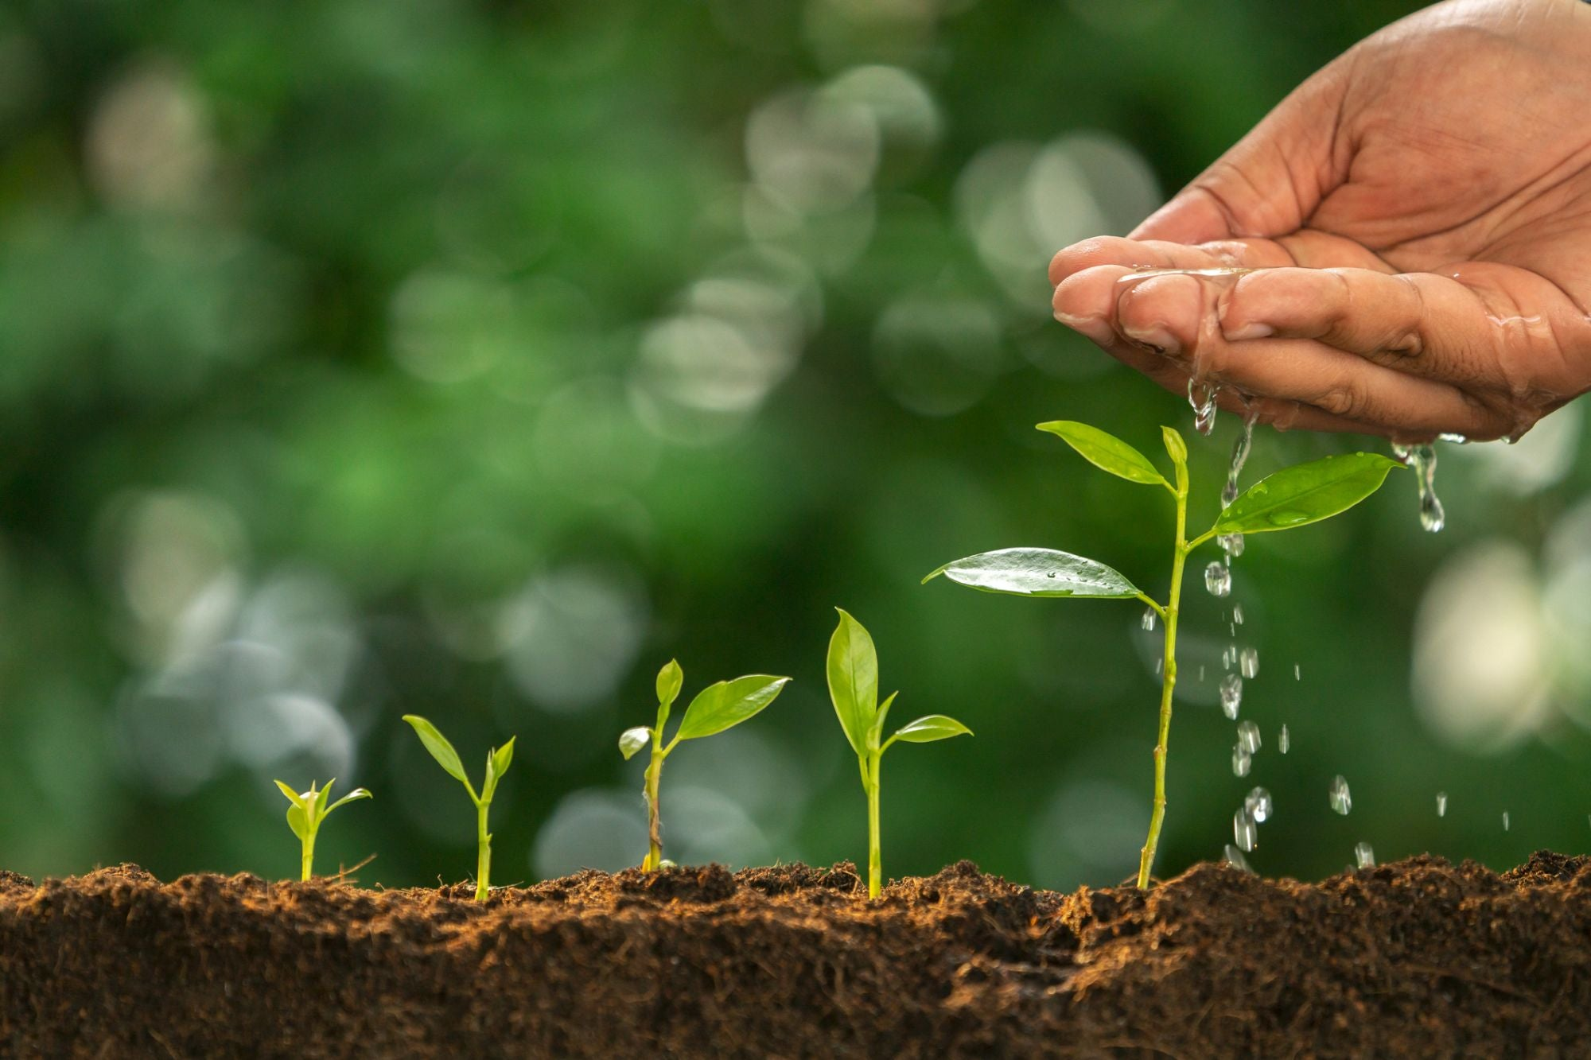
We are all a Work In Progress
As human beings, we are constantly evolving, learning, and growing, which is why we can be considered "a work in progress" in many aspects of our lives. Here's how:
Personal Growth: Throughout our lives, we experience various events, challenges, and opportunities that shape who we are. We learn from our experiences, reflect on our actions, and strive to become better versions of ourselves. This ongoing process of self-improvement and personal development is what makes us a work in progress. Can you think of one moment in your life that shaped who you are?
Emotional and Mental Health: Our emotional and mental well-being also undergoes constant change and development. We may face challenges such as stress, anxiety, or trauma, but we also have the capacity to heal, grow, and develop resilience. Through self-awareness, therapy, and self-care practices, we can actively work on our emotional and mental health, recognizing that it's an ongoing process. Is there something that you find easier to deal with today than you used to?
Relationships and Interactions: Our interactions with others also contribute to our growth and development. Every relationship we have, whether it's with family or friends, provides opportunities for learning, understanding, and personal growth. We learn to communicate better, navigate conflicts, and deepen our connections with others over time. Can you think of a relationship that has taught you something that has helped you grow?
Goals and Aspirations: As individuals, we often have goals, dreams, and aspirations that we are working towards. Whether it's advancing in our school work, building meaningful relationships, or pursuing personal passions, these goals keep us motivated and moving forward. Achieving these goals is often a gradual process, requiring perseverance, adaptation, and continuous effort, which reflects our status as works in progress. Can you think of a goal or dream that you are working towards?

Slide 14
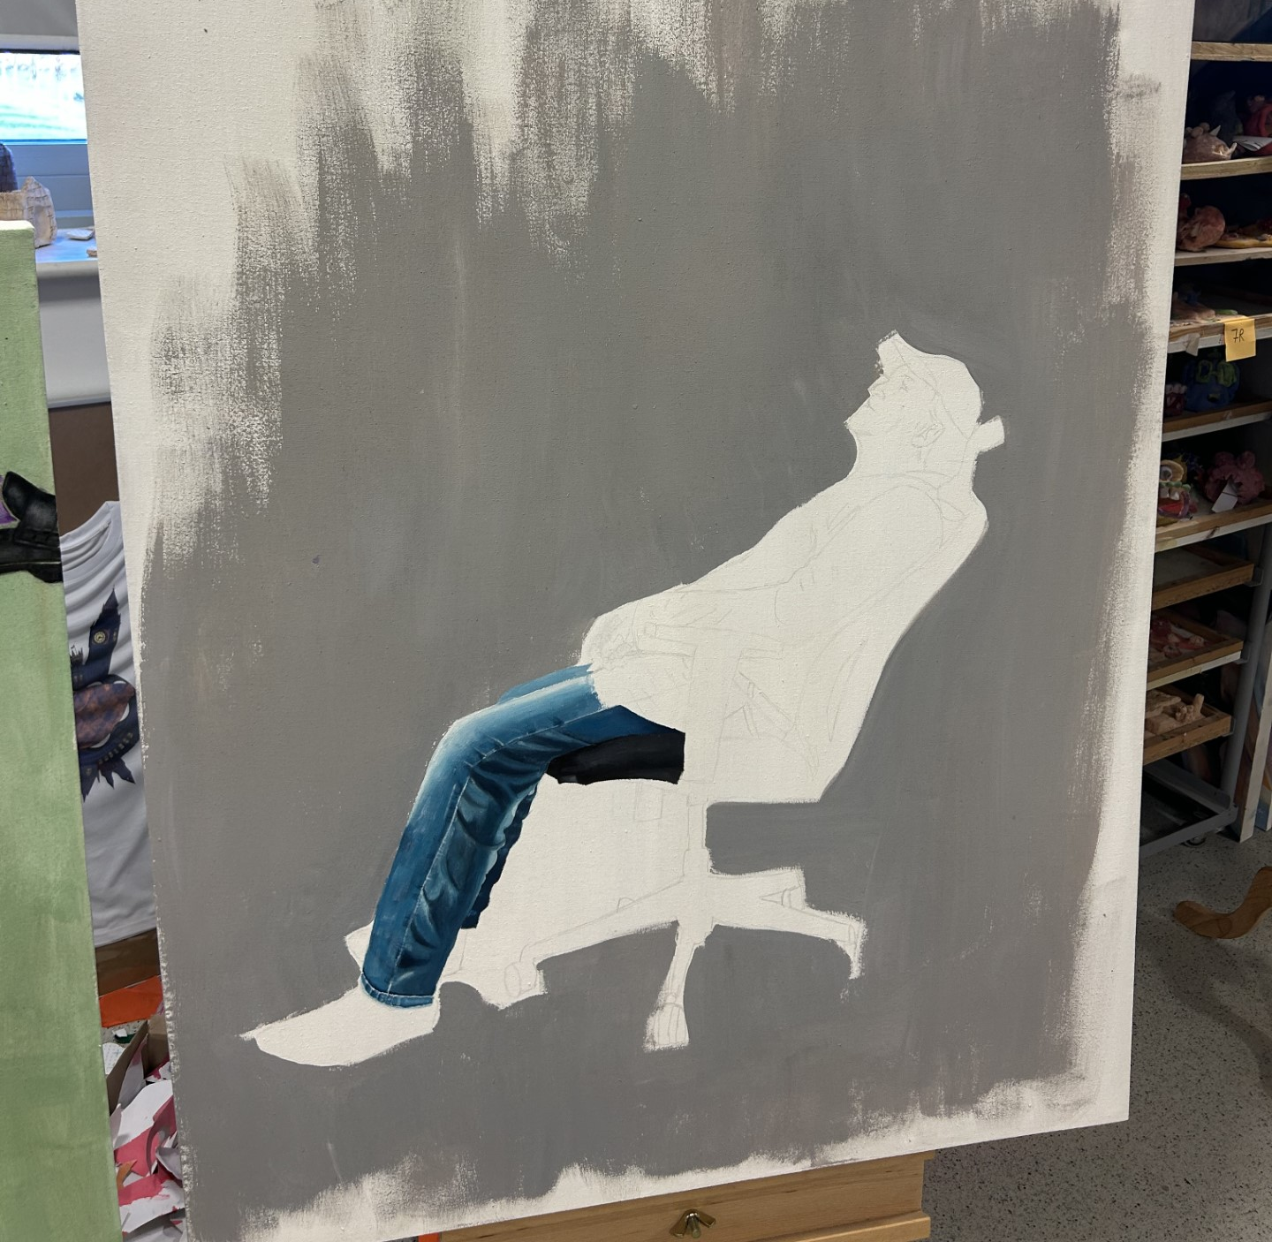
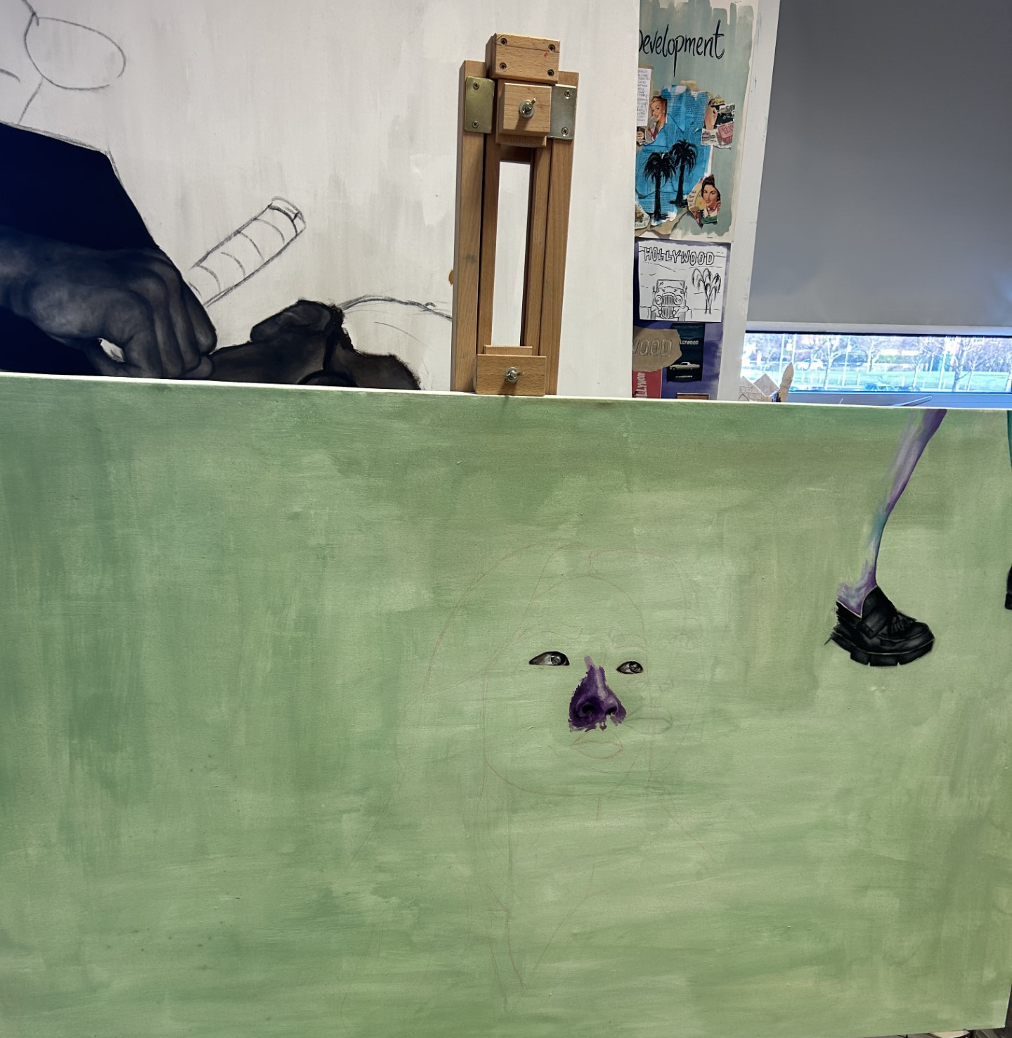
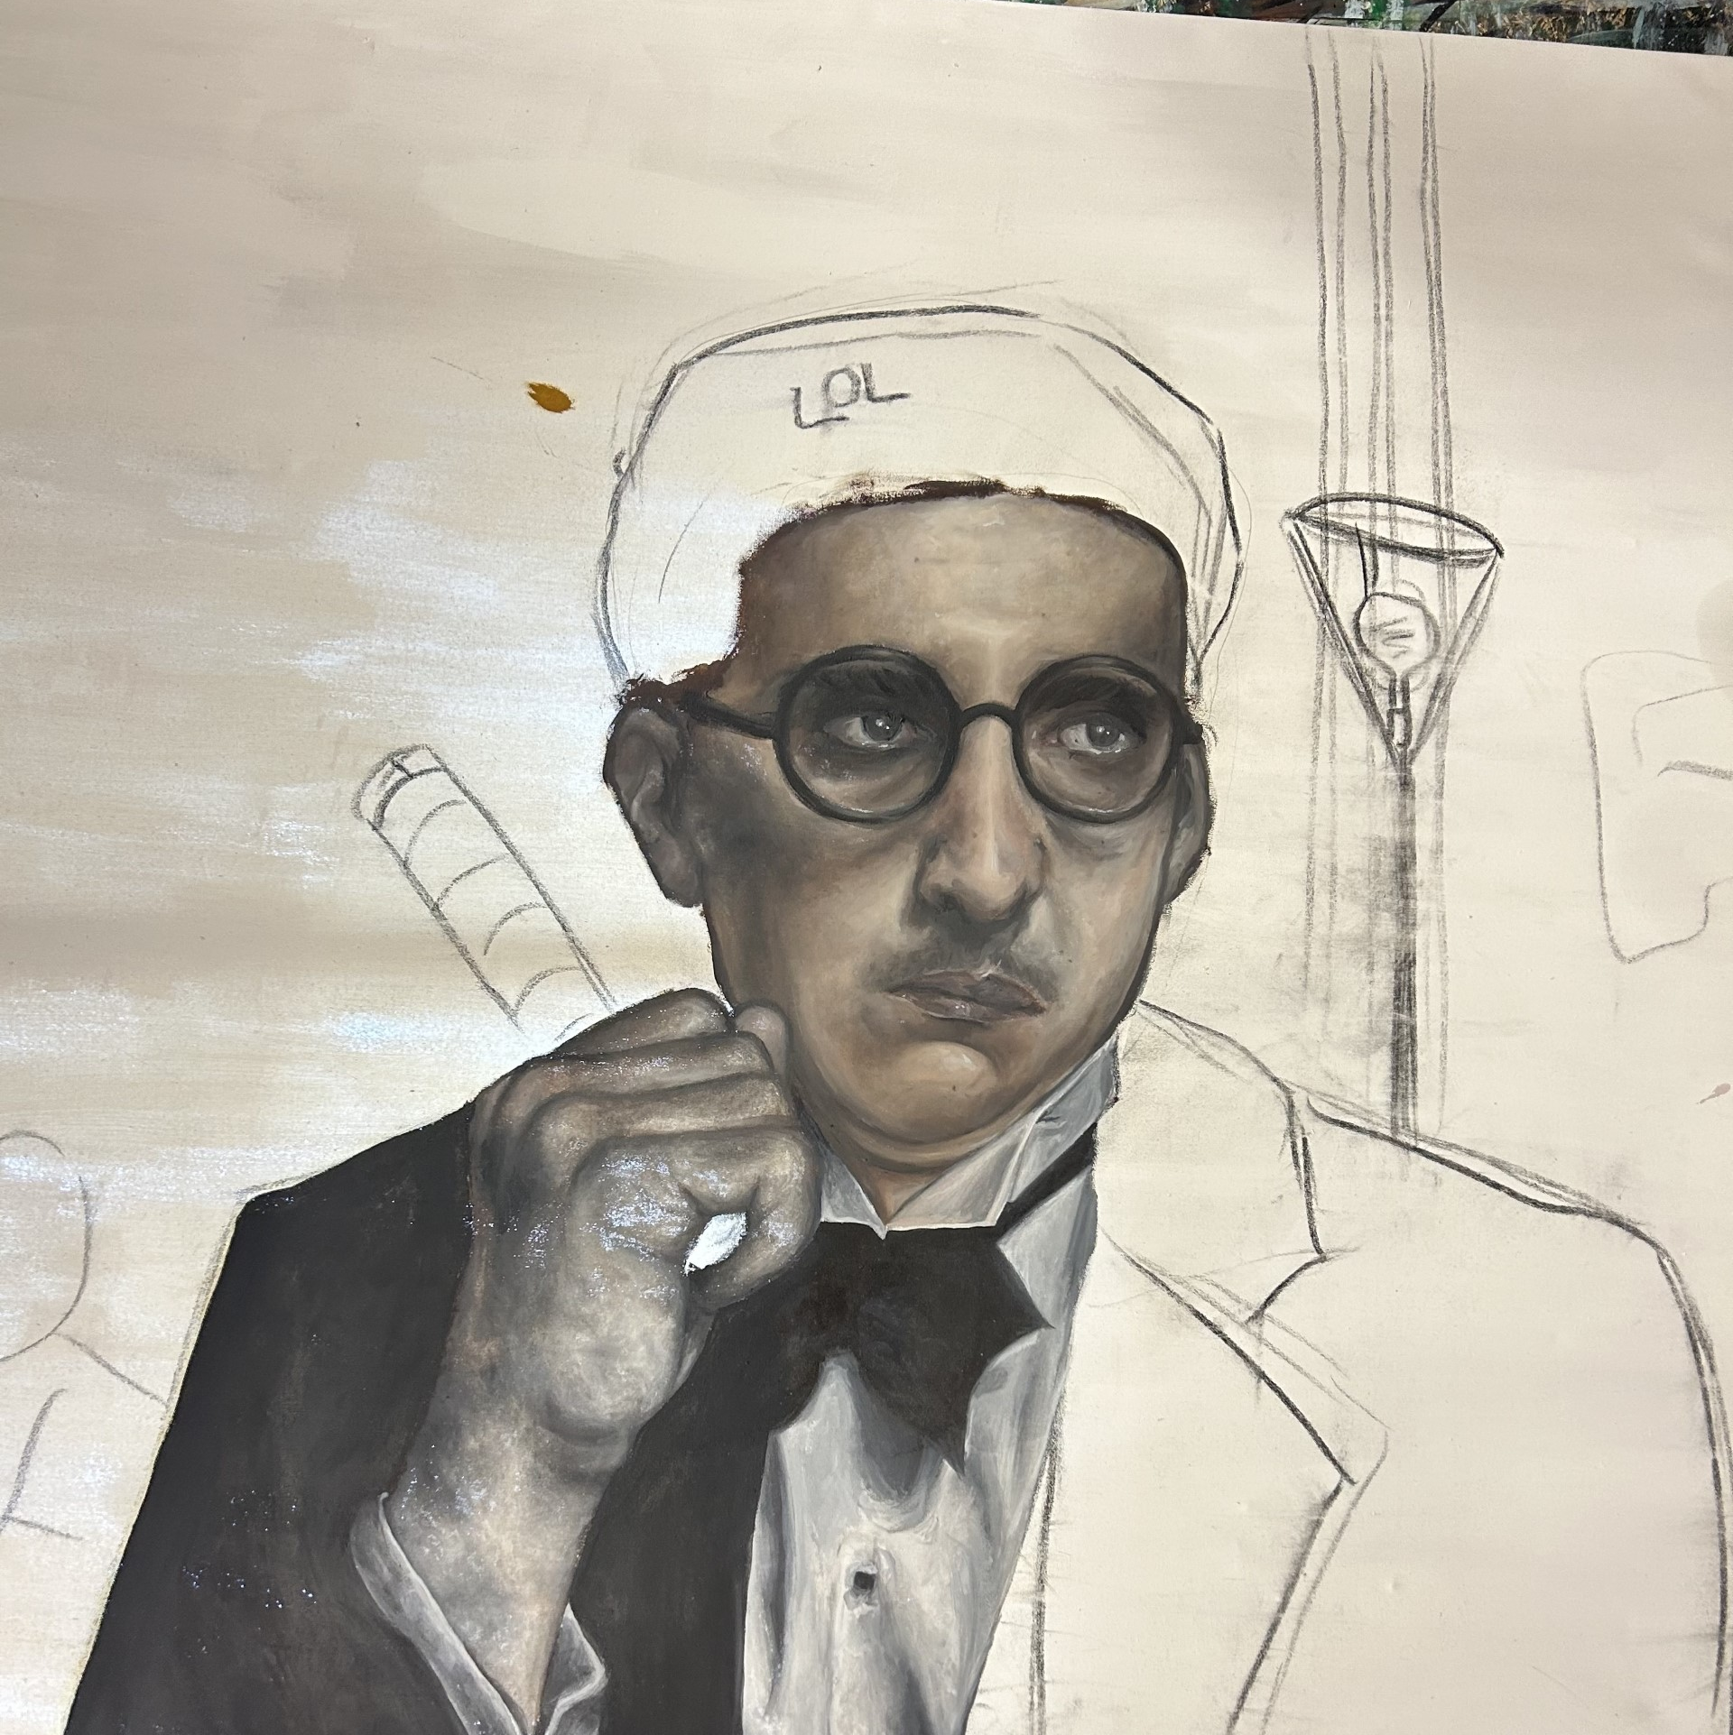

Here are three examples of 'works in progress' from Year 12 A level Art students at St Mary's

Slide 15
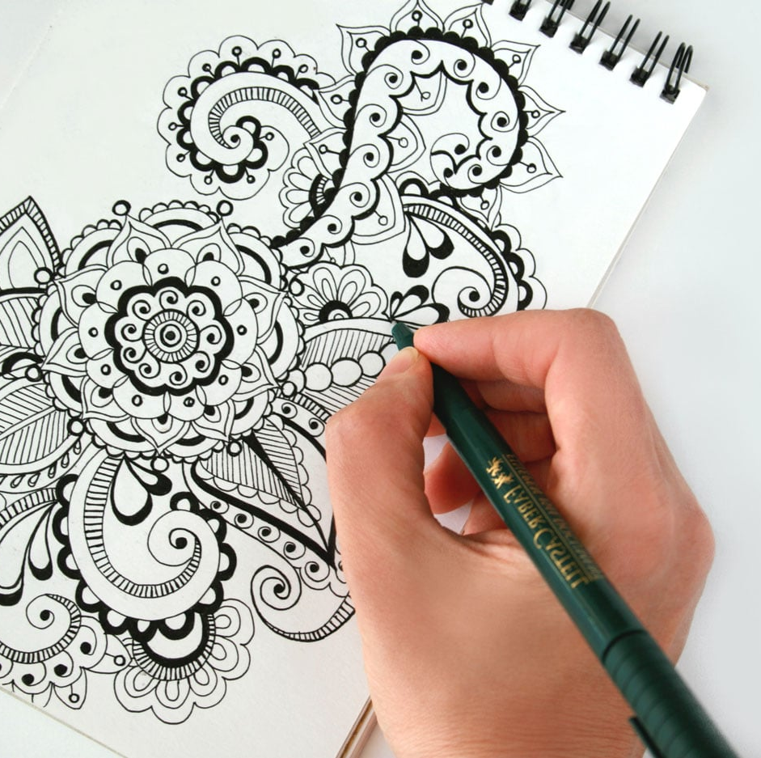
Let Us Pray
Write your name, the name of someone you’re praying for, or words from a scripture verse on a blank sheet of paper.
Draw a shape around it and begin to doodle.
Pray as you draw. Ask God to be a part of this prayer time with you.
You may like to play some quiet music in the background

Slide 16
Works of Art
Thoughts and Prayers
Monday 11th March – Friday 15th March

Slide 17
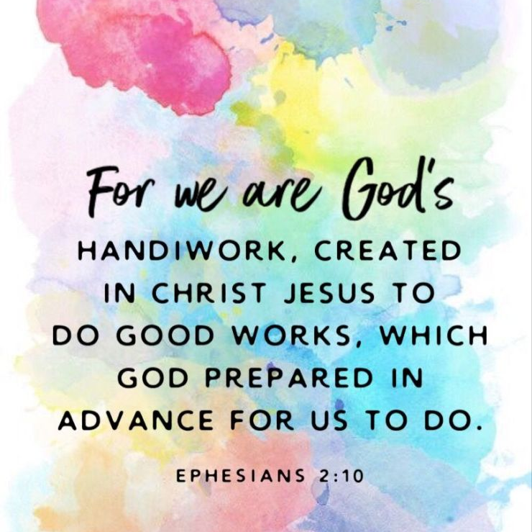
Our Scripture This Week
Ephesians 2:4-10

Slide 18
What does the scripture mean?
Reader One - In a world full of complexity and challenges, there exists an all-loving and creative force—God. He's like the ultimate artist, crafting the universe and all the people in it with care and intention.
But life can get messy. We make mistakes, we stumble, and we often find ourselves feeling broken and incomplete.
God, however, doesn't abandon His creations. He sees our struggles and imperfections and decides to do something about it. He sends Jesus into the picture, not just as a teacher or a leader, but as a divine artist of restoration.
Through Jesus, we find a pathway to redemption and renewal. It's like being refurbished—a restoration project undertaken by the greatest Artist of all time.
God's love isn't just a passive feeling; it's an active force that seeks to transform us. He offers us grace—a gift that says, "I see your flaws, but I choose to love you anyway. Let's work on this together."
Reader Two - Accepting this grace isn't just a matter of belief; it's an invitation to participate in the greatest collaborative artwork ever conceived. It's about joining forces with God to become the masterpiece He envisions us to be.
And guess what? We're not just random brushstrokes on God's canvas. We're His magnum opus—His greatest masterpiece. Each of us is uniquely designed with purpose and potential.
But God doesn't just create and leave us be. He equips us with the tools and talents to make a positive impact in the world. We're not just here to exist; we're here to make a difference—to bring light into darkness and to paint the world with love and compassion.
So remember this: You're not just a product of random chance or a collection of flaws. You're a divine work of art, fashioned by the hands of the Creator Himself. Embrace His grace, discover your purpose, and let your life be a masterpiece in the making.

Slide 19
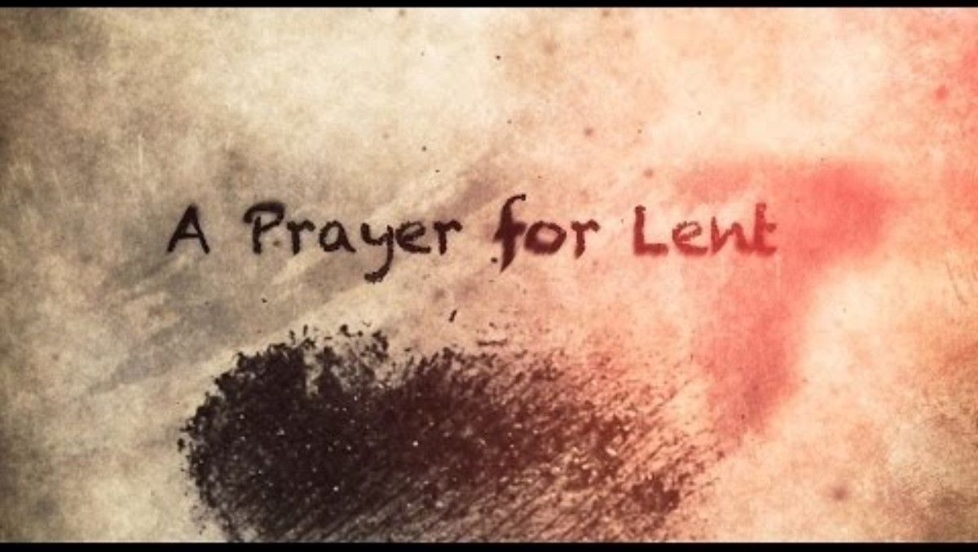

Slide 20
Works of Art
Thoughts and Prayers
Monday 11th March – Friday 15th March

Slide 21
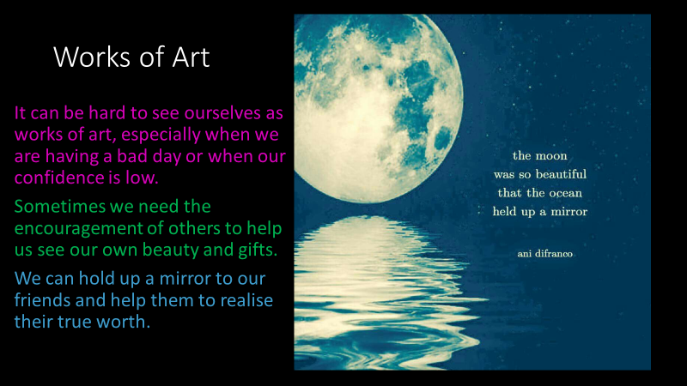

Slide 22
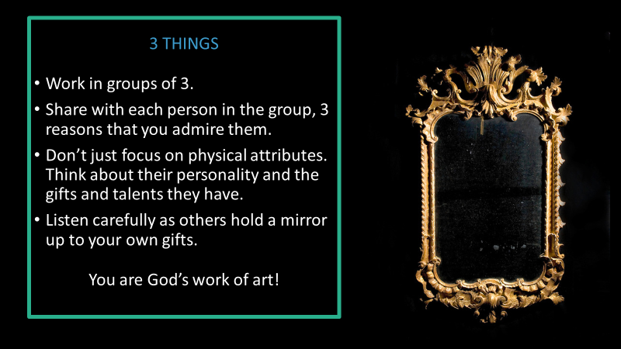

Slide 23
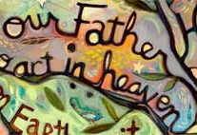
Let Us Pray
Dear Lord,
Thank you that your love is so personal, that you created me, and that there is only one of me. You set your eyes on me from the beginning. You created me with a purpose and you promise to work out all the plans you have for my life.
Thank you that you are a faithful God. That all throughout Scripture, time, and time again, you showed your faithful love to your people. Lord, remind me in moments of doubt, that you will never abandon me, for I am your unique workmanship. I am yours. I am your creation.
Lord, help me to not compare myself to others. You created me, just as I am, and you view me as your masterpiece.
Help me to see myself the way that you see me, not as the world sees me.
Remind me that you have given me everything I need to work out the plans you have set before me. Help me remember that if you have called me to it, you have also equipped me for it.
In Your loving name
Amen

