Slide 1
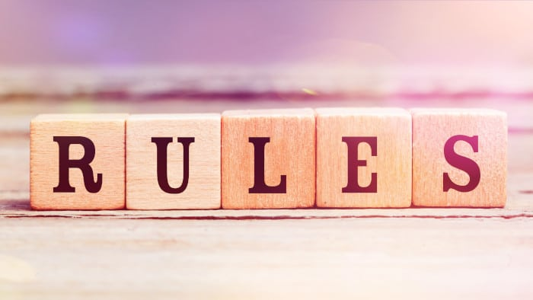
Theme of the week: Rules
Thoughts and Prayers 4th – 8th March

Slide 2


MORNING PRAYER IN THE CHAPEL THIS WEEK
Monday 12th February - 12T
Tuesday 13th February - 12M
Thursday 15th February - 12R
Friday 16th February - 12Y

Slide 3

Friday Mass
Who?
Mass this week will be led by 7I
When?
Friday Morning at 8.20am
Where?
In the School Chapel. See you there!
ALL ARE MOST WELCOME.
ALL WORDS ARE DISPLAYED ON THE SCREEN.

Slide 4
Lunchtime events: All are welcome..
Crafts and Mindfulness
(Mondays in the chapel)
Islamic Union
(Tuesday G15)
Christian Union
(Tuesdays in G16)

Slide 5
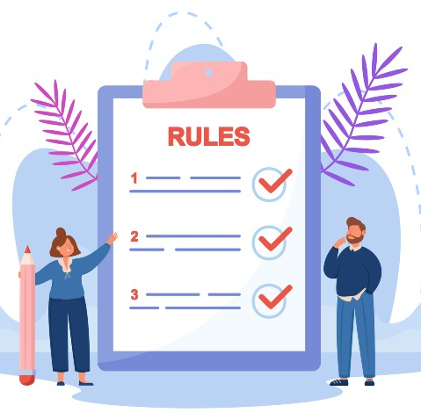
Rules
Today, we delve into the concept of rules and their significance in our lives.
Rules serve as guidelines that help maintain order, promote fairness, and foster harmony within our community.
In a Catholic context, rules are not merely regulations to be followed but are rooted in the teachings of Christ, guiding us towards living a life of virtue and love.

Slide 6
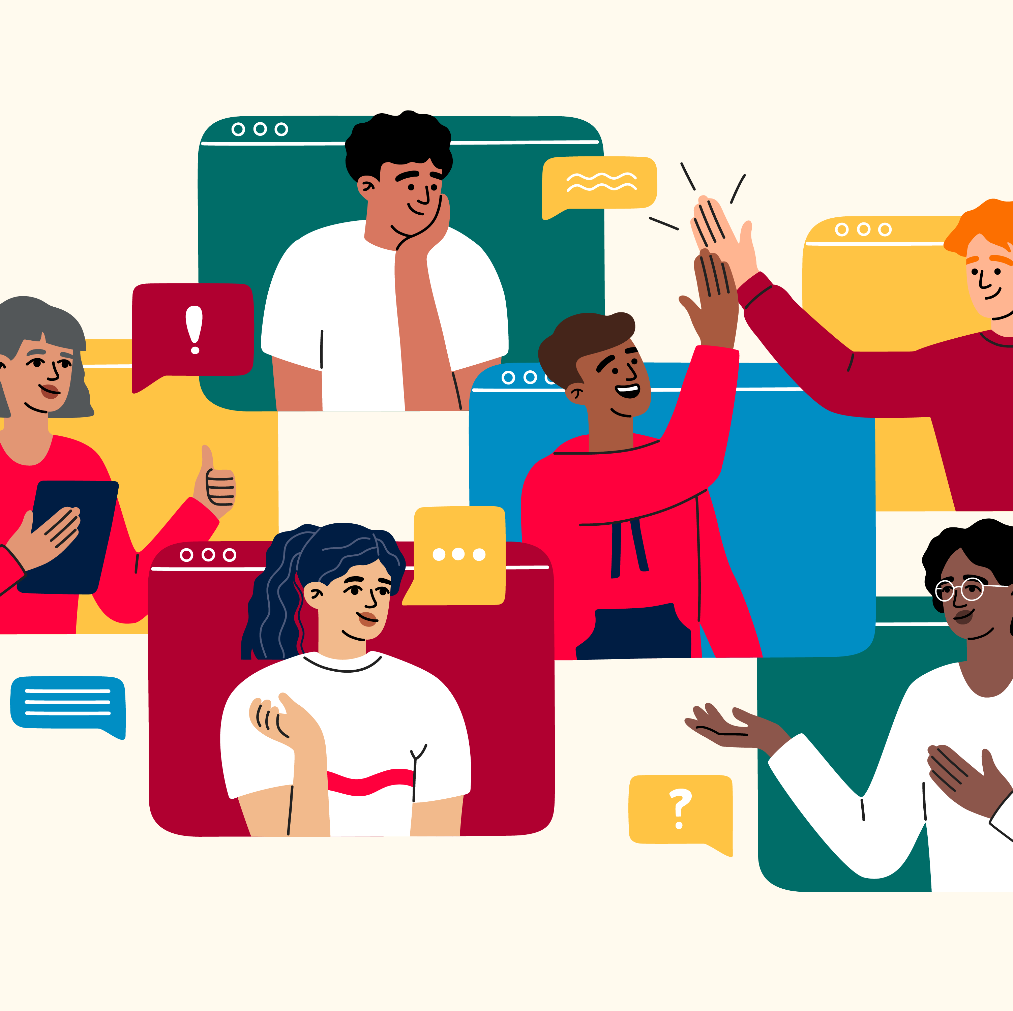
Discussion
Discuss examples of rules in different aspects of life. Can you think of rules you live by?
Reflect on the purpose behind these rules and how they contribute to the well-being of individuals and communities.
Different aspects of life to consider:
family
school
society
sports
work/business

Slide 7

Lord,
Help us to understand the importance of rules in our lives. May we see them not as restrictions but as pathways to righteousness and love. Grant us the wisdom to discern between just and unjust rules, and the strength to follow them with integrity.
Amen

Slide 8
Theme of the week: Rules
Thoughts and Prayers 4th – 8th March

Slide 9

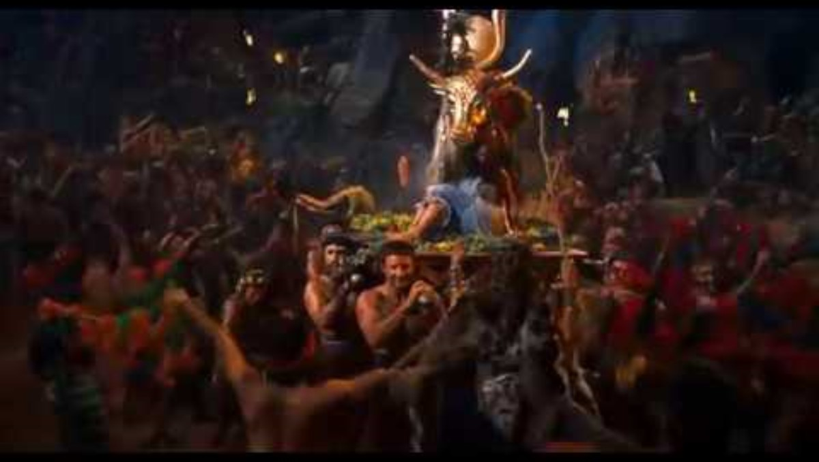
watch this cinematic portrayal of Moses receiving the ten commandments Try to remember as many as you can

Slide 10

Work with your partner and see if you can remember all 10 commandments.
How did you do?
Check your answers on the next slide

Slide 11
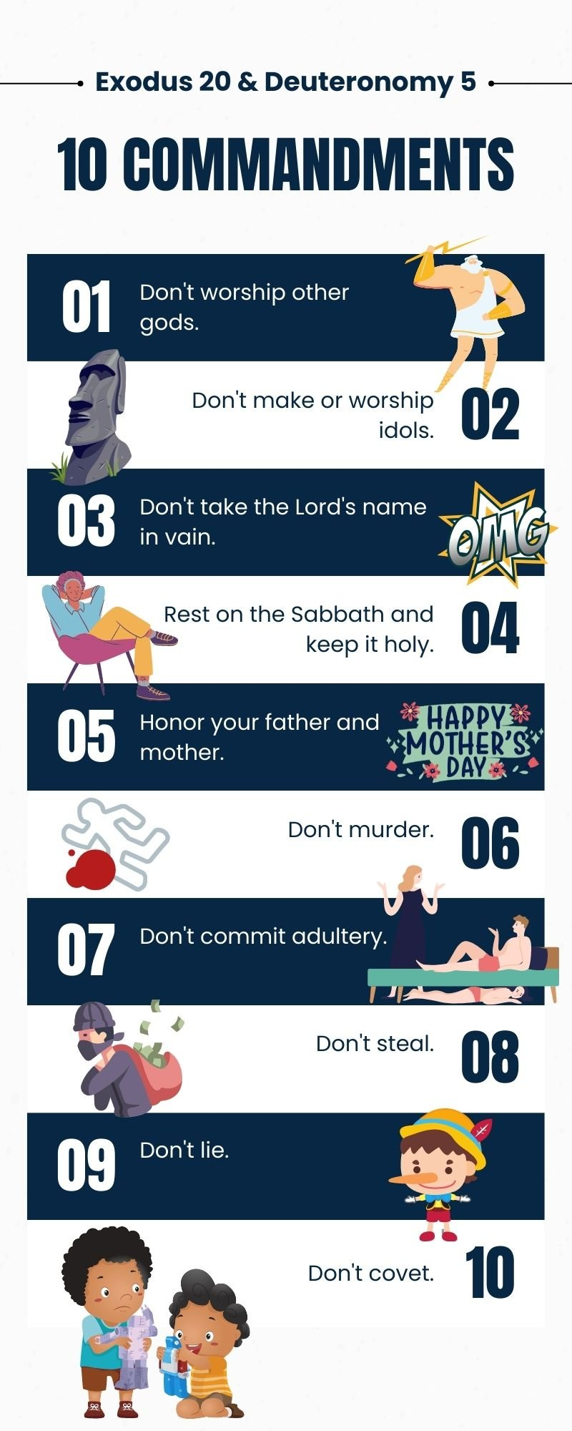
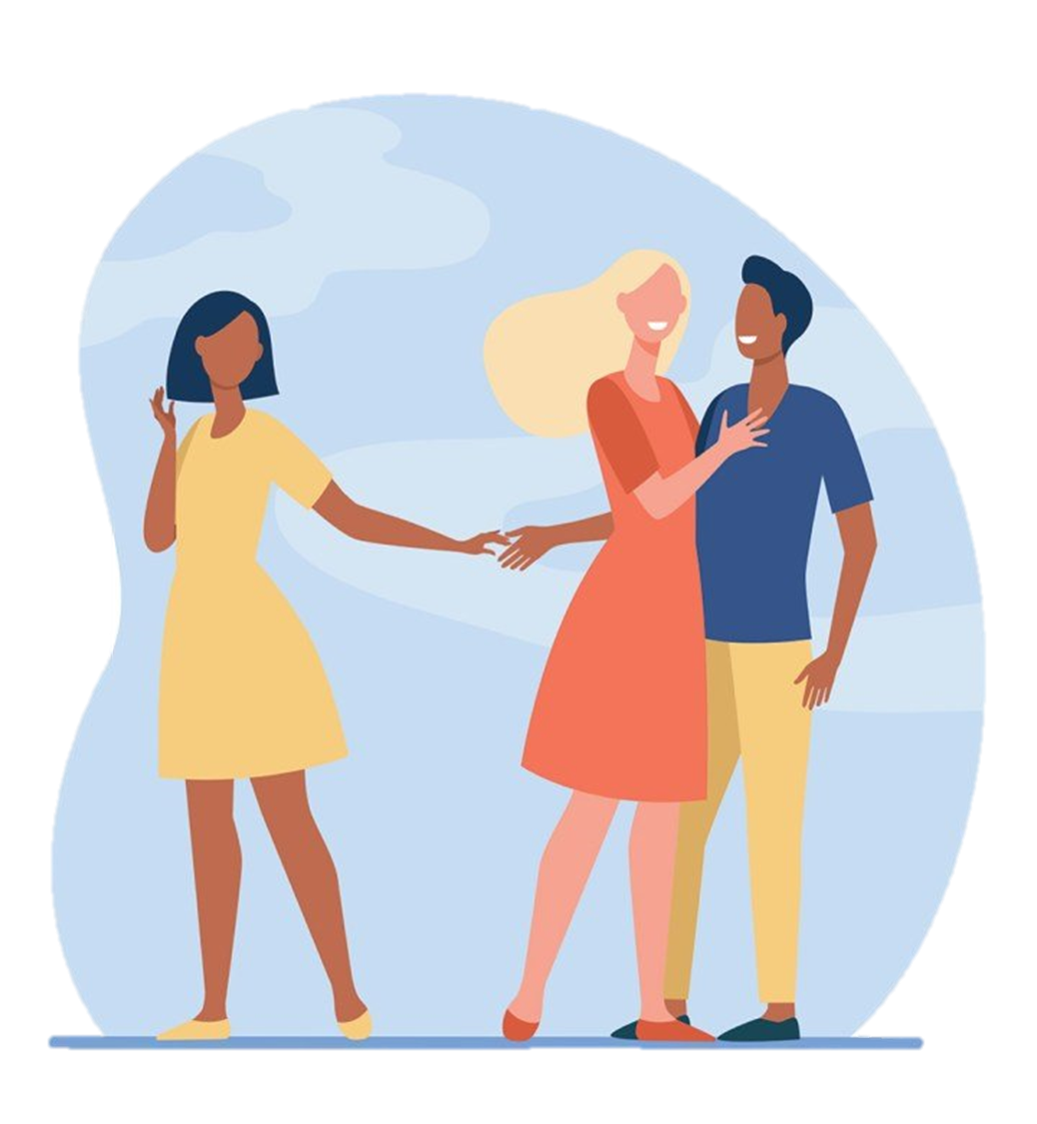

Slide 12
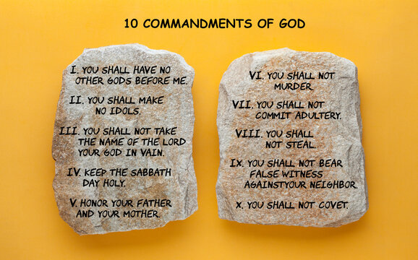
How relevant are the 10 commandments in today's society?
Discuss with your class...
Which commandments do you think you follow in your own lives?
Which commandments do you think are very important?
Would you change any of these commandments or add to them to fit our modern society? If so how and why?
If you were to write an eleventh commandment that would better humankind, what would it be?

Slide 13
PRAYER
Almighty Father,
We thank you for the gift of the Ten Commandments, which illuminate our path towards holiness. Grant us the grace to internalize these commandments in our hearts and live them out in our daily lives. Help us to honor You and love our neighbors as ourselves.
Amen

Slide 14
Theme of the week: Rules
Thoughts and Prayers 4th – 8th March

Slide 15

Debate on the Importance of Rules
Today, we engage in a lively debate on the importance of rules. While rules are essential for maintaining order and justice, it's also crucial to examine their impact on individual freedom and creativity. Through dialogue and reflection, we seek to gain a deeper understanding of the role rules play in our lives.
How to have a successful debate
One person to speak at a time
Your points should take into account what the opponent has said
It is imperative that you listen and pay close attention to the argument
Be respectful and do not purposefully offend or insult anyone
Listen to your teacher
Have fun!
"Are rules necessary for a thriving society?"

Slide 16
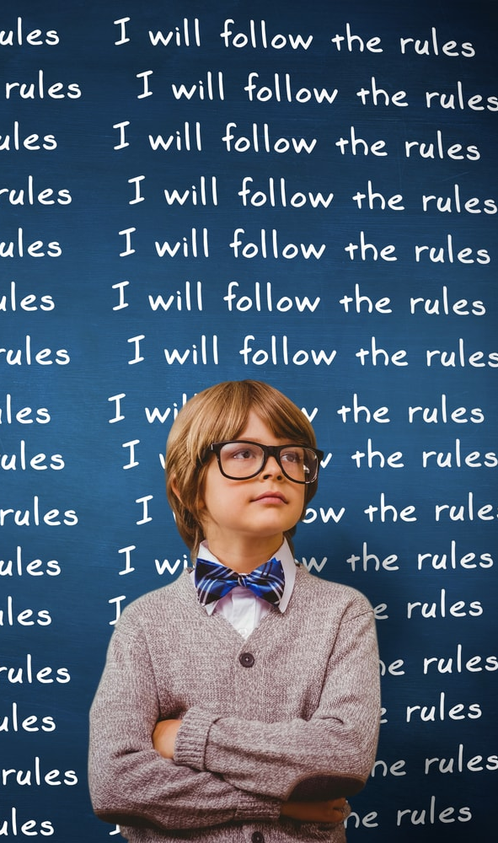
Post debate discussion
Ironically, the debate you had on the importance of rules had its own ground rules
Why do you think the rules for the debate were important?
What would a debate be without ground rules?
How do they help to create order and prevent chaos?
Did the debate change or sway your opinion?

Slide 17
Almighty Father,
Bless us as we engage in dialogue about the importance of rules in our lives. Help us to listen with open hearts, to respect differing viewpoints, and to seek truth and understanding. May our discussions lead us closer to Your wisdom and inspire us to live in accordance with Your will.
Amen

Slide 18
Theme of the week: Rules
Thoughts and Prayers 4th – 8th March

Slide 19
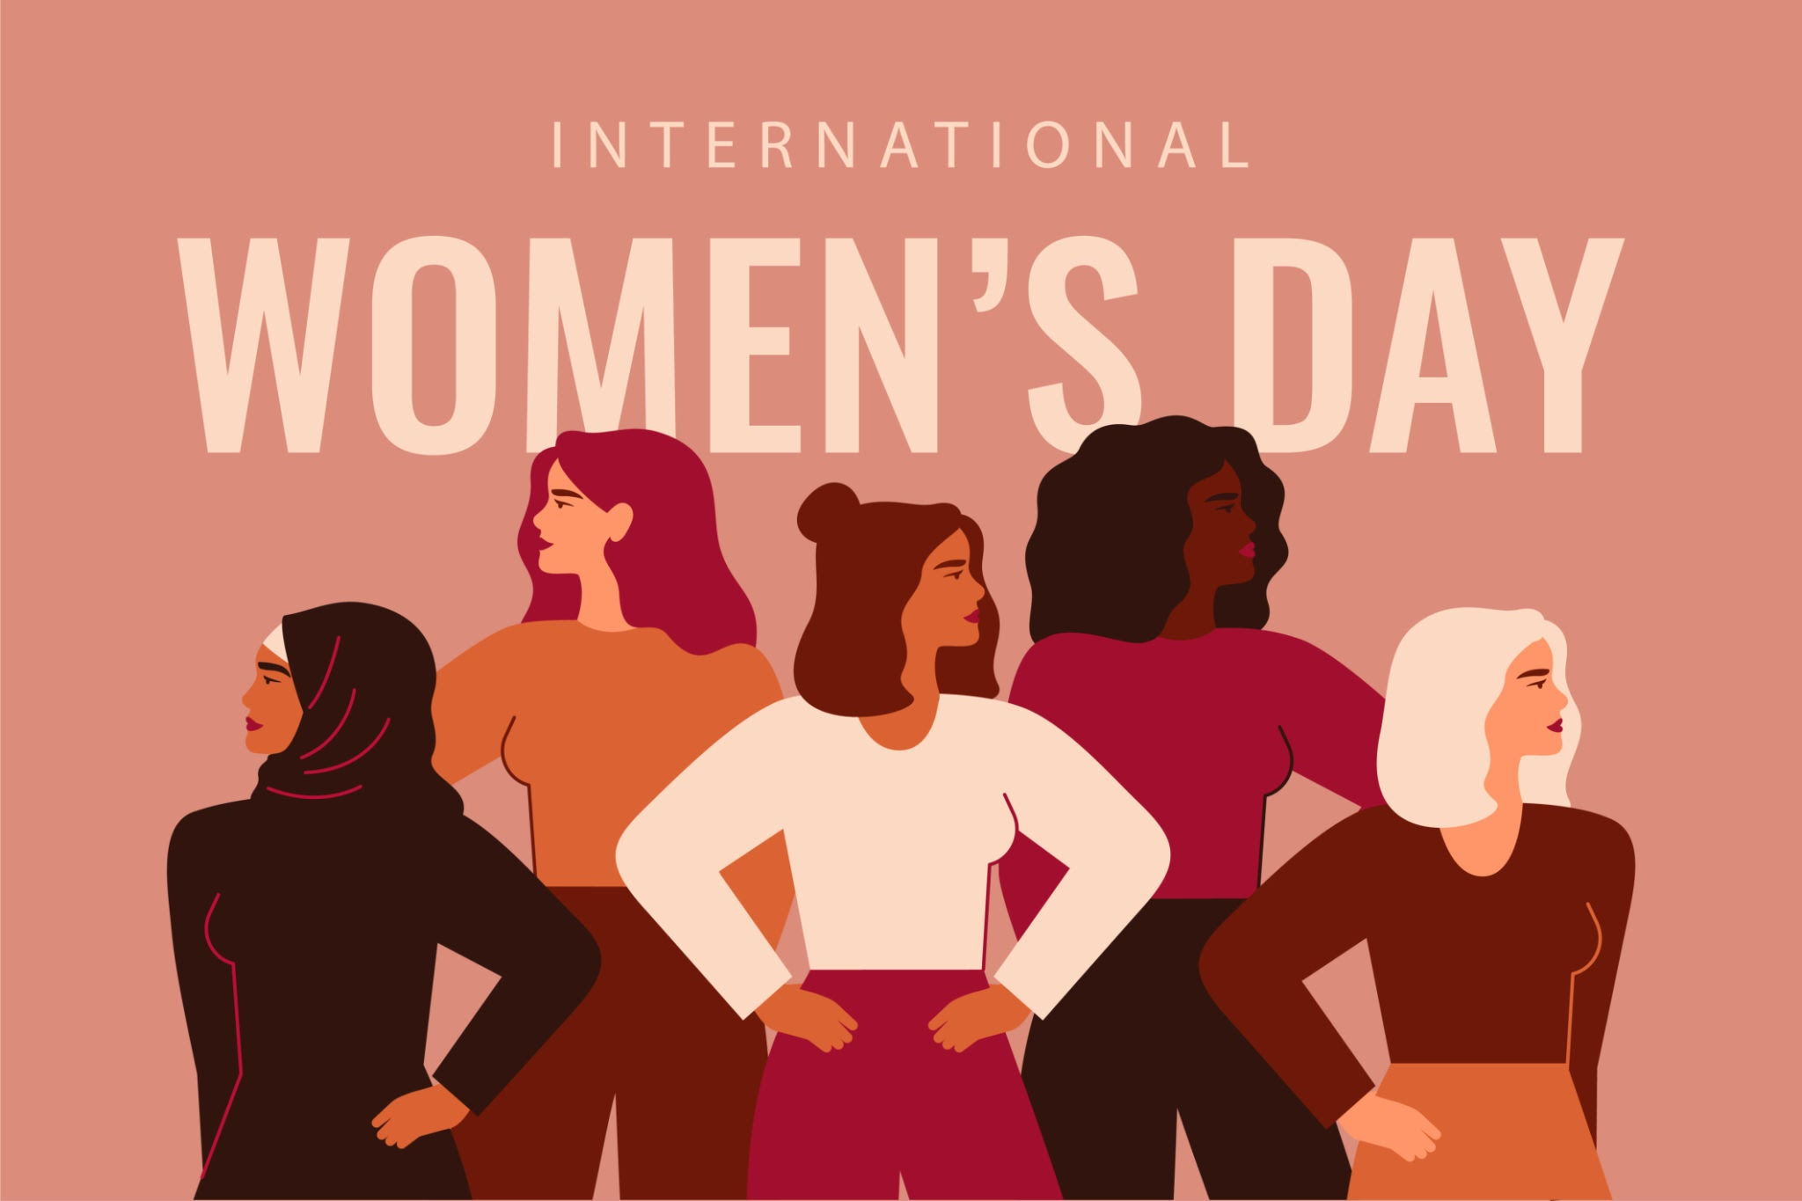
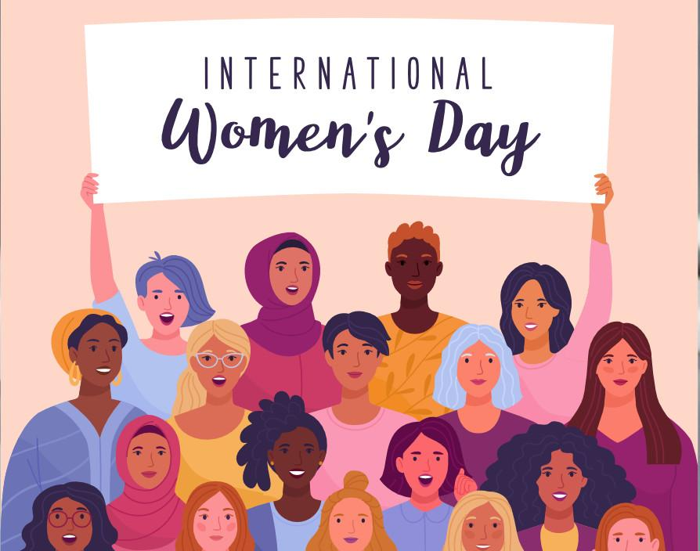
rule breakers and rebels
International Women's Day (IWD) is celebrated annually on March 8th to honour the achievements and contributions of women globally and to advocate for gender equality. It is a day to recognize the social, economic, cultural, and political achievements of women, while also acknowledging the ongoing struggles for gender equality and women's rights.
International Women's Day celebrates rebels and rule breakers by highlighting the courageous actions of women throughout history who have challenged societal norms, broken barriers, and fought against injustice and oppression. These rebels and rule breakers include activists, suffragettes, feminists, and trailblazers who have made significant strides in advancing women's rights and creating positive change.
Throughout history, women have defied restrictive social norms, discriminatory laws, and oppressive systems to assert their rights and demand equality. From suffragettes fighting for the right to vote to contemporary activists advocating for reproductive rights, LGBTQ+ rights, and racial justice, women have continuously pushed boundaries and challenged unjust rules to create a more inclusive and equitable society.

Slide 20

Celebrating Female Voices!
In honour of both World Book Day (Thursday 7th March) and International Women's Day (Friday 8th March), today we will discuss the importance of reading women's stories.
Representation in literature is so important and when girls can see themselves mirrored in the pages they read, they are able to envision a brighter future for themselves.
Reading about women is not just for girls! It is also important that all people read from a range of perspectives to improve their view of the world around them!

Slide 21


Slide 22

Click the link below to listen to the audio book preview of the book In Praise of Difficult Women by Karen Karbo
https://www.youtube.com/watch?v=sSYQaSgMhfc

Slide 23
Bidding Prayers
Reader 1: Guide us as we create our own personal rules for life.
Lord in your mercy,
ALL: Hear our prayer
Reader 2: May these rules be rooted in Your truth and inspire us to live with compassion, integrity, and purpose.
Lord in your mercy,
ALL: Hear our prayer
Reader 3: Grant us the courage to uphold these rules even in the face of challenges.
Lord in your mercy,
ALL: Hear our prayer
Reader 4: We pray today for women around the world. We celebrate their fight against inequality and we remember the rule breakers who pioneered a new freedom for girls everywhere.
ALL: Hear our prayer
Lord, hear our prayers as we come before you humbly. Amen

