Slide 1

TRANSFORMED
Thoughts and Prayers
Monday 26th February – Friday 1st March

Slide 2
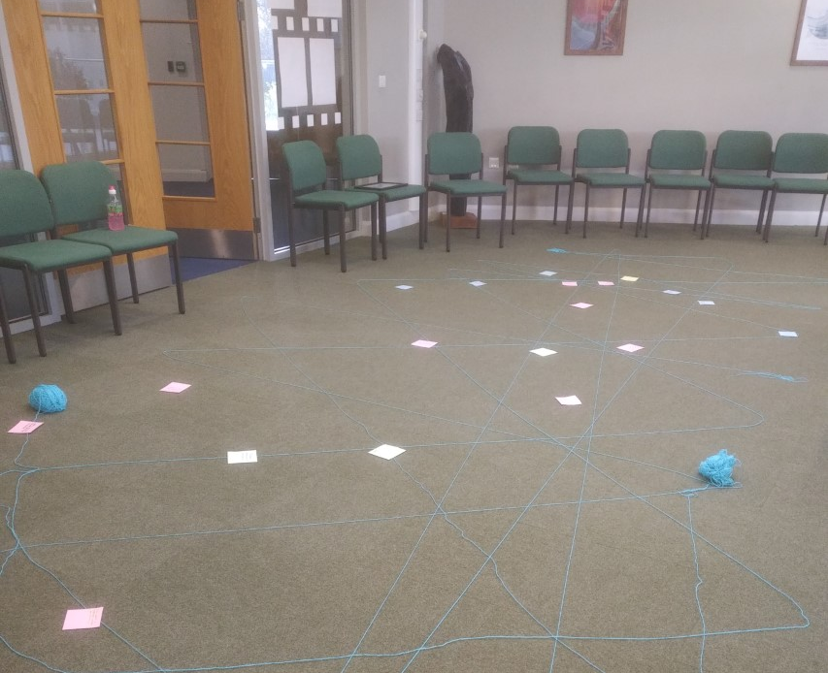

MORNING PRAYER IN THE CHAPEL THIS WEEK
Monday 26th February - 10T
Tuesday 27th February - 12S
Wednesday 28th February - 10M
Thursday 29th February - 10R
Friday 1st March - 10Y

Slide 3
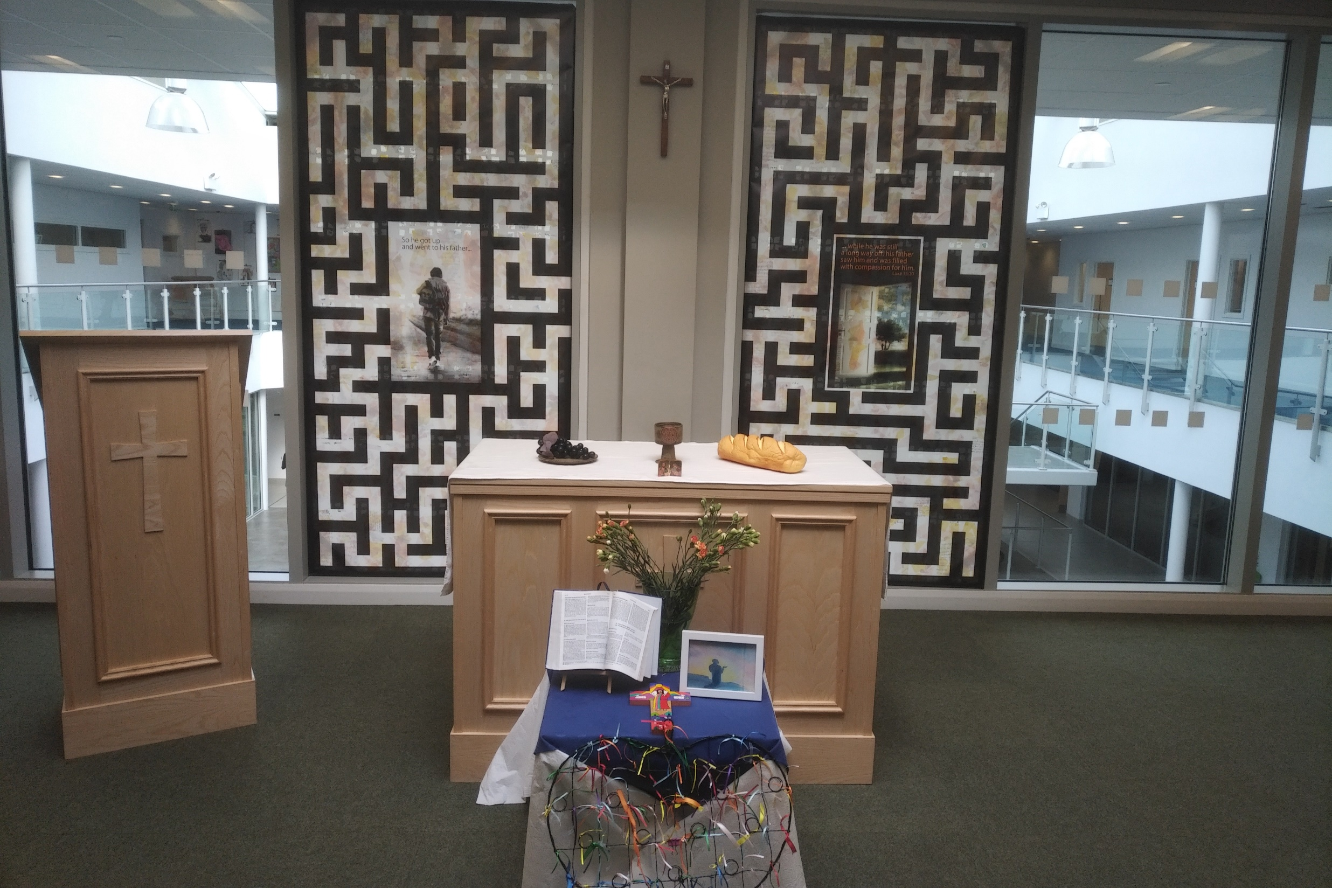
Friday Mass
Who?
Mass this week will be led by 13M and 13R
When?
Friday Morning at 8.20am
Where?
In the School Chapel. See you there!
ALL ARE MOST WELCOME.
ALL WORDS ARE DISPLAYED ON THE SCREEN.

Slide 4
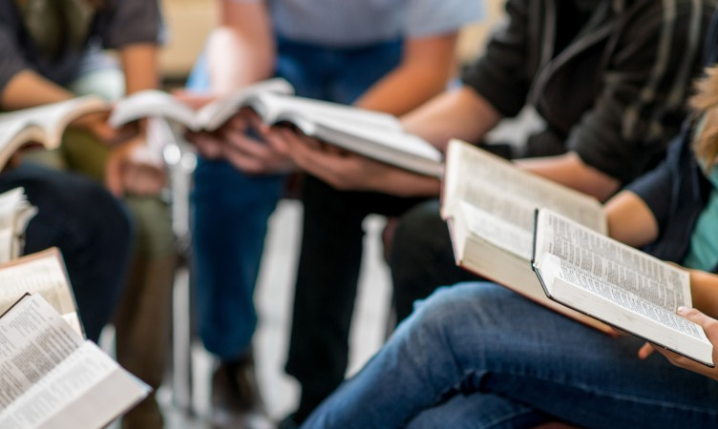
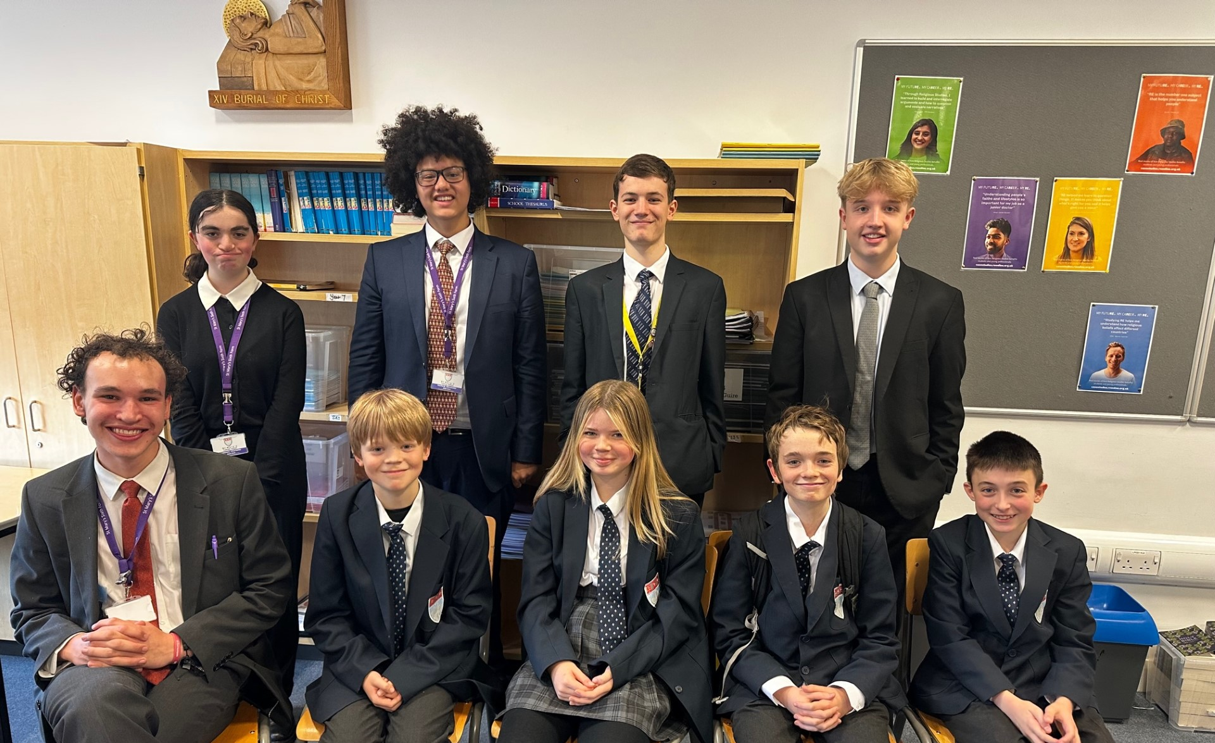
Join us at Christian Union this Spring Term
"CU is a place for anyone of any faith, year group or background to come into a safe environment, play games, have fun, share ideas and learn a little about the real-world significance of Jesus and faith (not to mention sharing biscuits). It exists to help students in their school and wider lives to find unconditional security, significance and acceptance from both the great people and activities, but most of all from God, who knows and loves each of us, and knows and wants what is best for our lives. We aim to do this in a fun relevant and engaging way. We love to welcome new faces."
Josh Sorensen (Year 12)
Leader of Christian Union
CU meets every Tuesday lunch time in G16. Feel free to bring lunch with you or see Mrs Blackburn for an early lunch pass.

Slide 5
TRANSFORMED
Thoughts and Prayers
Monday 26th February – Friday 1st March

Slide 6

What does the word "transformed" mean to you?
Being transformed typically refers to a significant change or alteration in something or someone, often resulting in a new state, appearance, or outlook.
This change can occur at various levels, including physical, emotional, psychological, or spiritual.
Transformation implies a fundamental shift from one state or condition to another, often involving growth, development, or improvement.

Slide 7

Timeline of Transformation
Draw a timeline of your life so far, marking significant moments where you have experienced transformation or change. This could be a time where you learnt a new skill or finally understood something properly for the first time.
Reflect on how these transformations have shaped who you are today.

Slide 8
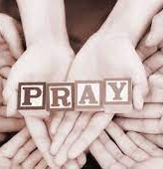
Dear Lord
We gather to reflect on the journey of transformation in our lives. From moments of joy to times of sorrow, and through love and loss, we experience change.
Grant us the courage to embrace transformation, the wisdom to find meaning in adversity, and the strength to navigate life's twists and turns with grace.
May we be open to the transformative power of love, and may we find peace and acceptance in the face of life's ultimate transformation
Amen

Slide 9
TRANSFORMED
Thoughts and Prayers
Monday 26th February – Friday 1st March

Slide 10

Metaphorical Mask
Class Discussion
What do you think is meant by a metaphorical mask when thinking about the theme
'Transformed'?

Slide 11
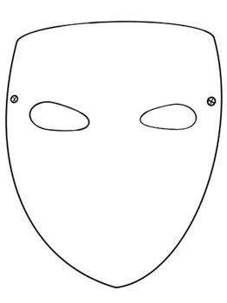

Individually
Draw a simple mask and write down all of the things you want to present to the world.
These could be things you already are or do, or it could include things you wish were true but sometimes you feel differently about inside

Slide 12

Who Is Your authentic Self?
We sometimes use metaphorical masks to transform ourselves for others as a means of self-protection, conformity, or social adaptation. Here are some reasons why:
Self-Protection: Wearing a metaphorical mask can be a way to shield our true selves from potential judgment, criticism, or harm. By presenting a different persona to the world, we may feel safer and more in control of how others perceive us.
Conformity: In certain social settings or contexts, there may be pressure to conform to societal norms or expectations. Wearing a metaphorical mask allows us to blend in with the crowd and avoid standing out or facing rejection.
Social Adaptation: Sometimes, we adapt our behavior or personality to fit in with different social groups or environments. Wearing a metaphorical mask enables us to navigate various social situations more easily by adjusting our outward appearance or demeanor.
Hiding Insecurities: We may use a metaphorical mask to hide our insecurities or vulnerabilities, projecting an image of confidence or strength instead. This can be a way to cope with feelings of inadequacy or fear of being exposed.
Maintaining Privacy: For some individuals, maintaining a sense of privacy or boundaries is important. Wearing a metaphorical mask allows them to control the information they share with others and maintain a level of distance or mystery.
Using a metaphorical mask to transform ourselves for others can serve as a coping mechanism or survival strategy in navigating social interactions and relationships.
However, it's essential to recognise the balance between authenticity and adaptation, ensuring that we maintain a genuine connection with ourselves and others amidst the transformations we undergo.

Slide 13

Dear Lord
As we journey through life's transitions, help us find balance between authenticity and adaptation.
Guide us in knowing when to reveal our true selves and when to wear the metaphorical masks that shield us.
Grant us wisdom to navigate social interactions with integrity, and courage to embrace our vulnerabilities.
May our transformations be guided by love and understanding, connecting us more deeply with ourselves and others.
Amen

Slide 14
TRANSFORMED
Thoughts and Prayers
Monday 26th February – Friday 1st March

Slide 15



Slide 16

Pair Share
In what areas of your life do you feel you could grow or improve during Lent?
How might setting specific goals for personal growth during Lent help you become a better person?
What are some simple acts of kindness you can perform during Lent to make a positive impact on others?
How do you think performing acts of kindness can contribute to your own transformation during this season?
How can reflecting on these values help guide your actions and decisions during this time?
In what ways can you cultivate a mindset of gratitude and appreciation during Lent?
How might expressing gratitude for the blessings in your life contribute to your overall transformation?

Slide 17

Transformation During Lent
Lent is traditionally a period of reflection, repentance, and spiritual growth leading up to Easter in the Christian calendar. Here are some ways in which you can be transformed during Lent:
Prayer: Use this time to deepen your prayer life. Spend more time in prayer, meditation, and contemplation. Reflect on your relationship with the divine and ask for guidance and strength.
Fasting: Consider fasting as a spiritual discipline during Lent. This doesn't have to be limited to abstaining from food; you can also fast from certain activities, habits, or indulgences that distract you from your spiritual journey.
Almsgiving: Practice generosity and charity by giving to those in need. This could involve donating money, volunteering your time, or performing acts of kindness for others.
Self-reflection: Take stock of your life during Lent. Reflect on your values, priorities, and goals. Consider areas where you need to grow or improve, and make a plan for personal development.
Scripture reading: Spend time reading and studying the Bible or other sacred texts. Allow the wisdom and teachings of these texts to guide and inspire you on your spiritual journey.
Community: Engage with your faith community during Lent. Attend worship services, participate in study groups or prayer circles, and seek support and encouragement from others on the same journey.
Forgiveness: Use Lent as an opportunity to seek forgiveness from others and to extend forgiveness to those who have wronged you. Let go of resentment and grudges, and strive to reconcile relationships that have been strained.
Simplicity: Simplify your life during Lent by decluttering your physical space and decluttering your mind. Let go of material possessions and distractions that weigh you down, and focus on what truly matters.

Slide 18
TRANSFORMED
Thoughts and Prayers
Monday 26th February – Friday 1st March

Slide 19
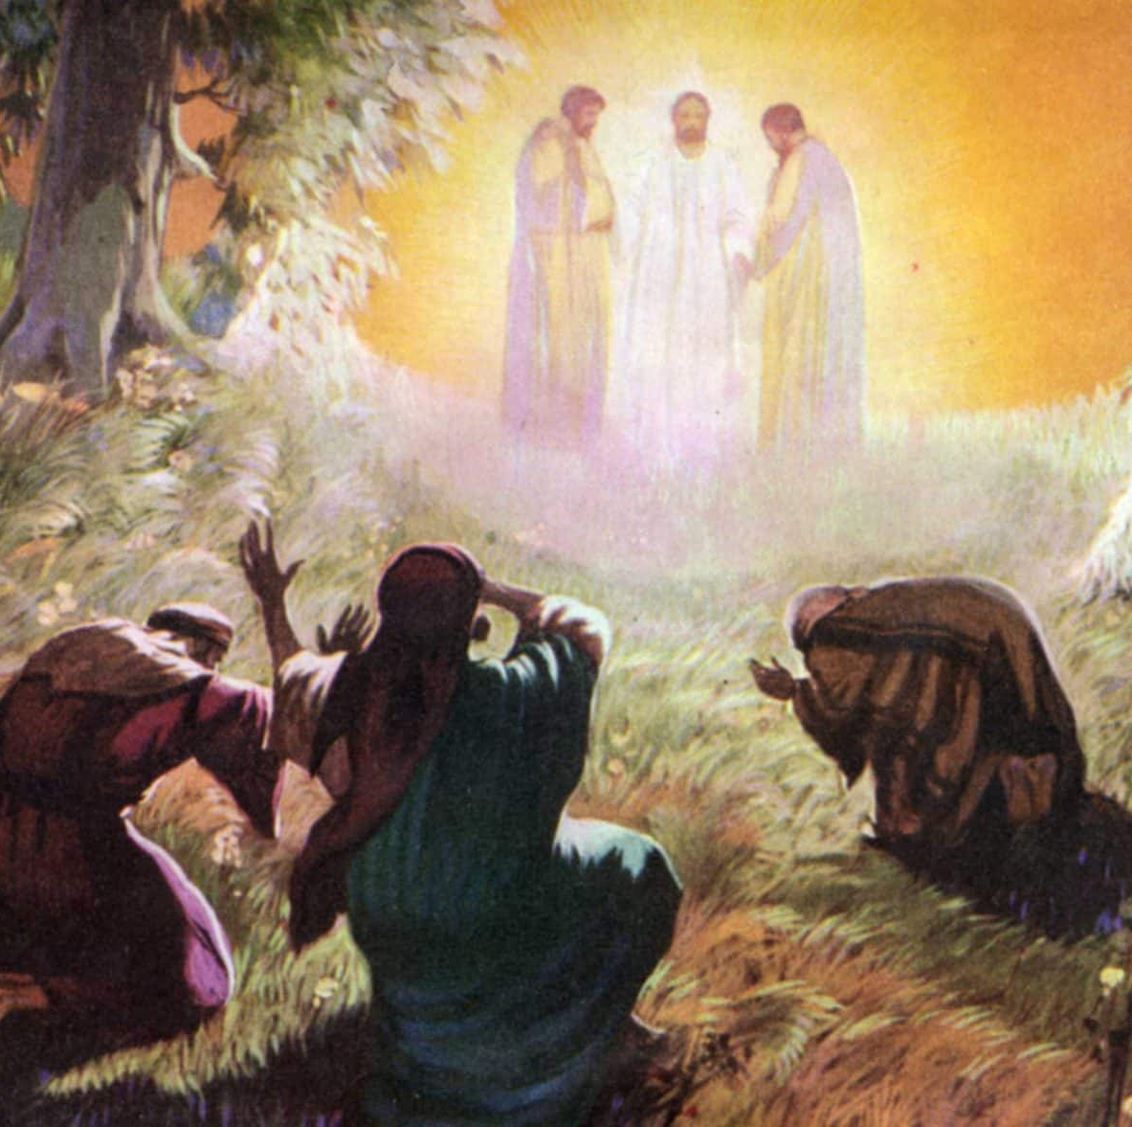
Our Scripture this week
“Jesus took with him Peter, James, and John, and led them up a high mountain, where they were alone. As they looked on, a change came over Jesus, and his clothes became shining white—whiter than anyone in the world could wash them. Then the three disciples saw Elijah and Moses talking with Jesus. Peter spoke up and said to Jesus, “Teacher, how good it is that we are here! We will make three tents, one for you, one for Moses, and one for Elijah.” He and the others were so frightened that he did not know what to say.
Then a cloud appeared and covered them with its shadow, and a voice came from the cloud, “This is my own dear Son—listen to him!” They took a quick look around but did not see anyone else; only Jesus was with them.
As they came down the mountain, Jesus ordered them, “Don't tell anyone what you have seen, until the Son of Man has risen from death.”
They obeyed his order, but among themselves they started discussing the matter, “What does this ‘rising from death’ mean?”
Mark 9:2-10

Slide 20

What Does The Transfiguration mean?
Reader 1 - Have you ever been reading a book and the plot’s looking very bleak and you’re worried about how things will turn out in the end? So, you decided to take a sneak peak at the ending of the book. By doing this you discover that although the story seems perilous at the minute everything turns out to be ok in the end. Everything works out well for the characters, PHEW! You then carry on reading the story, safe in the knowledge that everything is going to turn out ok.
Reader 2 - This is a little bit like what happened at the Transfiguration. About a week prior to this event, Jesus plainly told His disciples that He would suffer, be killed, and be raised to life (Luke 9:22). Things looked pretty bleak and uncertain to them. They would have been frightened and confused by Jesus’ warning and may have been questioning if they were indeed following the right person! Jesus gave them a glimpse of the end of the story. He took Peter, James and John up a mountain to pray. While praying, His personal appearance was changed into a glorified form, and His clothing became dazzling white. Moses and Elijah appeared and talked with Jesus about His death that would soon take place. A cloud enveloped them, a voice said, “This is My Son, whom I have chosen, whom I love; listen to Him!”

Slide 21
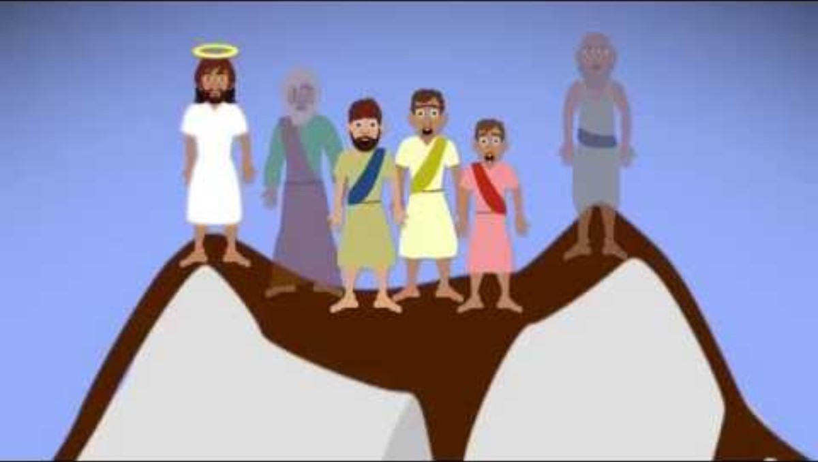

Slide 22

Let Us Pray
Heavenly Father,
As Jesus was transfigured before His disciples on the mountain, we come before you seeking transformation in our own lives. Just as Peter, James, and John witnessed the radiant glory of your Son, may we too experience the transforming power of your presence.
Grant us the courage to climb the mountain of faith, to leave behind the distractions of this world, and to open our hearts to your divine light. Transform our doubts into unwavering trust, our fears into boldness, and our weaknesses into strengths.
May we be transfigured by your grace, renewed in mind, body, and spirit. Help us to see glimpses of your glory in the ordinary moments of our lives, and to reflect that glory to others.
In times of uncertainty, may we listen to the voice of your beloved Son, Jesus Christ, who assures us of your love and guidance. And as we journey through this life, may the transformational power of your Spirit work within us, shaping us into vessels of your grace and instruments of your peace.
We pray this in the name of Jesus Christ, who lives and reigns with you and the Holy Spirit, one God, forever and ever.
Amen

