Slide 1

Theme of the week: Reaching Out
Thoughts and Prayers 12th – 16th February

Slide 2


MORNING PRAYER IN THE CHAPEL THIS WEEK
Monday 12th February - 7M
Tuesday 13th February - 7R
Thursday 15th February - 10I
Friday 16th February - 10A

Slide 3

Friday Mass
Who?
Mass this week will be led by 11Y & 11I
When?
Friday Morning at 8.20am
Where?
In the School Chapel. See you there!
ALL ARE MOST WELCOME.
ALL WORDS ARE DISPLAYED ON THE SCREEN.

Slide 4
Lunchtime events: All are welcome..
Crafts and Mindfulness
(Mondays in the chapel)
Islamic Union
(Tuesday G15)
Christian Union
(Tuesdays in G16)

Slide 5

Reaching Out
Begin the day by reflecting on the theme of "Reaching Out".
What does it mean?
How does this theme align with the teachings of Jesus?
Why are values such as compassion, empathy, and kindness so important in our daily lives?
How do we reach out to those in need?

Slide 6
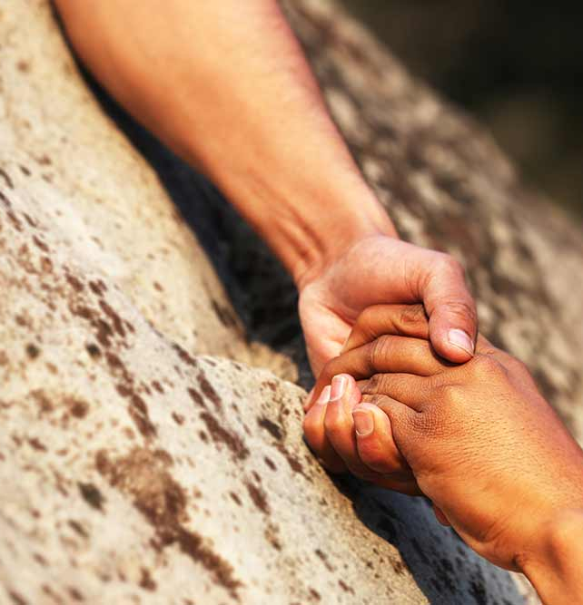
A guide to reaching out
Step 1: Be Observant Pay attention to changes in your friend's behavior, such as withdrawal from social activities, mood swings, increased irritability, or changes in appetite or sleep patterns. These could be signs that your friend is struggling.
Step 2: Trust Your Instincts If you have a gut feeling that something might be wrong, don't ignore it. Trust your instincts and take action to reach out to your friend.
Step 3: Choose the Right Time and Place Find a private and comfortable setting where you can have an open and honest conversation with your friend. Choose a time when both of you are relaxed and free from distractions.
Step 4: Express Concern and Listen Approach your friend with empathy and express your concern about their well-being. Let them know that you are there to listen and support them without judgment. Encourage them to share their feelings and experiences.
Step 5: Offer Support and Resources Assure your friend that they are not alone and that help is available. Offer to accompany them to seek help if needed and let them know that you are with them.
Remember, reaching out to a friend in need can make a significant difference in their life. Your support and willingness to listen can provide comfort and help them feel less alone during difficult times.

Slide 7




Reaching out through notes of encouragement
Who can you reach out and offer support and encouragement?
Is there someone in your life who is going through a struggle right now, or perhaps needs a friend?
Write a short note to let someone know you're thinking of them and that you're here for them

Slide 8

Lord,
Grant us the grace to open our hearts and reach out to others as a reflection of your love. May our words and actions be guided by compassion and empathy.
Amen

Slide 9
Theme of the week: Reaching Out
Thoughts and Prayers 12th – 16th February

Slide 10
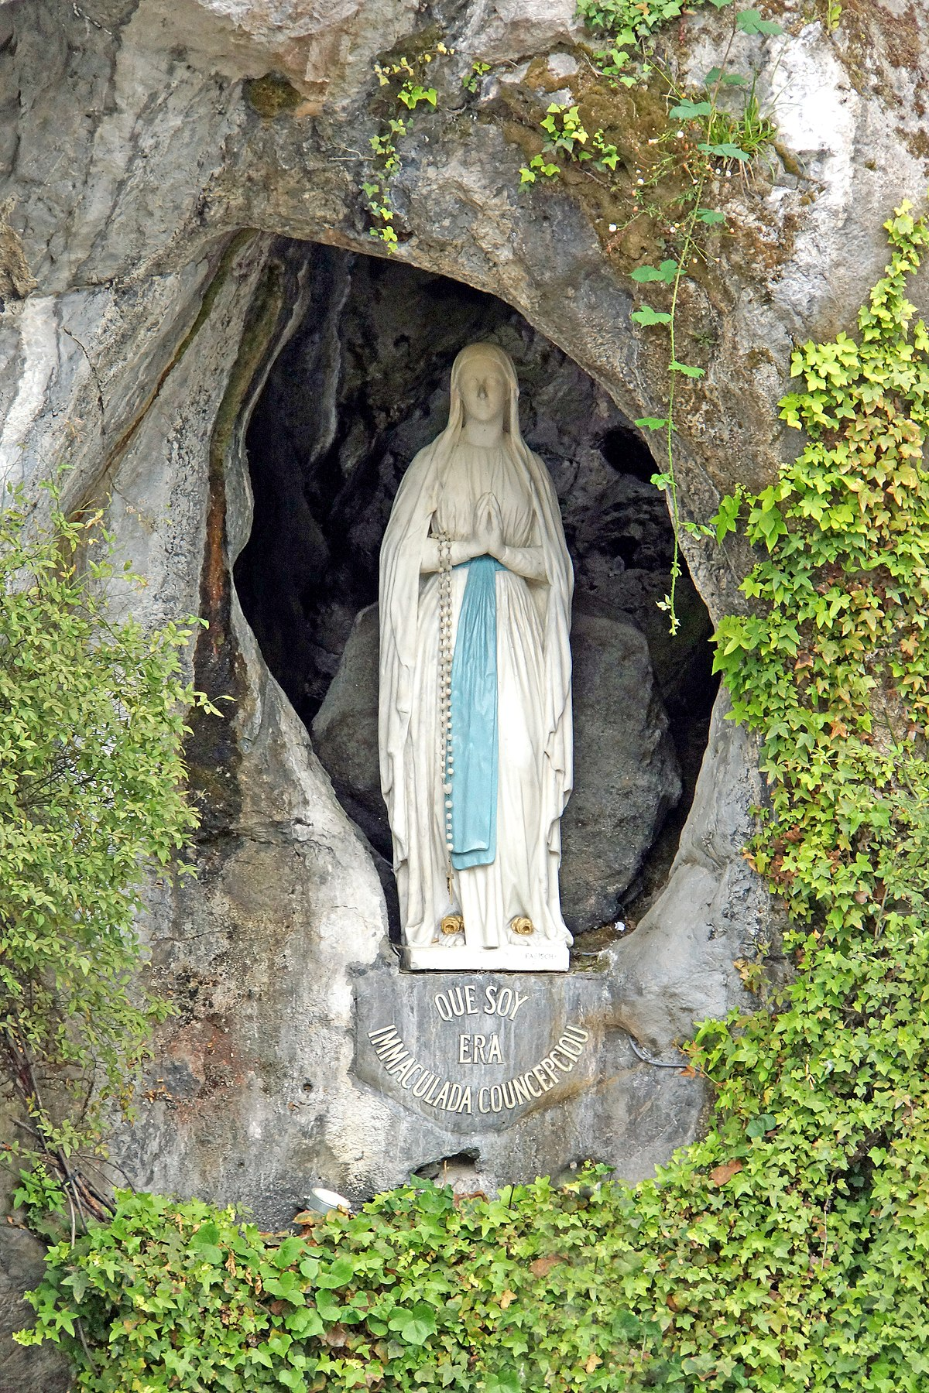
Reaching out to the sick and vulnerable
The World Day of Prayer for the Sick, observed on February 11th each year, is a day designated by the Catholic Church to offer prayers for those who are suffering from illness and to recognize the important role of caregivers and healthcare professionals. It is a day to reflect on the spiritual and physical well-being of individuals and to seek God's healing grace for those who are sick.
Our Lady of Lourdes refers to the Marian apparitions that took place in the town of Lourdes, France, in 1858. The Virgin Mary appeared to a young girl named Bernadette Soubirous multiple times, revealing herself as the Immaculate Conception and calling for penance and prayer. The site of the apparitions became a place of pilgrimage, known for its healing waters and miraculous cures.
In observing the World Day of Prayer for the Sick and honoring Our Lady of Lourdes, Catholics are reminded of their call to imitate Christ's compassion and mercy, especially towards those who are suffering from illness. These occasions provide an opportunity for prayer, reflection, and acts of solidarity with the sick, rooted in the teachings of the Gospel.

Slide 11

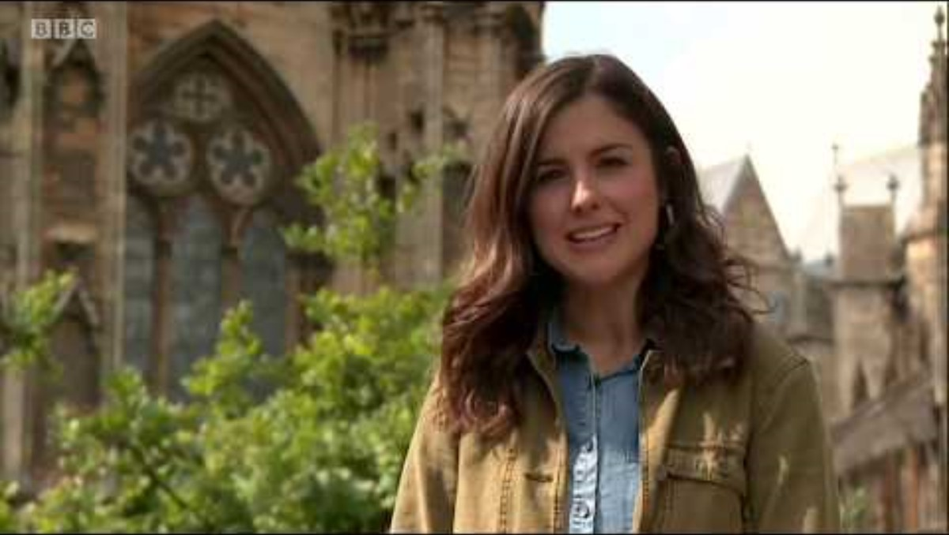
Every year, millions of people make the pilgrimage to lourdes to witness the healing power of our lady.

Slide 12
Almighty Father,
Reader 1: On this day dedicated to prayer for the sick, we ask for your healing touch to be upon those who are unwell.
Reader 2: May we be instruments of your love, reaching out to bring comfort and support to those in need.
Reader 3: We pray especially for those who make the sacred pilgrimage to Lourdes this year.
Reader 4: May they be witness to the power of your holy spirit as they begin this journey.
Amen

Slide 13
Theme of the week: Reaching Out
Thoughts and Prayers 12th – 16th February

Slide 14


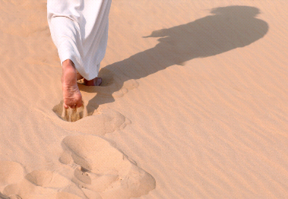
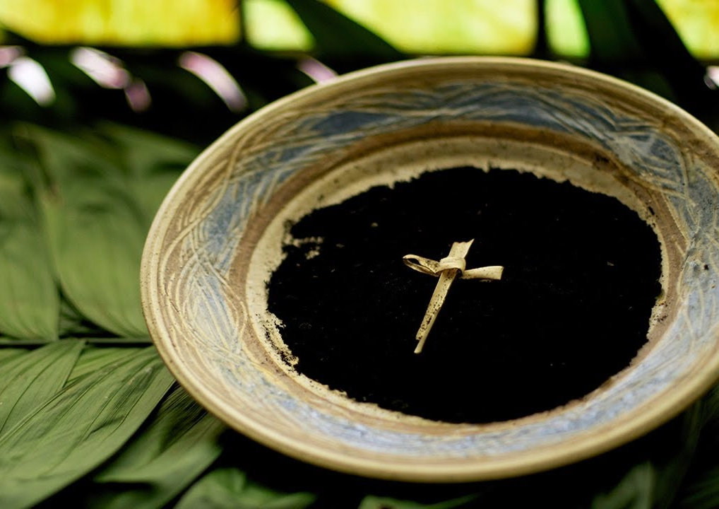
Think
Pair
Share
What do these images represent?
Can you link them to each other?

Slide 15
Think
Pair
Share
These images are all linked to Lent. This week, we celebrate Shrove Tuesday which is the last day before the official 40 days of Lent begins. People often celebrate by eating pancakes and chocolate before fasting or giving up sweet treats. Ash Wednesday marks the first day of Lent and the beginning of Jesus' 40 days in the desert.

Slide 16
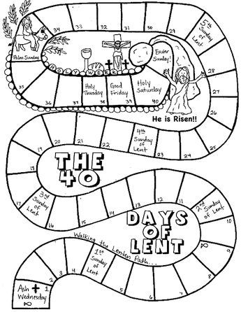
A guide to the 40 days of lent
Ash Wednesday:
Symbolic Start:
Marked by solemn services, believers receive ashes on their foreheads as a sign of repentance and humility.
Fasting, Prayer, and Almsgiving:
Spiritual Disciplines:
During Lent, Christians fast, pray, and give to those in need, deepening their faith and preparing for Easter.
Repentance and Reconciliation:
Seeking Forgiveness:
Christians engage in confession, acknowledging their sins and receiving God's mercy and grace.
Reflection on Scripture and Meditation:
Spiritual Contemplation:
Believers focus on Scripture and meditate on Jesus' passion narratives to deepen their understanding of Easter.
Holy Week:
Sacred Culmination:
The final week includes Palm Sunday, Good Friday, and Easter Sunday, commemorating Jesus' entry into Jerusalem, his crucifixion, and his resurrection.

Slide 17

Giving up or letting go?
Many Christians choose to give something up during Lent but this is also a time for Christians to let go—to lessen our grip on—all that inhibits our own ability to live the lives that God is calling us to. Letting go is a spiritual practice can be even more challenging than giving up. Pope Frances says "Lent is time to let go of the frivolous, to choose truth, love".
We might choose to let go of anger, pain or jealousy, or whatever is holding you back from following God's call
Are you going to give anything up this Lent?
What can you let go of?
Lent is not just about giving up chocolate!

Slide 18

Looking to do things differently this year?
This year,
CAFOD have suggested that people consider taking part in The Big Lent Walk.
Lent is a time for contemplation and reflection as well as charity and compassion.

Slide 19
Bidding Prayers
Reader 1: Grant us the power to let go of the frivolous and choose truth and love, and the wisdom to understand the differences.
Lord in your mercy,
ALL: Hear our prayer
Reader 2: In our moments of weakness, may we be reminded that your strength is within us. If we falter, you will steady us and if we fall, your loving hands will catch us.
Lord in your mercy,
ALL: Hear our prayer
Reader 3: May we always remember that as we fast or make our Lenten promises, there are people less fortunate than us who have been stripped of the freedom of choice.
Lord in your mercy,
ALL: Hear our prayer
Lord, hear our prayers as we come before you humbly. Amen

Slide 20
Theme of the week: Reaching Out
Thoughts and Prayers 12th – 16th February

Slide 21

Be truly honest with yourself: If you saw someone ostracised from the rest of your peers, would you have the courage to go against the rest of the crowd and reach out to them?

Slide 22
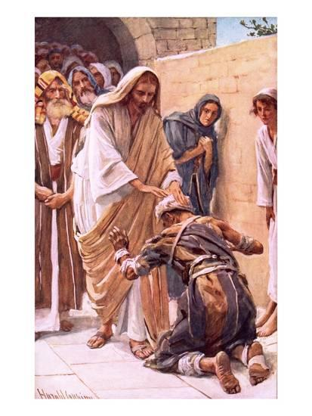
Following Jesus' Example
The theme of 'Reaching Out' is deeply rooted in Gospel teachings, particularly in the ministry of Jesus Christ.
In the Gospels, Jesus is depicted as showing compassion and healing the sick and those ostracized from society, demonstrating God's love and concern for those who are suffering.
The teachings of Jesus emphasize the importance of caring for the sick and showing compassion to those in need. In Matthew 25:35-36, Jesus says, "For I was hungry and you gave me food, I was thirsty and you gave me drink, I was a stranger and you welcomed me, I was naked and you clothed me, I was sick and you visited me." This passage underscores the Christian duty to reach out to the sick and provide them with care and support, following the example of Jesus' ministry.

Slide 23
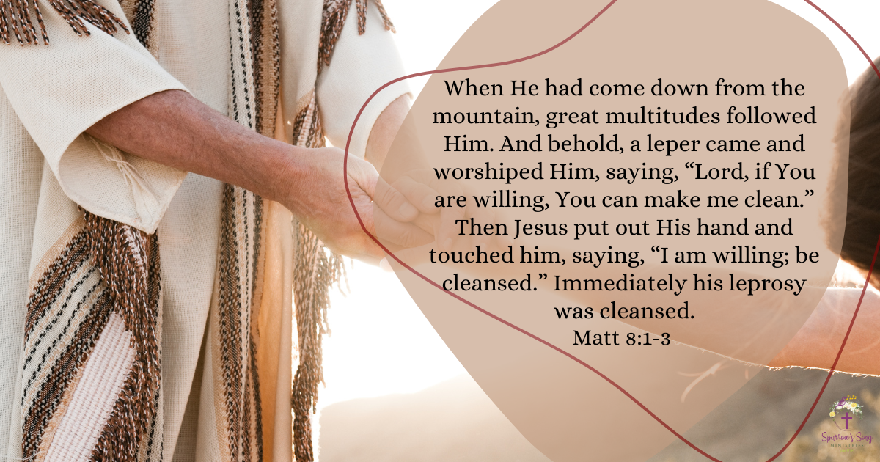
Our theme this week comes from Mark 1:40-45. In this verse Jesus heals a leper who reaches out to him in faith, saying, "If you are willing, make me clean." This act of healing illustrates Jesus' willingness to reach out to the marginalised and the sick, offering them physical and spiritual restoration.

Slide 24
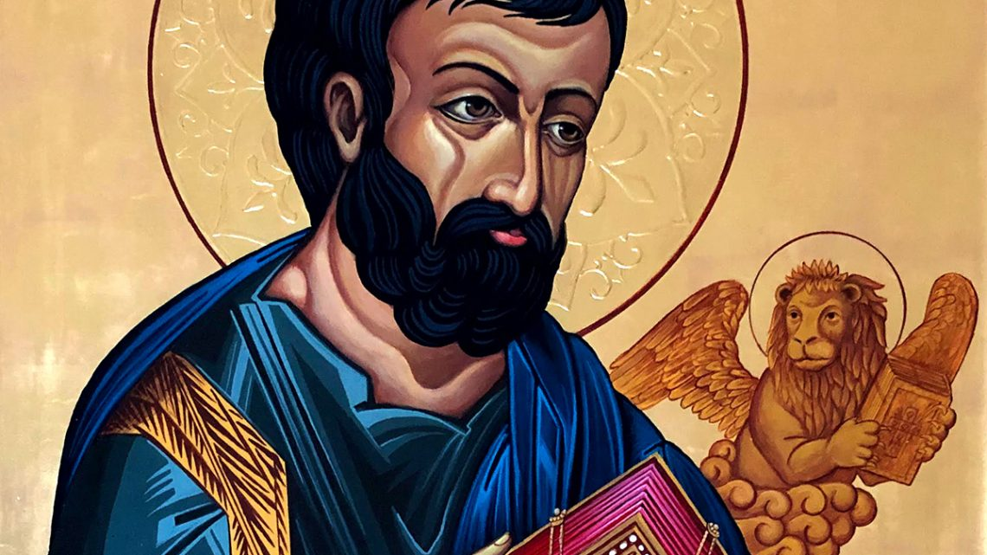
Making links to Scripture
The passage from Mark 1:40-45 recounts the story of Jesus healing a leper. In this narrative, a man afflicted with leprosy approaches Jesus, kneeling before him and saying, "If you are willing, you can make me clean." The leper expresses his faith in Jesus' ability to heal him but acknowledges that it ultimately depends on Jesus' willingness to do so.
In response, Jesus is moved with compassion and reaches out to touch the man, saying, "I am willing; be clean!" Immediately, the man's leprosy disappears, and he is healed. This passage demonstrates several important aspects of Jesus' ministry.
Firstly, it highlights Jesus' compassion and willingness to reach out to those who are marginalised and suffering. Despite the societal stigma surrounding leprosy and the risk of contamination, Jesus responds with love and healing. Secondly, it underscores the power of faith. The leper demonstrates faith in Jesus' ability to heal him, and Jesus affirms this faith by granting his request.
Finally, it reveals Jesus' authority over sickness and impurity. With a simple command, Jesus demonstrates his power to cleanse and restore. In summary, the passage portrays a powerful encounter between Jesus and a leper, illustrating Jesus' compassion, the importance of faith, and his authority to heal and restore.

Slide 25
Challenge: what will it take for you to be the one to reach out to the ostracised and marginalised members of society?

Slide 26
Almighty Father,
As we embark on this season of Lent, help us reach out to you with contrite hearts. Grant us the grace of renewal and transformation as we seek your forgiveness and mercy. We offer our small sacrifices in solidarity with those who hunger and thirst for justice. May our actions be a reflection of your love for all your children.
Amen

