Slide 1
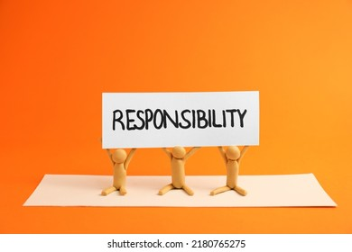
Thoughts and Prayers
Monday 5th February – Friday 9th February

Slide 2


MORNING PRAYER IN THE CHAPEL THIS WEEK
Monday 5th February - 7A
Tuesday 6th February-7I
Wednesday 7th February
Thursday 8th February - 7T
Friday 9th February- 10S

Slide 3

Friday Mass
Who?
Mass this week will be led by 11M and 11R
When?
Friday Morning at 8.20am
Where?
In the School Chapel. See you there!
ALL ARE MOST WELCOME.
ALL WORDS ARE DISPLAYED ON THE SCREEN.

Slide 4
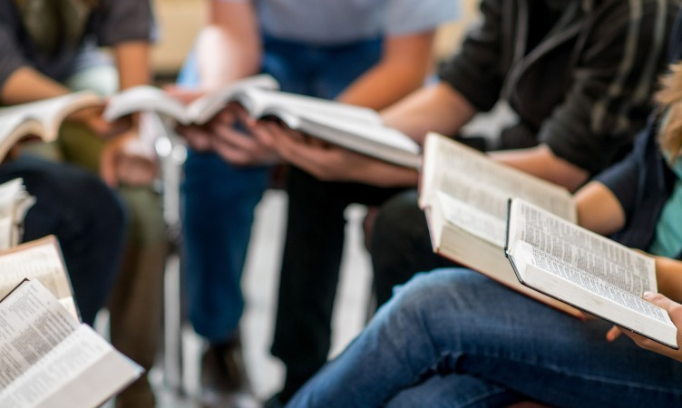
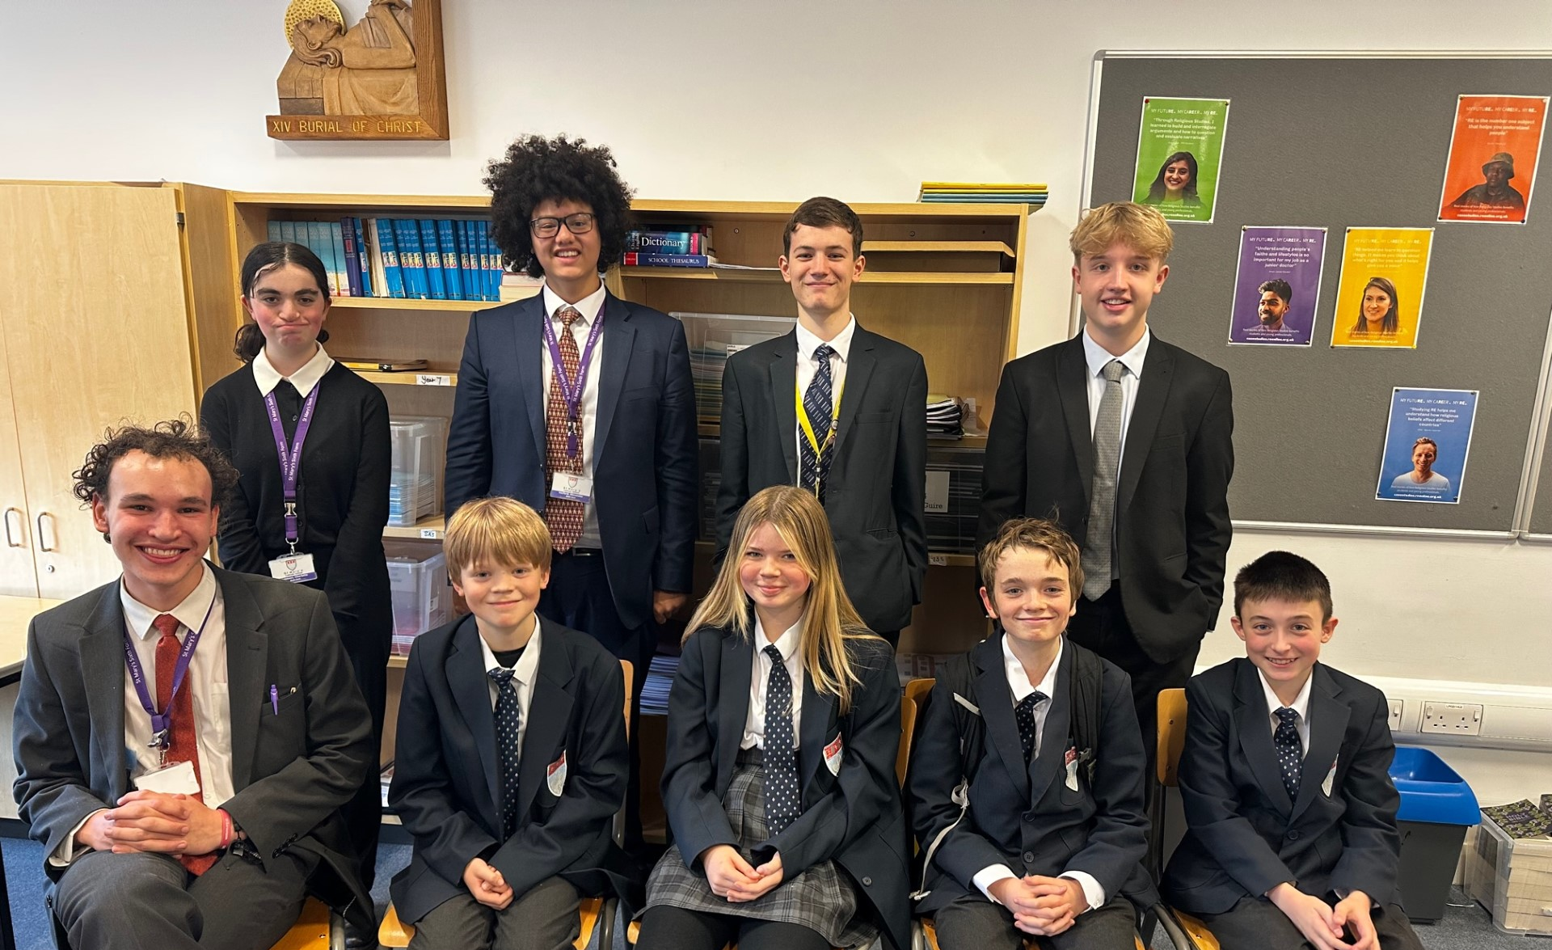
Join us at Christian Union this Spring Term
"CU is a place for anyone of any faith, year group or background to come into a safe environment, play games, have fun, share ideas and learn a little about the real-world significance of Jesus and faith (not to mention sharing biscuits). It exists to help students in their school and wider lives to find unconditional security, significance and acceptance from both the great people and activities, but most of all from God, who knows and loves each of us, and knows and wants what is best for our lives. We aim to do this in a fun relevant and engaging way. We love to welcome new faces."
Josh Sorensen (Year 12)
Leader of Christian Union
CU meets every Tuesday lunch time in G16. Feel free to bring lunch with you or see Mrs Blackburn for an early lunch pass.

Slide 5

Responsibility refers to the state or quality of being accountable for one's actions, decisions, and obligations.
It involves recognising and accepting the consequences of one's behaviour and the duties associated with a particular role or situation. Individuals who are responsible are reliable, trustworthy, and take ownership of their commitments.

Slide 6

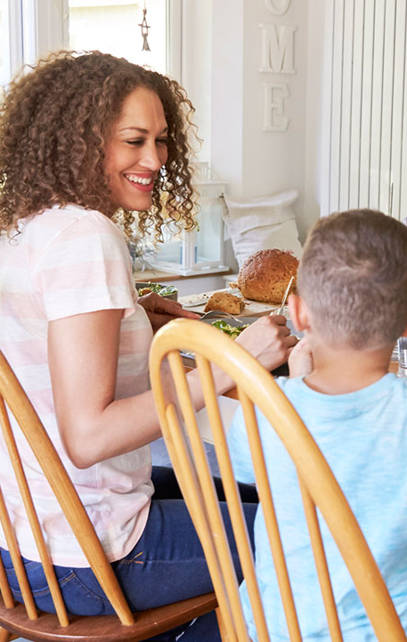
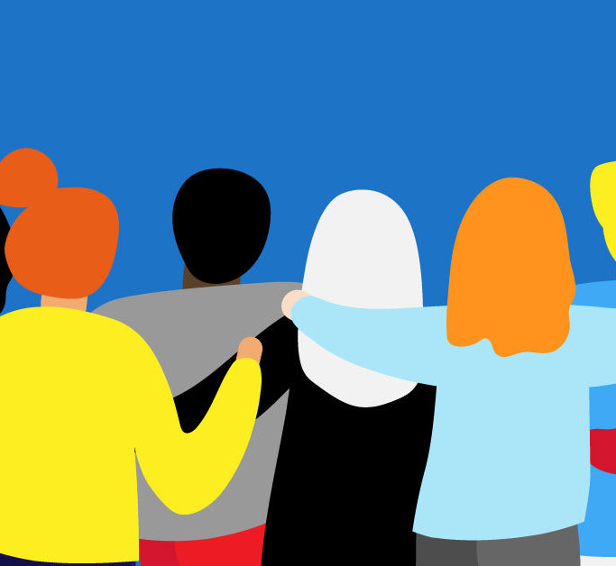
Responsibility can manifest in various aspects of life, including at home, at social time and at school.
In personal life, it may involve taking care of oneself, making thoughtful choices, and being accountable for one's well-being.
At school, responsibility entails fulfilling school duties, meeting deadlines, and contributing to the overall success of a team.
Social responsibility involves contributing positively to one's community and being aware of the impact of one's actions on others.

Slide 7

What are your responsibilities?
Home
School
On a post-it note, draw a cross to create four sections.
Make bullet points of all of the different responsibilities you have in the different areas of your life.
Social/Enviroment
Myself

Slide 8

Why is important to understand the responsibilities we have in different areas of our life?
Clarity of Purpose: Recognising the significance of our responsibilities provides clarity about why certain tasks or roles matter. This clarity helps in aligning our actions with our values and goals, giving us a sense of purpose and direction.
Motivation and Commitment: When we understand why our responsibilities are important, it can serve as a powerful motivator. Knowing the impact of our actions on ourselves, others, or the broader community can increase our commitment to fulfilling those responsibilities.
Effective Decision-Making: Understanding the importance of responsibilities aids in making informed decisions. When we are aware of the consequences and implications of our choices, we can make decisions that are aligned with our values and contribute positively to our well-being and the well-being of others.
Personal Growth and Development: Taking responsibility for various aspects of our lives is a fundamental aspect of personal growth. Recognising the importance of responsibilities allows us to learn, adapt, and grow through the challenges and experiences associated with fulfilling those duties.
Building Trust and Relationships: In both personal and professional relationships, understanding the importance of responsibilities is crucial for building trust. When others see that we are accountable and take our obligations seriously, it strengthens the foundation of trust and credibility.
Balancing Priorities: Recognising the importance of responsibilities helps individuals prioritize their commitments. It allows for a more effective allocation of time, energy, and resources, ensuring that essential tasks and obligations are given the attention they deserve.

Slide 9
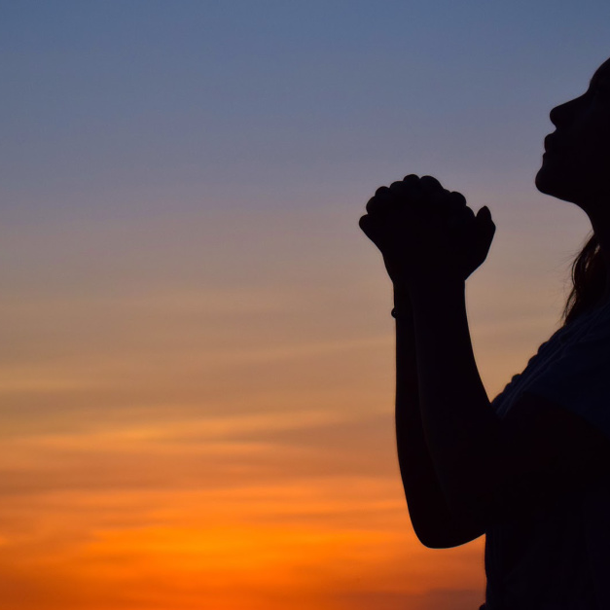
Let Us Pray
Lord,
Grant me wisdom to understand the importance of my responsibilities in all areas of life. May I approach each task with mindfulness and integrity.
In personal matters, help me care for myself and others, making decisions that contribute positively to our well-being. At school, guide me to fulfill my duties with diligence and contribute to the success of my team.
Grant me courage to learn from mistakes, resilience to navigate challenges, and humility to seek help when needed. May I balance priorities wisely and be a source of support for others.
In your guiding light, I find the strength and inspiration to fulfill my responsibilities with love, commitment, and purpose.
Amen

Slide 10
Thoughts and Prayers
Monday 5th February – Friday 9th February

Slide 11

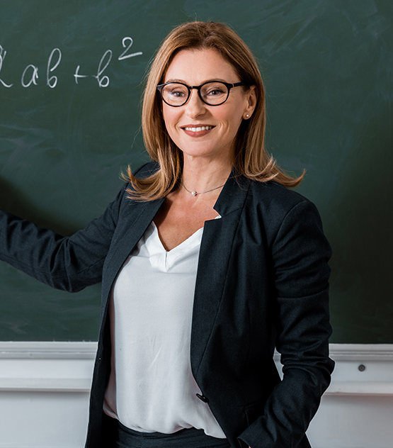
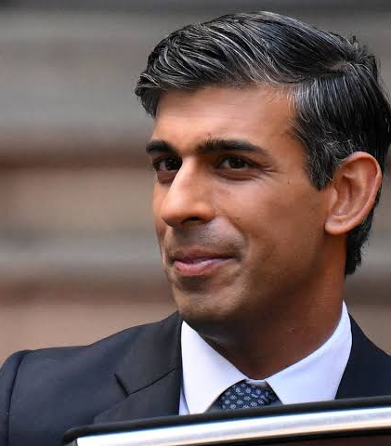
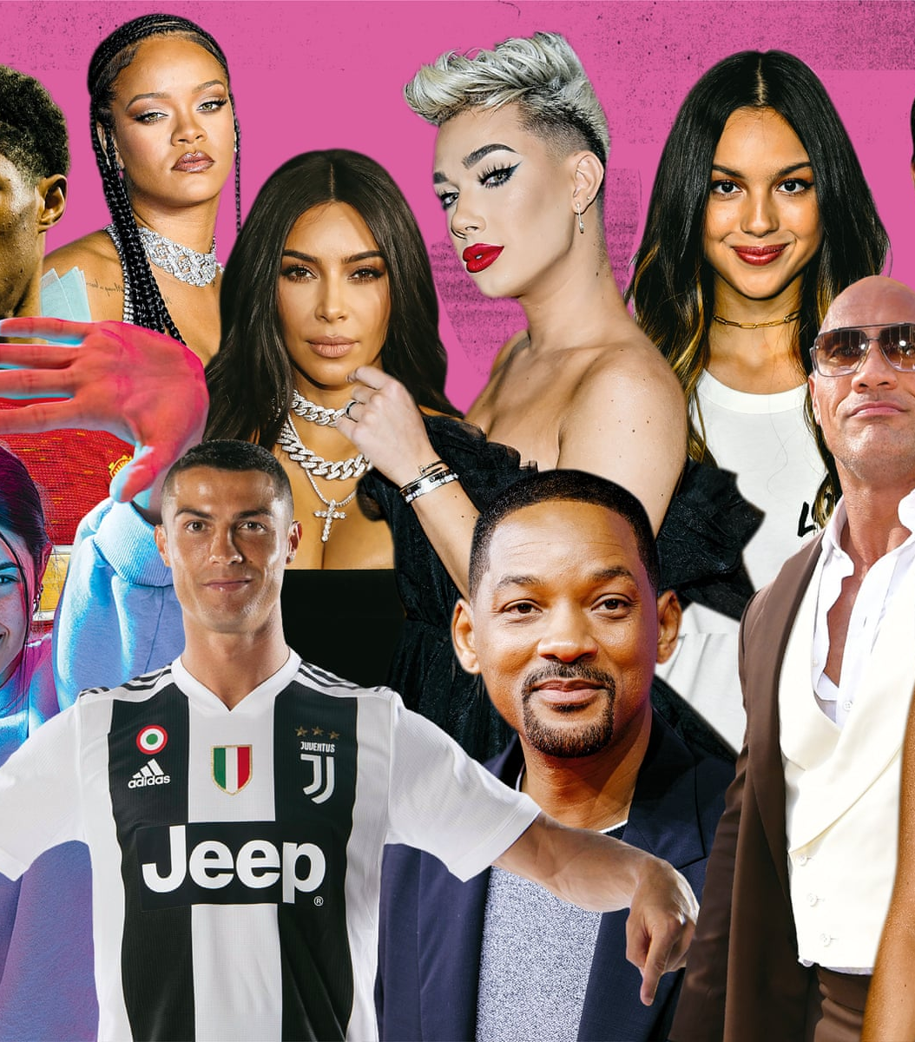
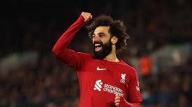
In Pairs
Discuss what responsibilities these people have

Slide 12
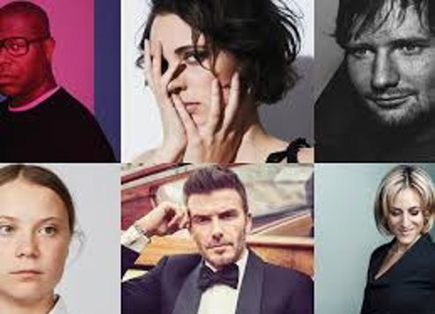
Celebrity Responsibility
Reader 1: Famous people, especially those with a significant public platform, have a considerable influence on society. Using their platform for good can have several positive impacts
Celebrities can bring attention to important social, environmental, or humanitarian issues. Their influence can shine a spotlight on problems that might otherwise receive less attention. Famous individuals can leverage their platform to raise awareness about specific causes, encouraging public discourse and engagement.
Celebrities can inspire people to take action and get involved in charitable activities or social causes. Their influence can motivate individuals to contribute time, resources, or expertise to make a positive impact.
They can use their influence to promote diversity and inclusion, challenging stereotypes and advocating for equal opportunities. This can contribute to a more inclusive and tolerant society.
Reader 2: Celebrities and famous people are often looked up to as role models. When they engage in positive behavior and support good causes, they set examples for their followers and the broader community.
Social media allows celebrities to directly connect with their audience. By sharing information, insights, and calls to action, they can mobilize a large number of people quickly and effectively.
Celebrities can use their influence to raise funds for charitable organizations, contributing to important causes and initiatives.
Their ability to reach and engage with a wide audience makes it important for them to use their platform responsibly. When famous people align their influence with positive values and causes, they contribute to a culture of social responsibility and inspire positive change on a broader scale.
Here are a few examples of celebrities that have taken responsibility to use their platform to promote change

Slide 13
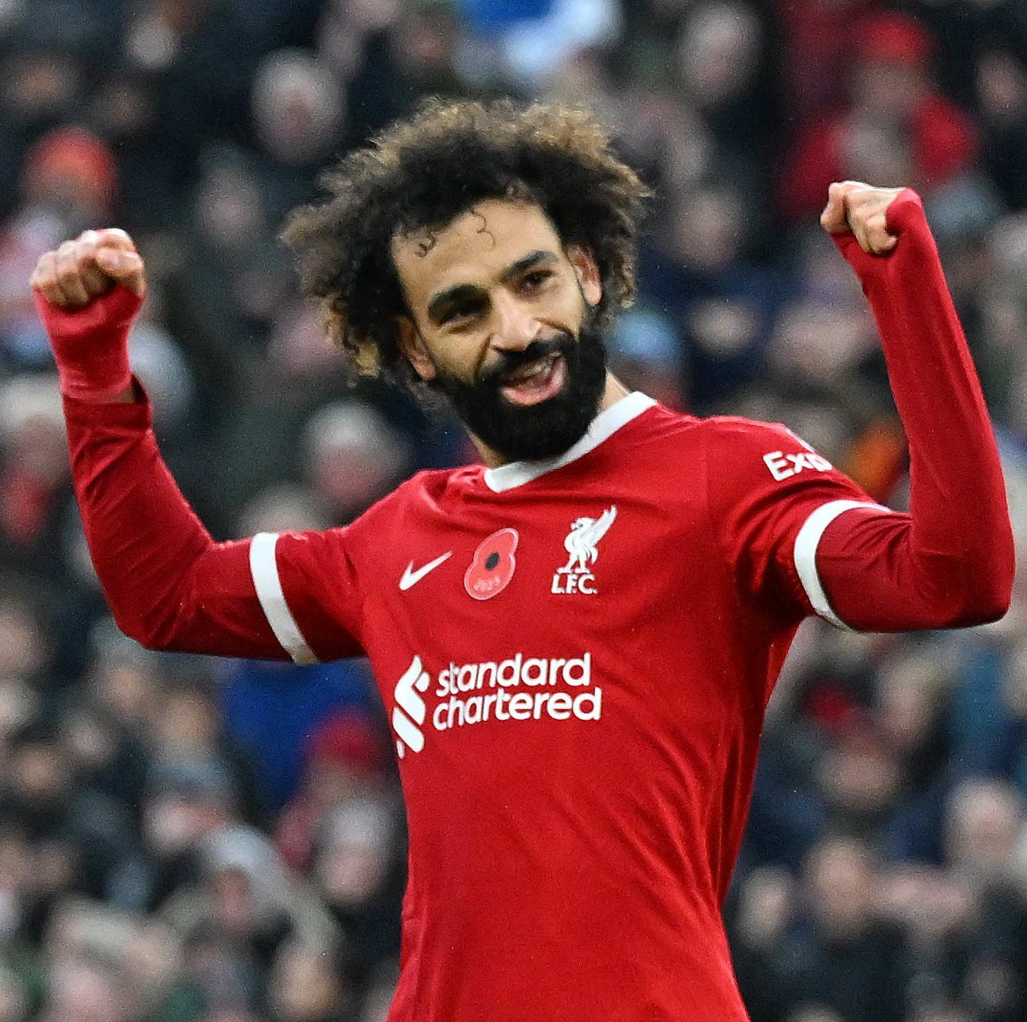
Mo Salah
Mo Salah has become a global sensation in the world of football, captivating audiences with his impressive skills on and off the field. From humble beginnings to becoming one of the world’s most recognisable athletes, Mo Salah’s story is an inspiring tale of perseverance and hard work.
Mo Salah has become a global sensation in the world of football, captivating audiences with his impressive skills on and off the field. From humble beginnings to becoming one of the world’s most recognizable athletes, Mo Salah’s story is an inspiring tale of perseverance and hard work. He has used his platform to bring attention to critical issues such as education, health care, and poverty alleviation, demonstrating that football can bring about meaningful change beyond the realm of sports.

Slide 14
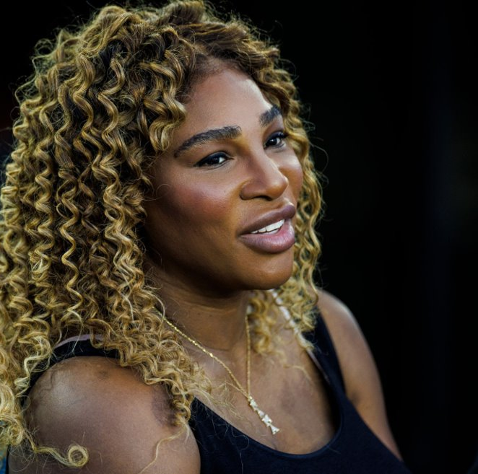
Serena Williams
In 2017, Serena Williams, now 40, wrote a letter to her mother, Oracene Price, and shared it on Reddit. It was about the body shaming she dealt with throughout her career. "I've been called man because I appeared outwardly strong," the 23-time Grand Slam tennis champion wrote.
She rebuffed those who told her she belonged in men’s sports because she looks stronger than other women. "No, I just work hard, and I was born with this badass body and proud of it. ... I am proud we were able to show them what some women look like. We don't all look the same. We are curvy, strong, muscular, tall, small, just to name a few, and all the same: We are women and proud!"
The message from Williams that bodies come in all shapes and sizes is simple, but clear "After decades of being taught that all bodies can and should be the same shape to be worthy, 'healthy,' or beautiful — especially women's bodies — this message cannot be shouted enough."

Slide 15
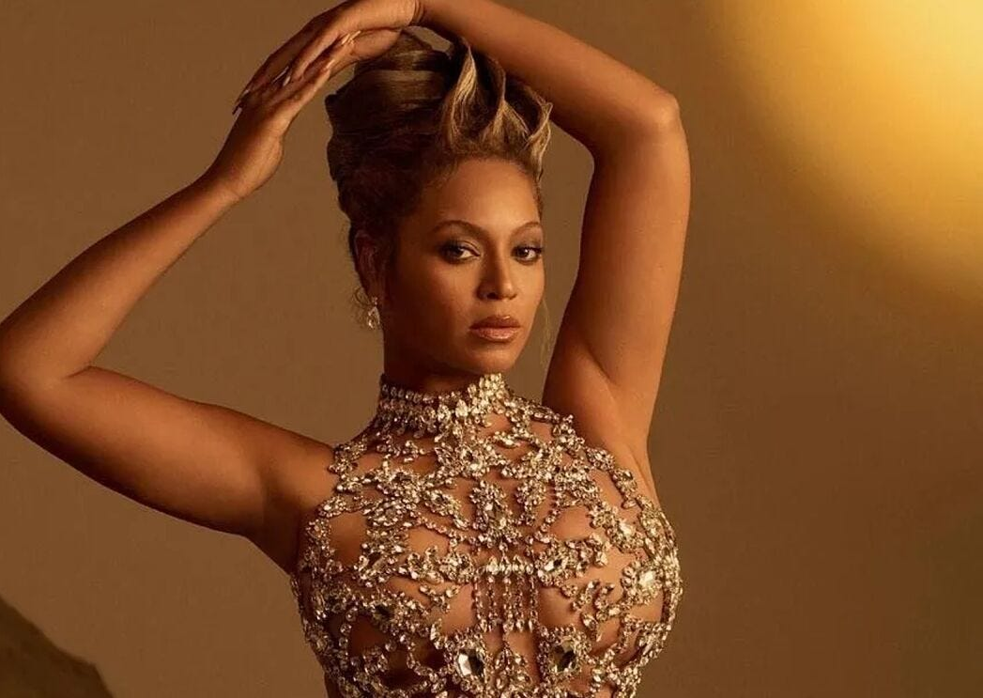
Beyonce Knowles
Beyoncé has millions of fans around the world, which makes it all the more impactful that she frequently uses her platform to speak out against systemic racism and promote social justice. In May 2020, the Texas native took to her Instagram to speak out following the murder of George Floyd—an unarmed Black man who was killed by a white Minneapolis police officer.
“No more seeing people of color as less than human. We can no longer look away. George is all of our family in humanity. He’s our family because he’s a fellow American,”
Beyoncé told her 200 million followers. She then called on them to sign a petition seeking justice for Floyd.
Beyoncé also encouraged her millions of fans to sign a petition asking for justice for Breonna Taylor—a Black woman who was shot and killed during a botched police raid while she slept in her own home in March 2020.

Slide 16
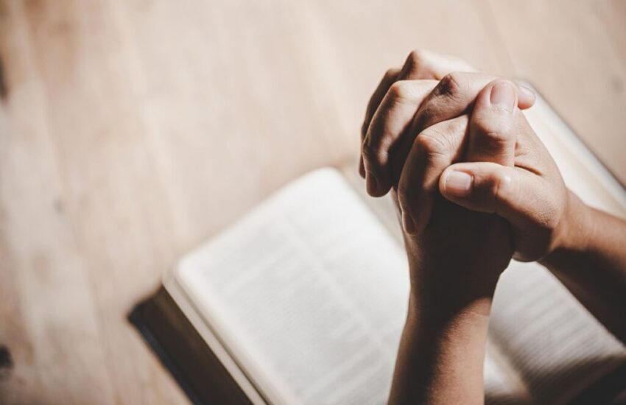
Let Us Pray
Lord,
Grant us the wisdom to recognize the power we hold, whether large or small, and inspire us to use it responsibly. May we, like shining lights in the darkness, illuminate the path of compassion, justice, and love for those around us.
We lift up those individuals, known and unknown, who dedicate their voices and actions to positive change. May their efforts be multiplied, and may their impact be felt far and wide. Strengthen their resolve, guide their decisions, and surround them with support as they work towards a better world.
Help us to understand that true change often requires collective efforts. May we unite across differences, embracing the diversity that makes us stronger together. In our pursuit of justice, equality, and kindness, may we find common ground and shared purpose.
In times of uncertainty, may we find strength in unity, hope in solidarity, and resilience in our shared humanity. Guide us in creating a world where love triumphs over hate, where justice prevails, and where each person is seen and valued.
Amen.

Slide 17
Thoughts and Prayers
Monday 5th February – Friday 9th February

Slide 18
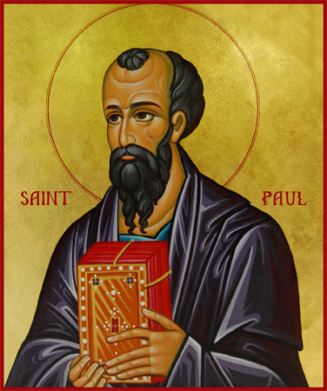
Our scripture this week
The passage 1 Corinthians 9:16-19, 22-23 is about the apostle Paul's perspective on his ministry and mission to spread the gospel.
Paul emphasises his deep sense of calling and obligation to share the message of Christ with others.
He expresses a willingness to adapt his approach and style in order to effectively reach different groups of people.
The passage highlights his commitment to becoming all things to all people, not compromising the core message but being flexible in his methods to connect with diverse audiences.
Ultimately, the overarching goal is to win people to Christ, and Paul demonstrates a selfless and adaptable approach in fulfilling this mission.

Slide 19
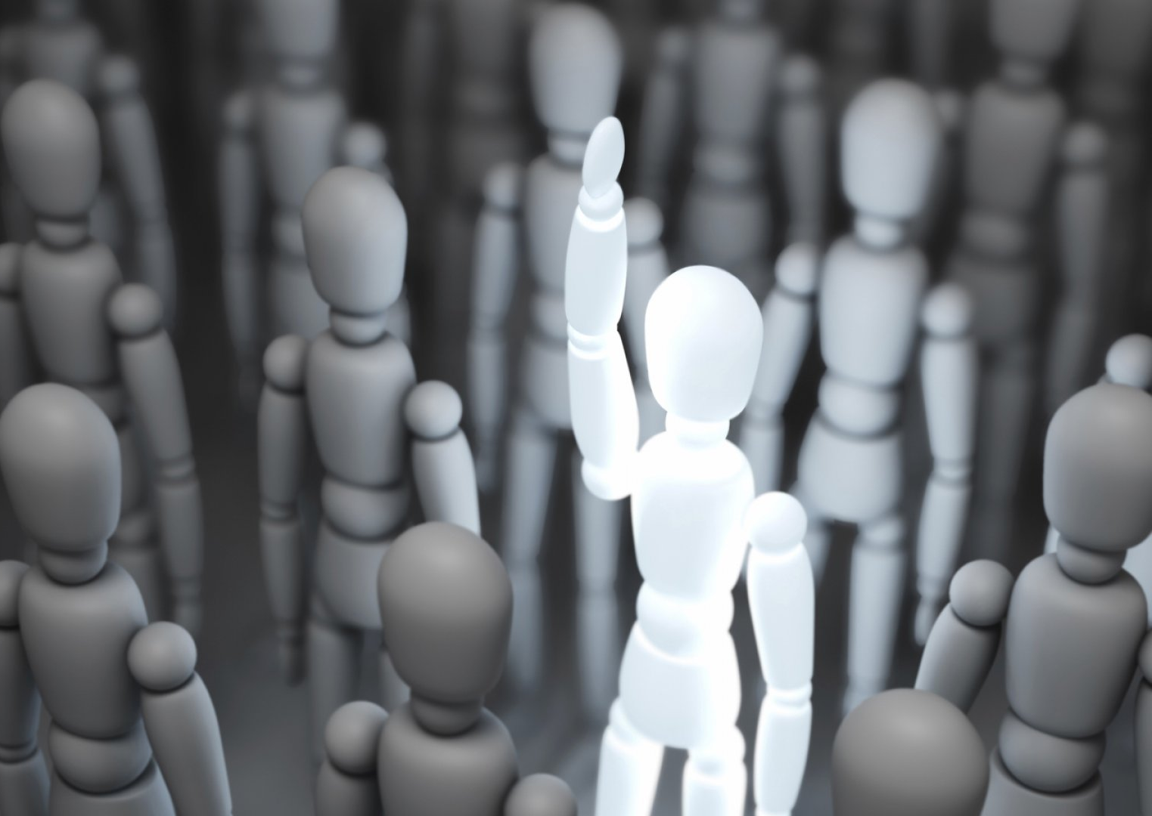
What responsibility has God given you?
On a Post – It, write down all the things you think God has invested in you and given you responsibility for. What tools has he given you that you can work with?
It might be a particular talent you have. It might be a characteristic such as being kind or generous or helpful!
Sometimes it isn’t easy to say out loud our good points but try to write down at least 3 things you think you have been blessed with

Slide 20
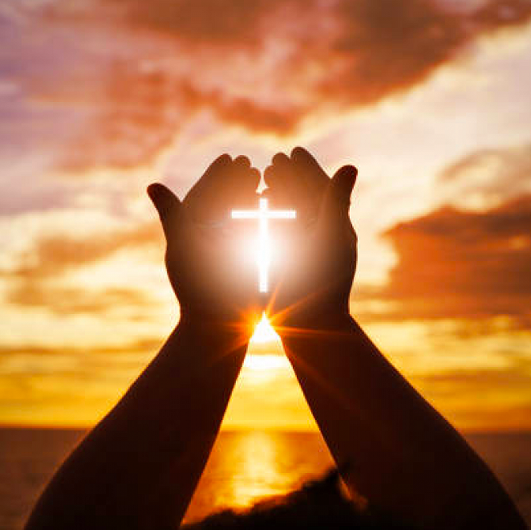
Let Us Pray
Lord,
We come before you with gratitude for the example of the apostle Paul, who, in his ministry, demonstrated a deep sense of calling and a willingness to adapt for the sake of sharing the gospel. We thank you for the message of Christ that transforms lives.
Lord, just as Paul felt compelled by a divine calling, we seek to understand and embrace the purpose you have for each of us. May we be sensitive to your leading and open to the ways you want to use us to spread the message of your love and salvation.
Grant us the same willingness to adapt our approach for the sake of connecting with those around us. Help us to be mindful of the diverse needs and backgrounds of the people we encounter, so that we may effectively communicate the unchanging truth of your Word in ways that resonate with them.
We commit ourselves to the ultimate goal of winning people to Christ. In all that we do, may it be for your glory and the expansion of your kingdom. We trust in your guidance and empowerment as we seek to fulfill the mission you have given us.
In Jesus' name, we pray. Amen.

Slide 21
Thoughts and Prayers
Monday 5th February – Friday 9th February

Slide 22
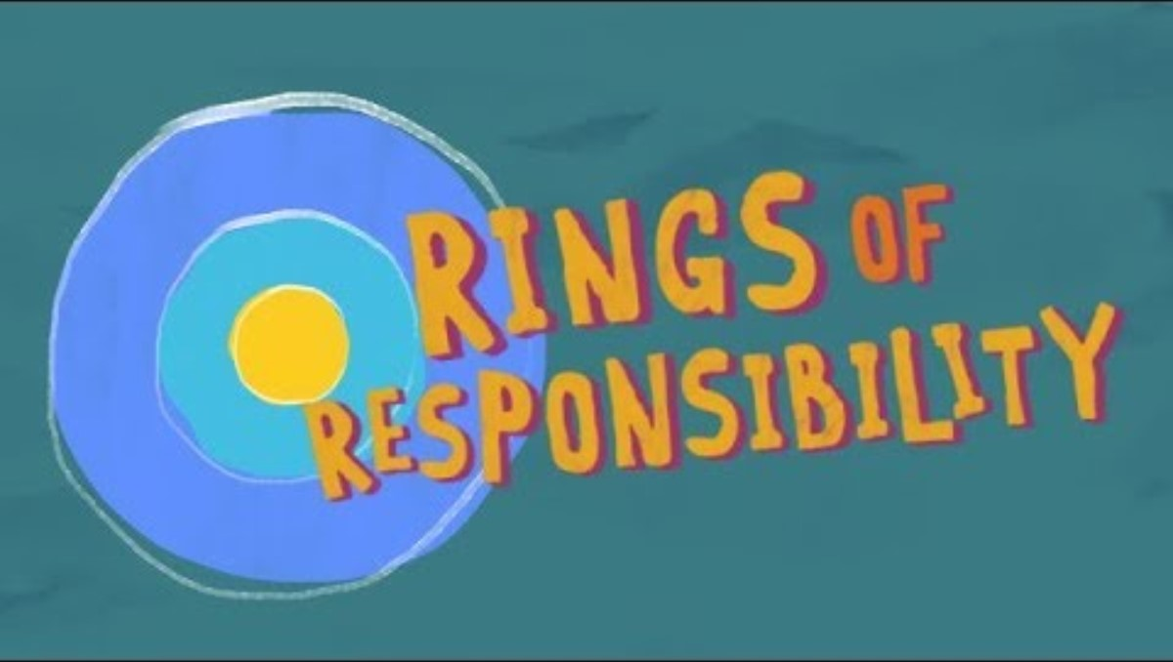

Slide 23
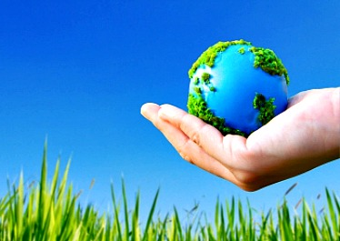
It Starts With Us!
This morning we will embark on a journey of self-reflection to explore a profound and shared responsibility that each of us holds—the responsibility to care for our world. As inhabitants of this planet, we are not merely spectators; we are active participants in shaping its future. Our choices, both big and small, contribute to the well-being of the Earth and its diverse ecosystems.
Consider this as a moment to pause and ponder the impact of your actions and the power you possess as an individual to effect positive change.
In pairs, discuss the following questions

Slide 24
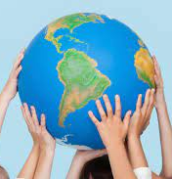
In Pairs
Personal Habits:
  How do your daily activities, such as energy use, transportation, and consumption choices, contribute to your environmental impact?
  Are there specific habits you could change to reduce your ecological footprint?
Global Awareness:
  How would you describe the interconnectedness of environmental issues on a global scale?
  Can you think of examples where actions in one part of the world have affected other regions?
Environmental Justice:
  In what ways do environmental issues impact different communities and social groups differently?
  How can individuals contribute to creating a more environmentally just and equitable world?
Educational Empowerment:
  How does education play a role in shaping your understanding of environmental issues?
  How can you share your knowledge with others to promote environmental awareness?
Community Engagement:
  What local initiatives or projects have you observed that contribute to environmental sustainability?
  How can you actively engage in community efforts to address environmental concerns?
Cultural Perspectives:
  How do different cultures view and value their natural resources?
  In what ways can cultural diversity contribute to sustainable practices globally?
Future Generations:
  How do your current choices impact the well-being of future generations?
  What steps can you take to ensure a more sustainable legacy for those who come after you?
Reflection and Action Plan:
  What insights have you gained from reflecting on your responsibility to care for the world?
  Can you create a personal action plan outlining steps you will take to contribute to a healthier planet?

Slide 25
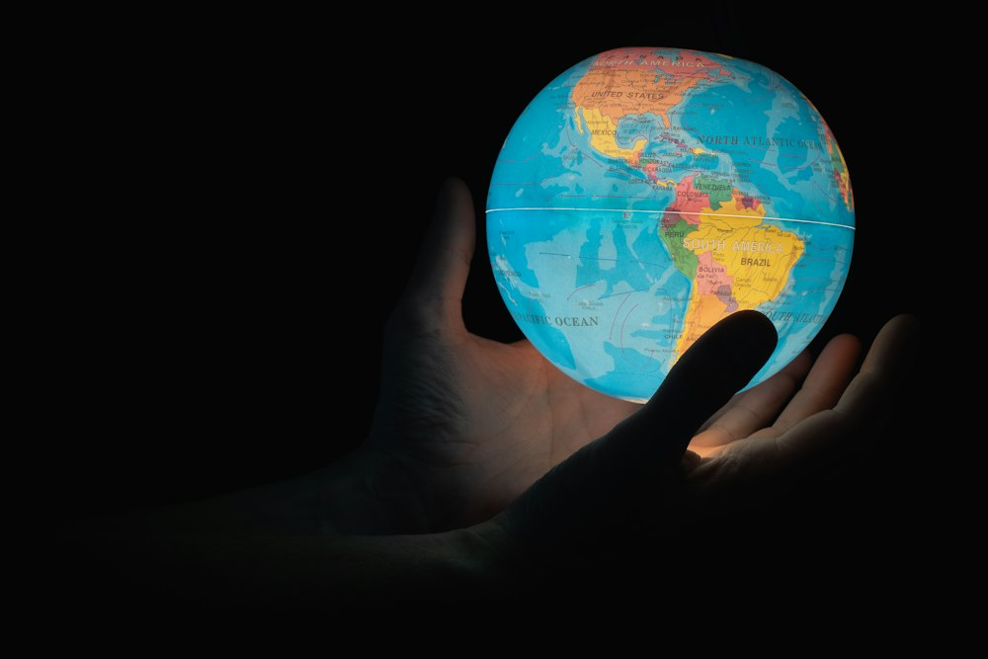
Let Us Pray
Lord,
As we reflect on our responsibility to care for this beautiful world, grant us wisdom. Open our hearts to the impact of our choices and guide us to be mindful stewards of the Earth.
May we embrace a sense of global responsibility, cultivating habits that honor and protect the environment. Grant us strength to address challenges with compassion, and may our actions contribute to a more sustainable and harmonious world.
Amen.

