Slide 1

Theme of the week: Listen
Thoughts and Prayers 15th October – 19th January

Slide 2
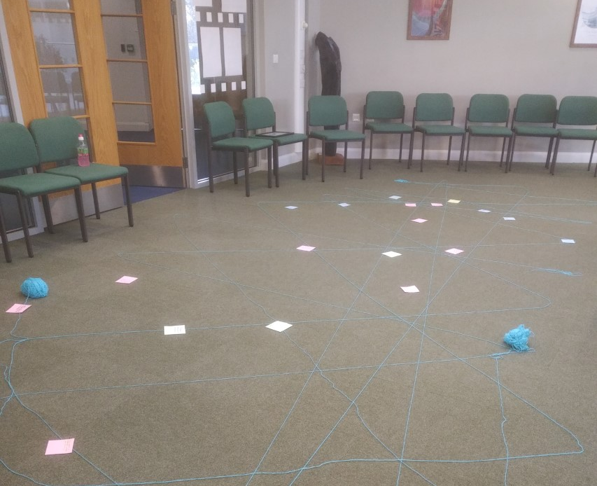
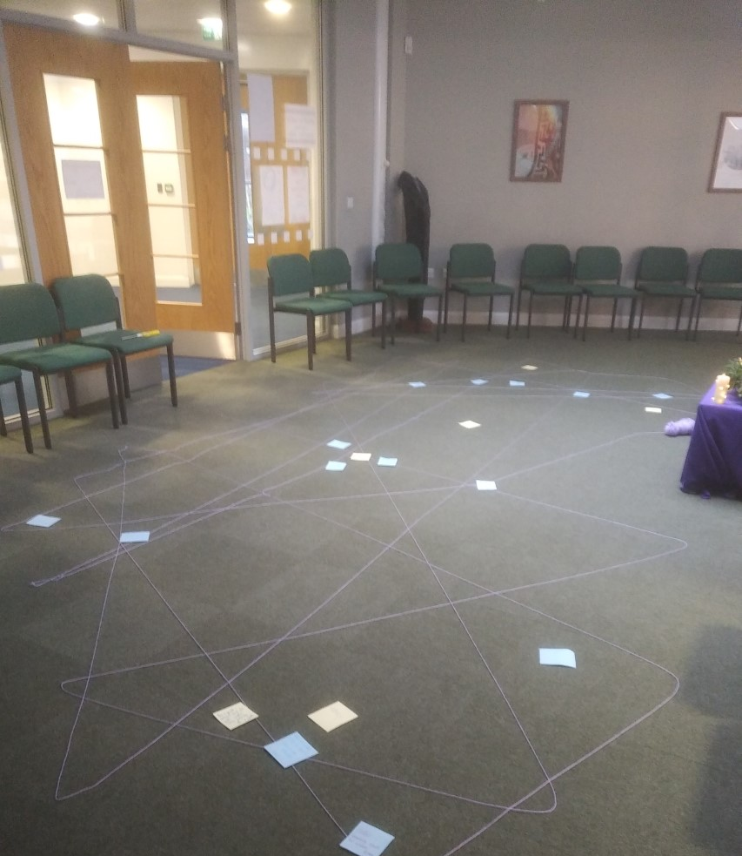
MORNING PRAYER IN THE CHAPEL THIS WEEK
Monday 15th January - 8S
Tuesday 16th January - 11S
Wednesday 17th January – 11T
Thursday 18th January - 11M
Friday 19th January- 11R

Slide 3
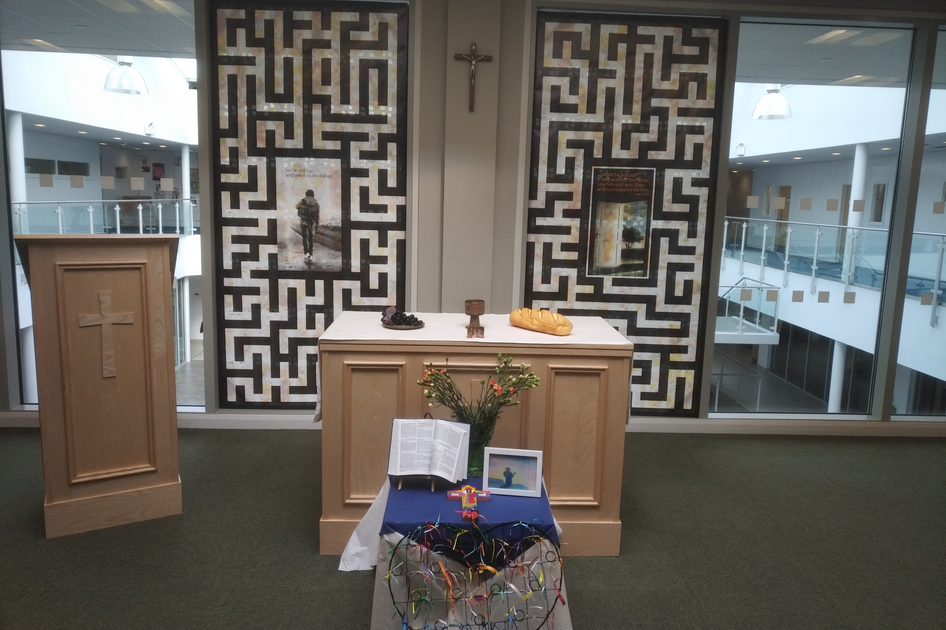
Friday Mass
Who?
Mass this week will be led by 11A & 11S
When?
Friday Morning at 8.20am
Where?
In the School Chapel. See you there!
ALL ARE MOST WELCOME.
ALL WORDS ARE DISPLAYED ON THE SCREEN.

Slide 4

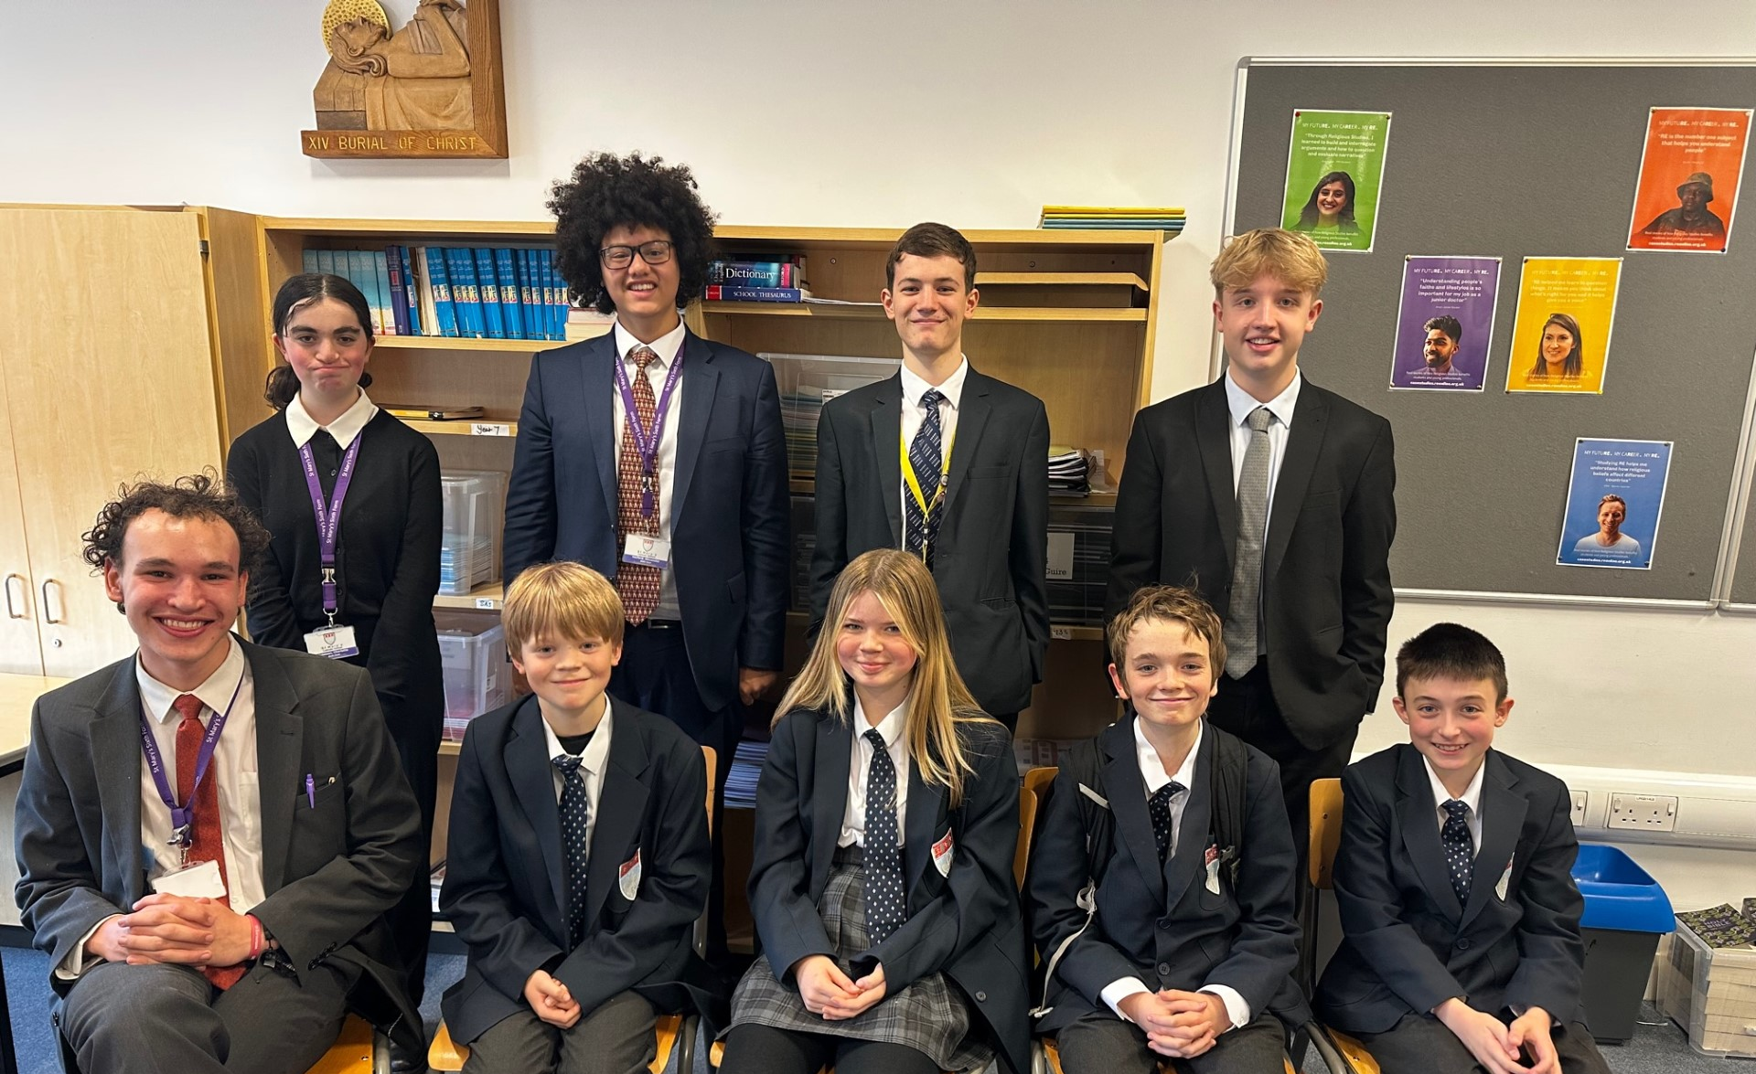
Join us at Christian Union this Spring Term
"CU is a place for anyone of any faith, year group or background to come into a safe environment, play games, have fun, share ideas and learn a little about the real-world significance of Jesus and faith (not to mention sharing biscuits). It exists to help students in their school and wider lives to find unconditional security, significance and acceptance from both the great people and activities, but most of all from God, who knows and loves each of us, and knows and wants what is best for our lives. We aim to do this in a fun relevant and engaging way. We love to welcome new faces."
Josh Sorensen (Year 12)
Leader of Christian Union
CU meets every Tuesday lunch time in G16. Feel free to bring lunch with you or see Mrs Blackburn for an early lunch pass.

Slide 5
Lunchtime events: All are welcome..
Crafts and Mindfulness
(Mondays in the chapel)
Islamic Union
(Tuesday G15)
Christmas club
(Fridays G13)
Christian Union
(Tuesdays in G16)

Slide 6

Tuning in to silence
Begin today by reflecting on the importance of silence in active listening. In a world filled with noise, taking time to embrace silence allows us to truly hear. When we are still and at peace, we are creating space for God to speak to us in the stillness. Peace and quiet doesn't just have to be about your relationship with God. It can also be powerful to find a quiet place for a few minutes each day to simply be still and listen to your body and mind. Being mindful in silence involves being fully present and engaged with the present moment without judgment.

Slide 7
Challenge: choose at least one way to enjoy silent mindfulness this week to give yourself time to listen to yourself.
Discuss your plan with a partner. Which of these is most appealing to you and why?
Breathe Mindfully:
  Sit comfortably and focus on your breath.
  Feel each breath without getting distracted.
  Bring your attention back when your mind wanders.
Body Check:
  Close your eyes and focus on each body part.
  Notice sensations, tension, or warmth.
  Move attention from toes to head.
Thought Watching:
  Sit quietly and observe thoughts without attachment.
  Imagine thoughts as passing clouds.
  Don't get emotionally involved with them.
Silent Nature Walk:
  Walk in nature without talking.
  Listen to sounds, feel each step.
  Engage senses fully in the experience.
Mindful Eating:
  Eat slowly and savor each bite.
  Notice taste, texture, and smell.
  No distractions during the meal.
6. Gratitude Time:
  Sit and think about what you're grateful for.
  Focus on positive aspects.
  Cultivate a sense of gratitude.
7. Stillness Sitting:
  Find a comfy seat and sit still.
  Be present without a specific focus.
  Notice sensations without reacting.
8. Listening Quietly:
  Sit quietly and listen to sounds.
  Observe sounds without judgment.
  Enhance mindful listening.
9. Digital Break:
  Take breaks from digital devices.
  Use the time to connect with yourself.
  Embrace silence without distractions.
  10. Creative Silence:
  Engage in silent creative activities.
  Draw, paint, or write without external noise.
  Allow creative expression without judgment.

Slide 8


Slide 9

Lord,
Help us find solace in silence. In the quiet moments, speak to our hearts, revealing the wisdom and love that often go unheard in the noise of the world.
Amen
As you may be aware, Sonny has a knee injury that requires an operation that will be happening over this weekend and therefore it is likely Sonny will not be in school next week. To support Sonny with the lessons he will be missing, please could I ask that the lesson material be posted on Teams for Sonny to complete when he is able to. It would be greatly appreciated. In addition, when Sonny returns he will be using crutches. To help with this and to help get around school, Sonny has been given a pass to use the lift and leave lessons a few minutes early. Please can you therefore allow Sonny and a friend to leave lessons a few minutes early to avoid the crowds on the corridors. Please also allow them to leave a few minutes early at the start of lunch. In lessons, please try to minimise the amount of moving around that Sonny does in lessons. For physical activities, such as PE, Sonny will need to sit out. Please also be aware of the following in the event of a fire alarm: >If Sonny is on the ground floor, he is to proceed out of the building with the rest of the class. >If Sonny is on the first or second floor, Sonny will have to be escorted to the nearest evacuation point and asked to remain there. You should then speak with either Danielle or Ian at the SLT assembly point, at the end of the RE/Music corridor, who will determine the best way to support Sonny to leave the building. If you have any questions or concerns, please let me know.

Slide 10
Theme of the week: Listen
Thoughts and Prayers 15th October – 19th January

Slide 11
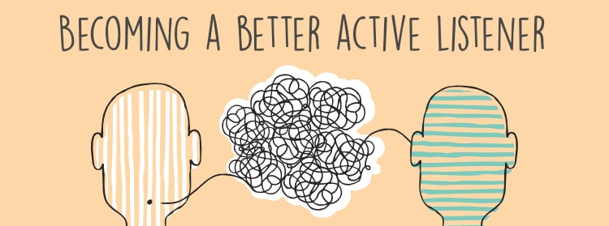
Listen to others
WHY is it important to truly hear others, not just with our ears but with our hearts?
HOW is it important to practice empathy and understanding by being fully present in your interactions?
Can you think of a time when you have felt truly heard in a conversation? How did it make you feel?
How does it feel when people don't listen to you?

Slide 12
If you could have dinner with any historical figure, who would it be and why?
Share a book or movie that has had a significant impact on you, and explain how it has shaped your perspective.
What's one skill or hobby you've always wanted to learn, and what steps have you taken or plan to take to achieve it?
Describe a memorable moment from your Christmas break or a recent holiday. What made it special for you?
If you could travel anywhere in the world, where would you go and what experiences would you hope to have there?
Share a personal achievement or accomplishment that you're proud of, and discuss the hard work or challenges you faced along the way.
What's a unique talent or skill you possess that not many people know about? How did you discover or develop it?
Discuss a current event or social issue that you feel strongly about. What are your thoughts on the matter, and how do you think it impacts our community?
Share a favorite quote or mantra that inspires you. What does it mean to you, and how does it resonate with your life?
If you could spend a day in someone else's shoes, who would it be and why? What do you think you would learn from the experience?
Take turns asking your partner some questions.
Remember to actively listen to their response and respond to what they have said.
Do not interrupt or stop them from speaking.
Listen carefully as you may be asked to share your partner's response!

Slide 13
Almighty Father,
Help us listen to others with compassion and empathy. May our hearts be open to understanding, and may our words be a source of comfort and encouragement.
Amen

Slide 14
Theme of the week: Listen
Thoughts and Prayers 15th October – 19th January

Slide 15
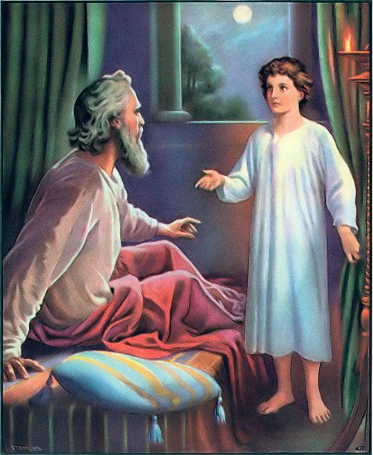
Imagine this...
You are just about to go to sleep but you hear a voice calling your name.
There is one other person in the house, perhaps it’s a family member, so you assume they have called you.
When you ask them, they say they have been asleep and it wasn't them calling your name.
How would you feel?
What would you do?

Slide 16
Our theme of 'listen' this week is from the Old Testament of the Bible, specifically from the book of 1 Samuel 3:9.
The context of this verse is the story of the young boy Samuel, who was serving in the house of the Lord under the high priest Eli. One night, while Samuel was lying down in the temple, he heard a voice calling his name. Thinking it was Eli, Samuel went to him and said, "Here I am; you called me."
However, Eli had not called him and instructed Samuel to go back and lie down. This happened three times, and finally, Eli realised that it might be the Lord who was calling Samuel.
So, Eli advised Samuel to respond to the voice by saying, "Speak, Lord, your servant is listening." Samuel followed Eli's guidance, and in the subsequent encounter, God spoke to Samuel, revealing important messages and plans for the future.
The passage is often interpreted as a model of attentive and humble submission to God's will. By saying, "Speak, Lord, your servant is listening," Samuel expresses his readiness to hear and obey God's guidance.
It reflects a posture of humility, attentiveness, and a willingness to serve and follow God's instructions.
The phrase shows how one should approach God with an open heart, ready to receive divine guidance and direction in their lives.

Slide 17

Discerning God's Voice
Our modern world is filled with noise and sometimes, it is difficult to tune in to what really matters.
How can we discern the voice of God?
How can we discern our own voice?
How can we tune out of the background noise that overwhelms and distracts us?

Slide 18
Lord,
Like Samuel, grant us the wisdom to discern your voice. In the midst of life's challenges, help us listen attentively and respond with open hearts, saying, "Speak, Lord, your servant is listening."
Amen

Slide 19
Theme of the week: Listen
Thoughts and Prayers 15th October – 19th January

Slide 20

The Power of Music
Music can be seen as a form of prayer and connection with God.
Discuss with your partner how various genres of music can evoke emotions and help us tune into our spiritual selves.
If you had to create a playlist that serves as a soundtrack for your life, what would be your TOP THREE?
Listen to the song on the next slide and try to truly hear the lyrics. What do they mean to you?

Slide 21


Slide 22
Almighty Father,
We thank you for the gift of music that speaks to our souls. May the melodies and rhythms guide us in prayer, helping us listen to the whispers of your love and grace.
Amen

